Slide 1
Update on Hurricane Harvey
Zhigang Peng
08/29/2017

Slide 2
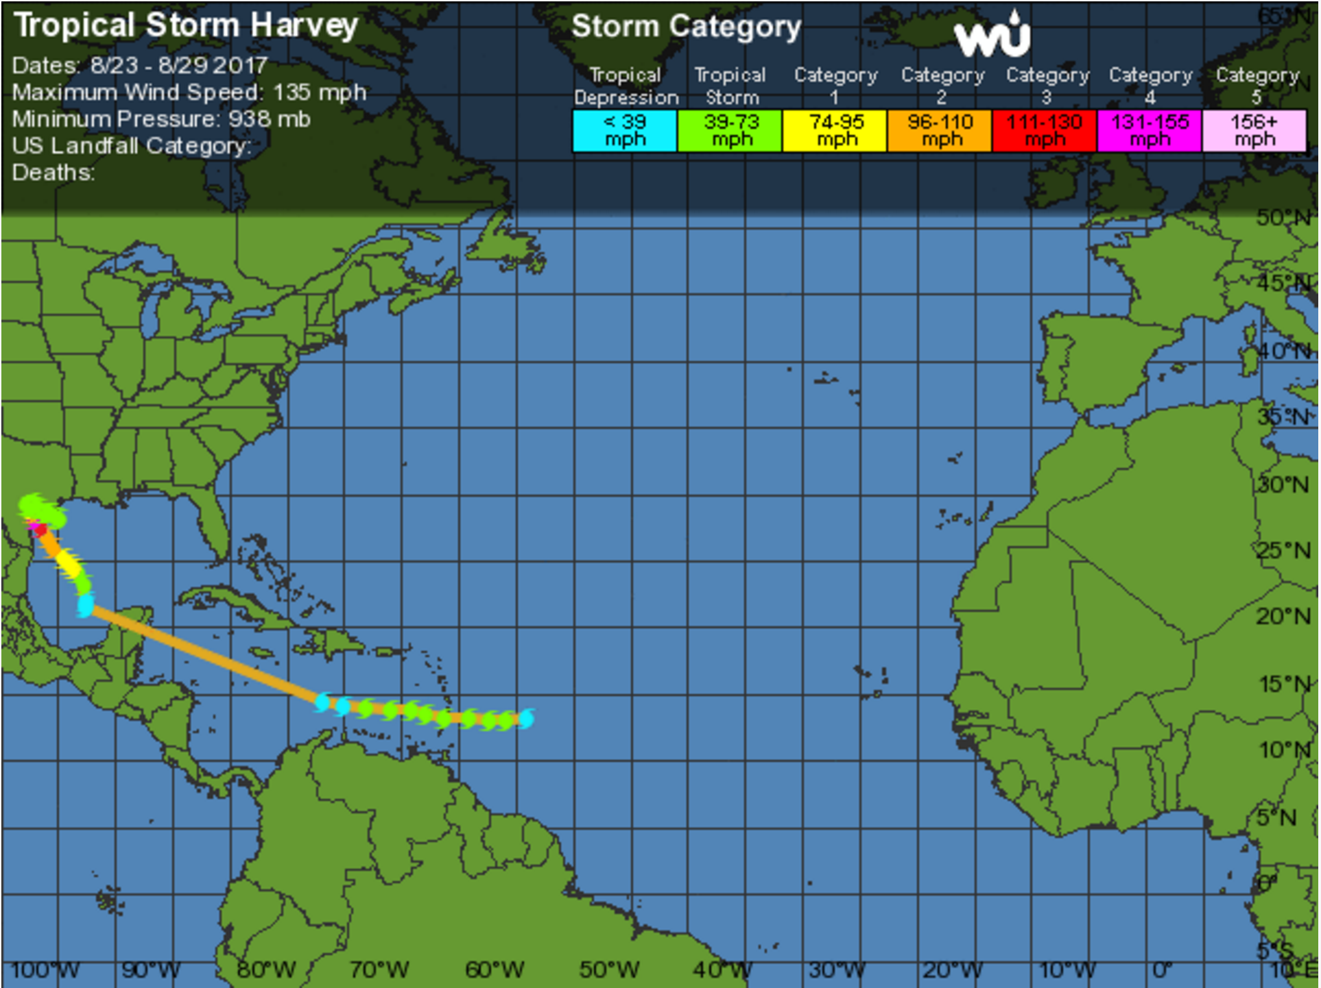
https://www.wunderground.com/hurricane/atlantic/2017/tropical-storm-harvey

Slide 3
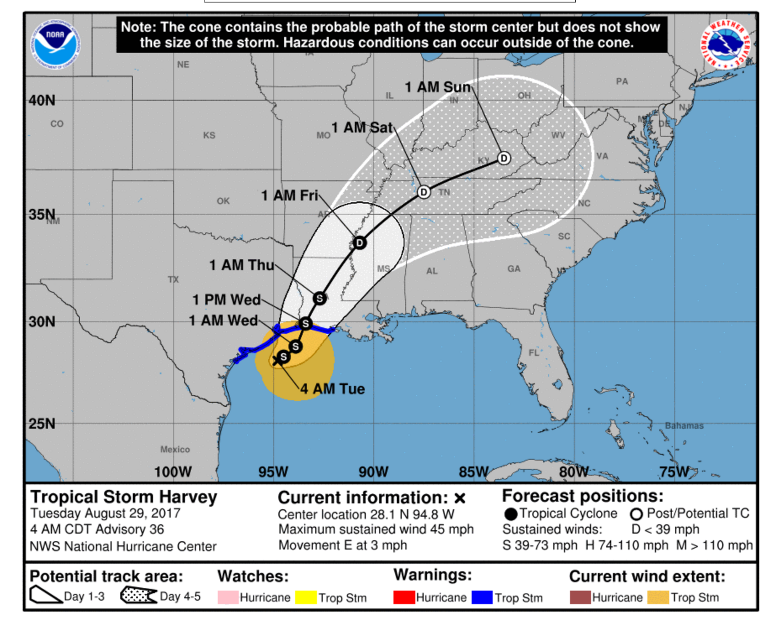
http://www.nhc.noaa.gov/graphics_at4.shtml?cone

Slide 4
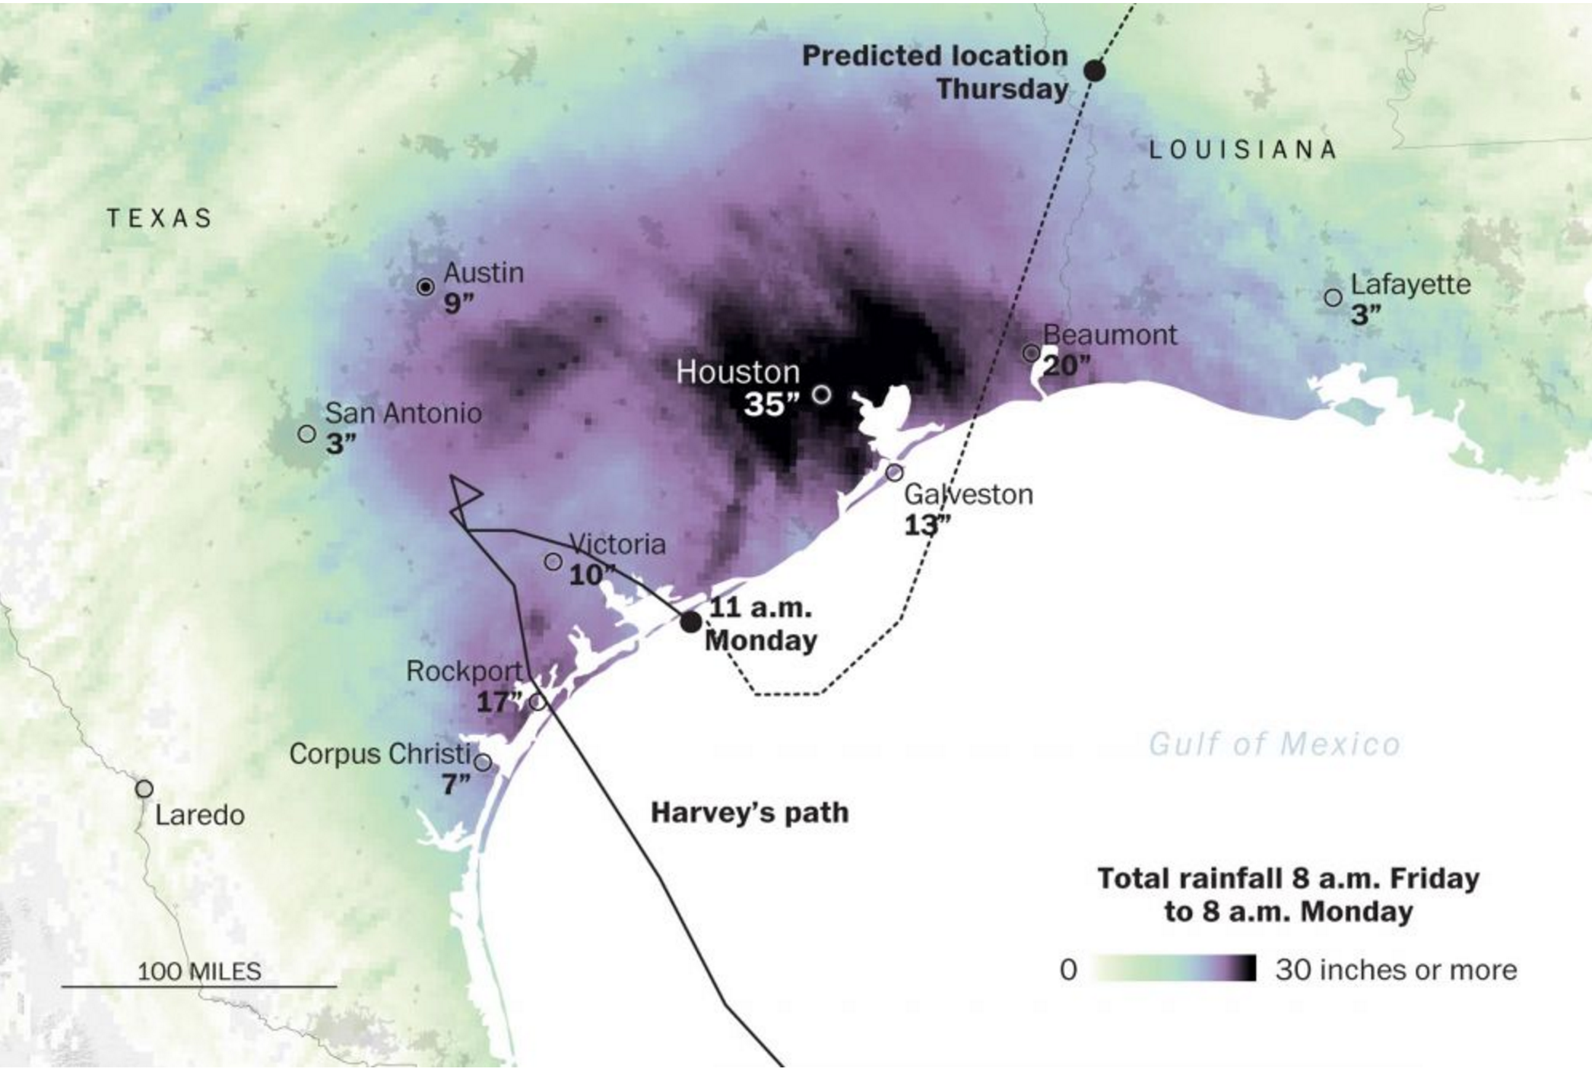
https://www.washingtonpost.com/news/post-nation/wp/2017/08/28/harvey-may-force-30000-people-into-shelters-while-flooding-will-linger-officials-warn/?utm_term=.65b3e0780fd4

Slide 5
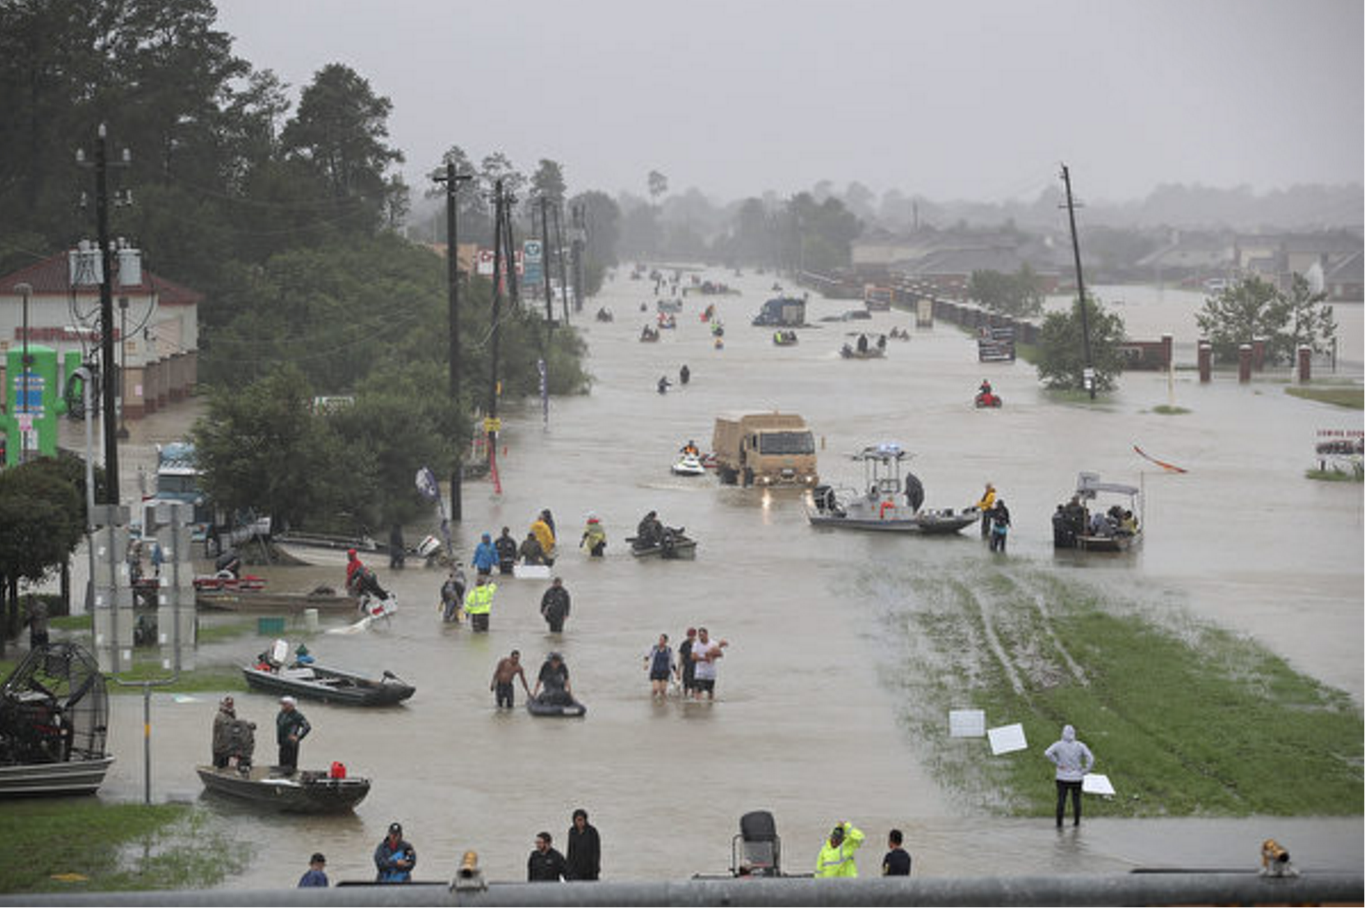

Slide 6
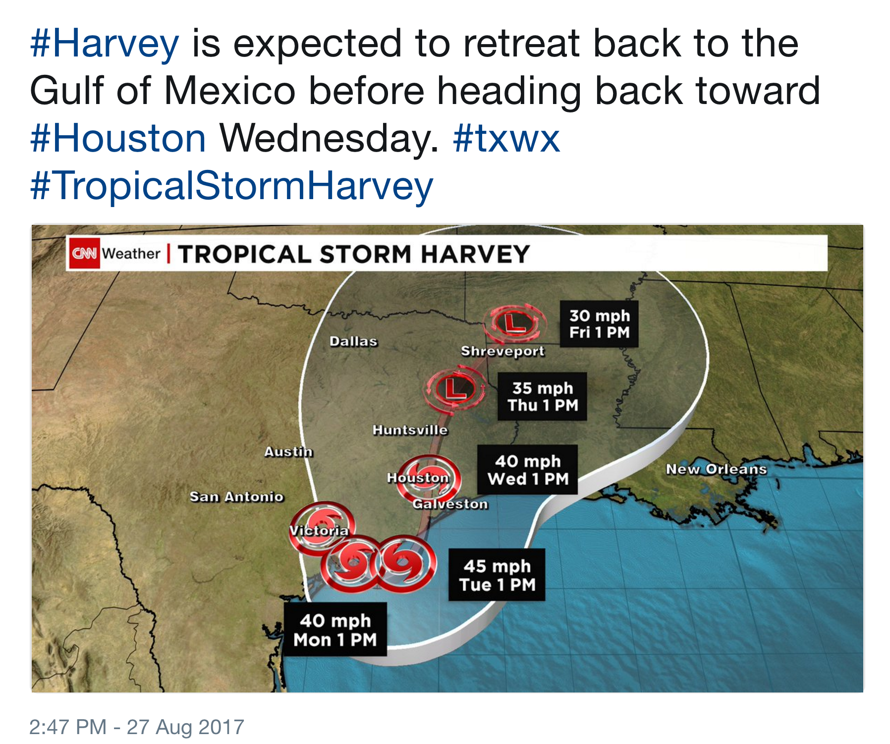

Slide 7
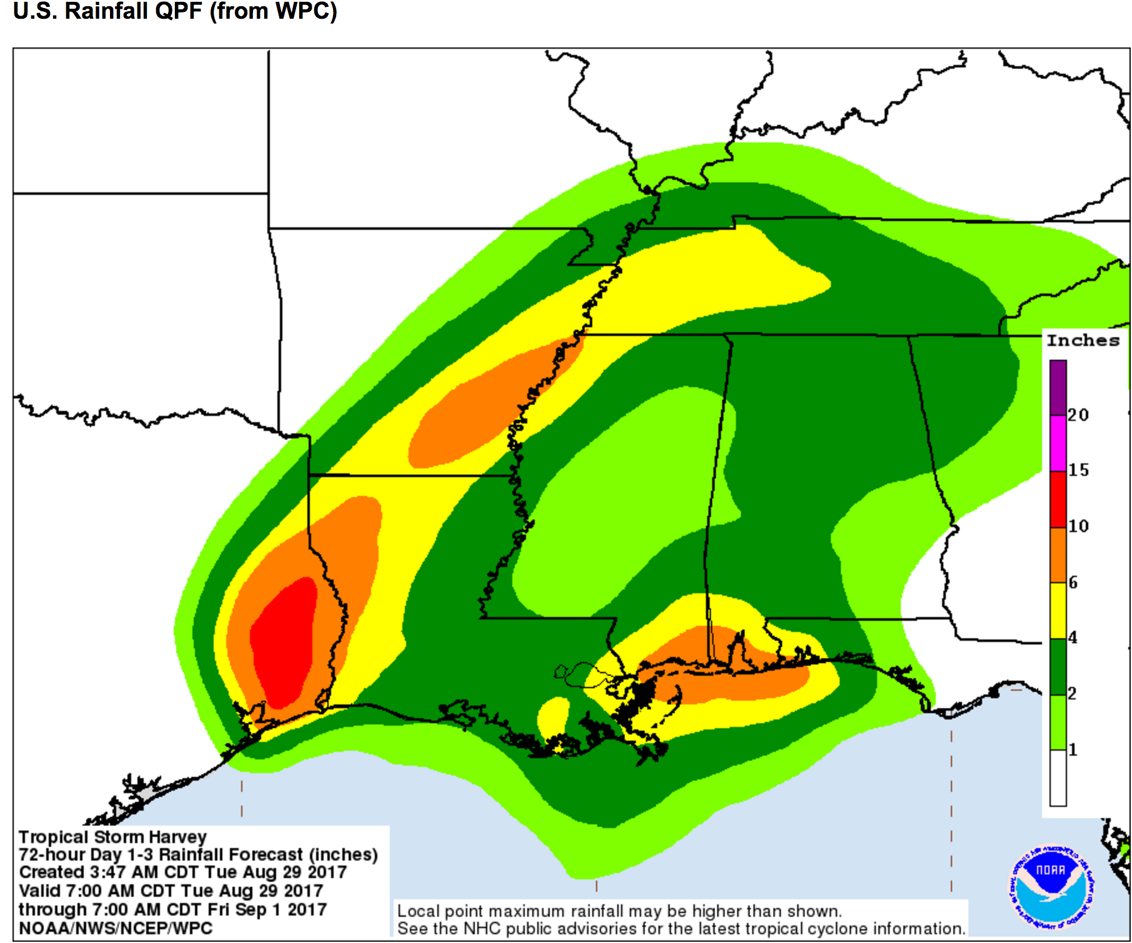
http://www.nhc.noaa.gov/refresh/graphics_at4+shtml/092530.shtml?rainqpf#contents

Slide 8
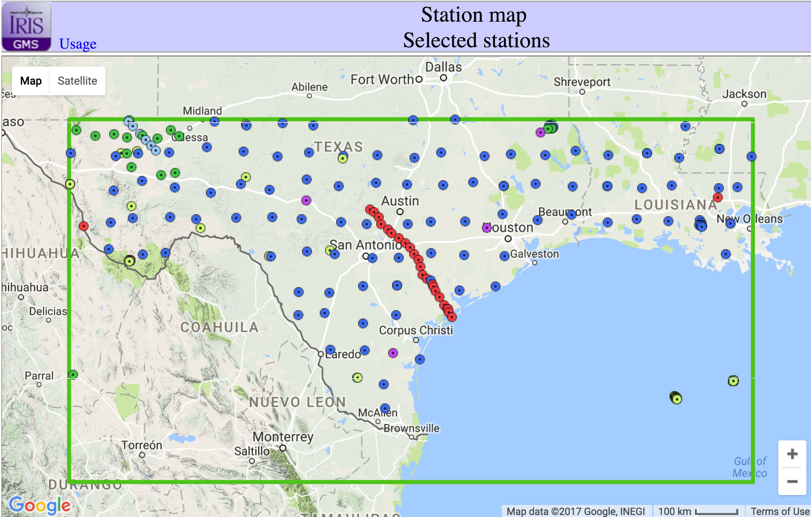
http://ds.iris.edu/gmap/?minlat=25&maxlat=32&minlon=-105&maxlon=-90

Slide 9
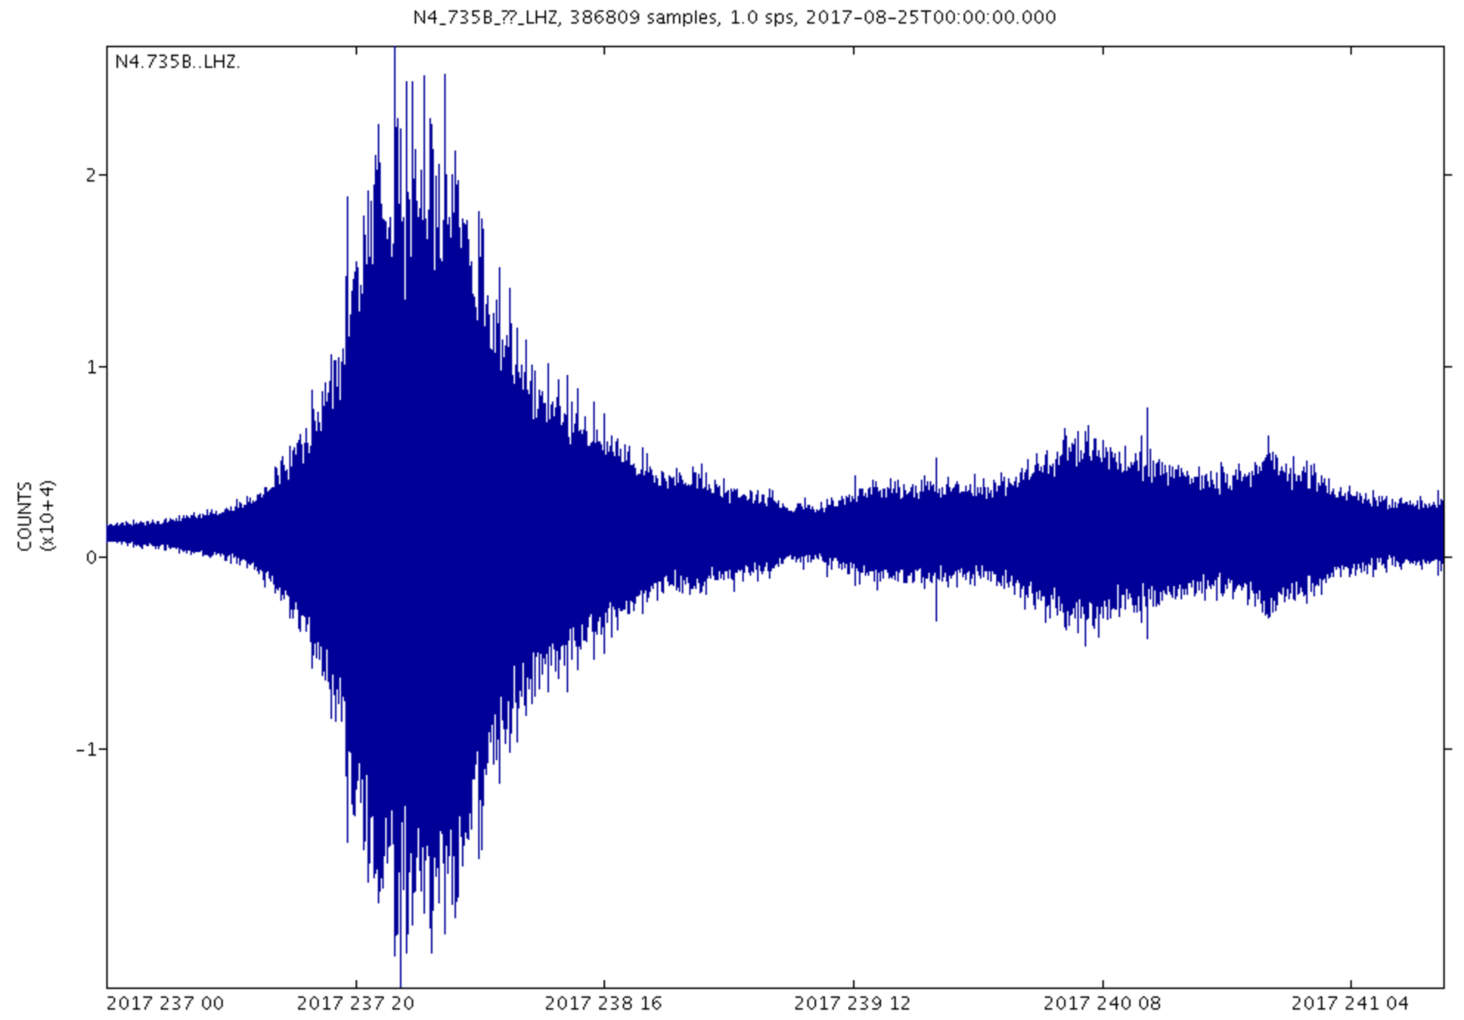
Plot: https://service.iris.edu/irisws/timeseries/1/query?net=N4&sta=735B&cha=LHZ&start=2017-08-25T00:00:00&end=2017-08-30T00:00:00&output=plot&loc=--
Data: https://service.iris.edu/irisws/timeseries/1/query?net=N4&sta=735B&cha=LHZ&start=2017-08-25T00:00:00&end=2017-08-30T00:00:00&output=ascii&loc=--
URL builder: https://service.iris.edu/irisws/timeseries/docs/1/builder/
Station info: http://ds.iris.edu/mda/N4/735B

Slide 11
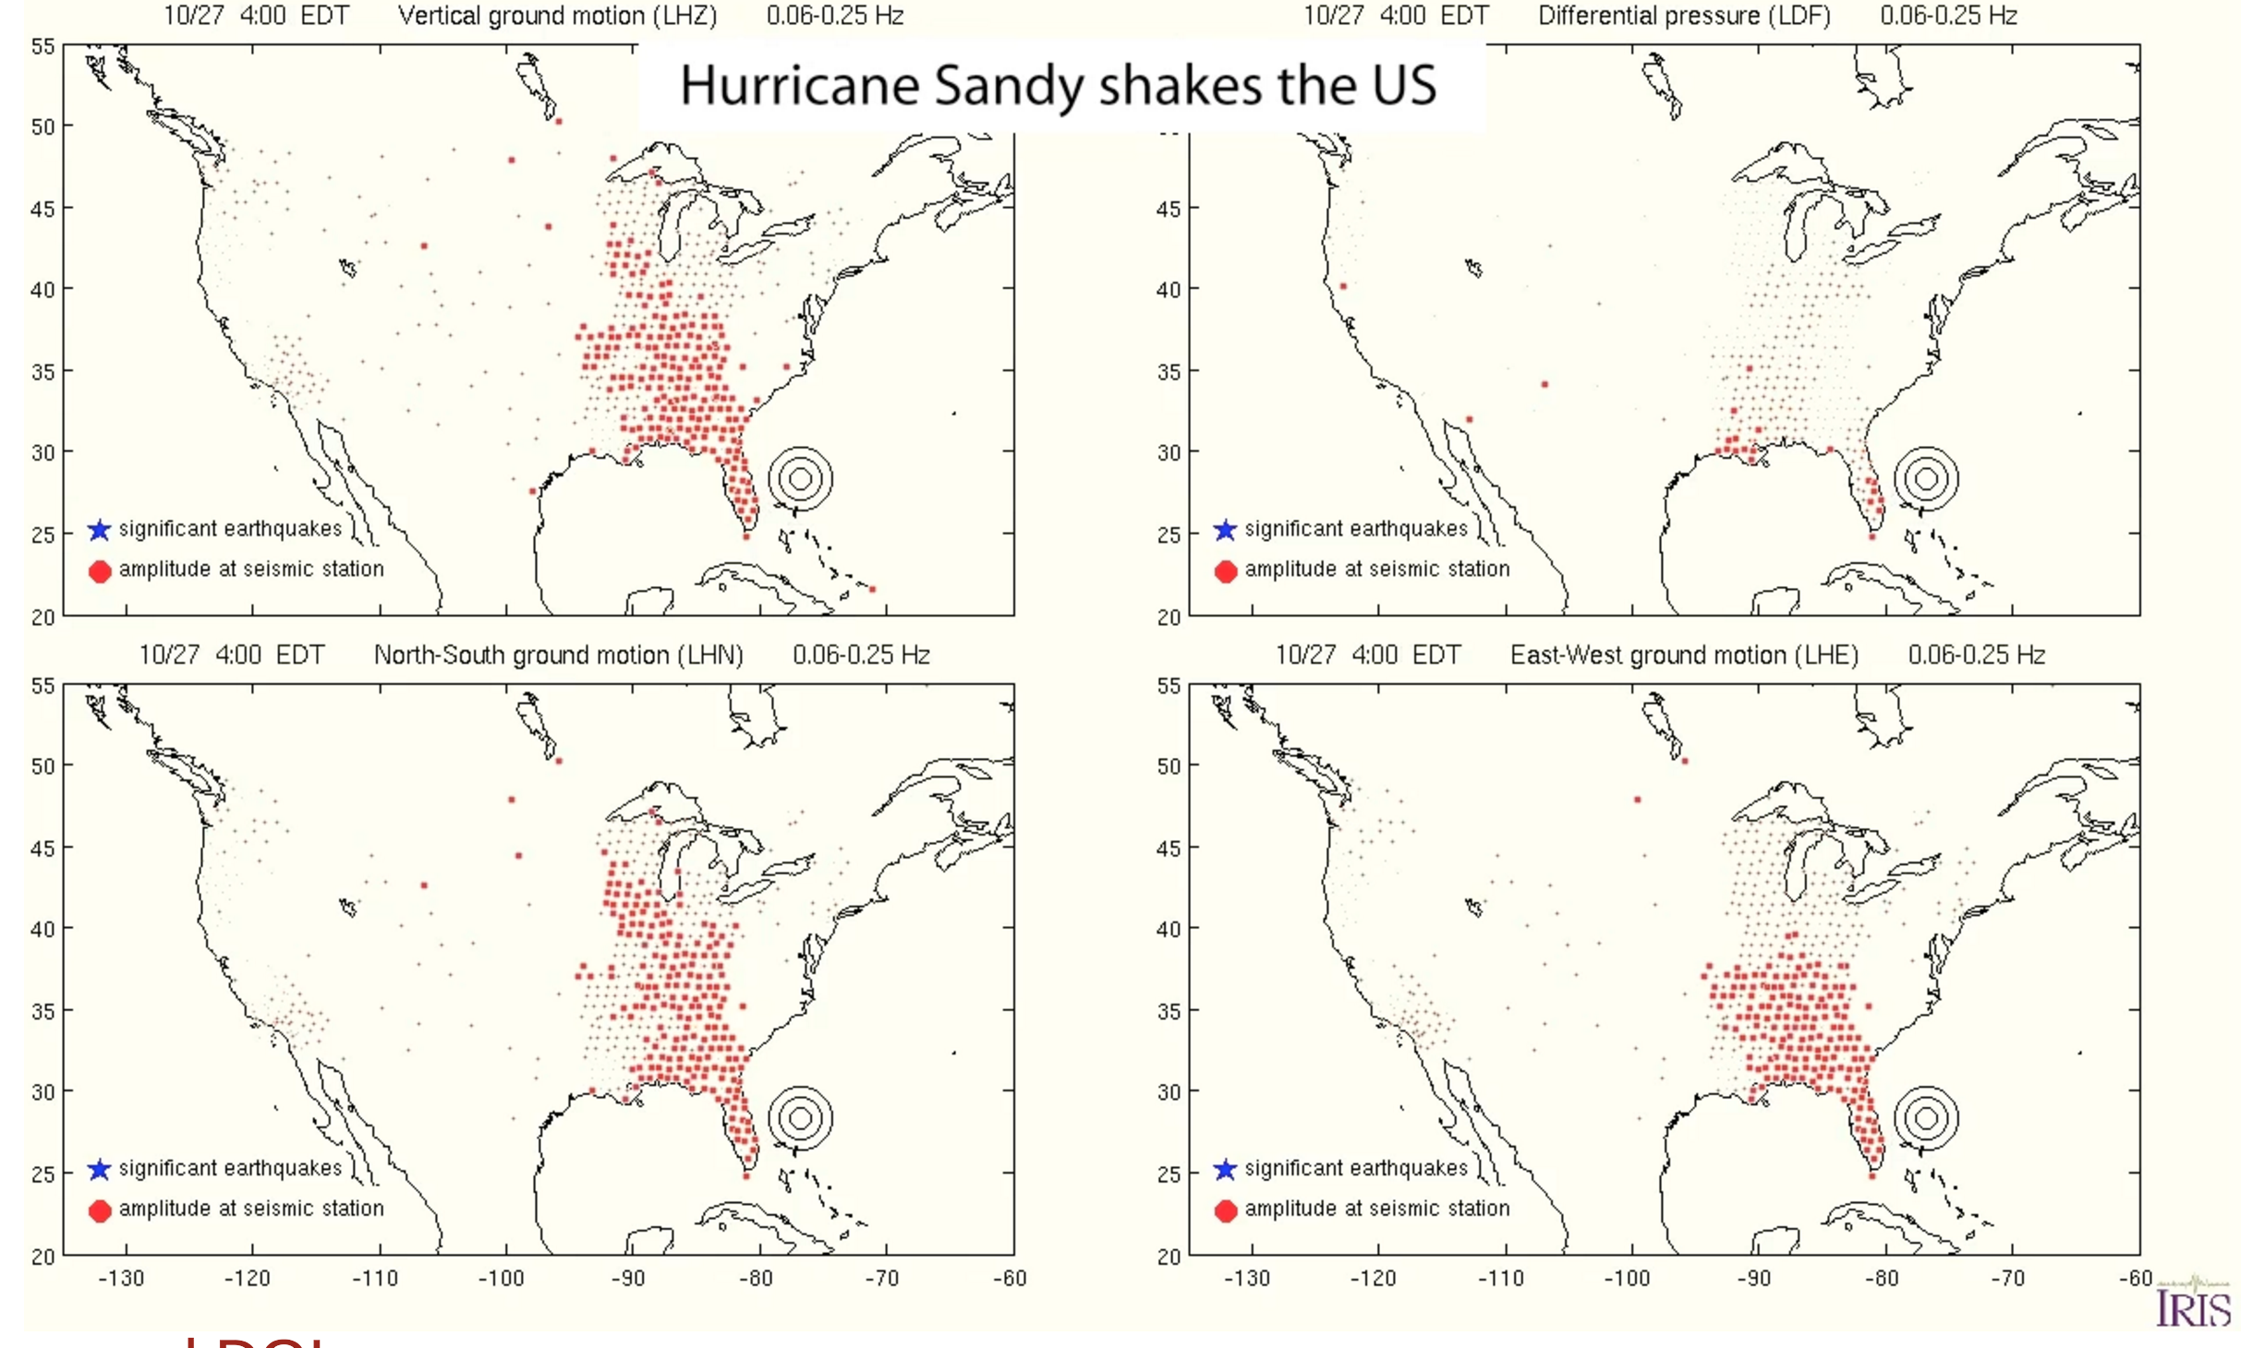
http://ds.iris.edu/ds/products/hurricanesandy/
http://ds.iris.edu/media/product/hurricanesandy/files/HurricaneSandyShakesUS.mov

Slide 12
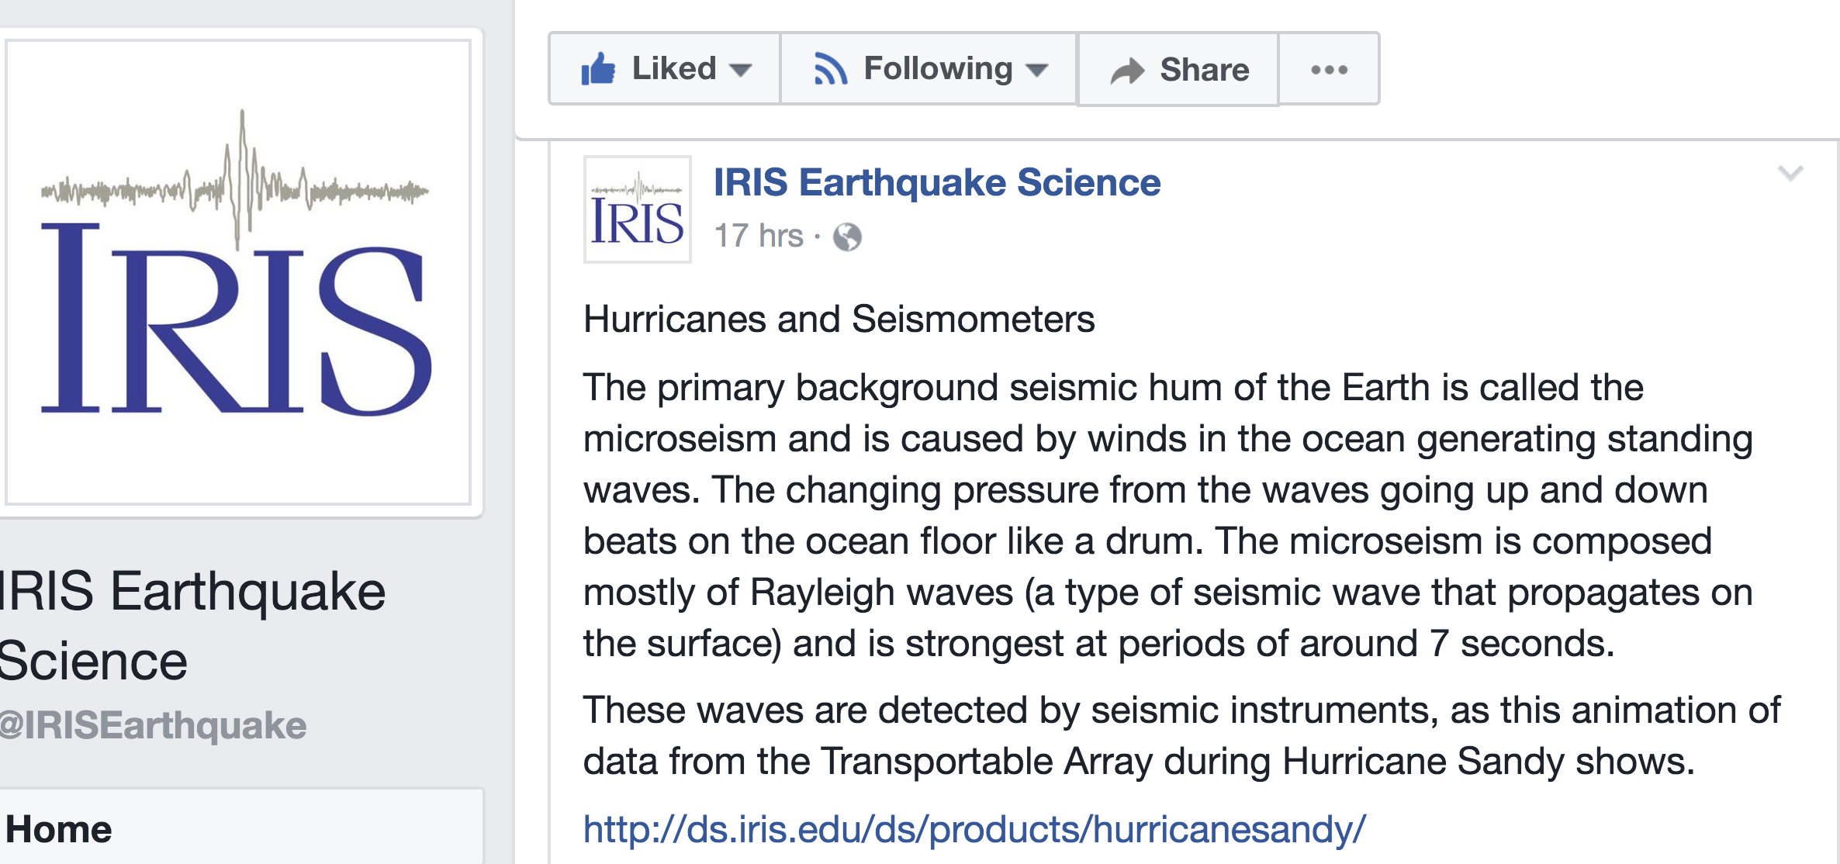
http://www-udc.ig.utexas.edu/eqdisplay/?date=20170825&station
https://www.livescience.com/31802-hurricane-sandy-shakes-seismometers.html
Global P, PP, and PKP wave microseisms observed from distant storms http://onlinelibrary.wiley.com/doi/10.1029/2008GL036111/pdf

