Slide 1
Updating SEED Responses in PDCC After Calibration

Slide 2
SEED Fields to Update
Sensitivity:
Sensor gain (Stage 1, Blockette 58)
Total sensitivity (Stage 0, Blockette 58)
Frequencies of gain and sensitivity
The total sensitivity for a channel should be the product of the stage gains (if the frequencies of the stage gains are the same).

Slide 3
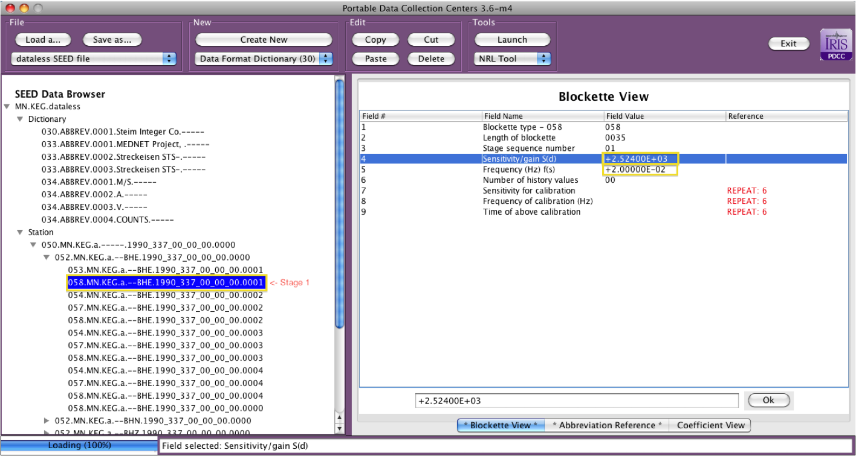
Changing the Sensor Gain

Slide 4
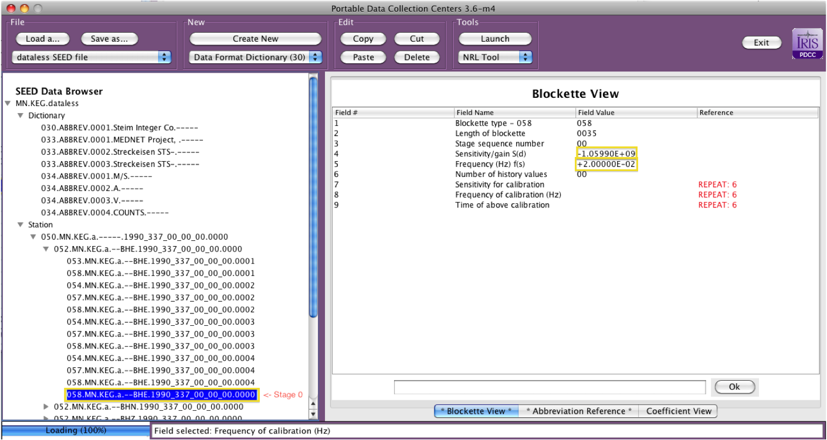
Changing the Total Sensitivity

Slide 5
Other Potential Updates
New Poles and Zeros are entered in Stage 1, Blockette 53
Data logger configuration changes usually mean digital filter changes. FIR filters are in Blockette 54’s and IIR filters are in Blockette 53’s (or 54’s)

