Slide 1

Cayman Islands
Network Report
Presented by Lee Madison
Manager of Information and Technology

Slide 2
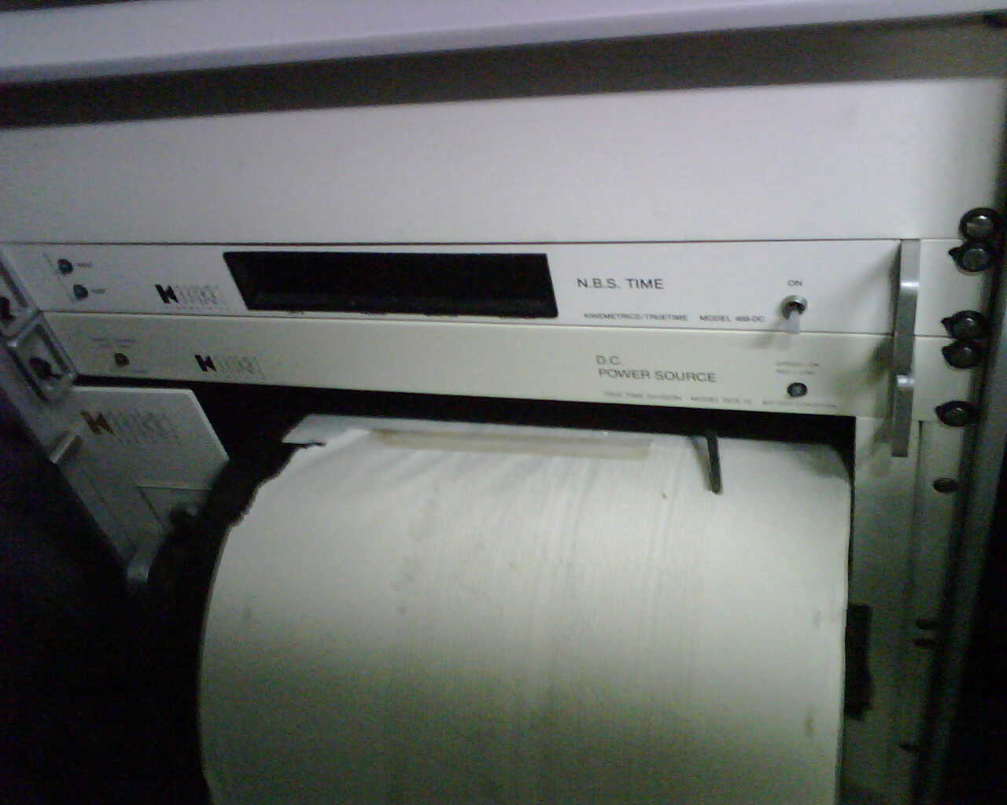

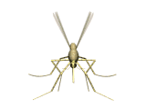
HISTORY
1984-1996 First seismograph managed by Mosquito Research and Control Unit
Late1996 Office of Telecommunications

Slide 3
1997-2004
1997 Seismograph was decommissioned
Two new seismographs purchased in 1997, not networkable, still required paper.
Sat in boxes, never installed
December 14th 23:20:14 UTC
6.8 magnitude earthquake
35 km (20 miles) SSE George Town
Depth 10 km (6.2 miles)

Slide 4
Mid 2005 )
Equipment loaned from Jamaica
Installed at MRCU
MRCU scientists trained
Equipment recalled in 2007
Money found to purchase own equipment
MRCU developed an RFP in 2006
Contract with Digital Technology Associates signed to supply Guralp Systems equipment

Slide 5
2007)
New Equipment arrives
MRCU staff trained for the installation
Project stalled
Project given to lands and Survey
Site Surveys completed
Frank Sound and West Bay construction begins

Slide 6
2007 ( Continued)
Hazard Management Agency formed
Project handed to Hazard Management
Frank Sound install completed (2008)
West Bay Install completed (2009)
Cayman Brac Install estimated (2010)
Little Cayman Install Completed (2010)

Slide 7
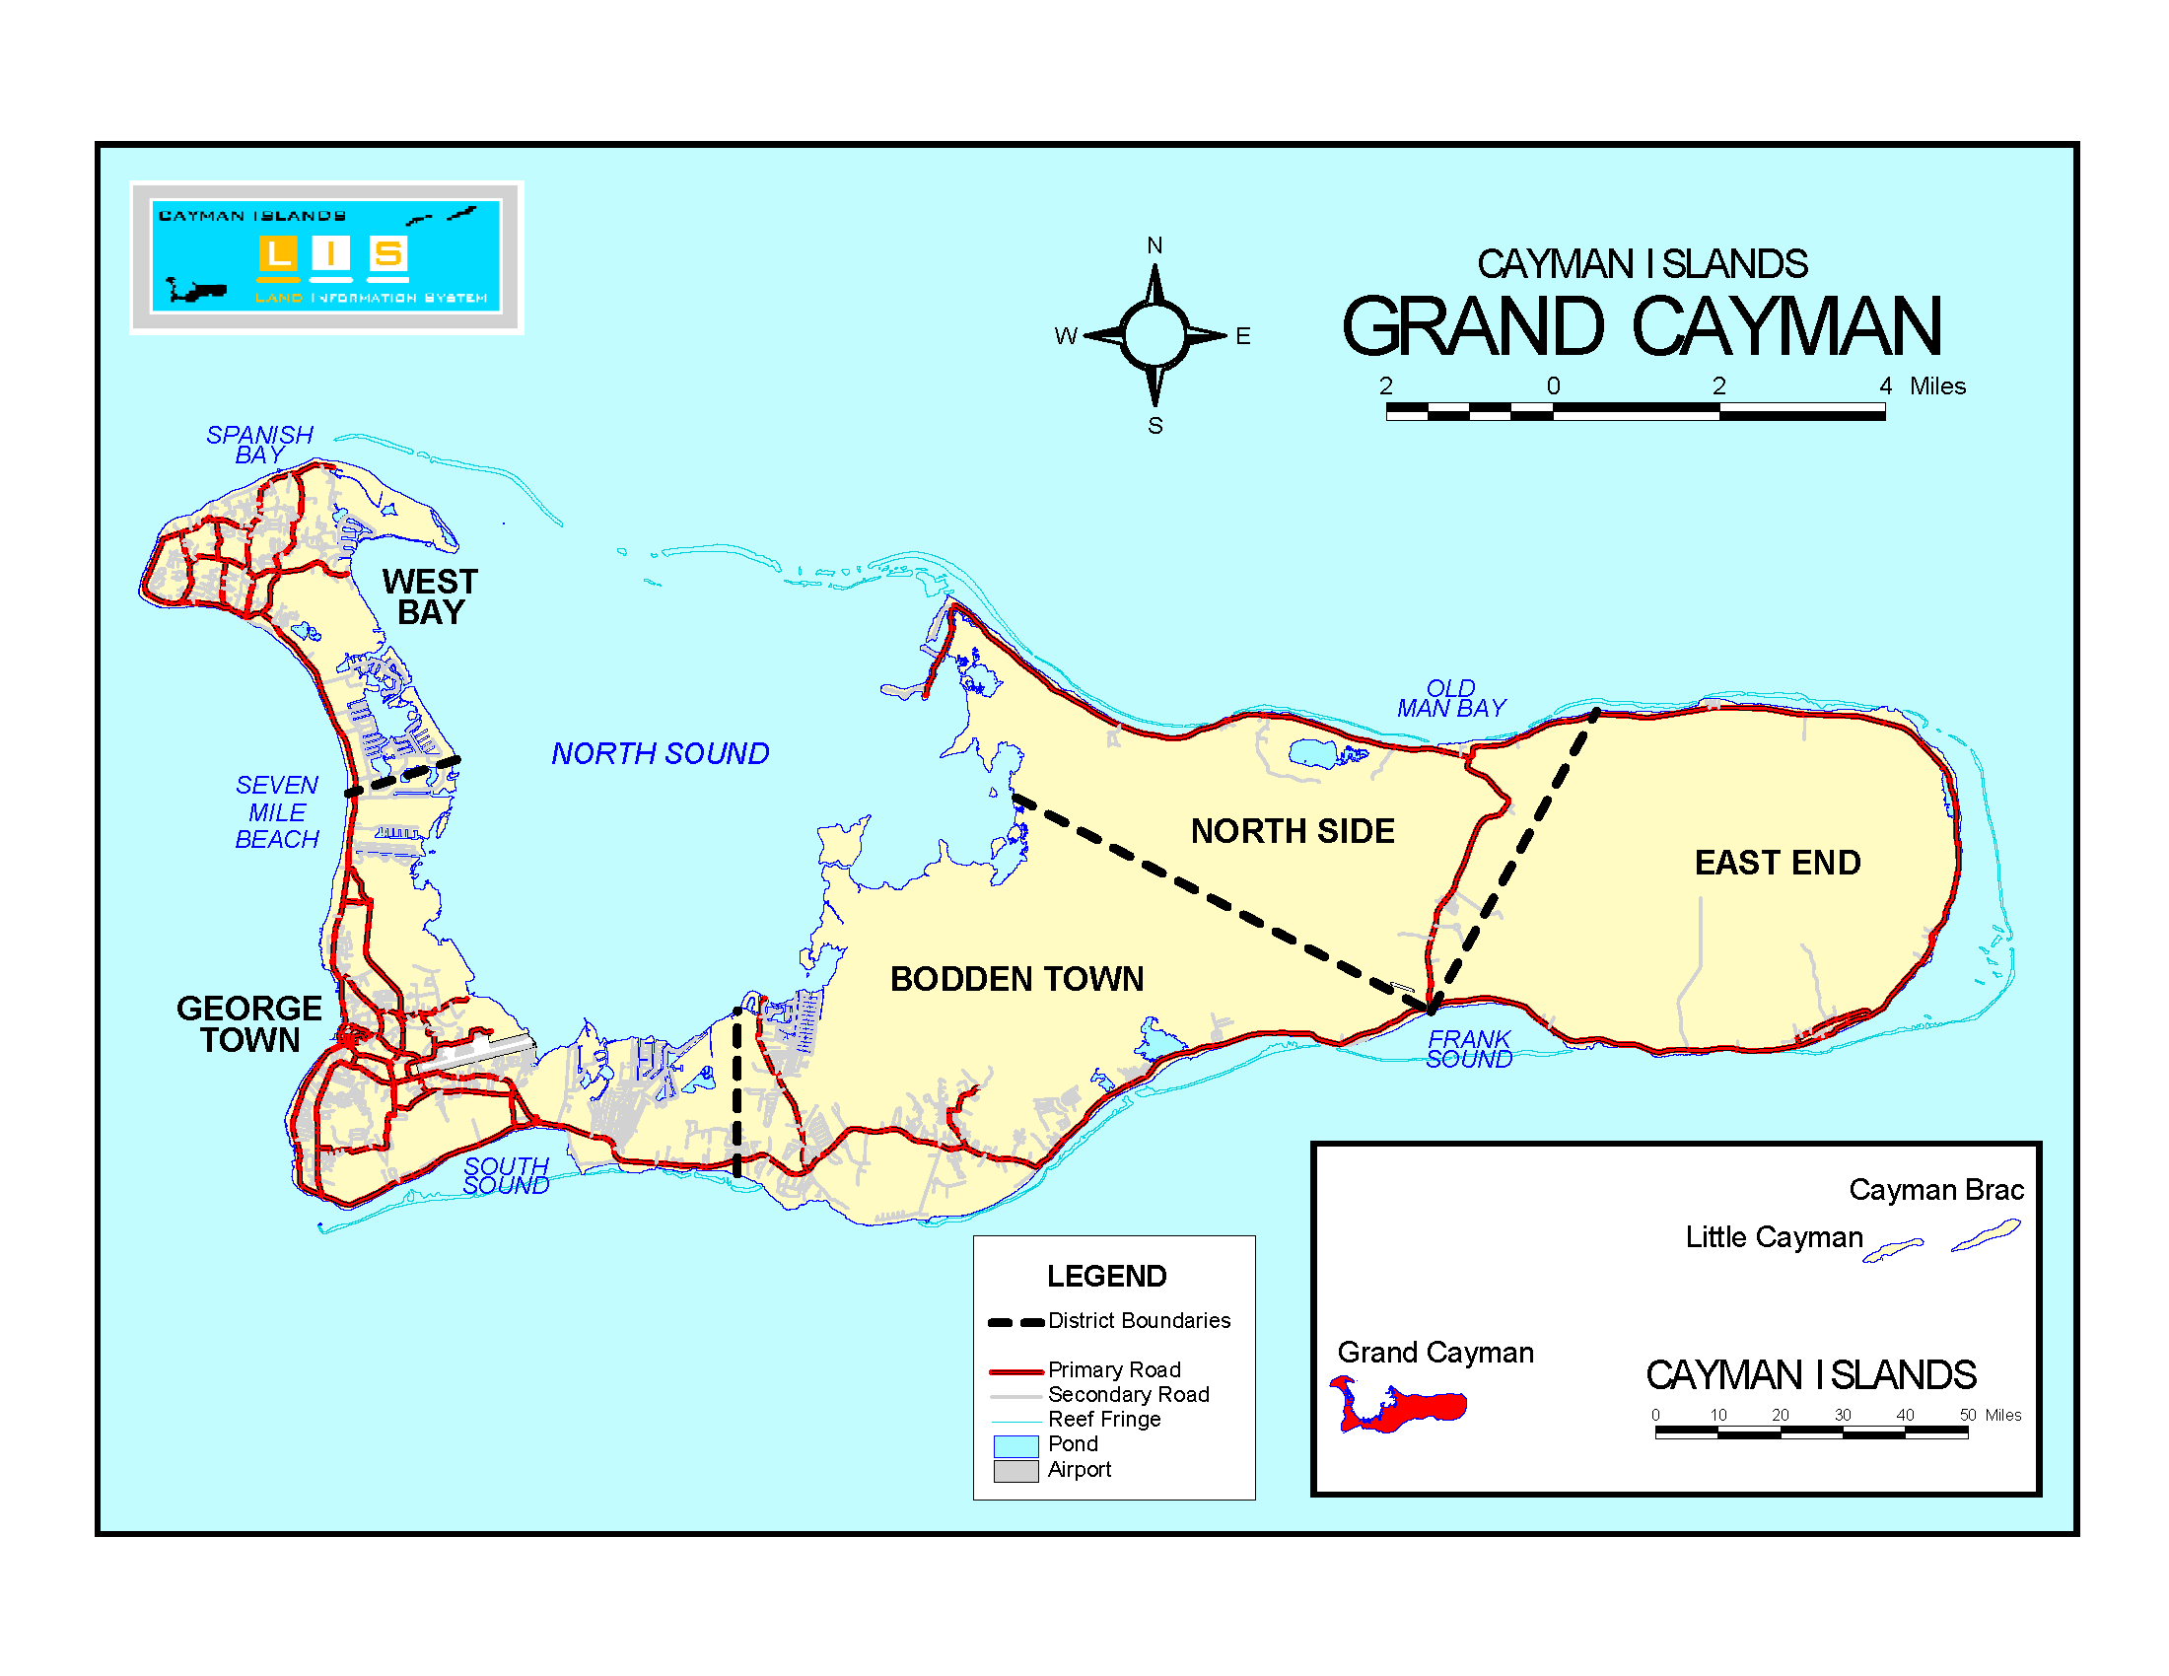
19.376,-81.397
19.3130, -81.1835

Slide 8
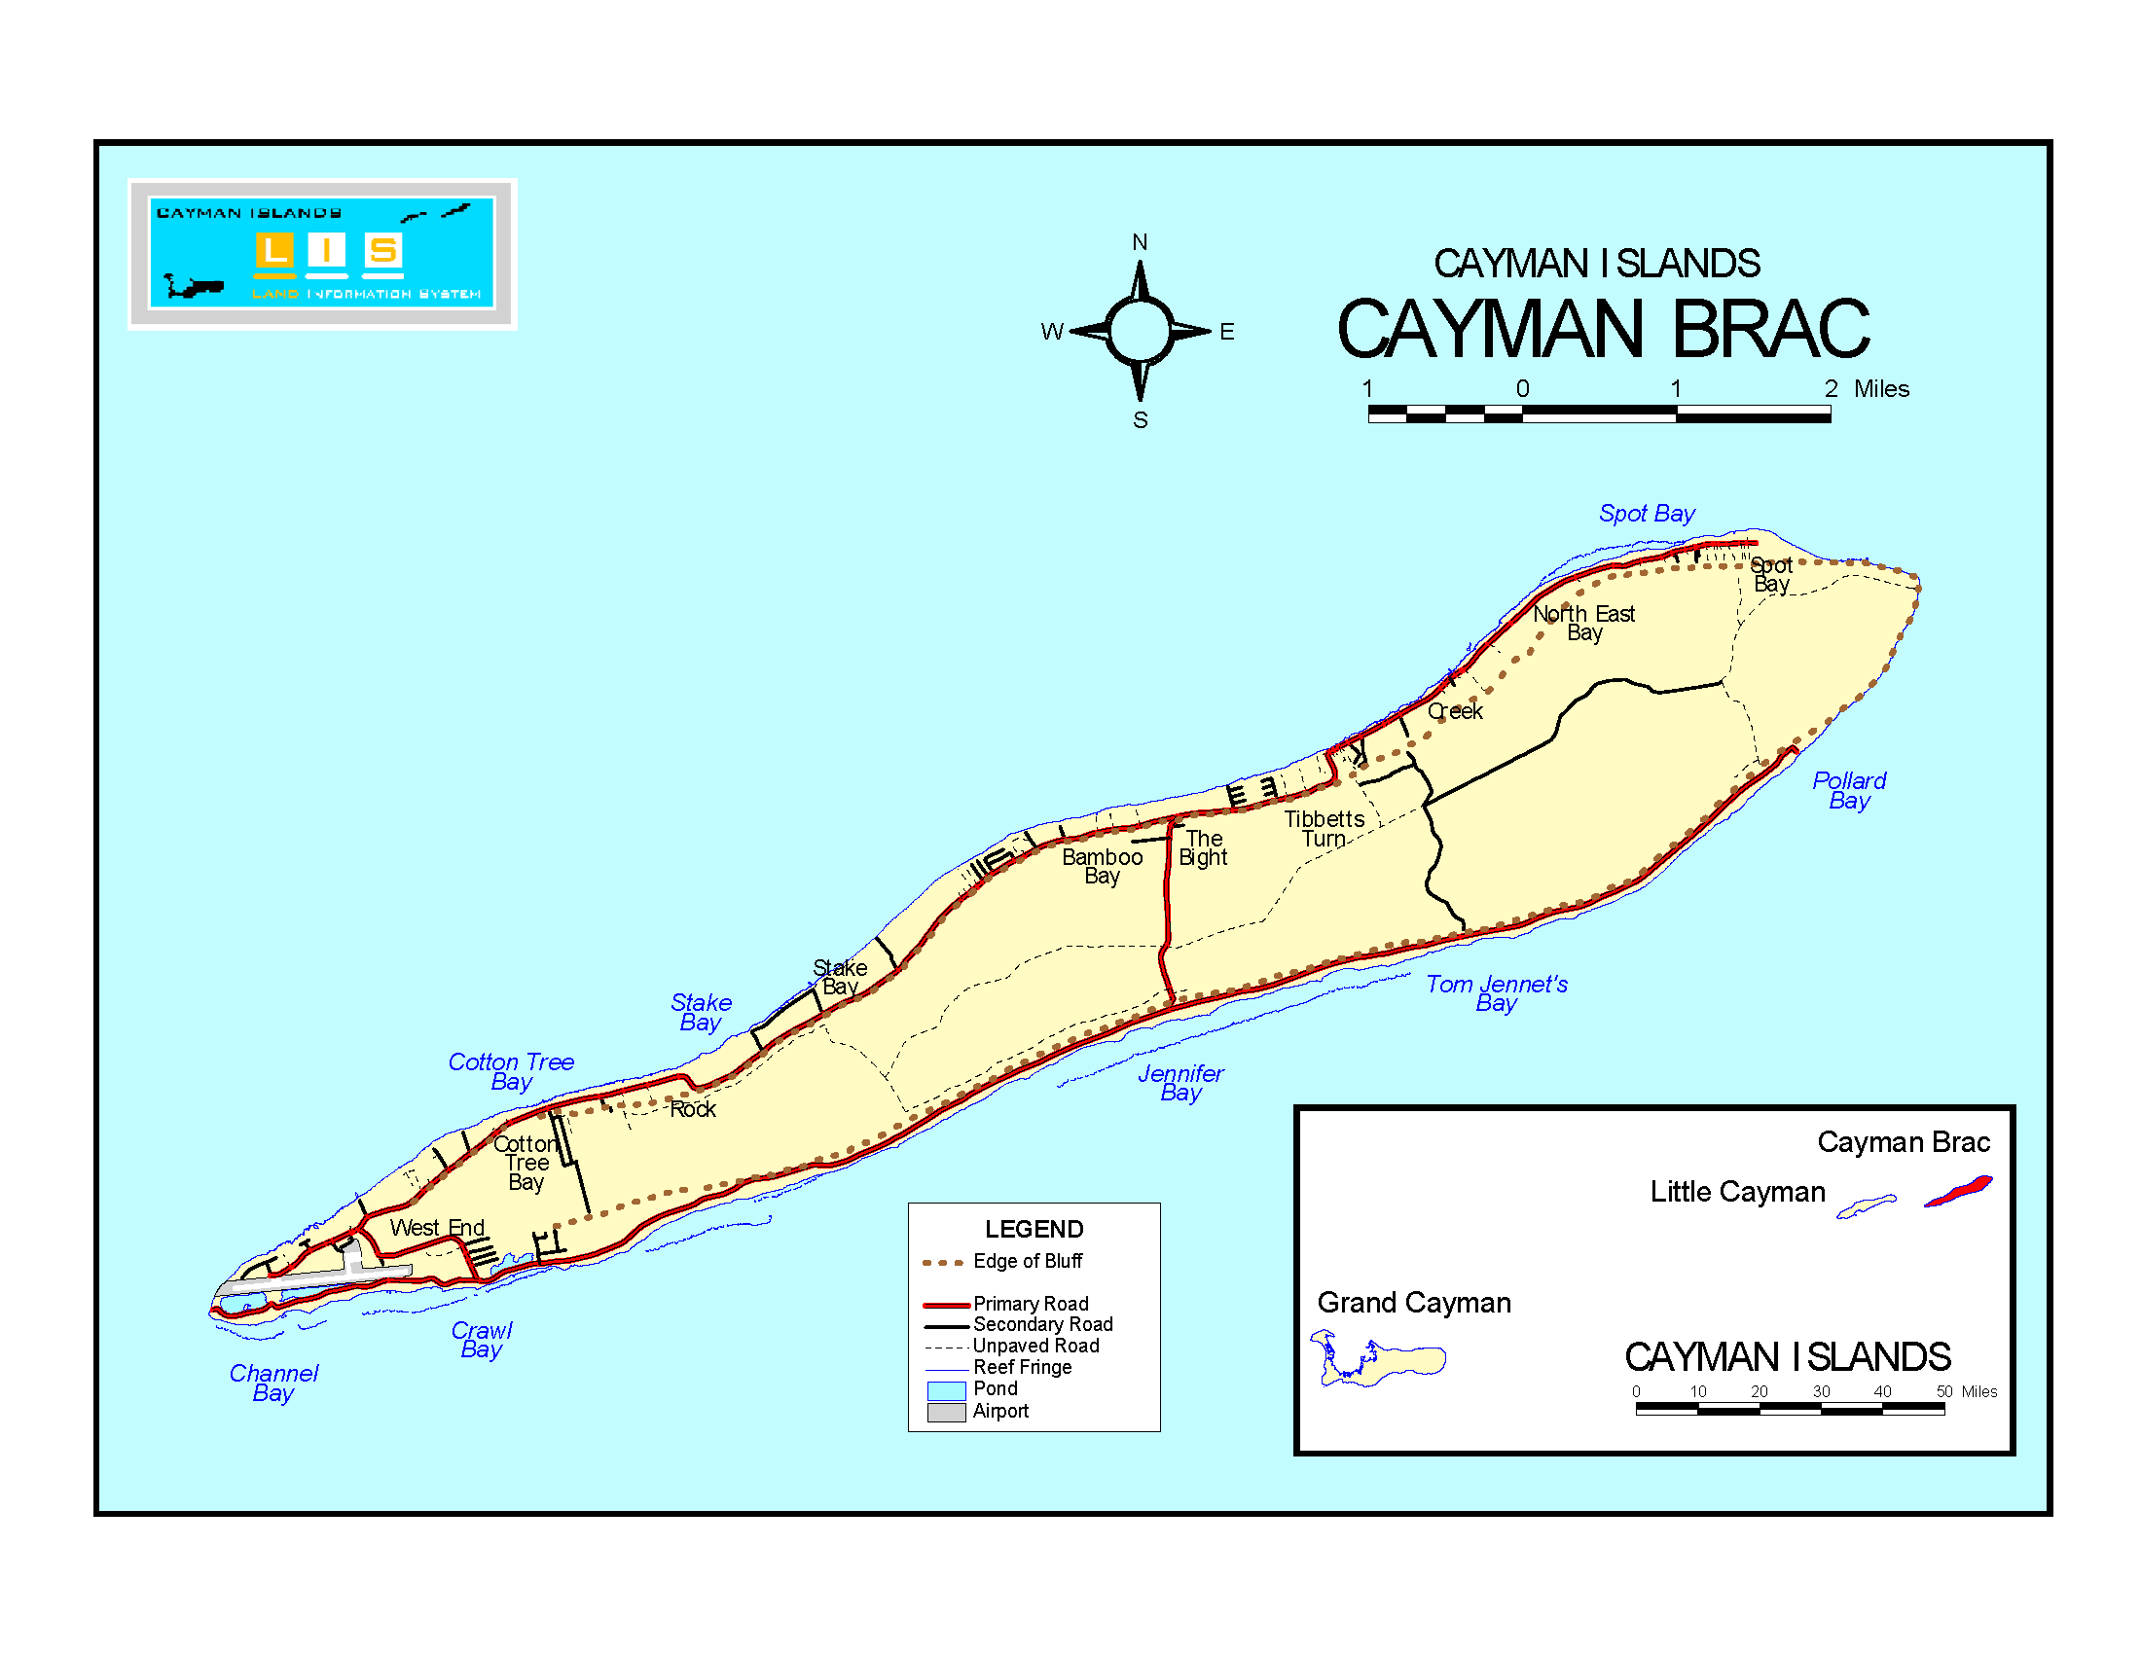
19.7225, -79.7944

Slide 9
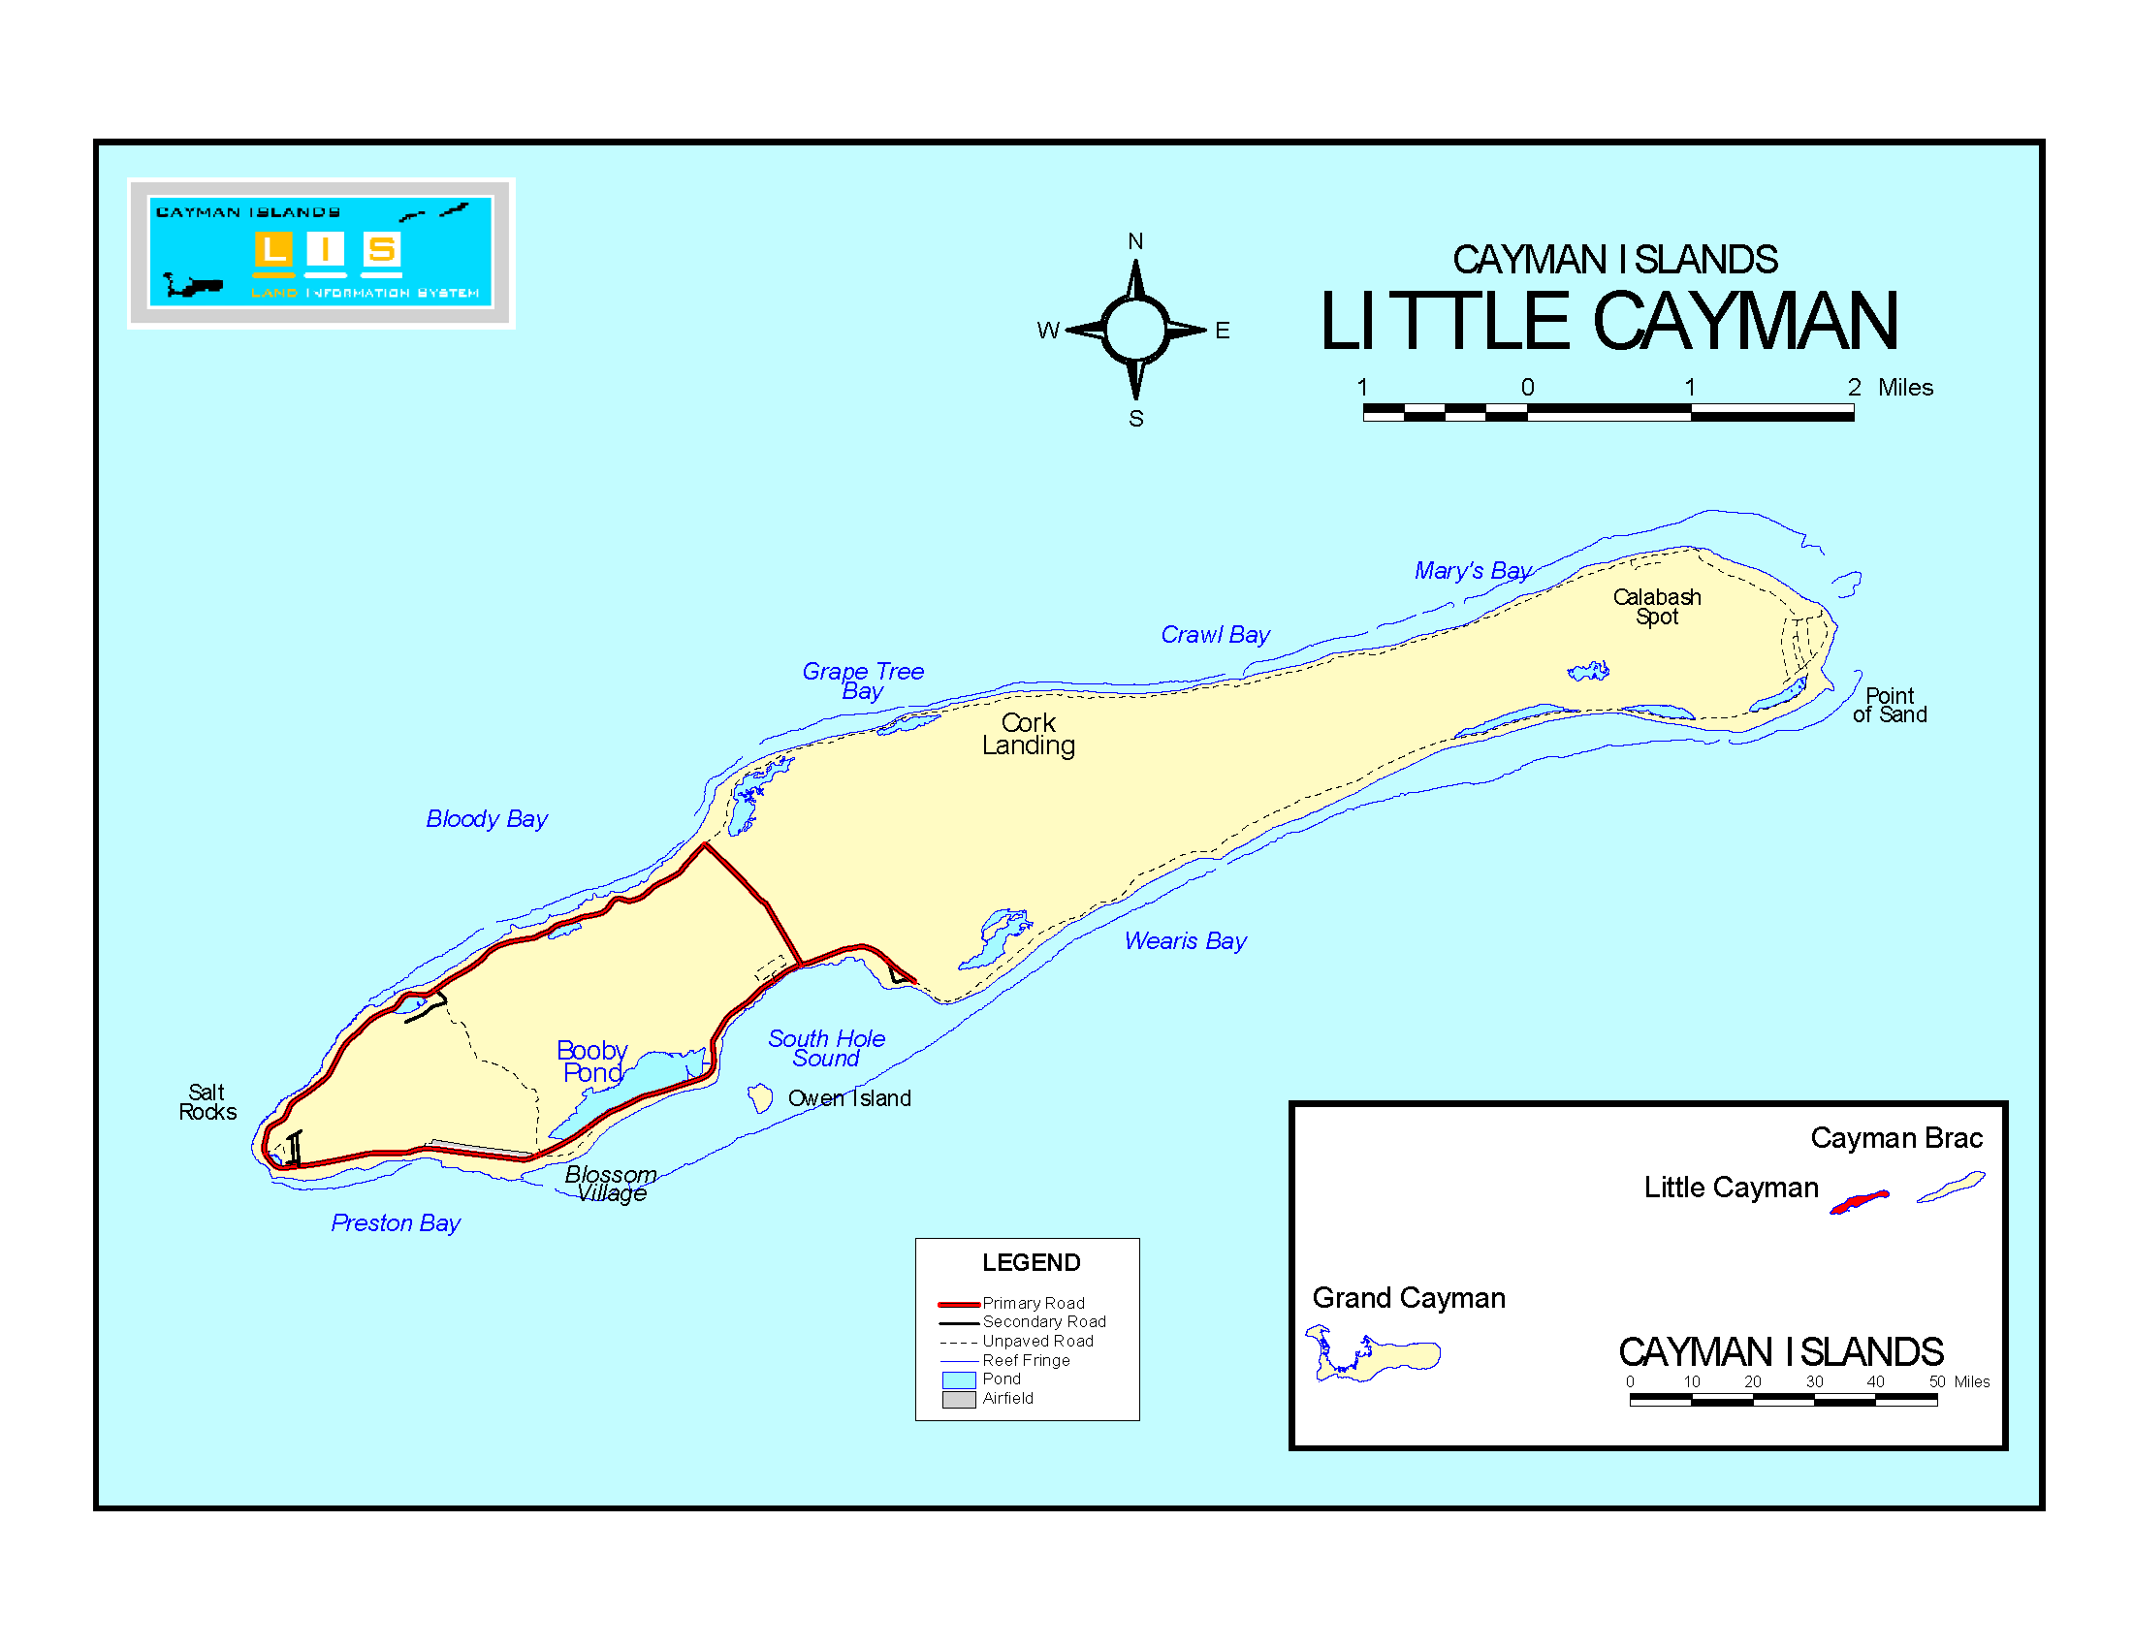
19.6673, -80.0828

Slide 10

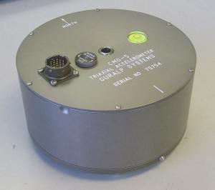
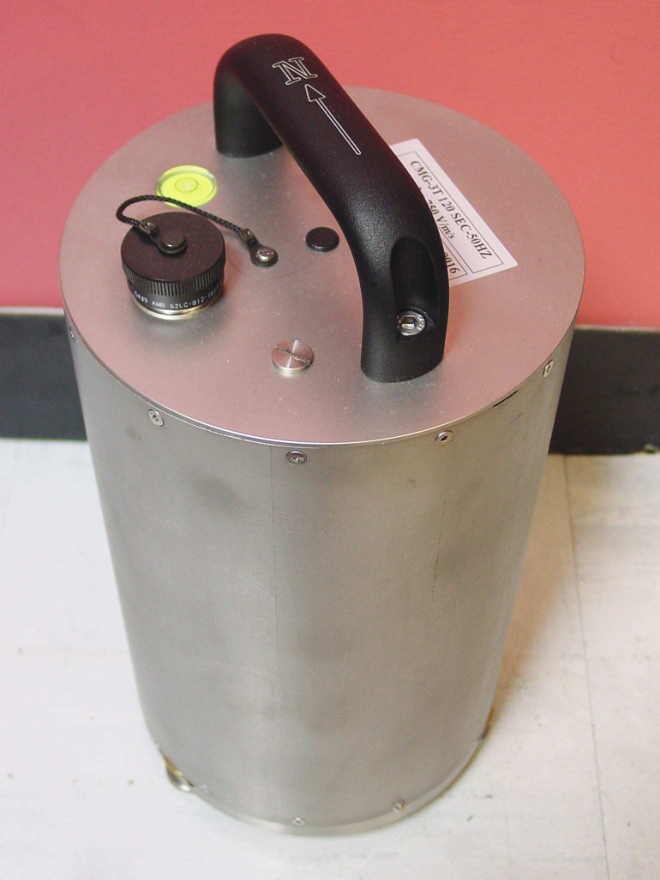
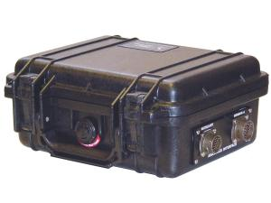
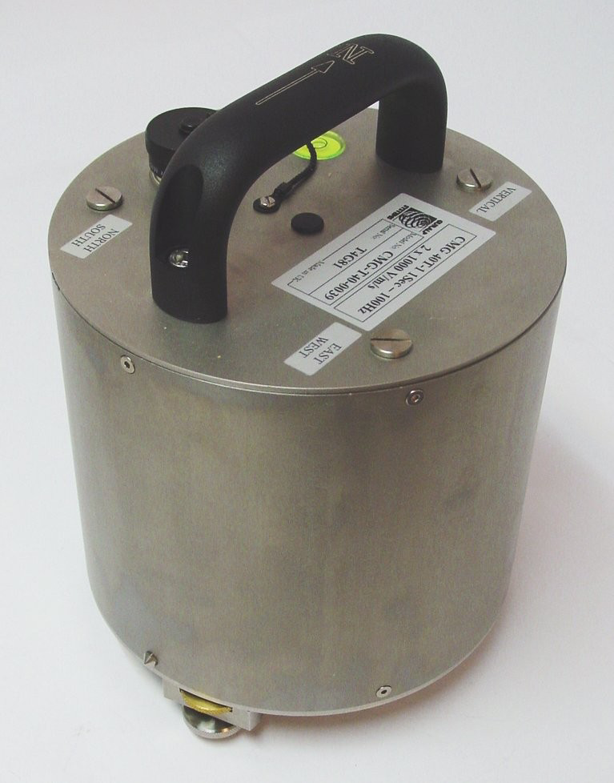
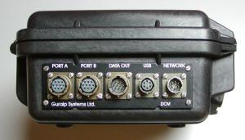
Equipment
CMG-5T
CMG-40T
CMG-3T (CYB)
CMG-M24MK3
CMG- DCM

Slide 11
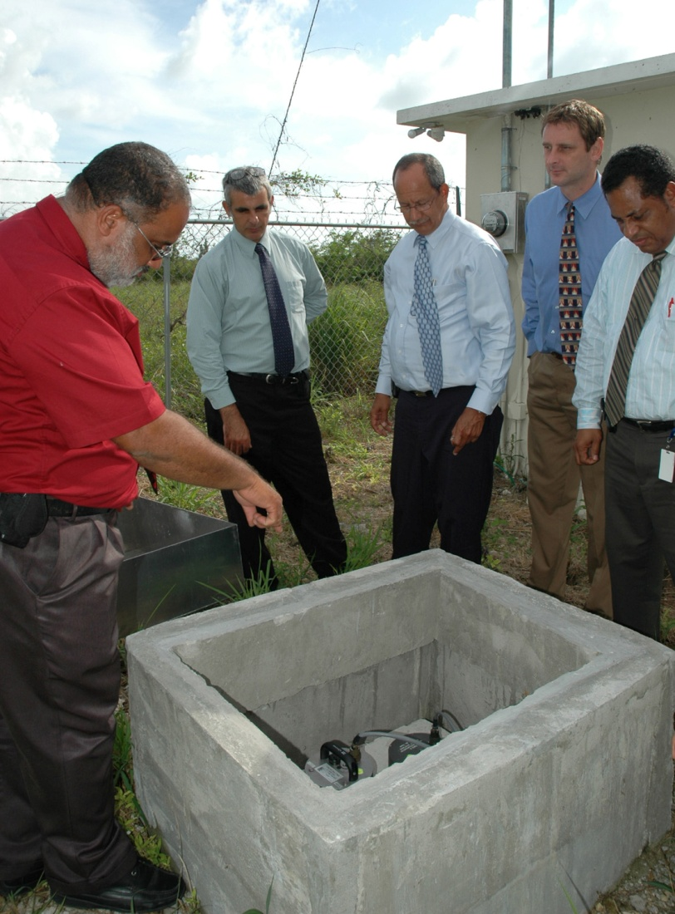
Frank Sound Site

Slide 12
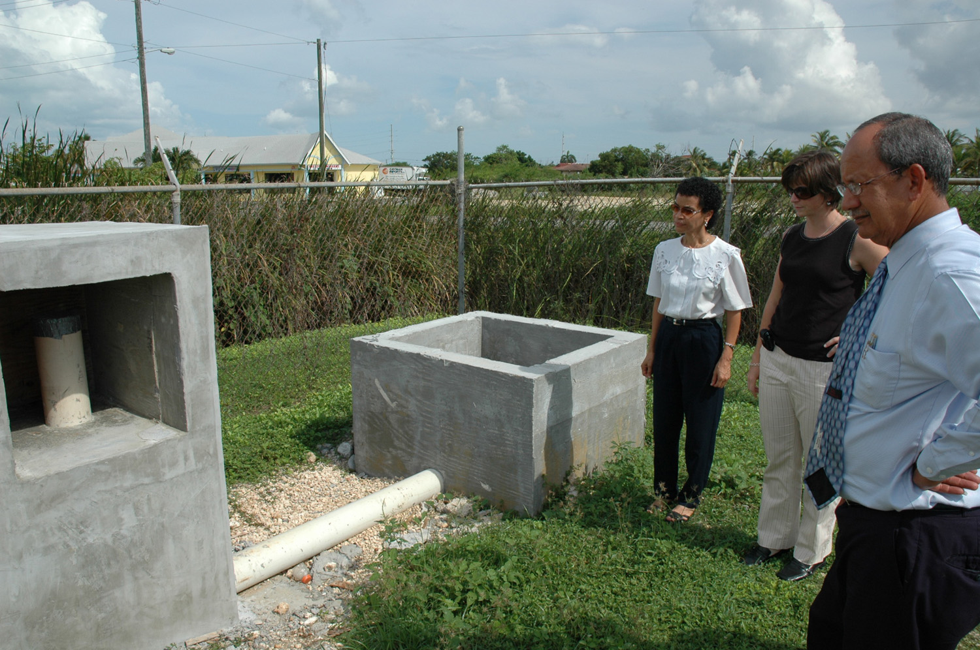
West Bay Site

Slide 13
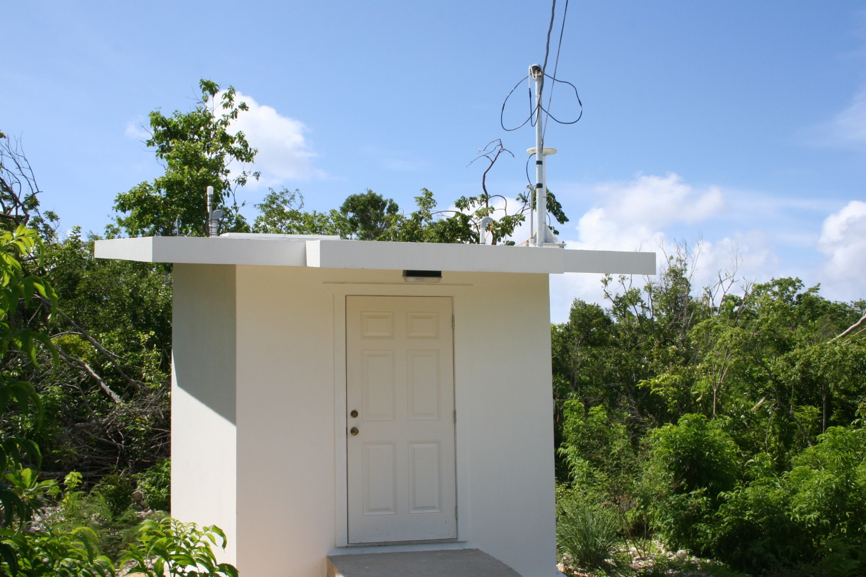
Cayman Brac Site

Slide 14
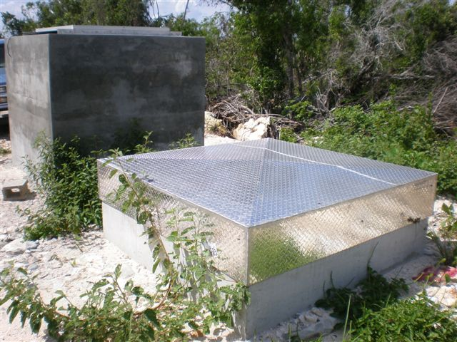
Little Cayman Site

Slide 15
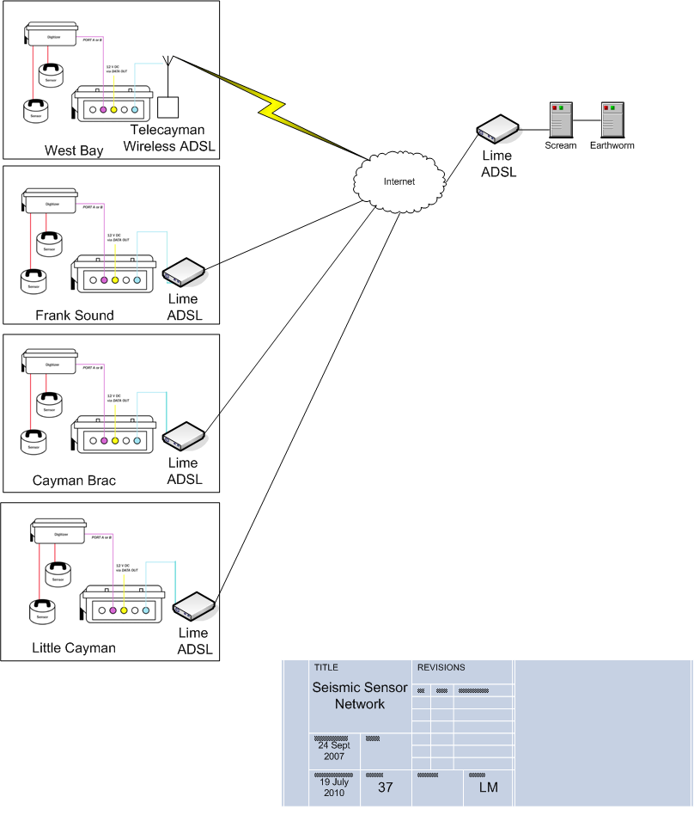

Slide 16
Monitoring Sites
National Emergency Operation Centre
National Meteorological Office
Hazard Management Office

Slide 17
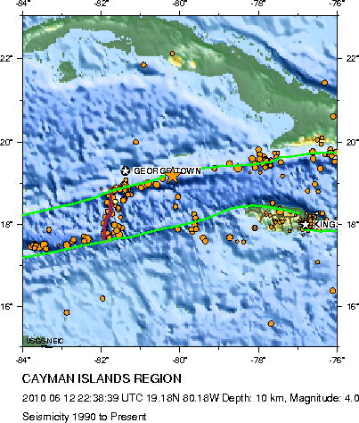
ACTIVITY
Activity

Slide 18
QUESTIONS?

