Slide 1
Data Quality Control of
IRIS/IDA GSN Data
IRIS Metadata Workshop
August 16, 2010
Peter Davis
Project IDA
Scripps Institution of Oceanography
University of California, San Diego

Slide 2
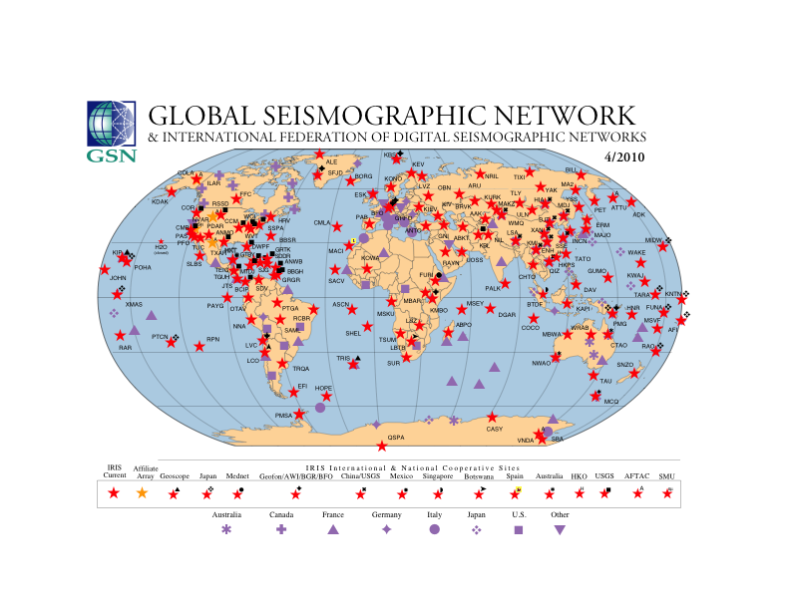

Slide 3
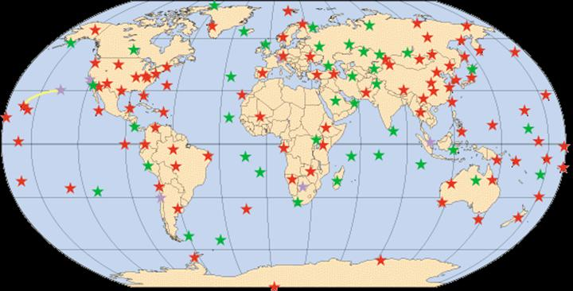
The Global Seismographic Network
- USGS Albuquerque Seismological Laboratory
- IRIS/IDA Group at IGPP, Scripps Institution of Oceanography
University of California, San Diego
- University Networks and Affiliates

Slide 4
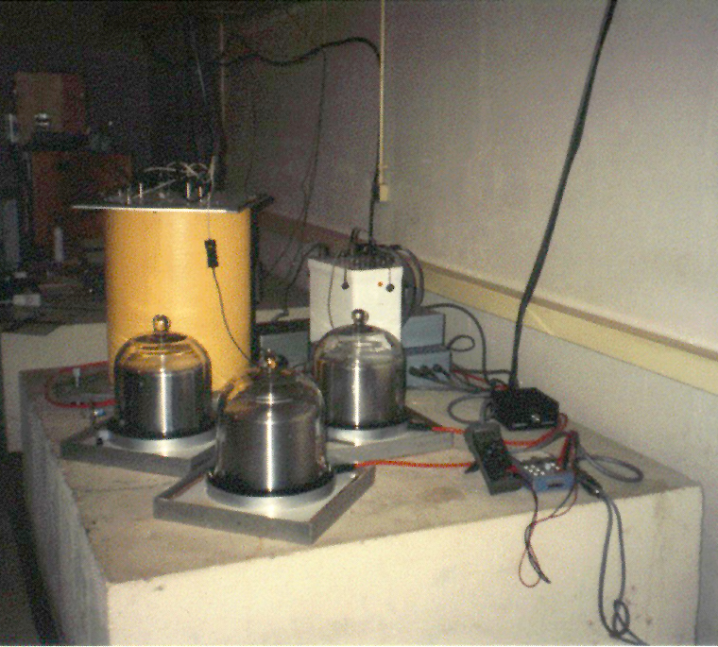
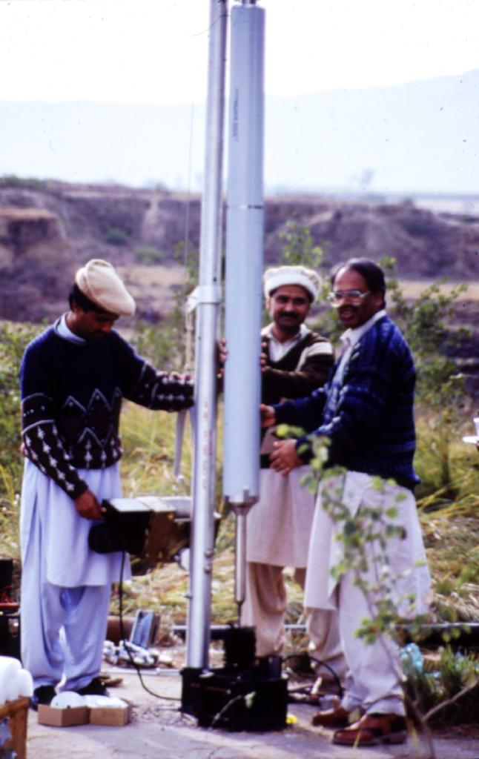
Streckeisen STS-1
Seismometers
Teledyne KS-54000-I

Slide 5
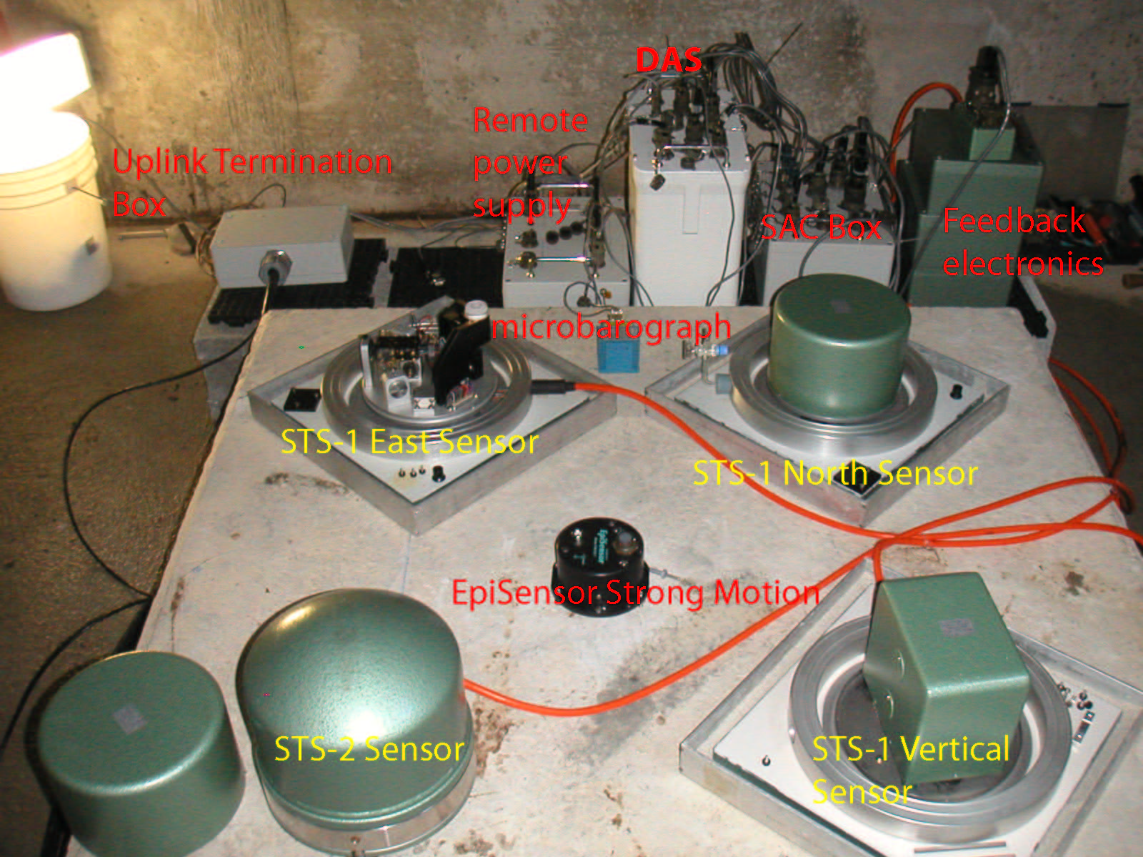

Slide 6
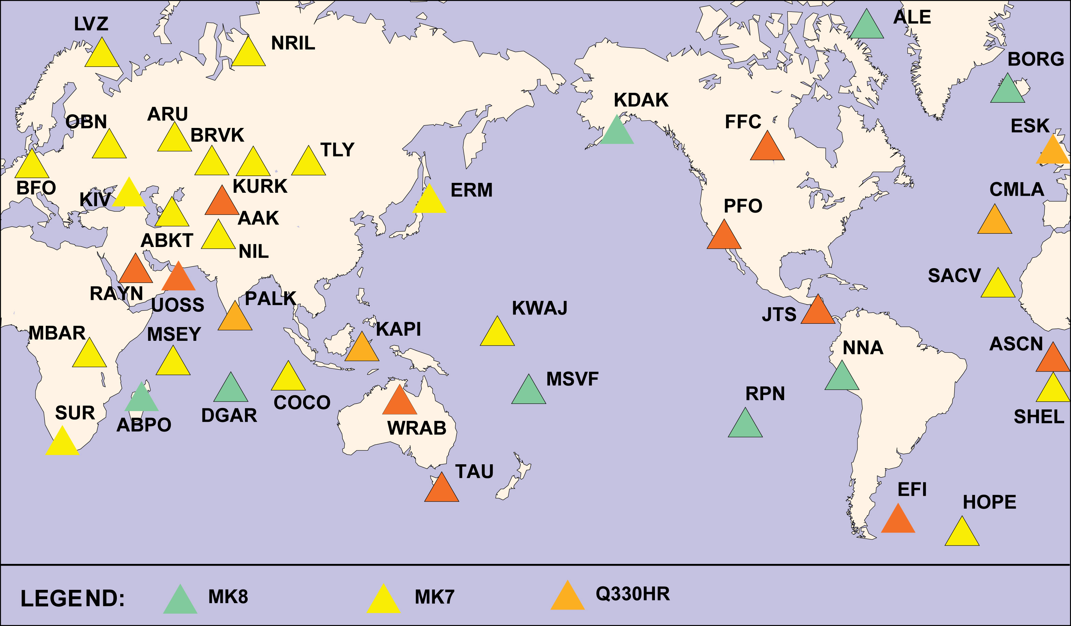
Q330 Upgrades – June 2010

Slide 7
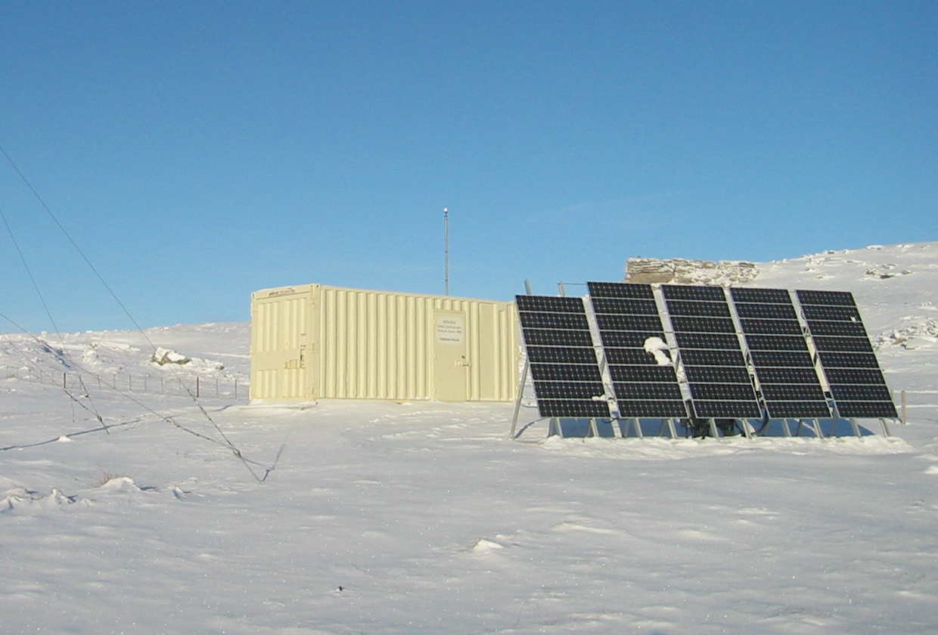
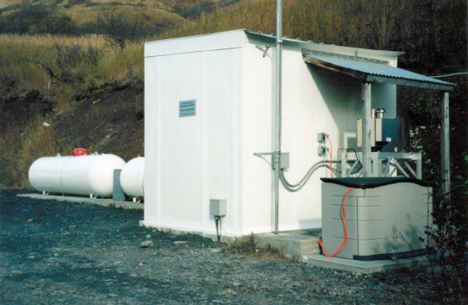
Thermoelectricity
Solar power
Power:

Slide 8
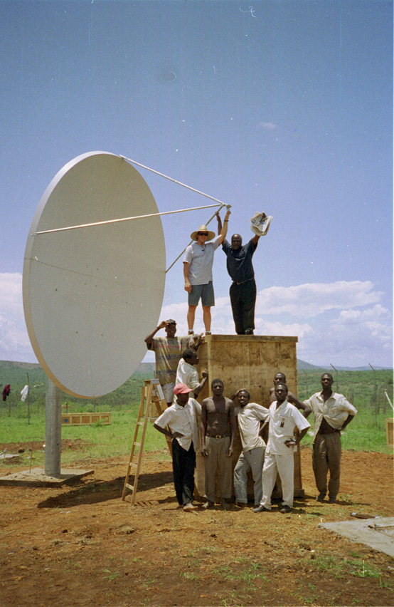
Telemetry links:
LAN
leased lines / VSATs
international dialing
local ISP

Slide 9
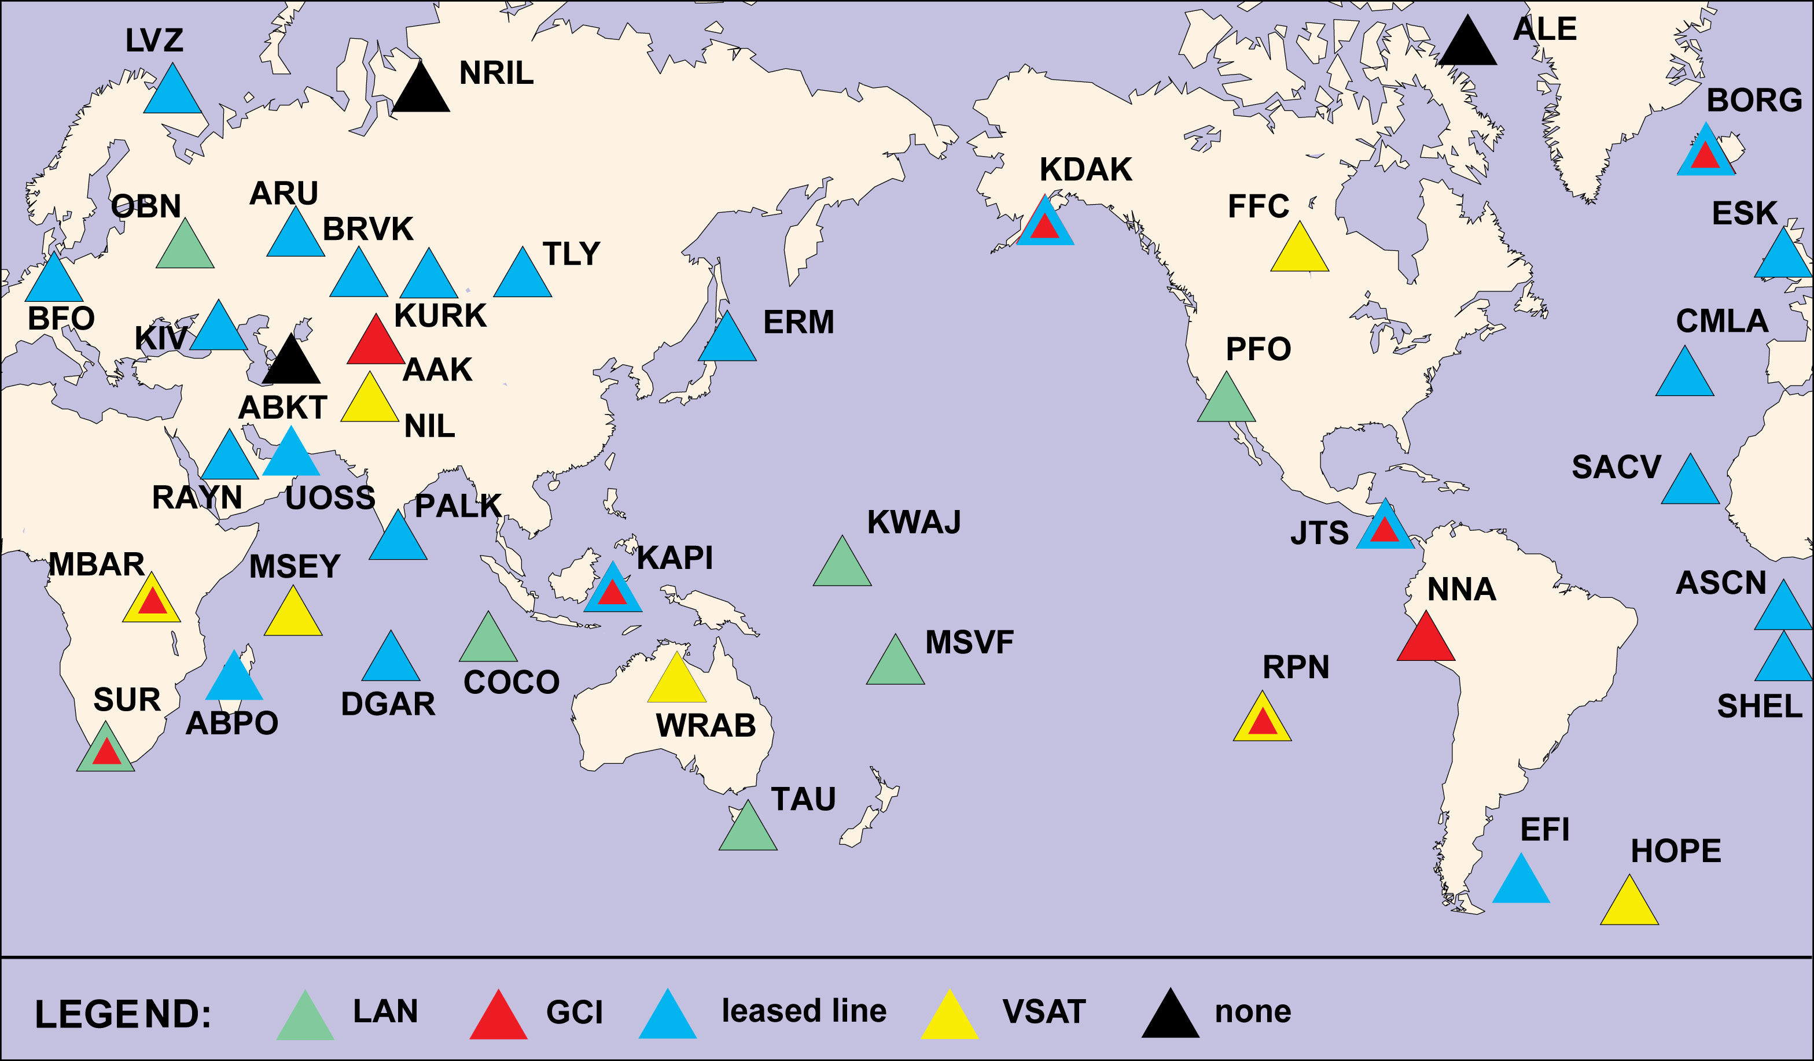
II Telemetry Topology – June 2010

Slide 10
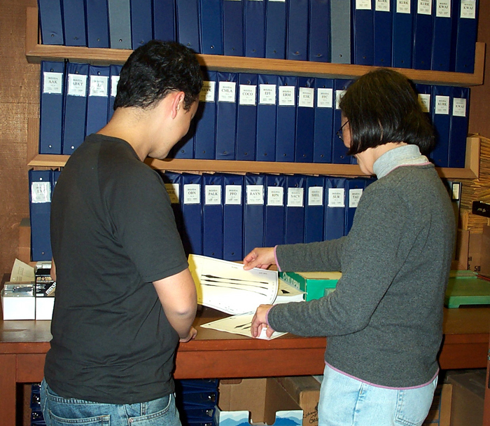
Detecting problems you expect:
(These computer programs written at UCSD.)

Slide 11
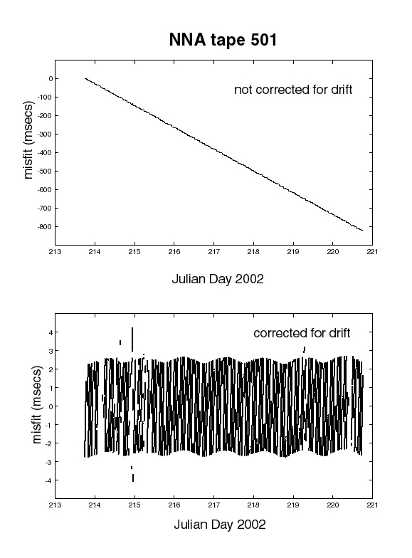
sample rate correction (clocks on old systems are permitted to drift freely)

Slide 12
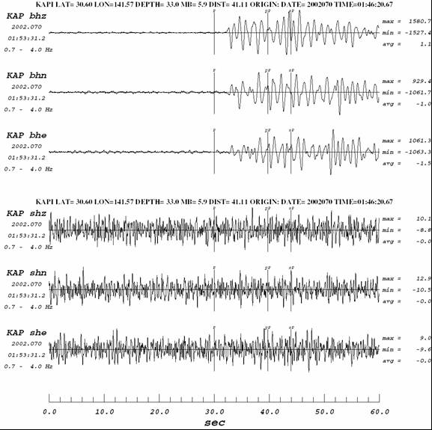
Sensor failure:
(We make use of earthquake locations announced by USGS NEIC.)

Slide 13
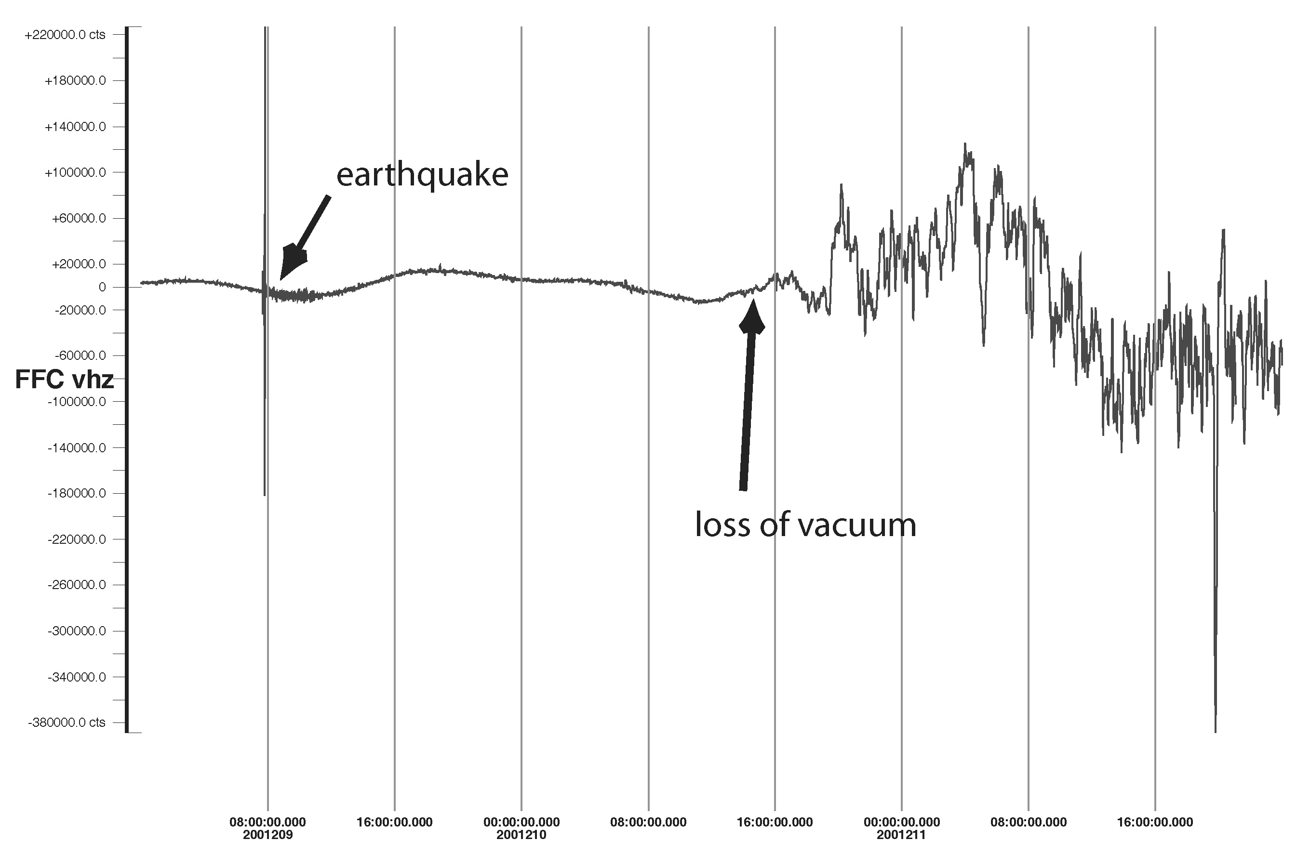
loss of vacuum (We examine long data segments.)

Slide 14
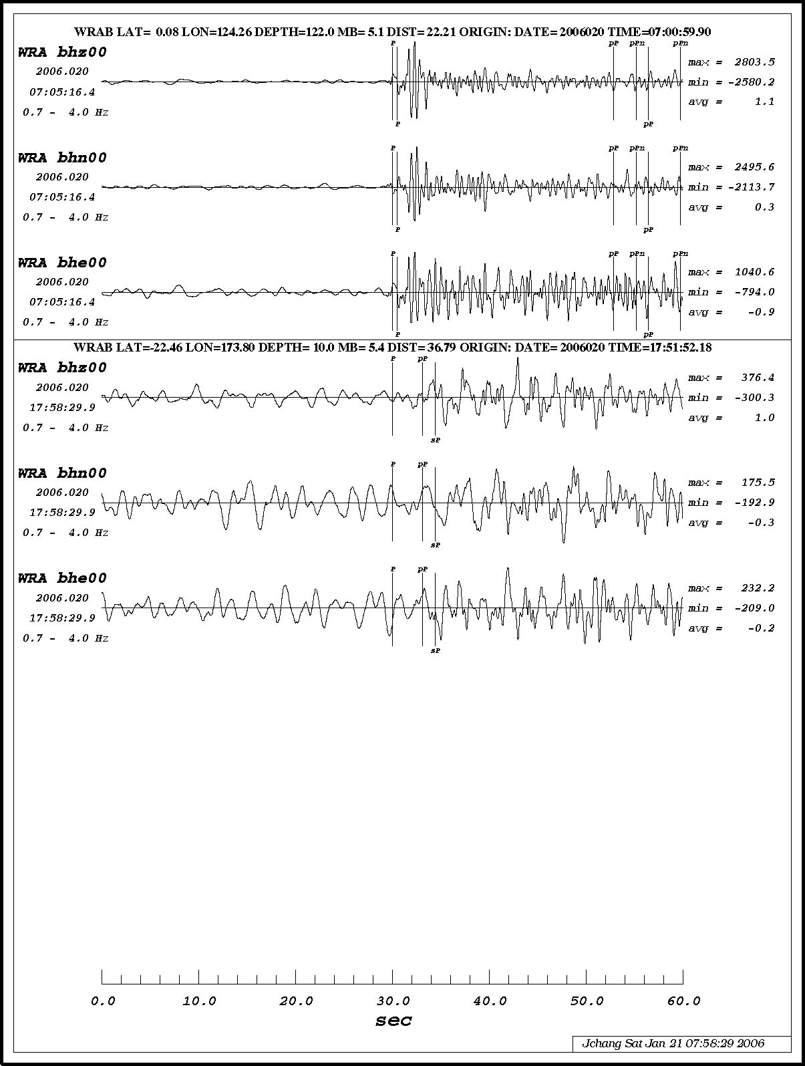
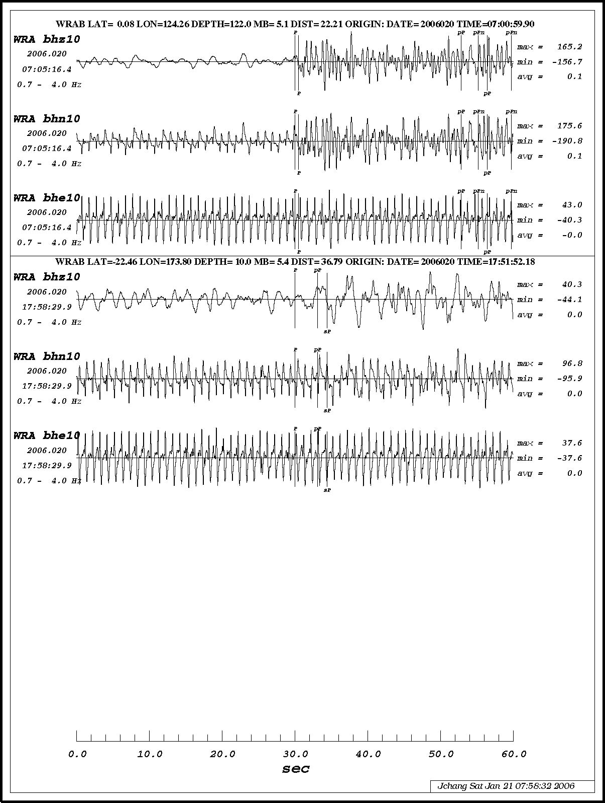
compare primary and secondary sensors(We exploit data redundancy.)

Slide 15
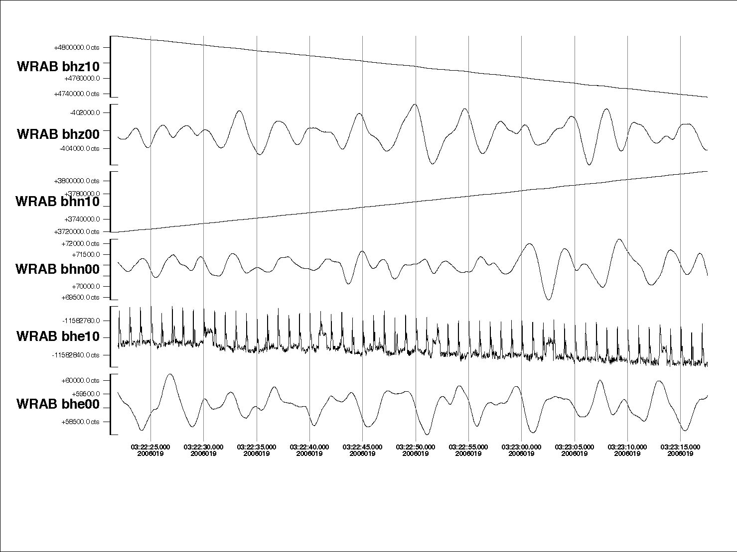
problems unique to tri-axial sensors

Slide 16
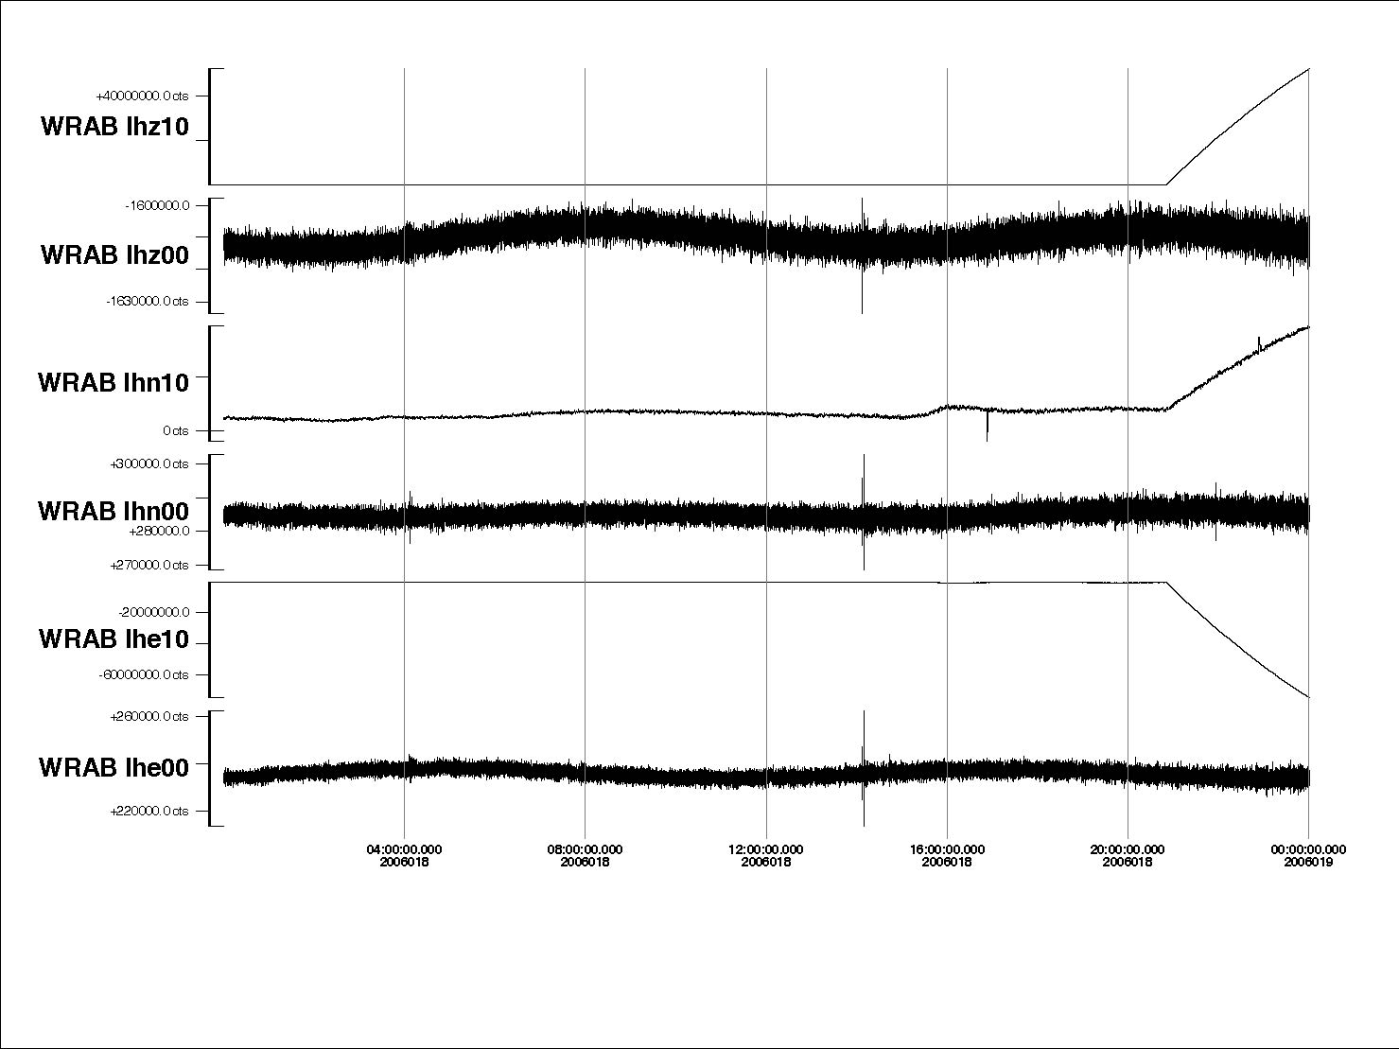

Slide 17
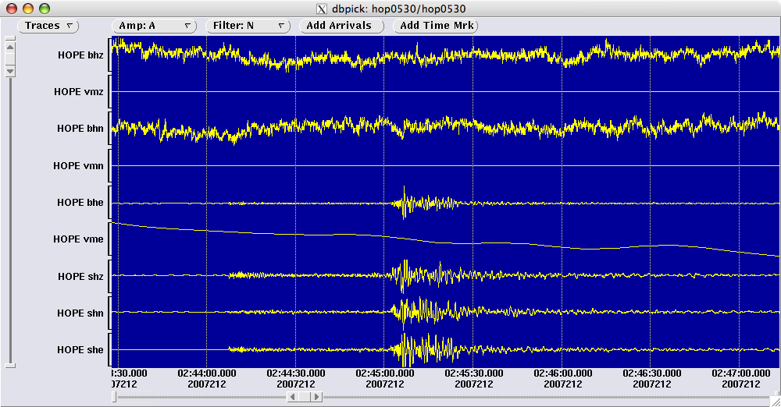
Seismometer masses saturated

Slide 18
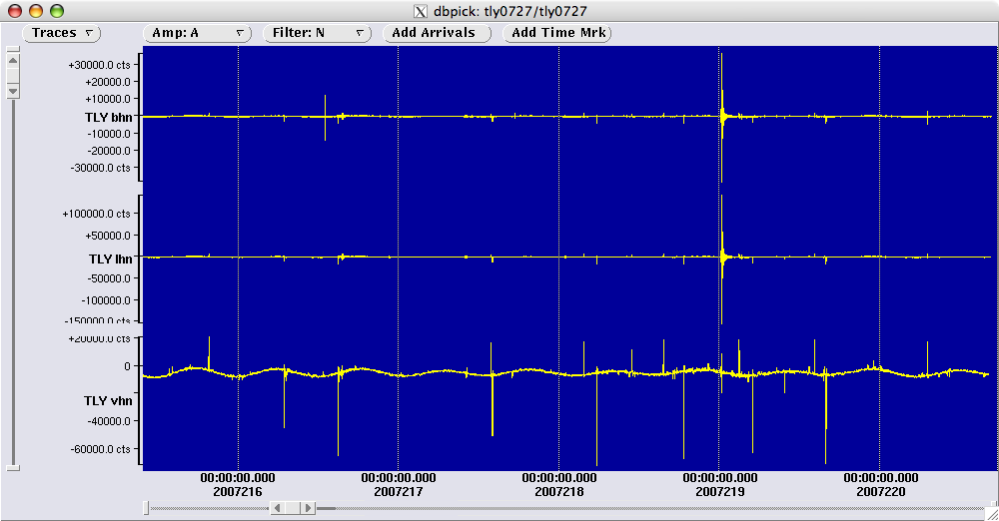
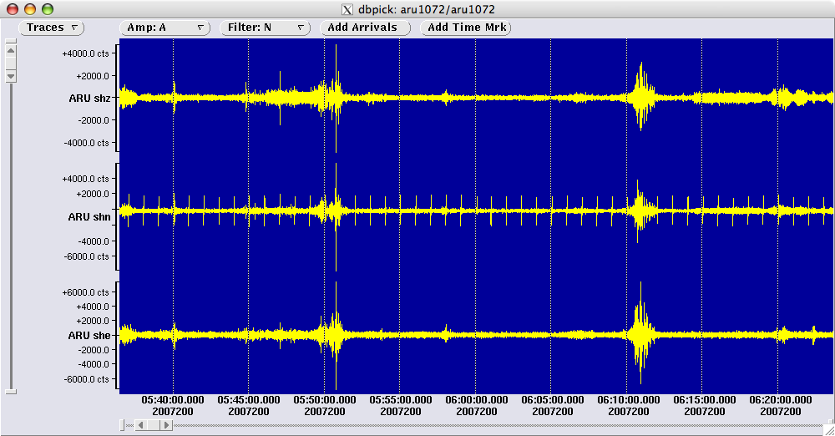
Excessive Spiking

Slide 19
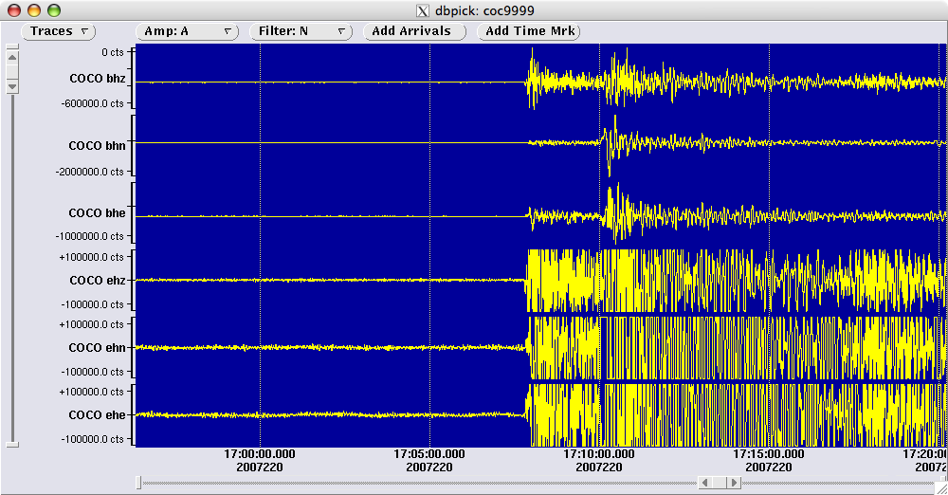
Clipping

Slide 20
Take advantage of IRIS resources:
http://www.iris.edu/servlet/quackquery/

Slide 21

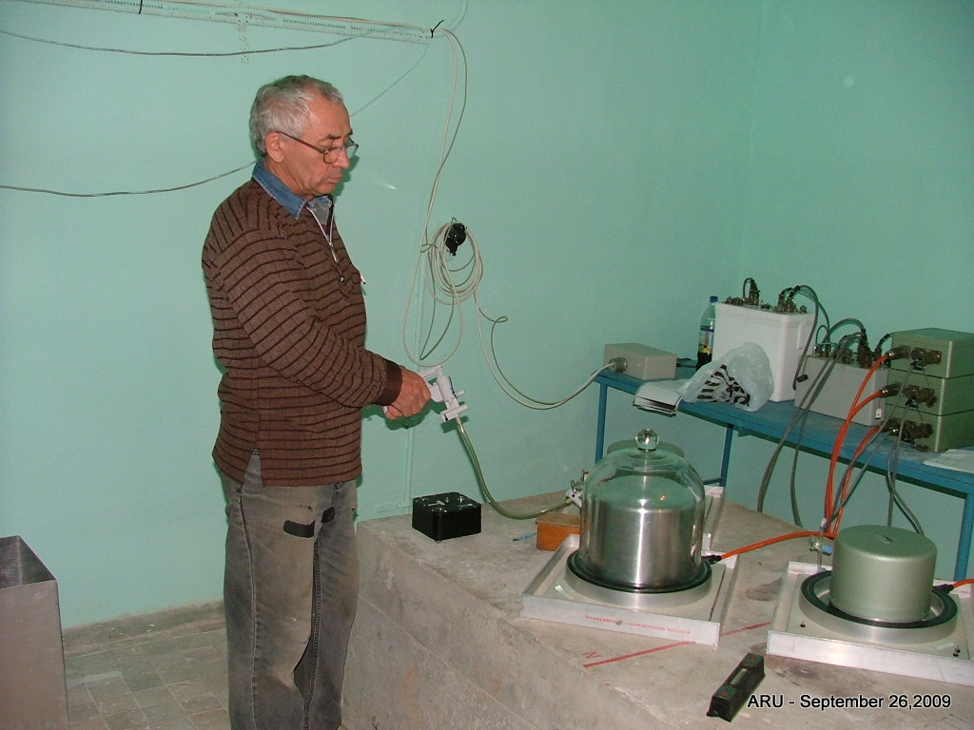
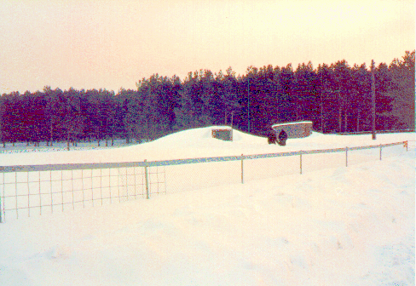
ARU:
Equipment relocated to new vault by EME staff

Slide 22
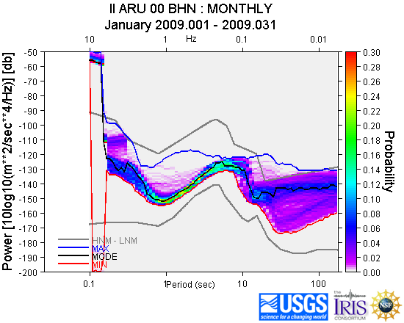
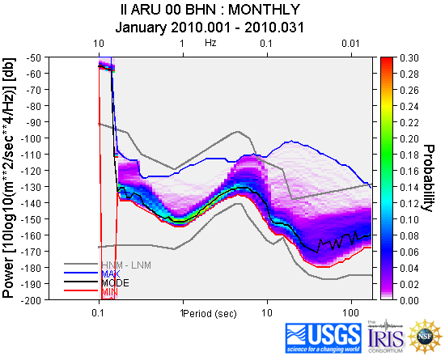
ARU:
http://www.iris.edu/servlet/quackquery/

Slide 23
Take advantage of other resources:
http://www.ldeo.columbia.edu/~ekstrom/Projects/WQC//MONTHLY_HTML/V_201003_rank.html

Slide 24
Checking that the metadata are correct…

Slide 25
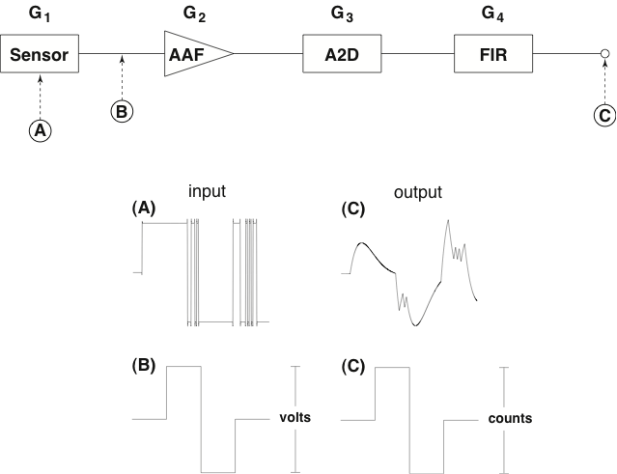
Traditional calibration procedures verified the DAS sensitivity and measured shape of system response.

Slide 26
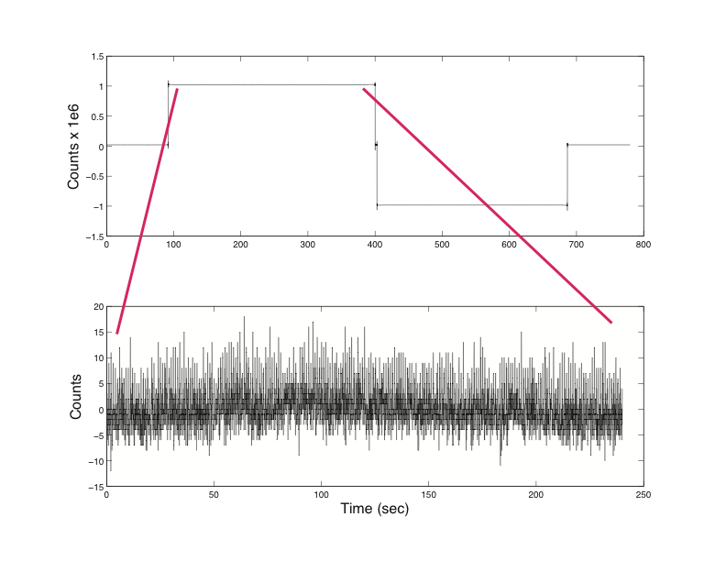
DC Calibration Test

Slide 27
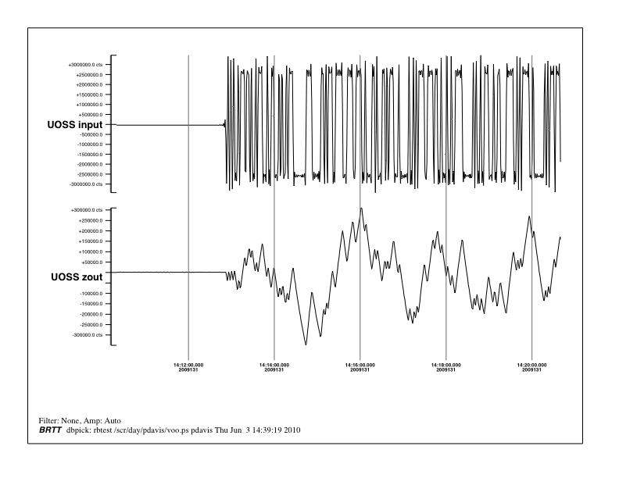

Slide 28
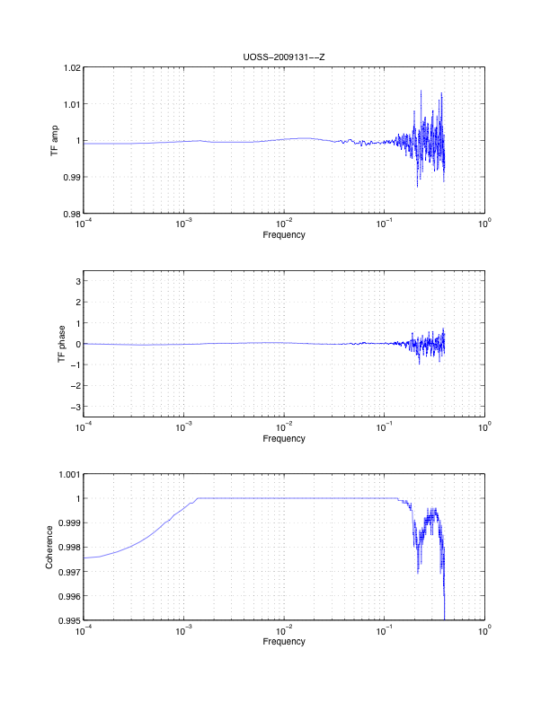
Convolve model of sensor response with input
Compare observed output with model
Iterate until fit acceptable

Slide 29
What these tests measure:
Random binary test determines shape of response curve within 1%
Step input to digitizer determines sensitivity to > 0.1%
Manufacturer provides value of sensor generator constant to within 1%

Slide 30
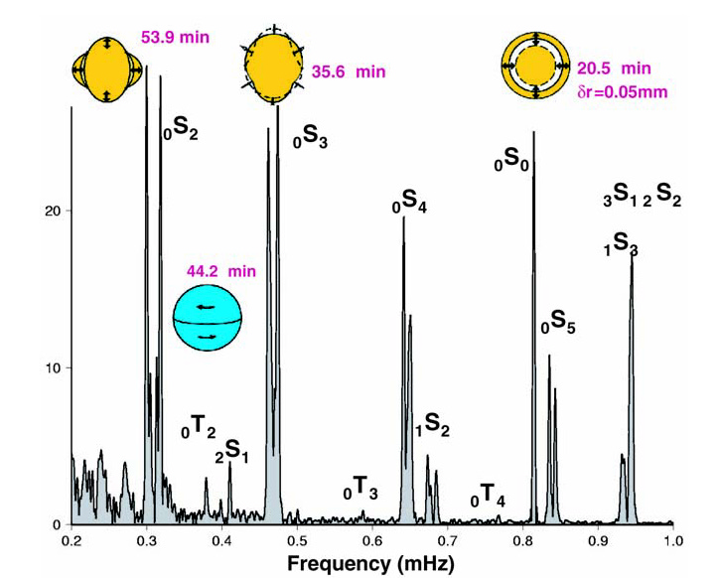
Sumatra-Andaman earthquake excited many low frequency normal modes
Figure from Park et al. (2004), courtesy G. Roult

Slide 31
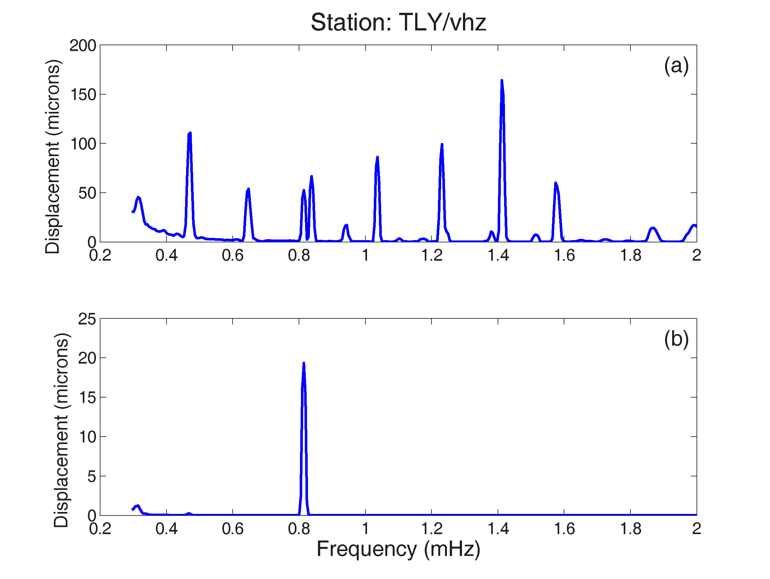
Spectra from 60 Hr time series beginning (a) one day (b) 11 days after event.

Slide 32
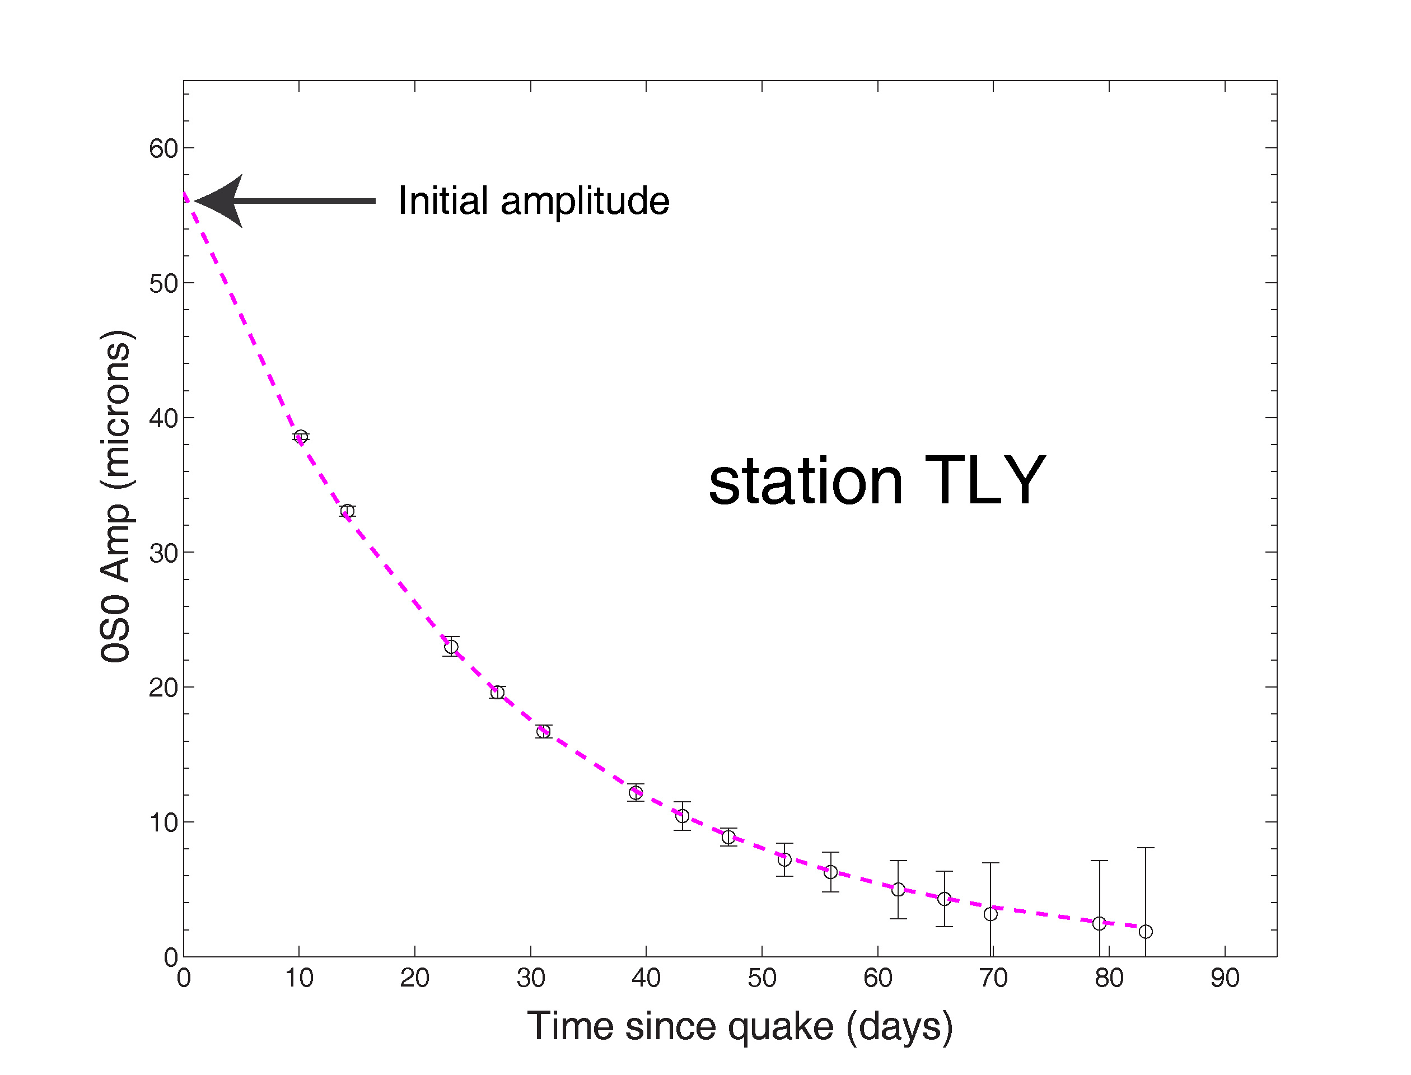
Each point from 96 hour long time series

Slide 33
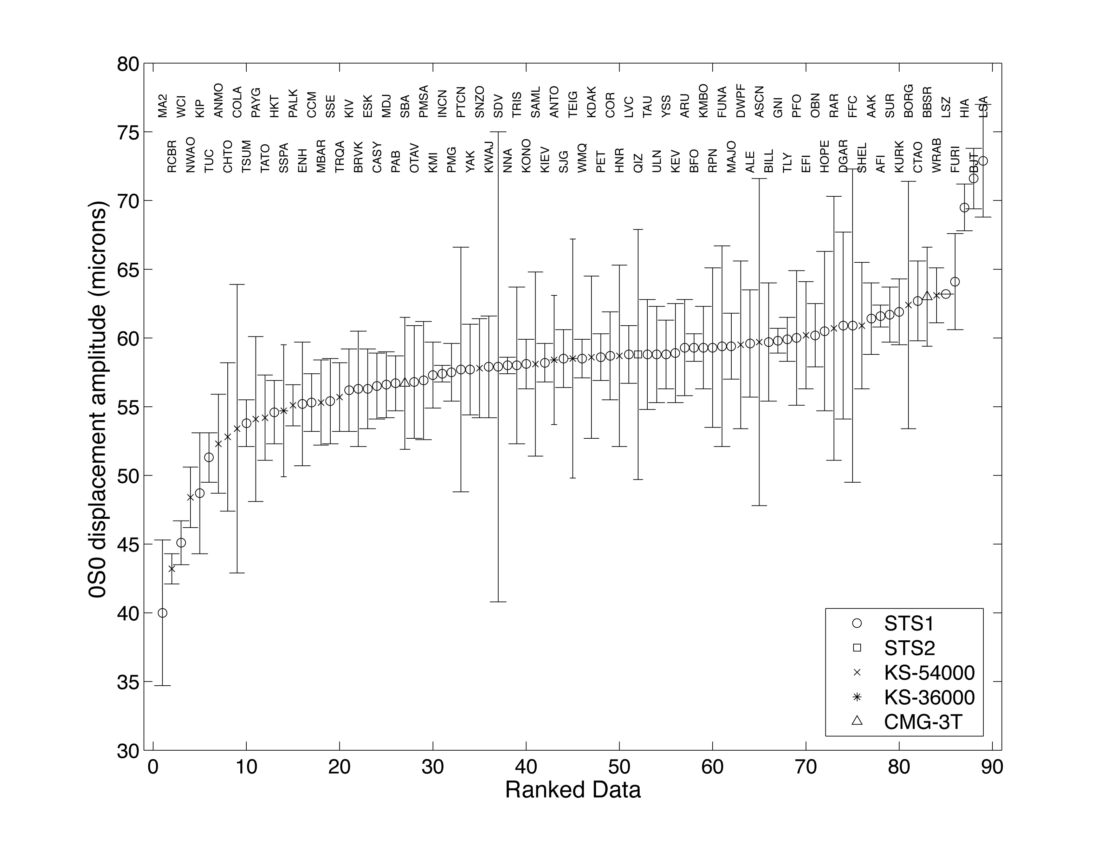

Slide 34
What this test measures:
Relative performance of GSN as a network
    Pitfall – no measure of absolute sensitivity
    Pitfall – accuracy limited by mode coupling
    Pitfall – need a very large earthquake to excite the mode to observable amplitude

Slide 35
Why use tides?
Tides are a continuous, constant signal
Tidal amplitudes can be predicted to 1% accuracy globally
Tides are observed at all times at most GSN stations
    Pitfall – must include effects of ocean loading
    Pitfall – horizontal sensors effected too strongly by local tilts
    Pitfall – tidal periods outside band of seismic interest

Slide 36
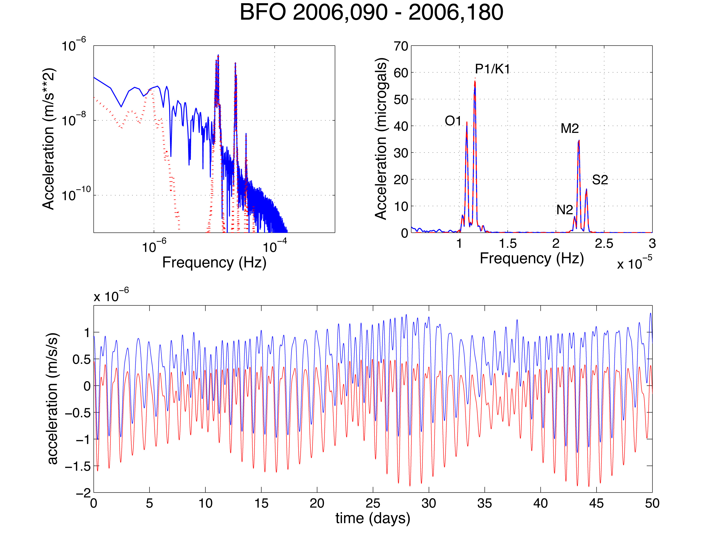

Slide 37
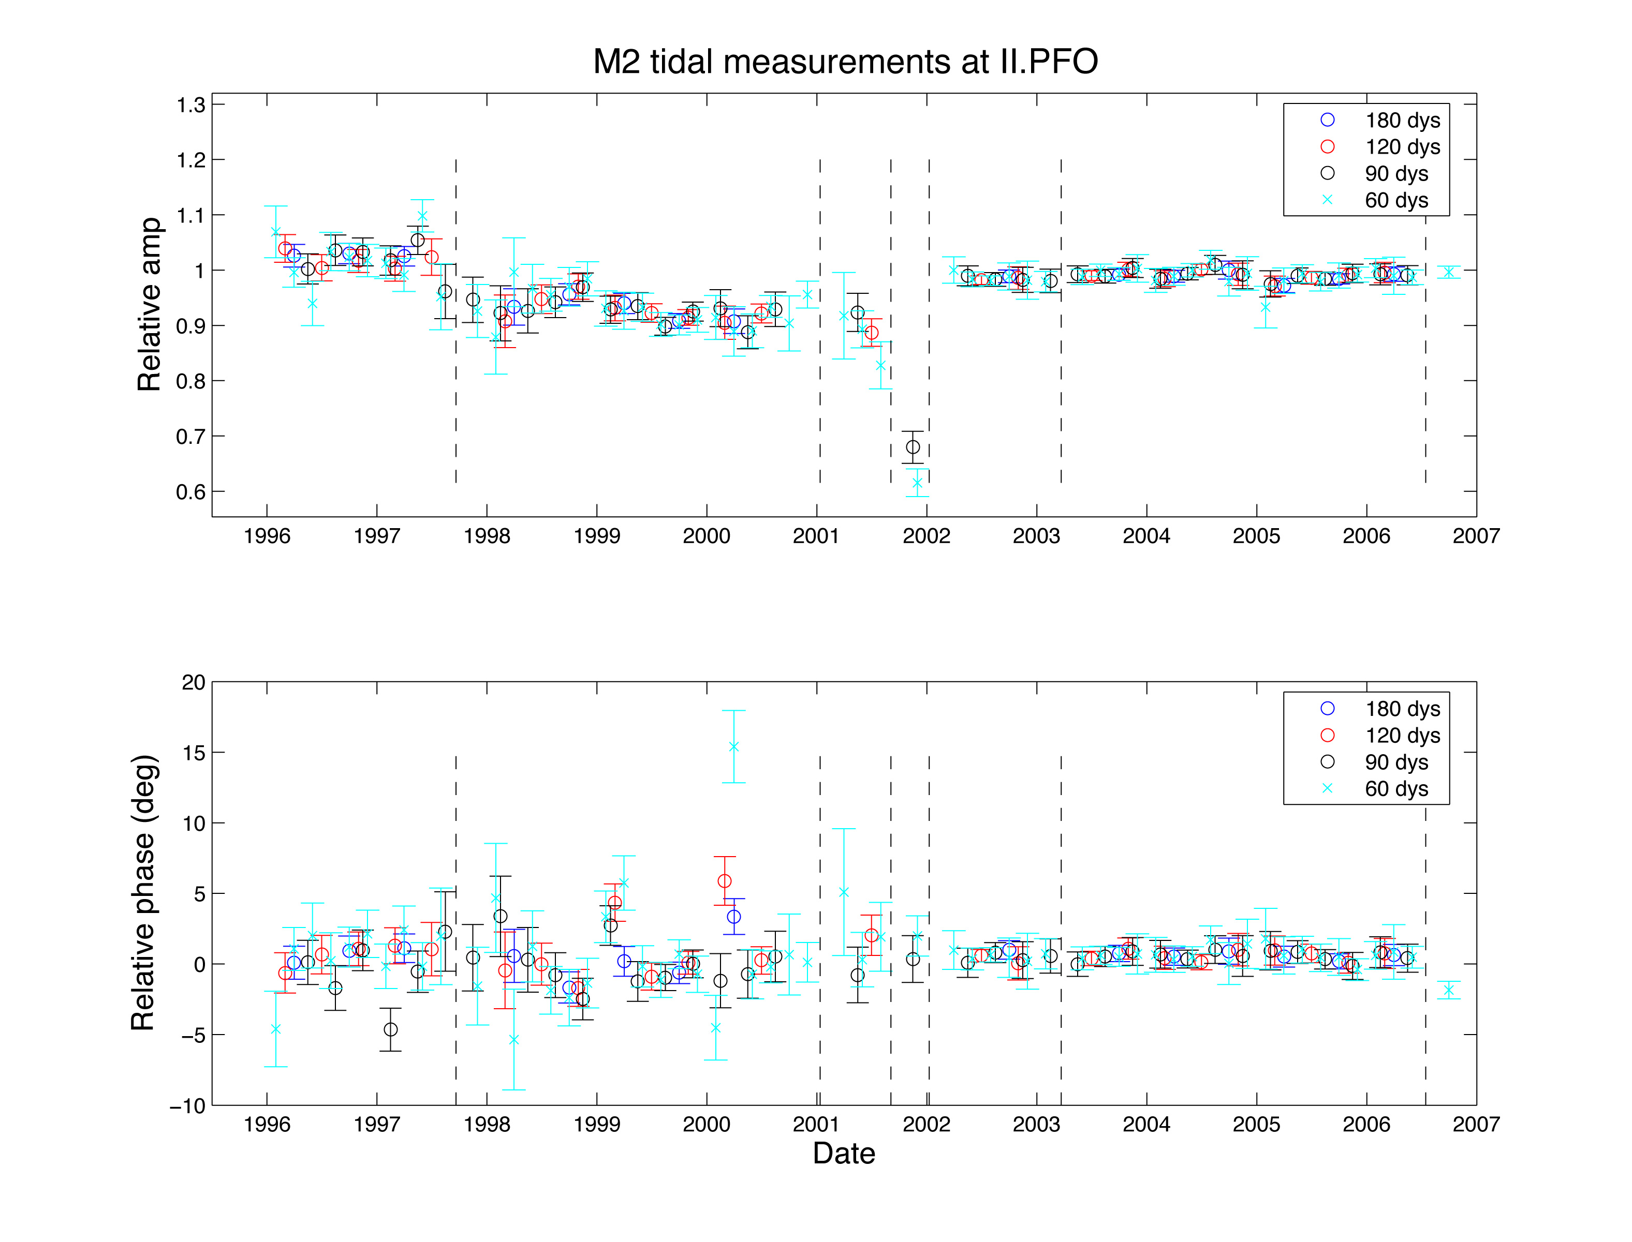

Slide 38
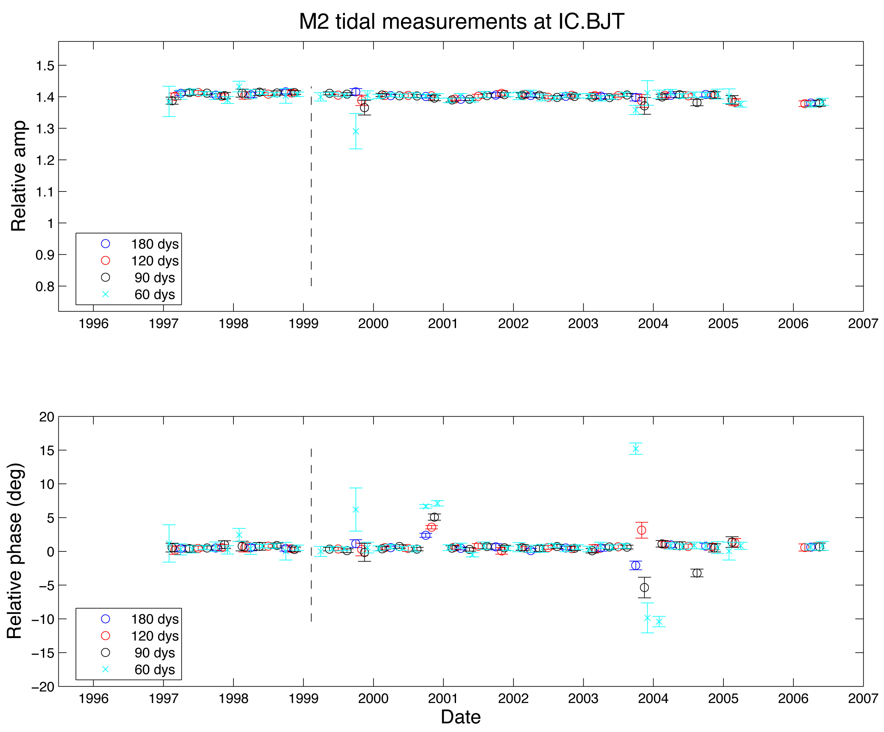

Slide 39
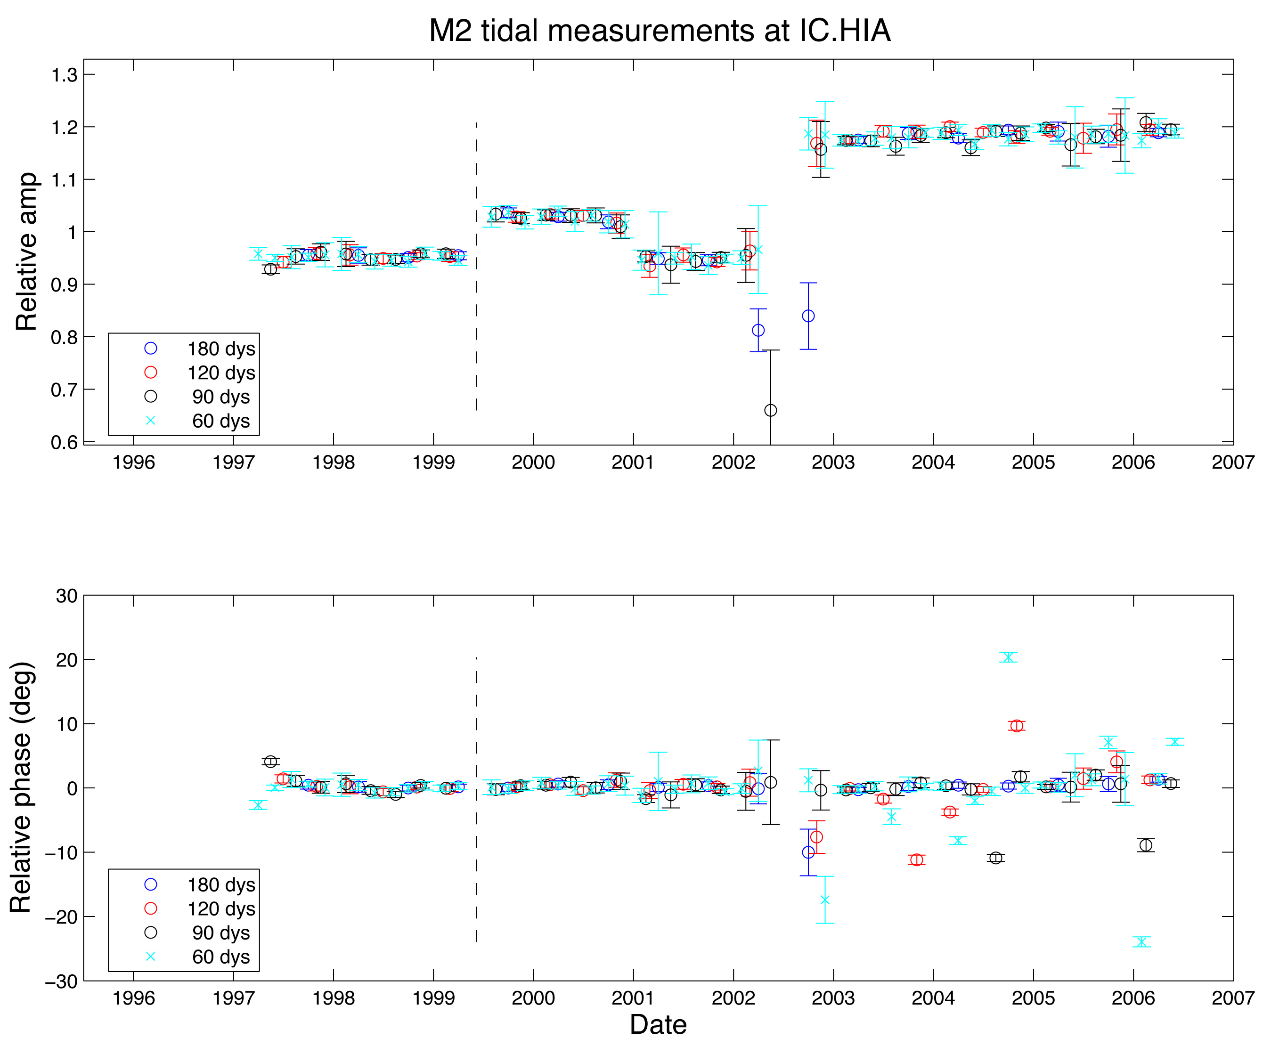

Slide 40
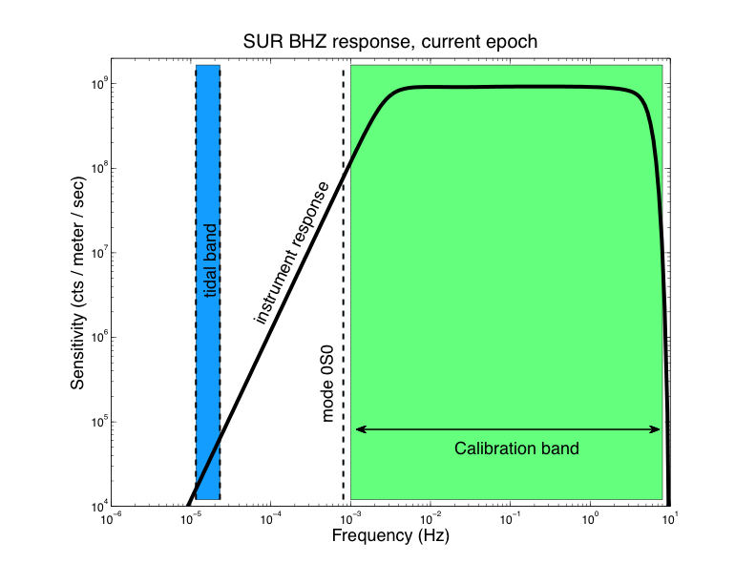

Slide 41
What comparing co-located broadband sensors measures:
Accurate determination of relative response of the common instruments
Accurate determination of relative orientation

Slide 42
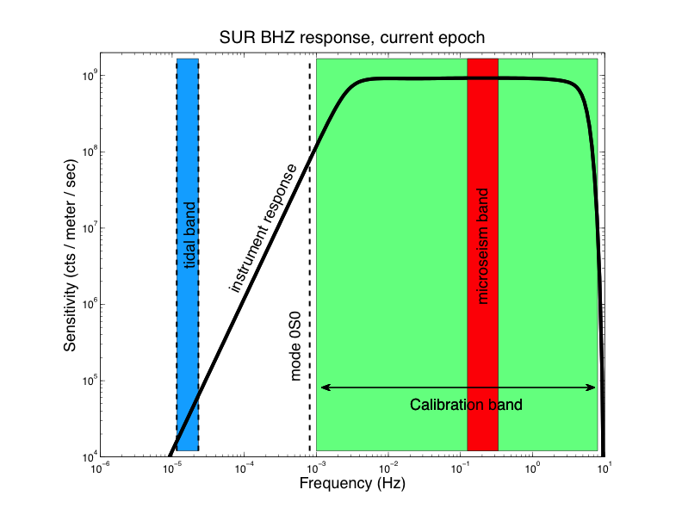

Slide 43
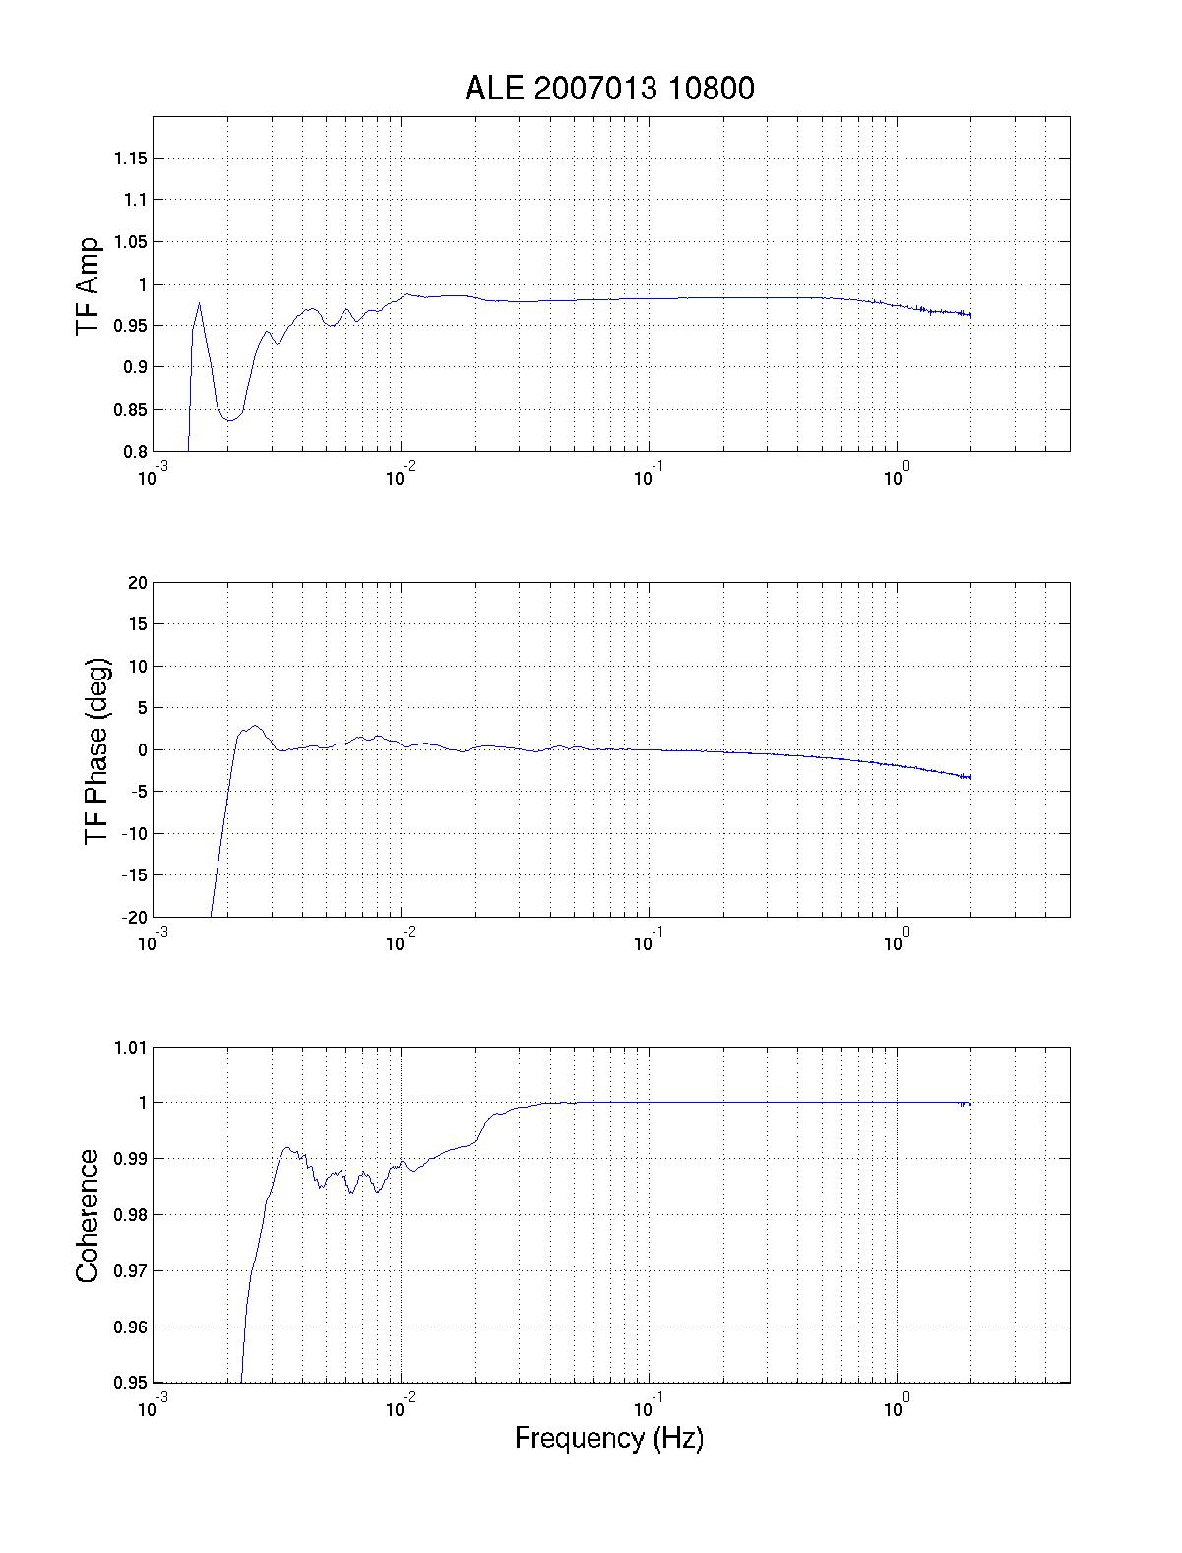
Cross-spectral analysis
Compare STS1 + STS2-Z
Compensate for response differences
Use quakes OR microseisms

Slide 44
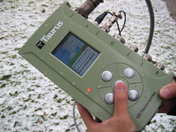
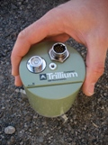
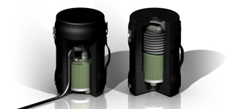
Calibrate with independent, portable sensor:
Nanometrics compact Trillium 120 and Taurus digitizer

Slide 45
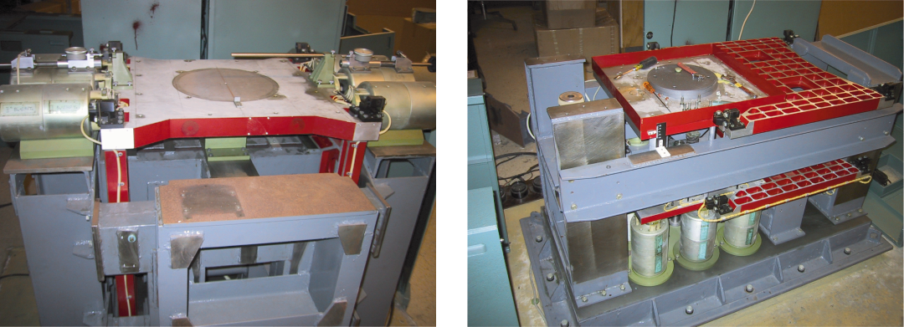
Shake tables

Slide 46
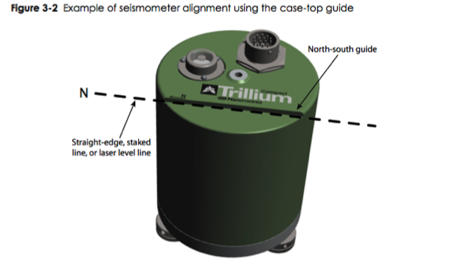
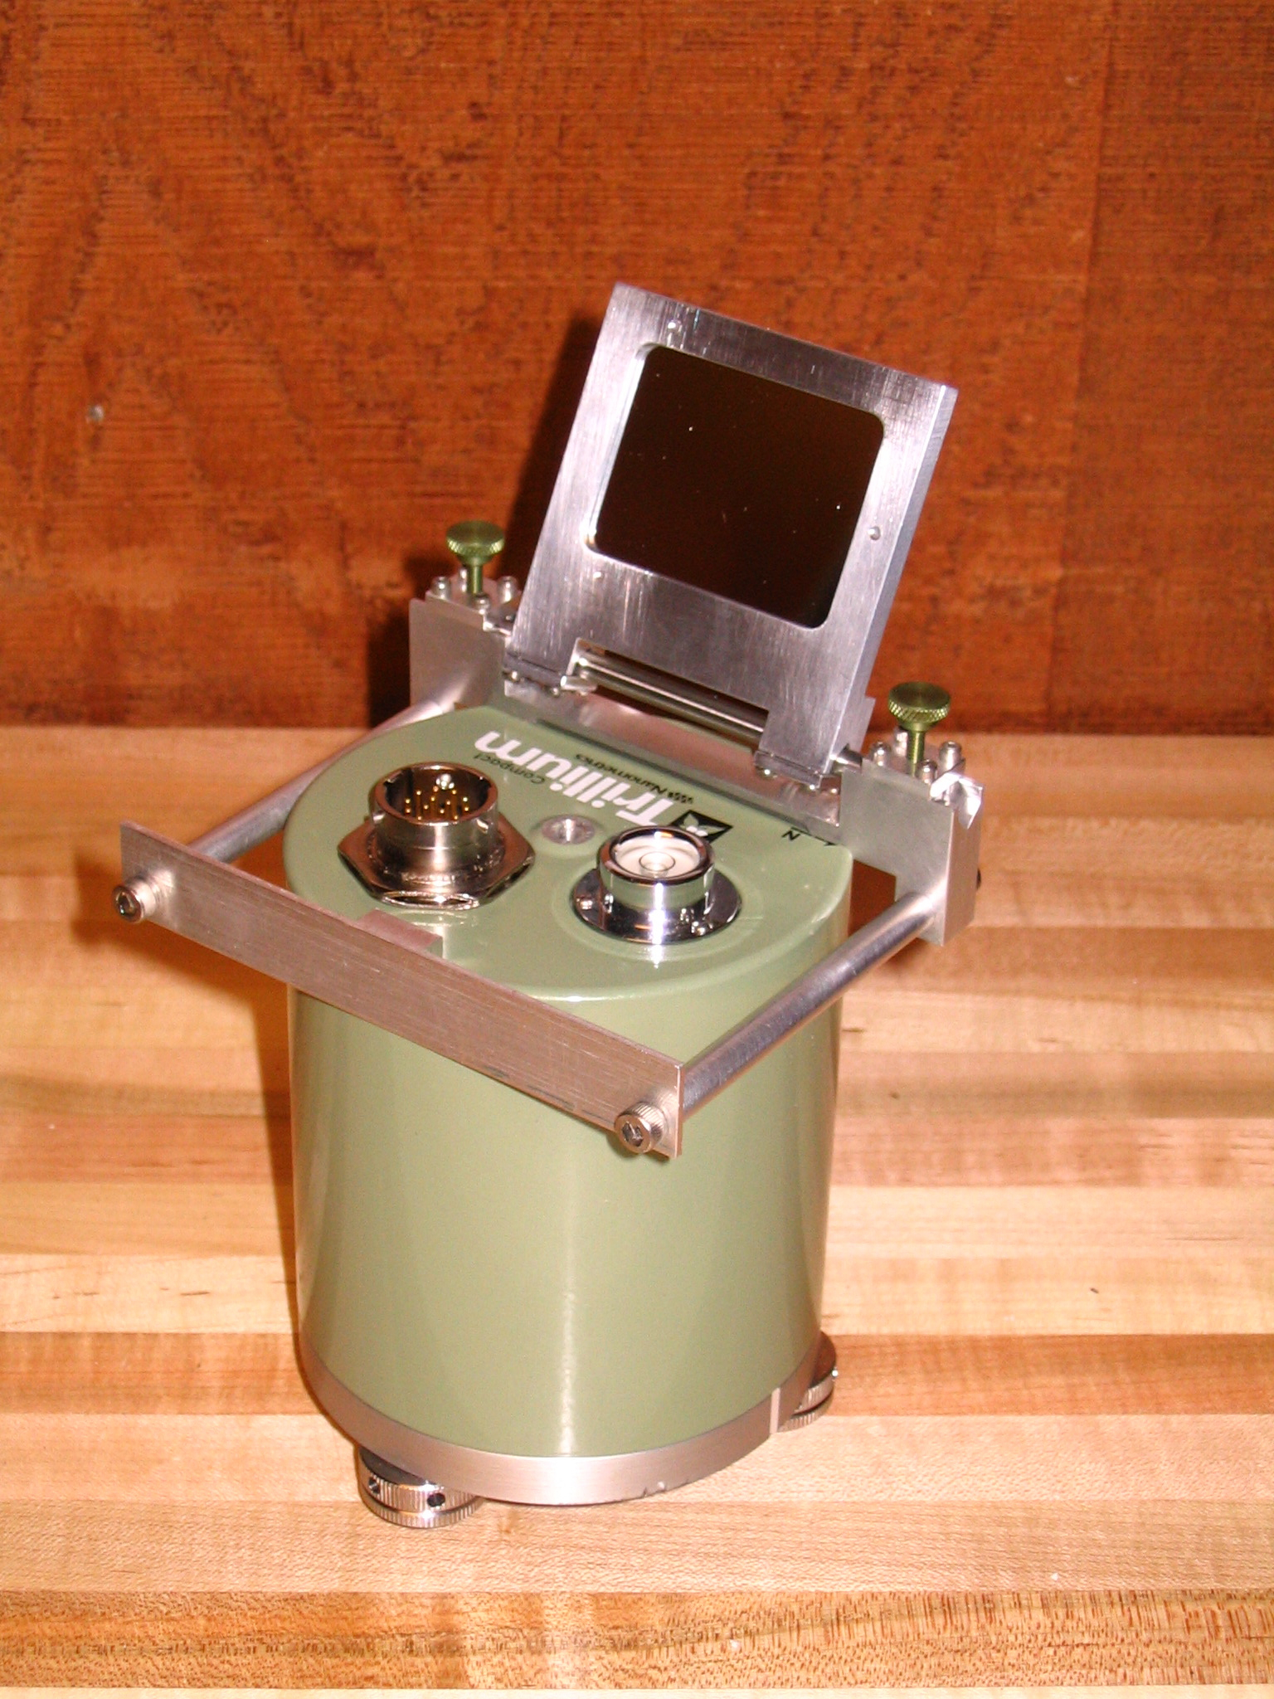
Sensor Calibration and Orientation

Slide 47
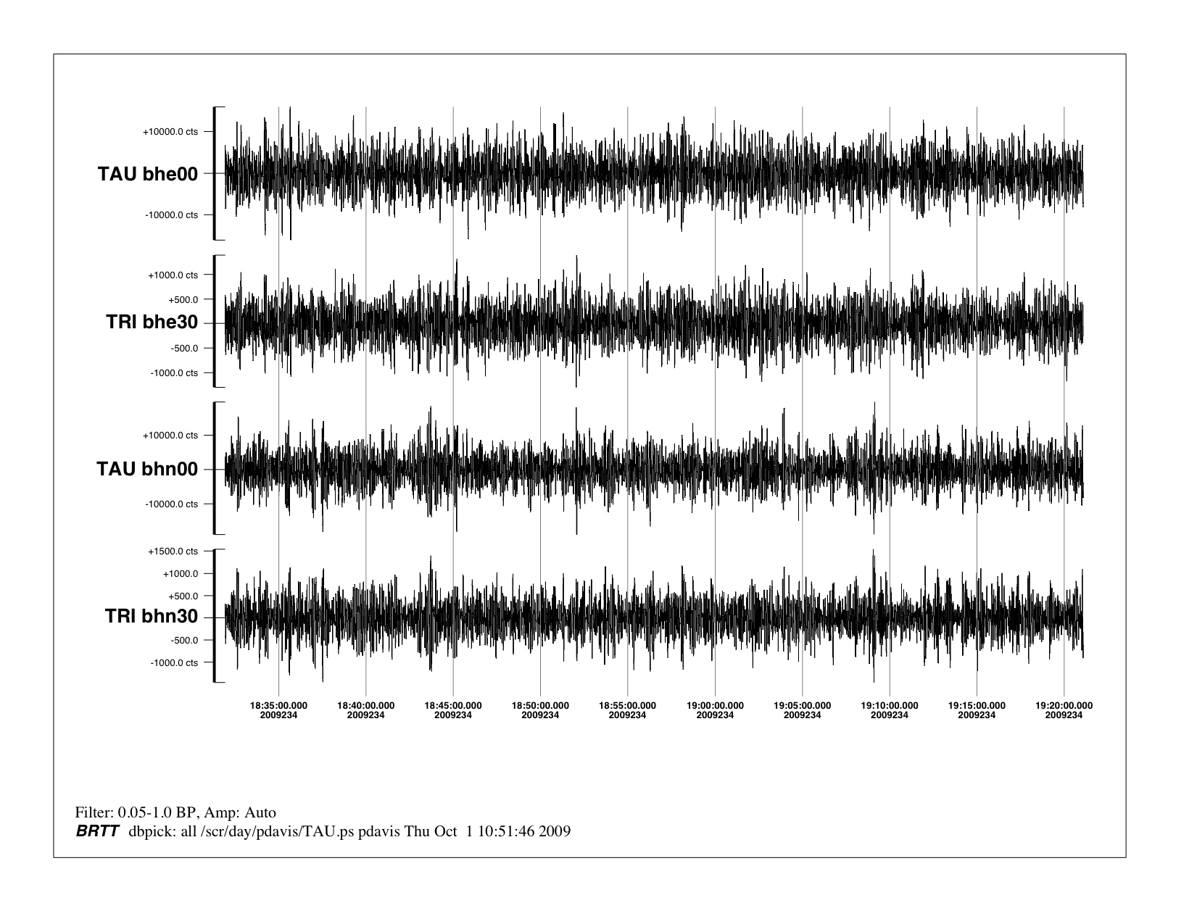
GSN sensor
Reference sensor
GSN sensor
Reference sensor
Sensor Calibration and Orientation

Slide 48
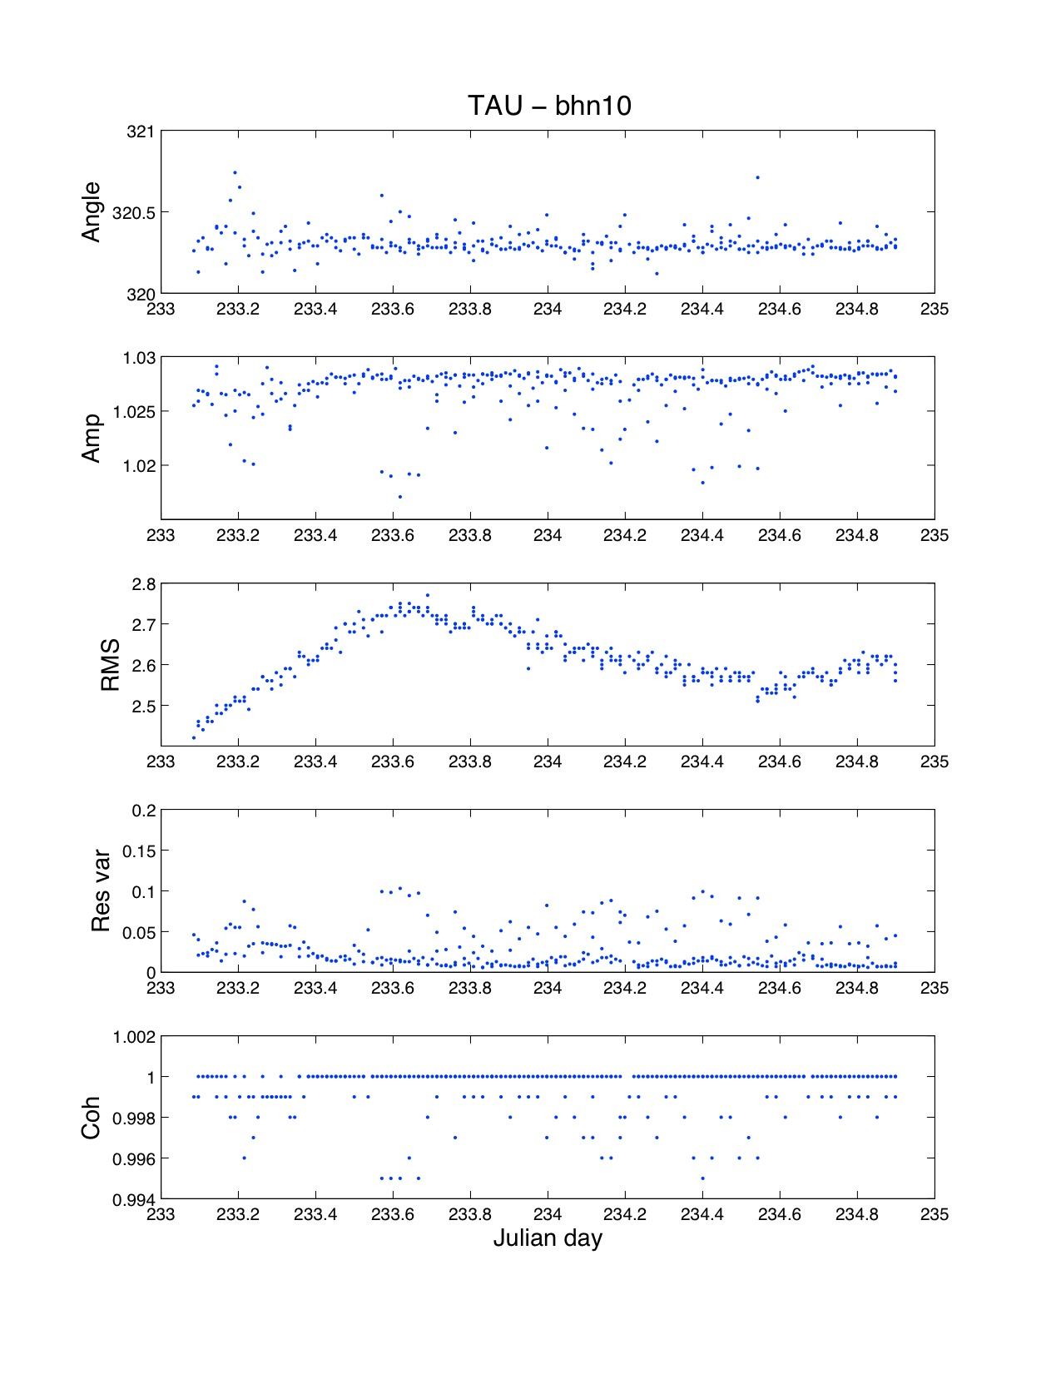
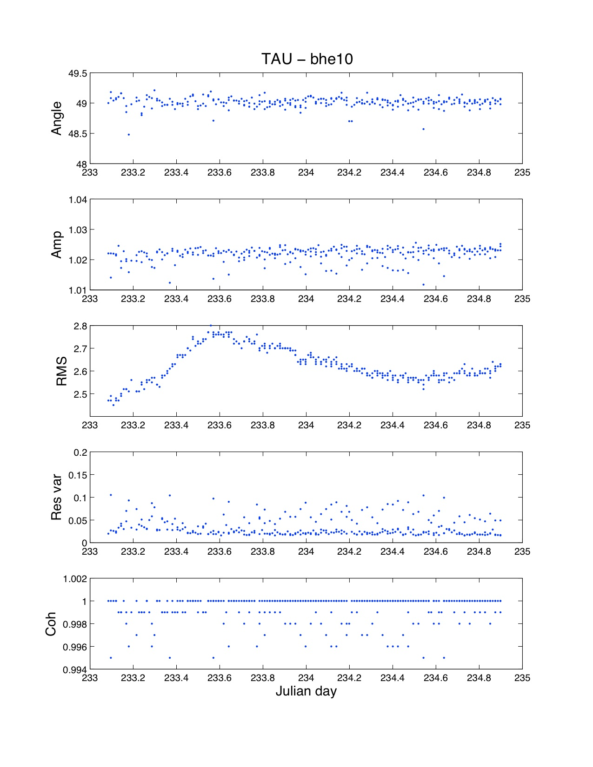
Sensor Calibration and Orientation

Slide 49
Future challenge:
Setting schedule for more regular RB calibration tests
Co-locate portable, calibrated sensor to check absolute sensitivity
Develop method to check stations without secondary broadband sensor

Slide 50

Pier at the Scripps Institution of Oceanography, UCSD

