Slide 1
Analysis Tools

Slide 2
PQLX
Primarily focused on waveform review
Design handles huge data sets
Modern interface using GTK+
Routinely calculates PSD/PDFs for new data
Requires MySQL and server installation
Multiple review clients can use one server
Works with Mini-SEED, SAC, RESP
http://www.iris.edu/software/pqlx/
Notes:
IRIS makes many tools available for dealing with SEED and Mini-SEED

Slide 3
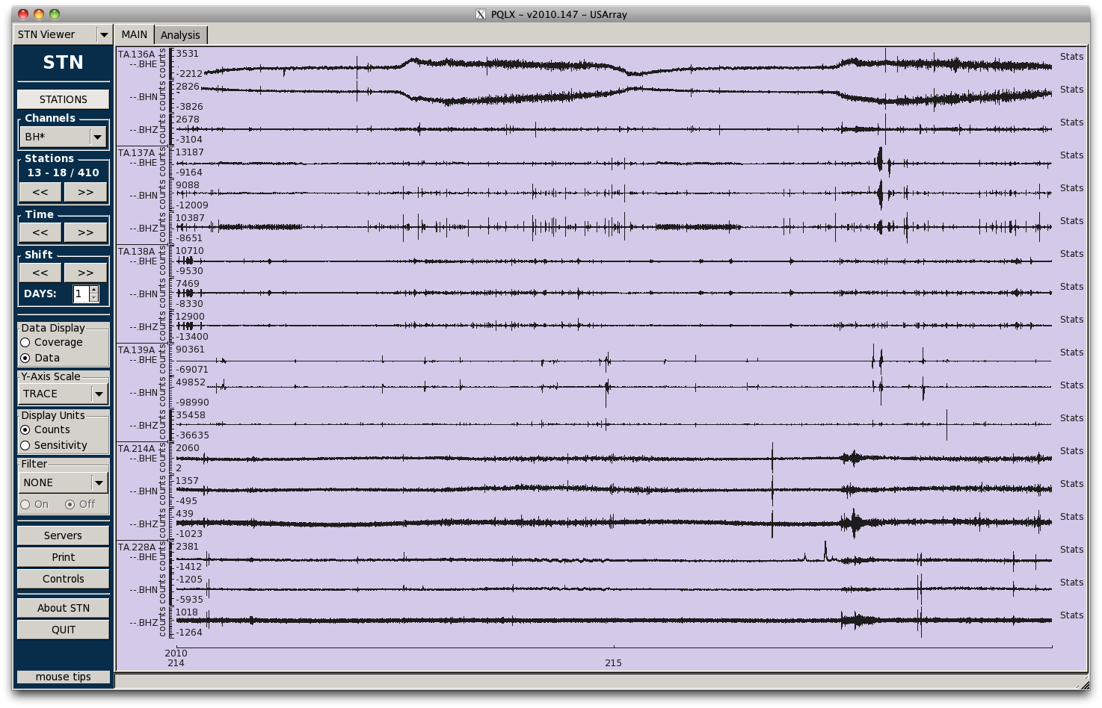
PQLX Waveform Review
Notes:
IRIS makes many tools available for dealing with SEED and Mini-SEED

Slide 4
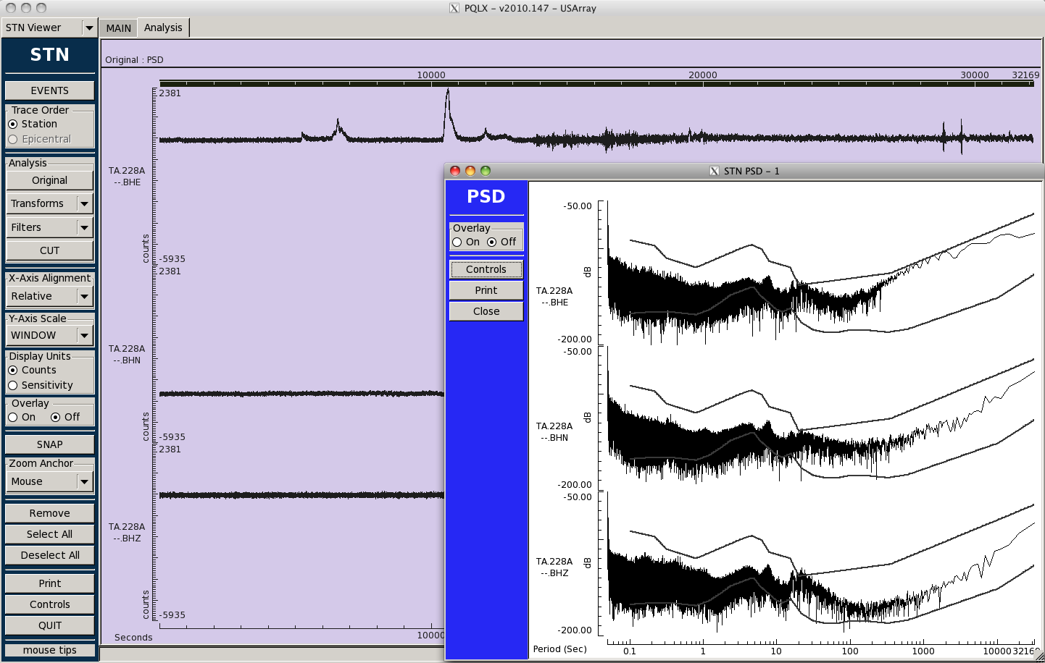
PQLX Waveform Analysis
Notes:
IRIS makes many tools available for dealing with SEED and Mini-SEED

Slide 5
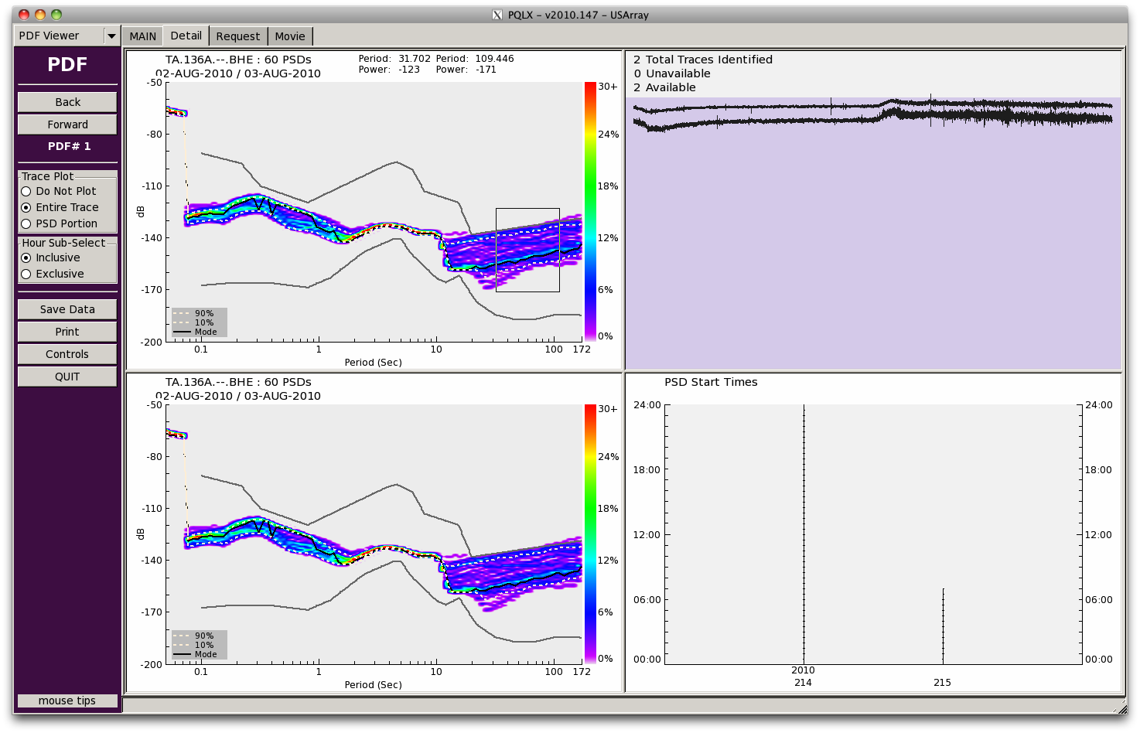
PQLX Integrated PSD/PDFs
Notes:
IRIS makes many tools available for dealing with SEED and Mini-SEED

Slide 6
Seismic Analysis Code: SAC
Well known, antiquated interface
Includes a comprehensive suite of data processing algorithms relevant for research
The de-facto standard
http://www.iris.edu/software/sac/
Notes:
IRIS makes many tools available for dealing with SEED and Mini-SEED

Slide 7
Seismic analysis within MATLAB
MATLAB™ is increasingly being used for seismic data analysis. Multiple toolkits have been developed working with seismic data including:
The Waveform Suite:
http://kiska.giseis.alaska.edu/Input/celso/matlabweb/waveform_suite/waveform.html
Seismon:
http://seismon.sourceforge.net/
MatSeis:
https://na22.nnsa.doe.gov/cgi-bin/prod/nemre/matseis.cgi
CORAL:
http://earthweb.ess.washington.edu/lnk/kcc/coral_doc.html
Notes:
IRIS makes many tools available for dealing with SEED and Mini-SEED

Slide 8
Other data analysis systems
SeismicHandler:
http://www.seismic-handler.org/
SeisAn:
http://seis.geus.net/software/seisan/
ftp://ftp.geo.uib.no/pub/seismo/SOFTWARE/SEISAN/
SeisComP
http://www.seiscomp3.org/
Notes:
IRIS makes many tools available for dealing with SEED and Mini-SEED

