Slide 1
MALAYSIAN SEISMOLOGICAL NETWORK
Devadas Ramachandran
Geophysics and Tsunami Division
Malaysian Meteorological Department
Notes:
1

Slide 2
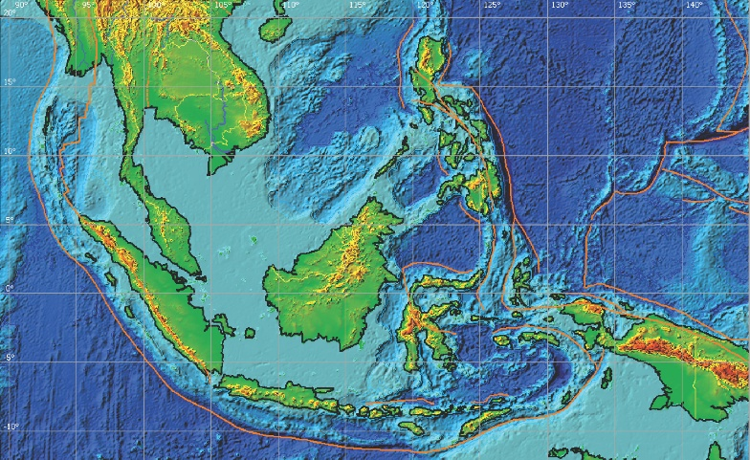
THAILAND
PHILLIPINE PLATE
PHILLIPINES
EURASIAN PLATE
MALAYSIA
INDONESIA
INDO- AUSTRALIAN PLATE
Notes:
2

Slide 3
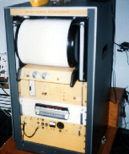
HISTORY OF
EARTHQUAKE MONITORING
IN MALAYSIA
BEGIN - UNESCO(UNDP) PROJECT
– 1975-1979 setup 4 stns
Instrument ( Kinemetrics USA )
VR-1 Analog Recorder
SS-1 Ranger Seismometer (Single component Vertical Channel)
AM-1/AS330 Amplifier Module
TS-120 Timing system
Radio receiver ( For time code )
Notes:
3

Slide 4
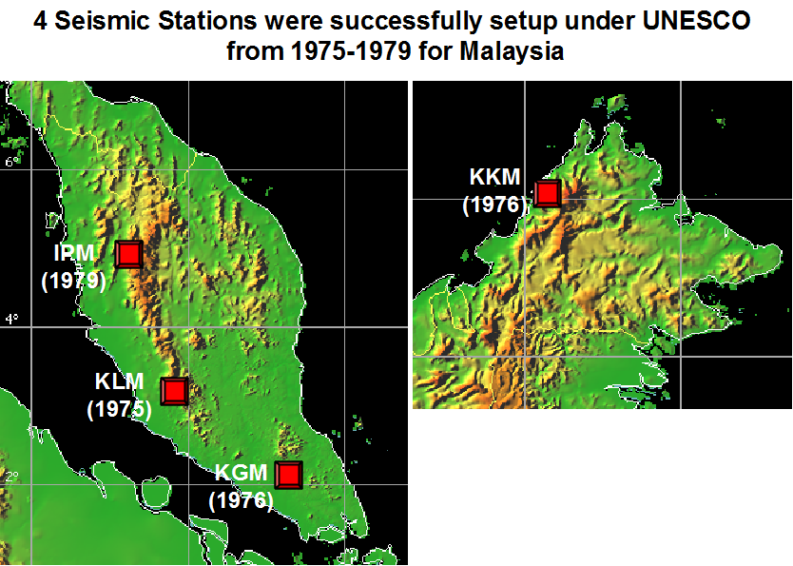

Slide 5
K2 DIGITAL RECORDER

Slide 7
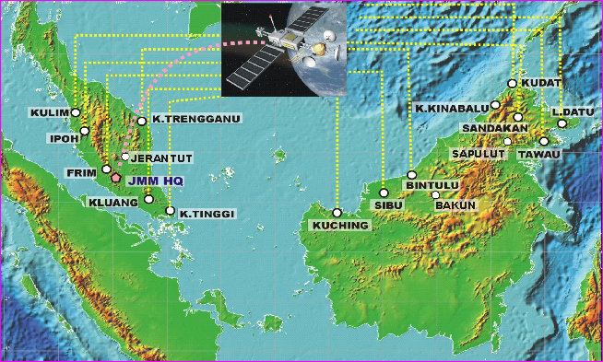
Malaysian seismological Network
as of December 2011
Notes:
7

Slide 8
 | Stn Code | Stn Name | Lat ( °N ) | Long( °E ) | Elev ( meter ) | Foundation (Soil Type) | Recorder/Digitizer (Type/Model) | Seismometer (Type/Model)
1 | KUM | Stesen Seismologi Kulim | 5.2902 | 100.6492 | 74 | Granite | Q330 Digizer | Streckeisen STS-2
2 | IPM | Stesen Seismologi Ipoh | 4.4795 | 101.0255 | 247 | Granite | Q330 Digizer | Streckeisen STS-2
3 | FRM | Stesen Seismologi FRIM | 3.2333 | 101.6333 | 97 | Granite | Q330 Digizer | Kinemetrics SS-1 Ranger
4 | KGM | Stesen Seismologi Kluang | 2.0157 | 103.319 | 103 | Granite | Q330 Digizer | Kinemetrics SS-1 Ranger
5 | KOM | Stesen Seismologi Kota Tinggi | 1.7922 | 103.8467 | 49 | Sandstone | Q330 Digizer | Streckeisen STS-2
6 | KTM | Stesen Seismologi K.Terengganu | 5.3283 | 103.1356 | 33 | Meta Sedimen | Q330 Digizer | Kinemetrics SS-1 Ranger
7 | JRM | Stesen Seismologi Jerantut | 3.8867 | 102.4767 | 55 | Sandstone | Q330 Digizer | Streckeisen STS-2
8 | KSM | Stesen Seismologi Kuching | 1.4733 | 110.3083 | 66 | Volcanic Rock | Q330 Digizer | Streckeisen STS-2
9 | SBM | Stesen Seismologi Sibu | 2.4529 | 112.214 | 237 | Sandstone | Q330 Digizer | Streckeisen STS-2
10 | BTM | Stesen Seismologi Bintulu | 3.2000 | 113.0833 | 156 | Sandstone | Q330 Digizer | Kinemetrics SS-1 Ranger
11 | BNM | Stesen Seismologi Bakun | 2.7767 | 114.035 | 166 | Sandstone | Q330 Digizer | Streckeisen STS-2
12 | KDM | Stesen Seismologi Kudat | 6.9167 | 116.8333 | 3 | Granite | Q330 Digizer | Kinemetrics SS-1 Ranger
13 | KKM | Stesen Seismologi Kota Kinabalu | 6.0443 | 116.2147 | 830 | Sand Stone | Q330 Digizer | Streckeisen STS-2
14 | SDM | Stesen Seismologi Sandakan | 5.6409 | 117.1950 | 463 | Sand Stone | Q330 Digizer | Kinemetrics SS-1 Ranger
15 | LDM | Stesen Seismologi Lahad Datu | 5.1777 | 118.498 | 177 | Sand Stone | Q330 Digizer | Streckeisen STS-2
16 | TSM | Stesen Seismologi Tawau | 4.2936 | 117.8725 | 62 | Granite | Q330 Digizer | Kinemetrics SS-1 Ranger
17 | SPM | Stesen Seismologi Sapulut | 4.7083 | 116.465 | 275 | Sand Stone | Q330 Digizer | Streckeisen STS-2

Slide 9
DATA SHARING
DATA EXPORT TO IRIS
Notes:
9

Slide 11
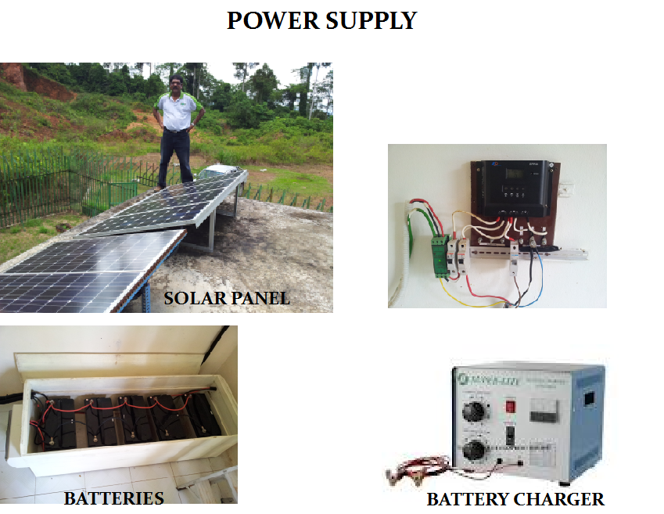
SOLAR CHARGE CONTROLLER

Slide 12
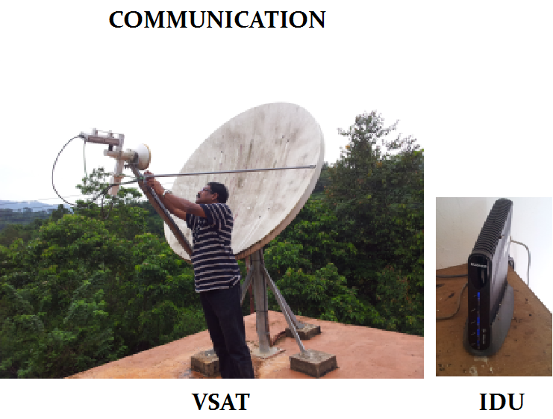

Slide 13
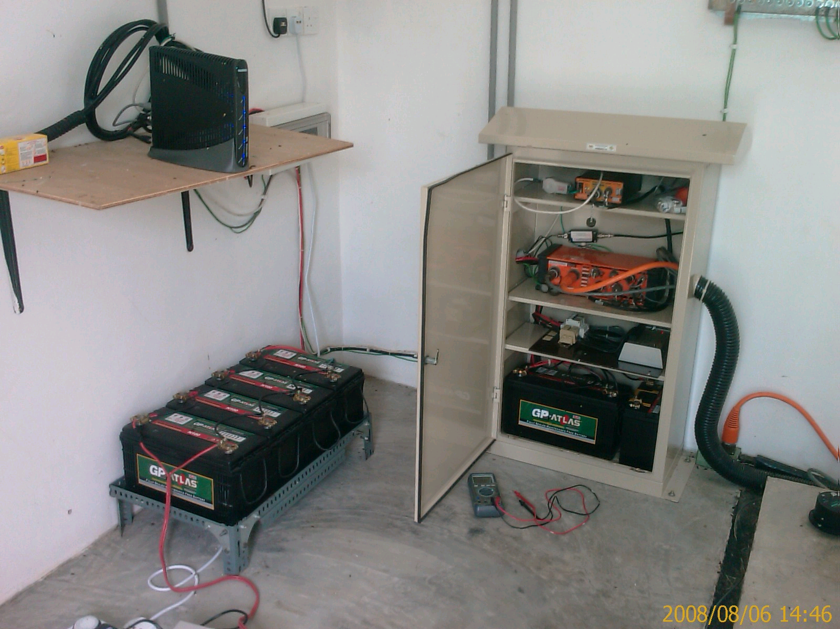

Slide 14
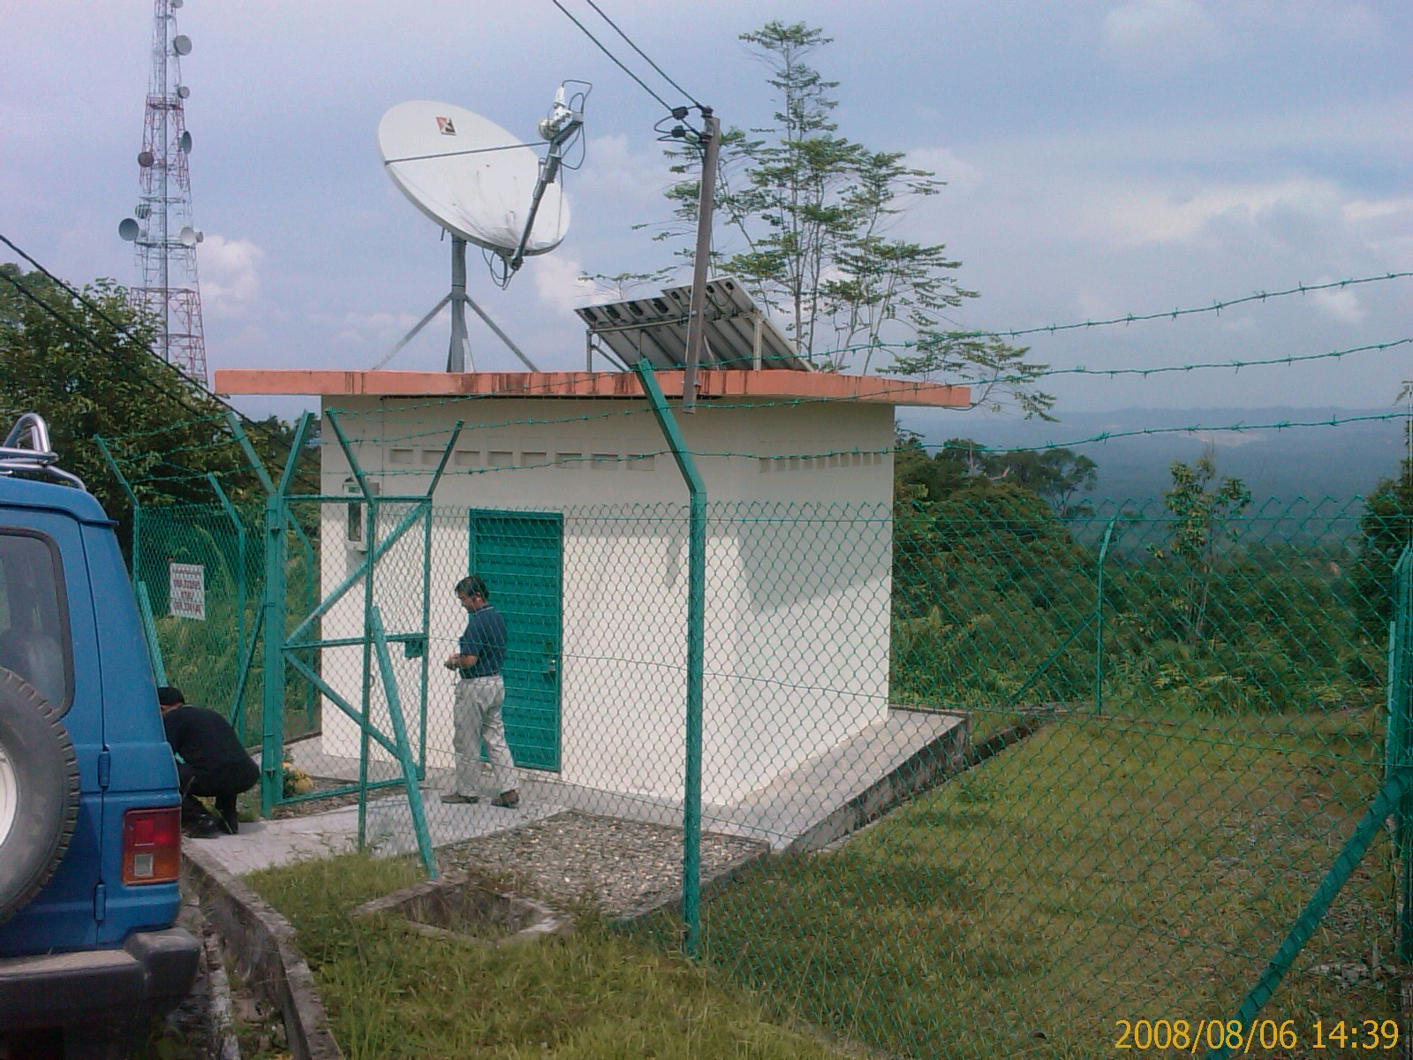

Slide 15
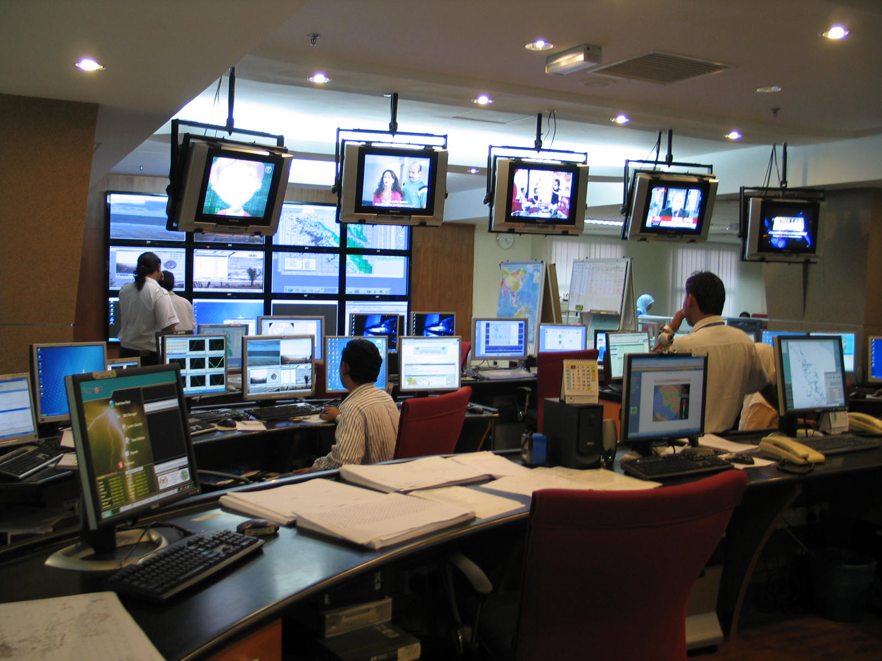
MALAYSIAN EARTHQUAKE/ TSUNAMI
MONITORING CENTER
Notes:
15

