Slide 1
Tuesday January 10, 17:05

Slide 2
PDCC: Portable Data Collection Centers Single Station: Starting from Scratch
Rick Benson
IRIS DMC

Slide 3
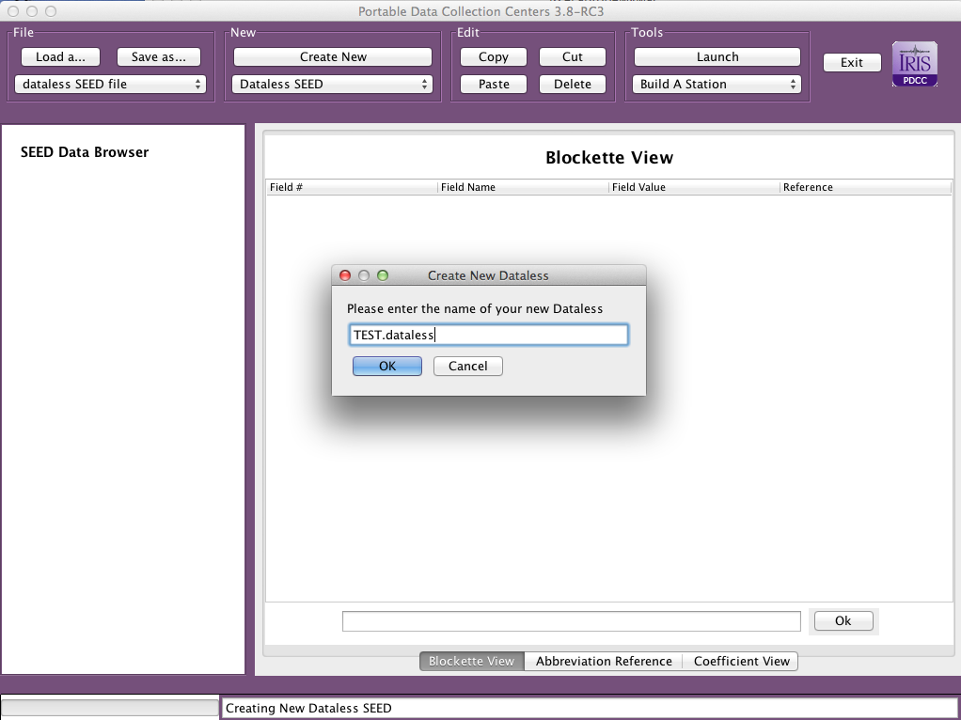
Single Station Creation
Step 1:
Create New
Dataless SEED
Step 2:
Name your New
Dataless SEED

Slide 4
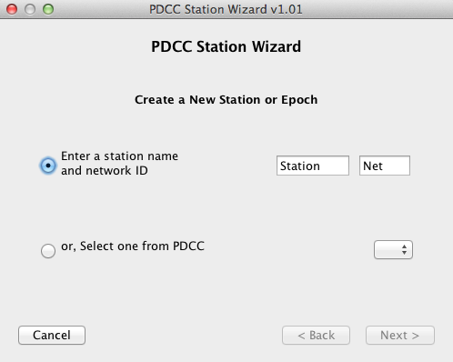
Step 3: Click on
dataless name in
left frame
Step 4: Launch the
“Build a Station”
Tool

Slide 5
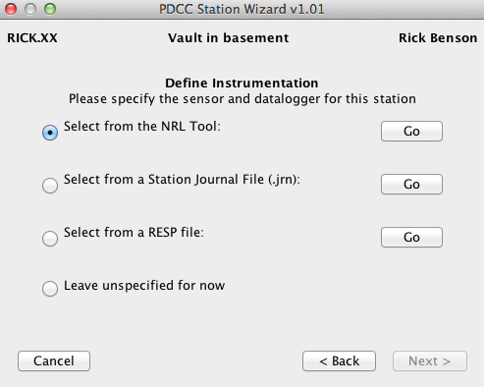
Step 5: Fill in all pop-up
Information, proceeding
to NRL Tool Option
Step 6:
Use this NRL GUI
to complete
equipment
information

