Slide 1
Taiwan 24-bit Real Time Seismic Data System
Central Weather Bureau
Yi-Jing Lo

Slide 2
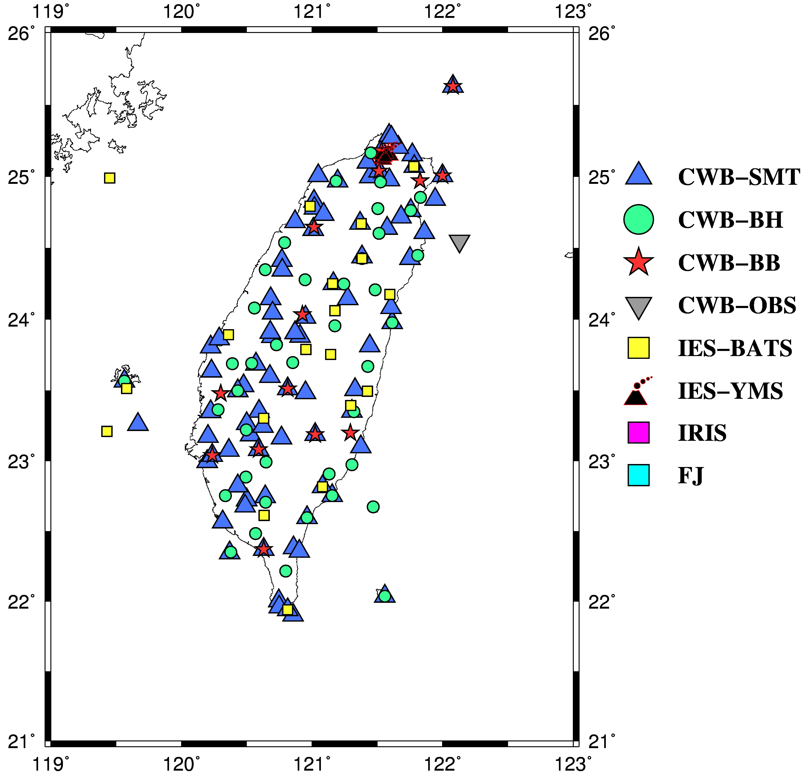
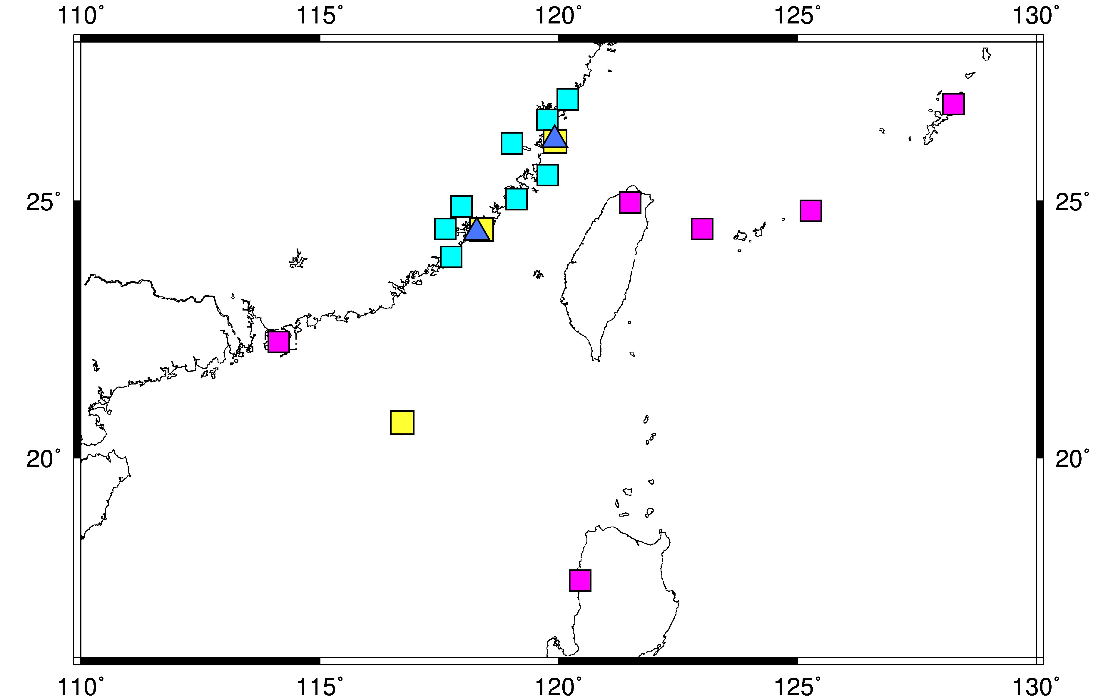
24-bit seismic data system
Distribution of stations
High density of stations
High quality of data
Real time
Wide coverage
Data diversification
188 Sites
338 Instruments

Slide 3
Station
Channel
Network
Location
Channel
Ch1~Ch3 | acceleration (HLZ，HLN，HLE)
Ch4~Ch6 | Short period (velocity) (HSZ，HSN，HSE)
Ch7~Ch9 | broadband (HHZ，HHN，HHE)
Network
CWB_BH | Down hole seismic network
CWB_BB | Broadband seismic network
CWB_SMT | Smart24 seismic network
CWB_OBS | OBS seismic network
IRIS_JPN | JMA seismic network
IRIS_IU | Global seismic network
IRIS_HK | Hong Kong seismic network
IES_YMS | TVO seismic network
IES_BATS | IES broadband seismic network
IES_FJ | Fu Jien seismic network
Location
01 | Surface
02 | Downhole
03 | Ocean Bottom seismometer

Slide 4
Data Types
Fu Jien
Internet
ADSL
YUS
TVO
CWB Earthquake Center
Tainan
MPLS
OBS
Tou Cheng
Outer net
stations
Inner net
SP
FBA
BB

Slide 5
Structure of 24-bit Seismic Network
SP
FBA
BB
OBS
Others
Internet
MPLS、ADSL、 optic fiber submarine cable 、microwave
Data Receiving
Layer
module
Data Integrating
Layer
Data Exchange
Earthworm
WaveServer
Ringserver
Ringserver
Data Applying
Layer
Seismisity
monitoring
Earthquake
reporting
Early
Warning
Tsunami
waining
CMT
Focal
Mechanism
Local
monitoring
Geophysical Database Managemant System (GDMS)

Slide 6
Structure of 24-bit Seismic Network
import

Slide 7
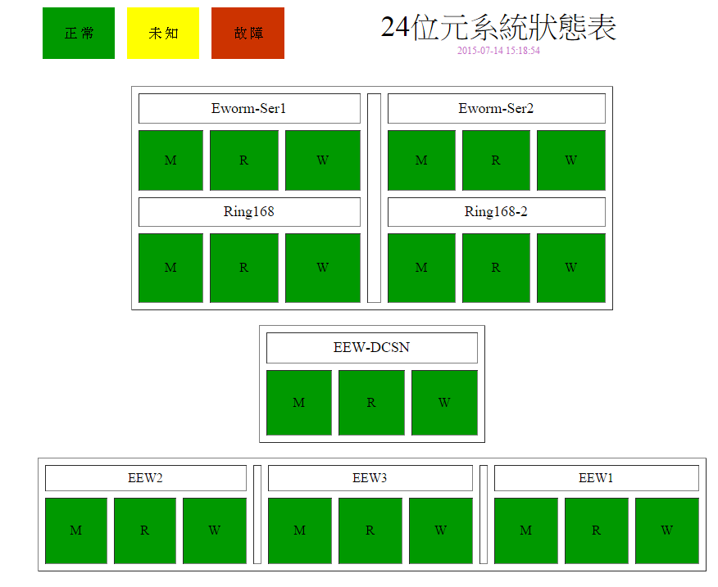
Monitoring All the Seismic Network
The list of the 24-bit situation
normal
unknown
broken
module
ring
Wave server

Slide 8
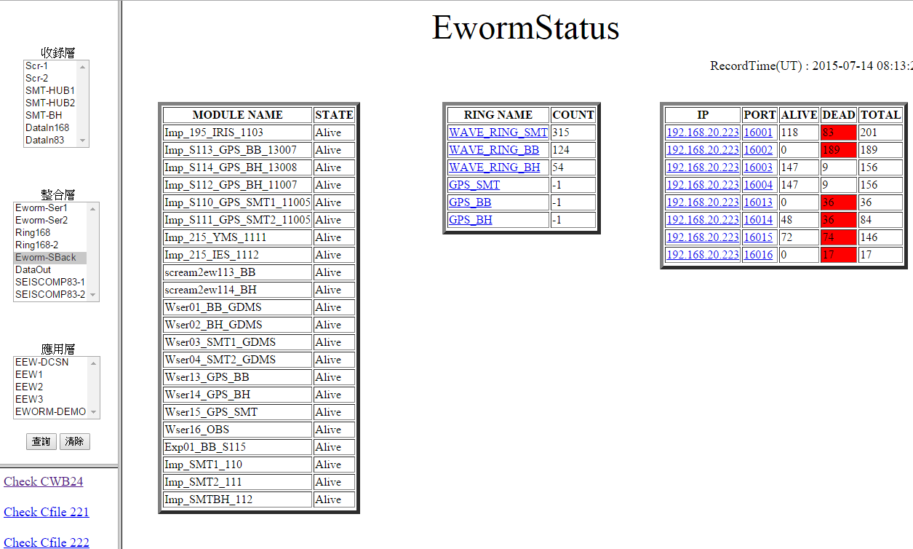
Monitoring All the Seismic Network
Layer 1
module
Wave server
Ring
Layer 2
Layer 3

Slide 9
Earthquake Early Warning (EEW)
P-wave auto-picking
Earthquake message
At least 6 stations
RMS less than 0.8.
Proceed updating procedure.
EEW report
Skip the first and second earthquake message
Take the third earthquake message as the first EEW report.
EEW update
Difference of location > 20 km
Difference of magnitude > 0.5
Large event
Small event
9
9

Slide 10
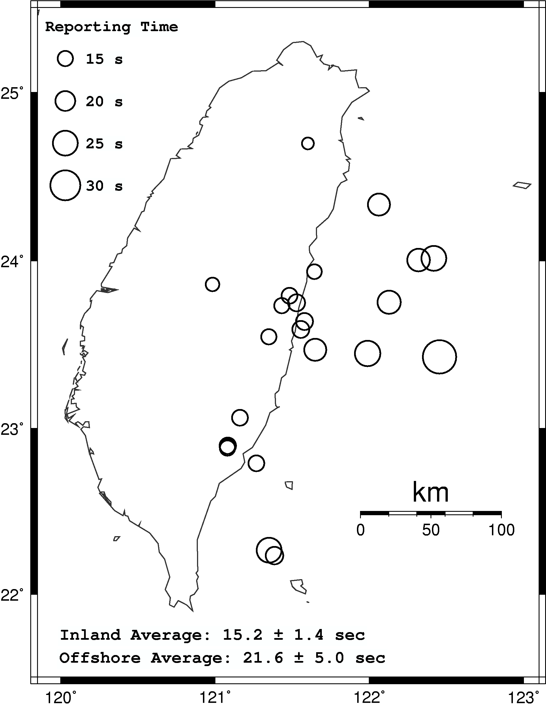
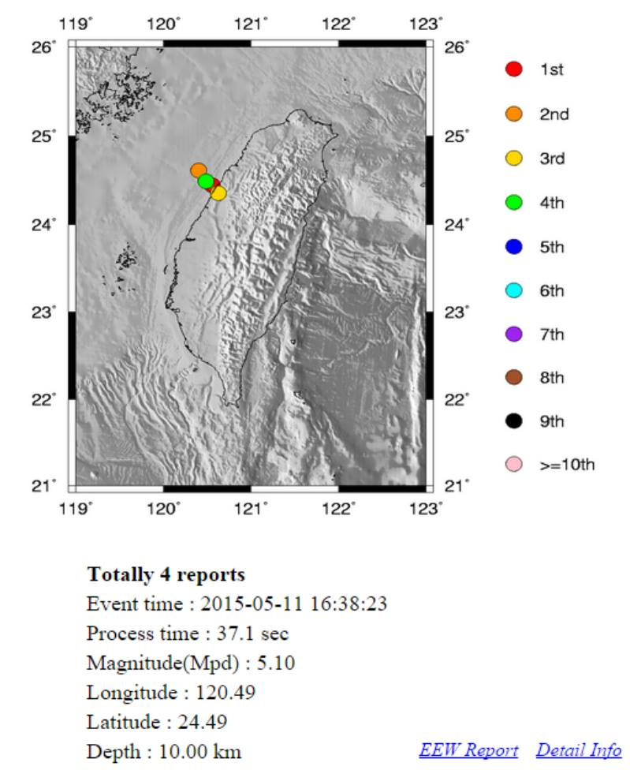
Earthquake Early Warning (EEW)
Processing Time :
In-land 15.2 sec off-land 21.6 sec
EEW update report

Slide 11
Thank you for your listening

