Slide 1
MUSTANG DataBrowser

Slide 2
MUSTANG Data Browser
IRIS Data Services Browser
http://www.iris.edu/mustang/databrowser

Slide 3
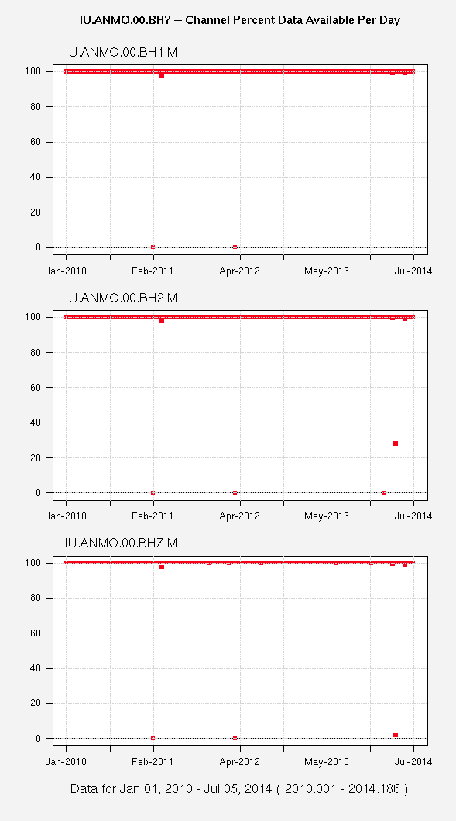
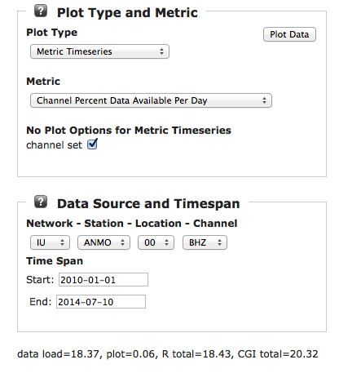
MUSTANG Data Browser

Slide 4
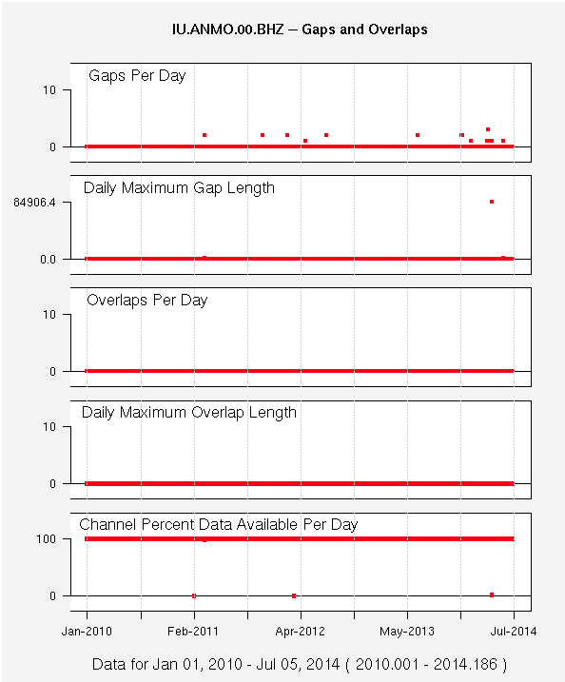
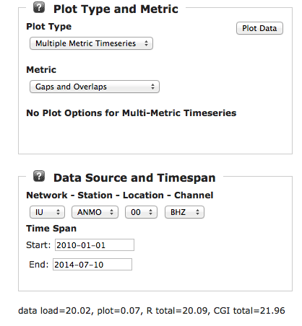
Multiple Metric Displays

Slide 5
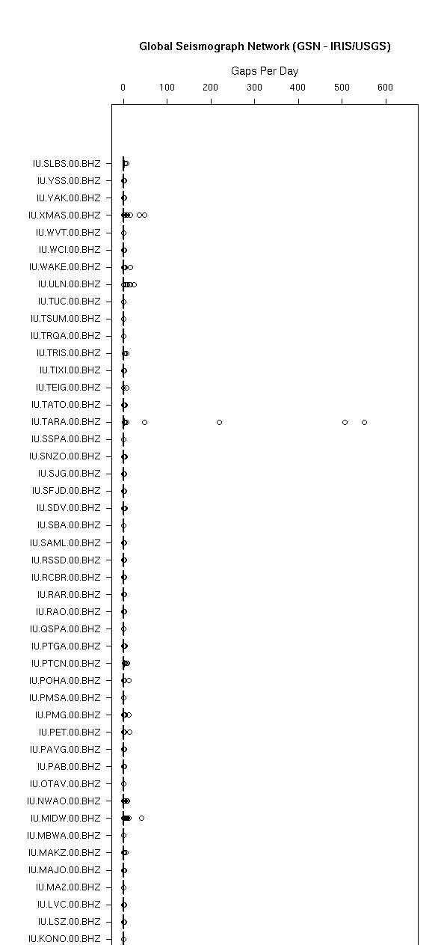
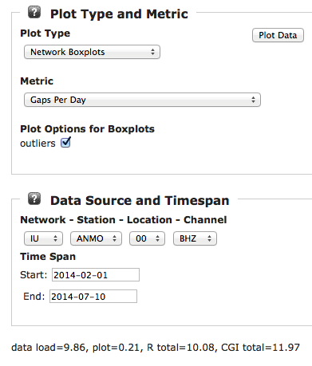
Network Box Plots

Slide 6
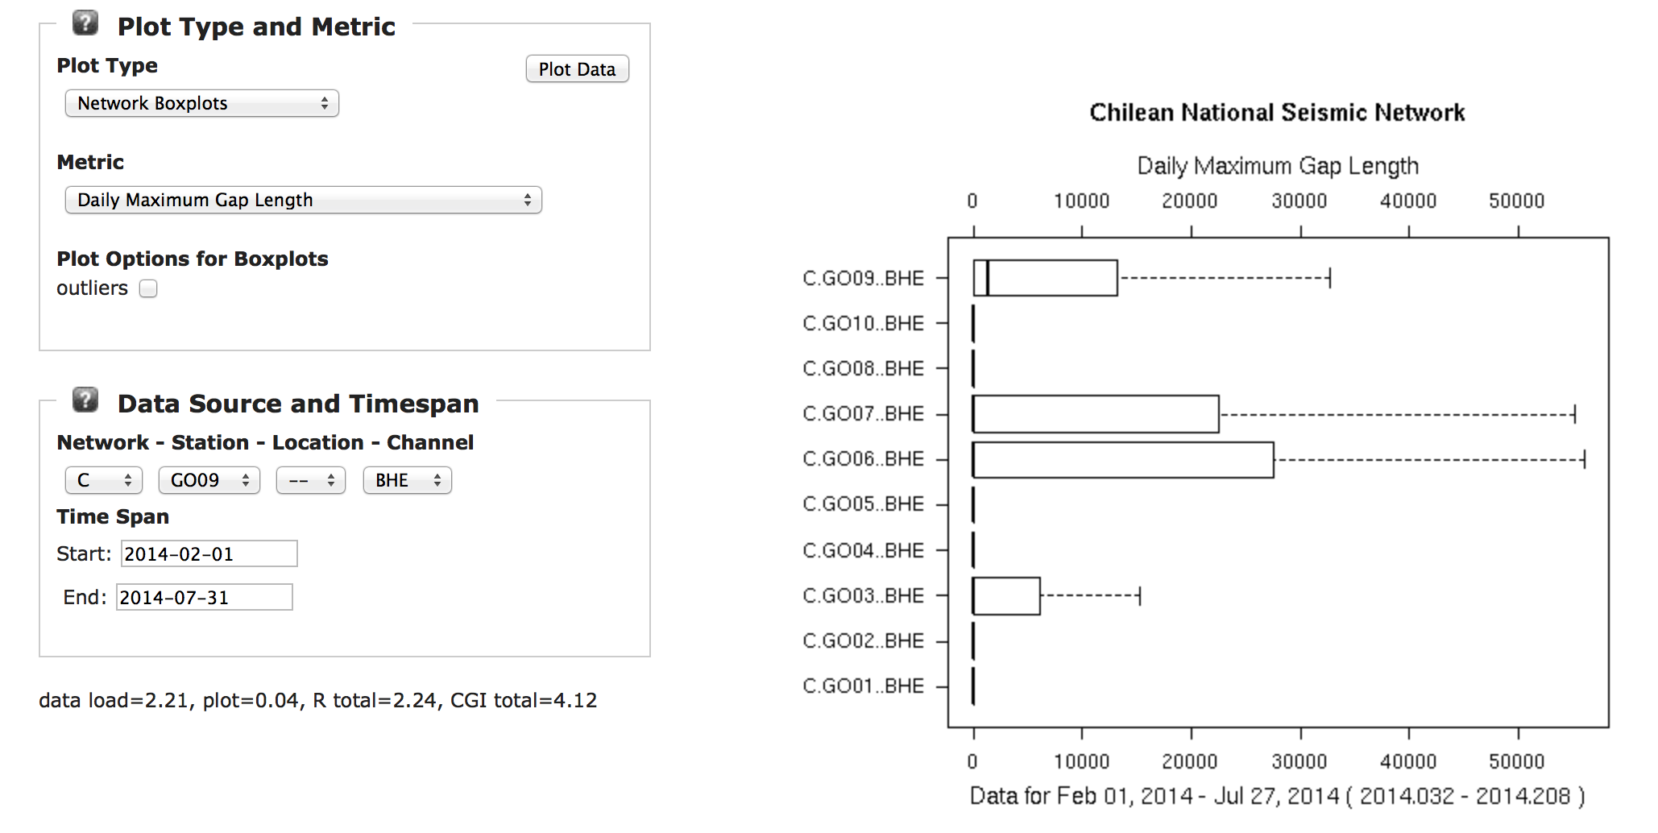
Network Box Plots

Slide 7
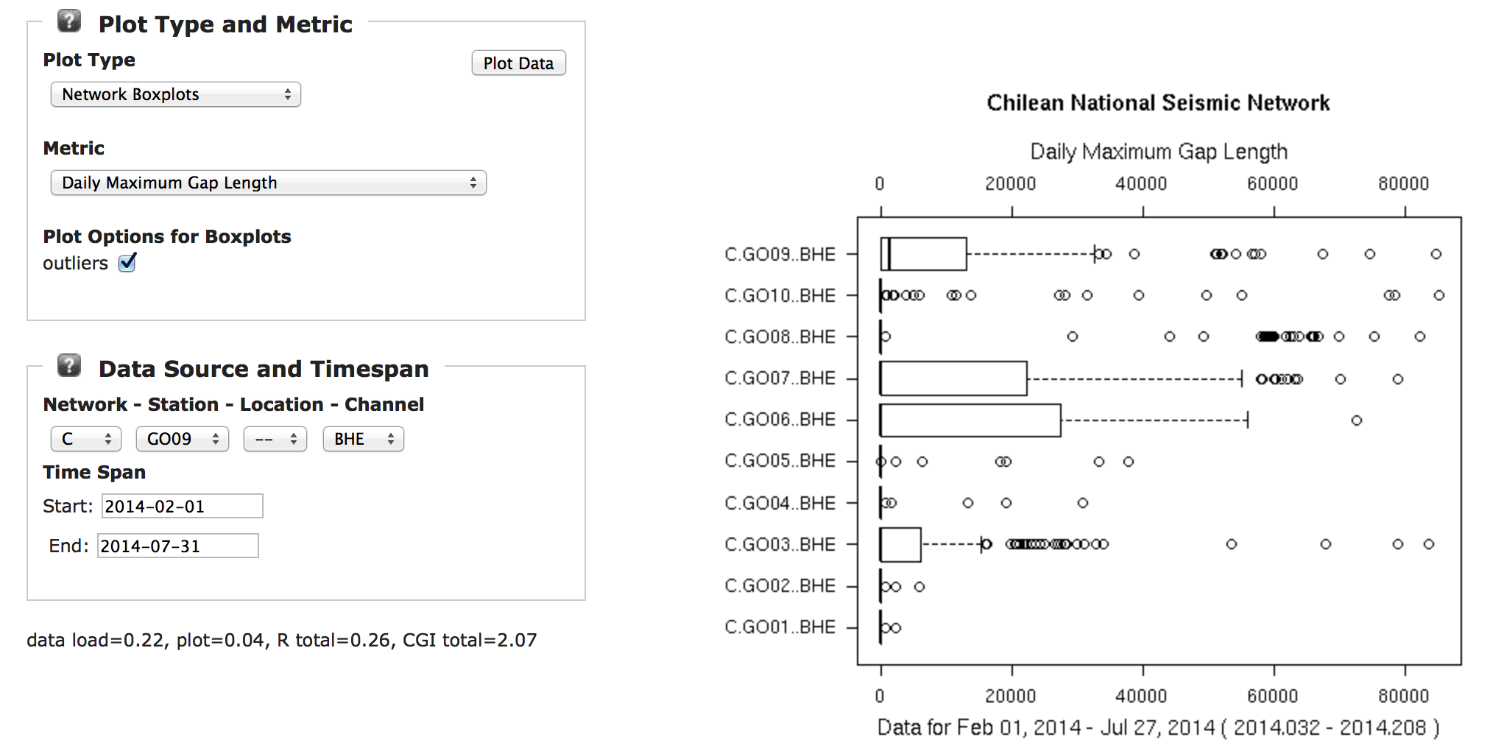
Network Box Plots

Slide 8
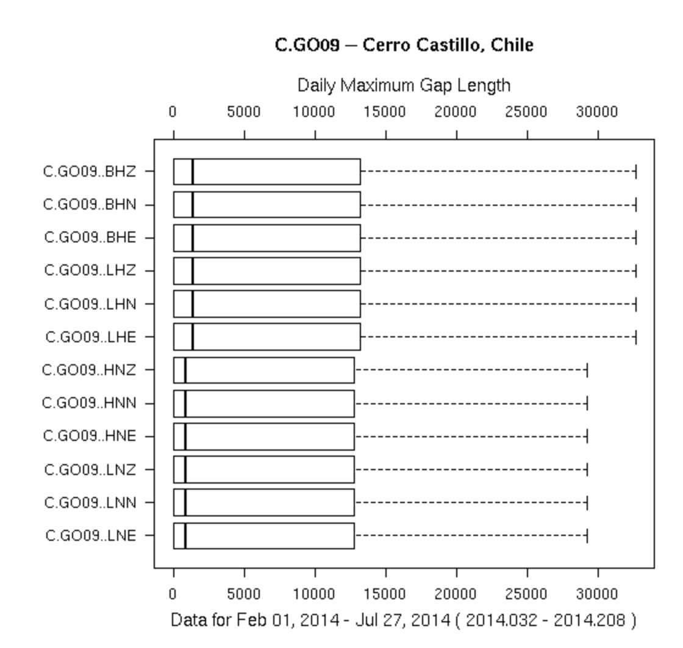
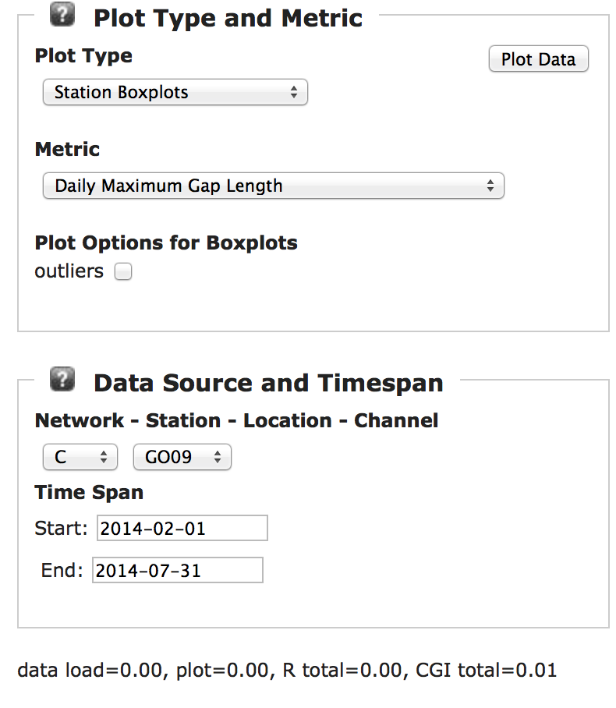
Station Box Plots

Slide 9
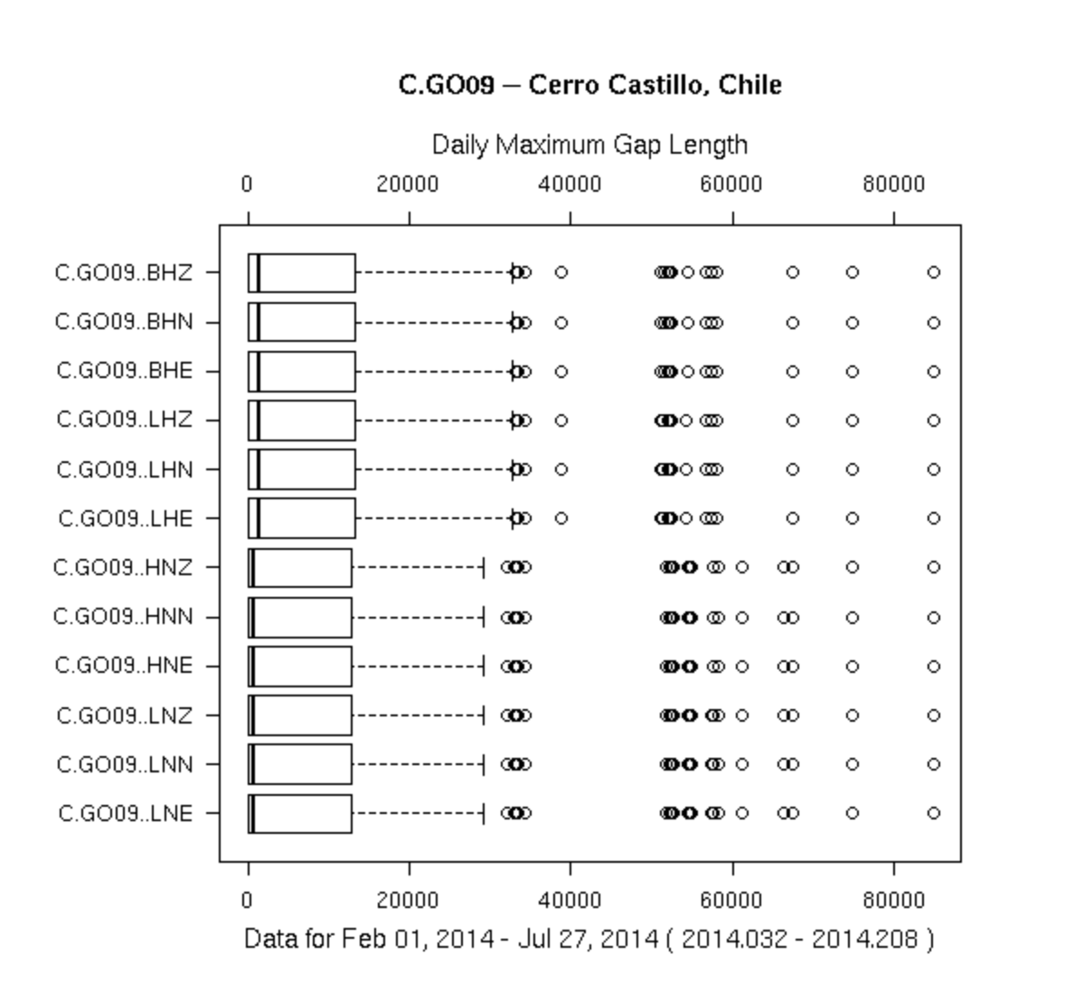
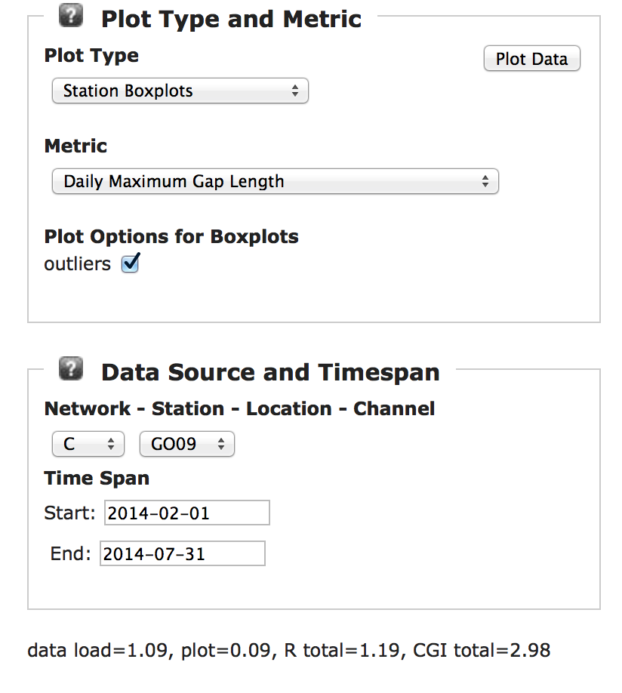
Station Box Plots

Slide 10
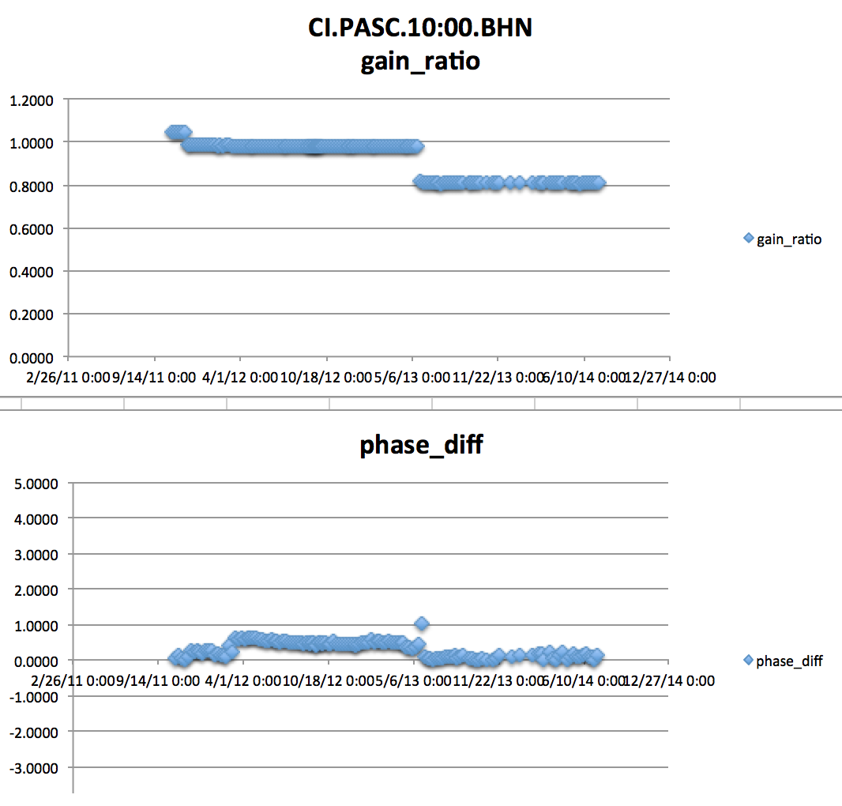
New metrics can always be added
The two steps in gain ratio steps can be tracked to metadata changes taking place
This plot represents gain ratios and phase differences
@ T=6s
measured weekly
only values with magnitude squared coherence > 0.999 are shown

