Slide 1
IRIS Data Services
Shortcourse
December 15, 2014
MOMA Room, Palomar Hotel

Slide 2
Agenda
8:00 Welcome and Introductions Tim Ahern
8:10 Rick Benson, DMC Operations
What Types of Data Does the DMC Manage
Focus on raw seismic data
How data are referenced in SEED using naming conventions, UTC Times, Virtual Networks
8:25 Chad Trabant, Products and Services
Fundamentals of Web Services
Review of Web Services at the DMC
Exercise using web services, URL builders
Web Services beyond the browser: Fetch scripts, Java, MATLAB, ObsPy
Exercise Using FetchData
9:10 Manoch Bahavar, Product Specialist
Event related data access with WILBER3, a browser based web services client
9:30 Rick Benson
Other DMC Services: SeedLink and BreqFast
9:45 Mary Templeton, Quality Assurance Analyst
The IRIS MUSTANG Quality Assurance System
MUSTANG system
MUSTANG Data Browser
LASSO
Automated scripts for advanced QA
10:30 Tim Ahern
Research Ready Data Sets
Answering your questions

Slide 3
What Data Does DMC Have?

Slide 4
Virtual Networks: Currently 54

Slide 5
USArray Virtual Networks
Virtual Network | Description
_US-TA | USArray Transportable Array
_US-REF | USArray Reference Network
_US-FA | USArray Flexible Array
_US-MT | USArray Magnetotelluric
_US-ALL | All USArray Components
_PBO | Plate Boundary Observatory
_SAFOD | SAFOD

Slide 6
An overview of web services
Web services use HTTP to get information from IRIS to your computer.
Next: the basics and what the IRIS DMC has to offer.
service.iris.edu

Slide 7
Web Service Requests
Client
Web Services
URL
(with parameter list..)
Header &
Content
Notes:
Here’s a schematic, laying out the mechanics of a basic web service request and response.

Slide 8
Communicate using client
Client
Web Services
URL
(with parameter list..)
Header &
Content
Notes:
The person or program that needs the data uses the CLIENT to make a request.
The term “Client” refers to any program that can communicate over the web

Slide 9
Communicate using client
Web Services
Browser
cURL
Fetch
irisFetch
Your Own
URL
(with parameter list..)
Header &
Content
Notes:
It could be a browser, command-line uitlity such as cURL or wget, or something specially designed to work with our services, such as Fetch Scripts, Python clients, or the MATLAB interface.
YOU CAN BUILD YOUR OWN, as the Programmatic support to build HTTP clients is ubiquitious.

Slide 10
Request is passed as URL
Client
Web Services
URL
(with parameter list..)
Header &
Content
Notes:
The client sends a URL to the web services. The URL not only specifies which web service to use (such as the EVENT webservice)., but also provides information to the webservice about what kind of data you’d like to retrieve
For example, were I to ask for all earthquakes with a primary magnitude of 8 or more (in text format), then the URL would contain parameters pairs: minimumMagnitude=8, output=text, etc. The specific parameters vary from service to service, and you’ll see examples of this shortly.

Slide 11
Web Service executes request
Client
Web Services
URL
(with parameter list..)
Header &
Content
Notes:
The web services then interprets those parameters, using them to figure out exactly which data to retrieve, and how to format it so that it can be returned.

Slide 12
Content is returned
Client
Web Services
URL
(with parameter list..)
Header &
Content
Notes:
It sends this information back to the client along with an HTTP header describing the content that is being returned. If all goes well, then the client will get back the requested information.
If not, it will get an error message and a numeric code describing what went wrong. Examples where you might not successfully retrieve data include:
instances when the data was not found?
When the web service was unable to interpret the URL
Etcetera.

Slide 13
A web service in action
http://service.iris.edu/…/query?what=TPSreport&when=2013-08-10&gotmemo=true
PARAMETERS
what = TPSreport
when = 2013-08-10
gotmemo = true
Valid Request?
400 – Invalid parameter PCLOADLETTER
✖
Web Service
✔
Data Exists?
404 (204) – Not Found
✖
✔
Get Data
200 – Data Data Data Data Data
Notes:
Remember again, all the builders do is fill in the URL parameter pairs.

Slide 14
Available via services…
Waveforms
dataselect
rotation
timeseries
Metadata
station
sacpz
resp
Event Information
event
Processing & Calculation
traveltime
distaz
flinnengdahl
evalresp
service.iris.edu
Notes:
[lead off with just a web service example to add relevance]
As you can see from the list, there are a variety of services available thorough the web interface. The ability to retrieve Waveforms, station metadata (and responses), and event information are complimented by services that can do signal processing, compute times and distances, etc. Plus, we have a web interface to the data products area. There you can find Event plots, Global Moment Tensors, Back projections, visualizations, and much more.
All these services can be accessed from the link shown.
Don’t worry about jotting it down right now, as a list of links will be provided at the end of the talk.
Some services have been standardized, and are provided as FDSN services. These include
The services that will be touched upon in this presentation are the two raw-waveform services, the station service, and the event service.
The DATASELECT service can retrieve a one or more seismic traces, and can be provided a laundry-list of channels & times.
The station service is capable of retrieving station metadata at a variety of detail levels: You can get network overview information all the way down to channel response information.
The EVENT service can retrieve earthquake magnitudes, origins, arrival times, and more.
TRANSITION: These are our web services, but how does one define a “web service”?
----- Meeting Notes (11/8/12 10:02) -----
mention instrument response

Slide 15
service.iris.edu
Notes:
Here are our core services,

Slide 16
FDSN standardization
Common set of interfaces:
fdsnws-dataselect
fdsnws-station
fdsnws-event
What you learn here applies to other datacenters.
Notes:
Federation of Distributed Seismic Networks
----- Meeting Notes (7/18/13 12:32) -----
web services

Slide 17
service.iris.edu
Notes:
many more supporting services

Slide 18
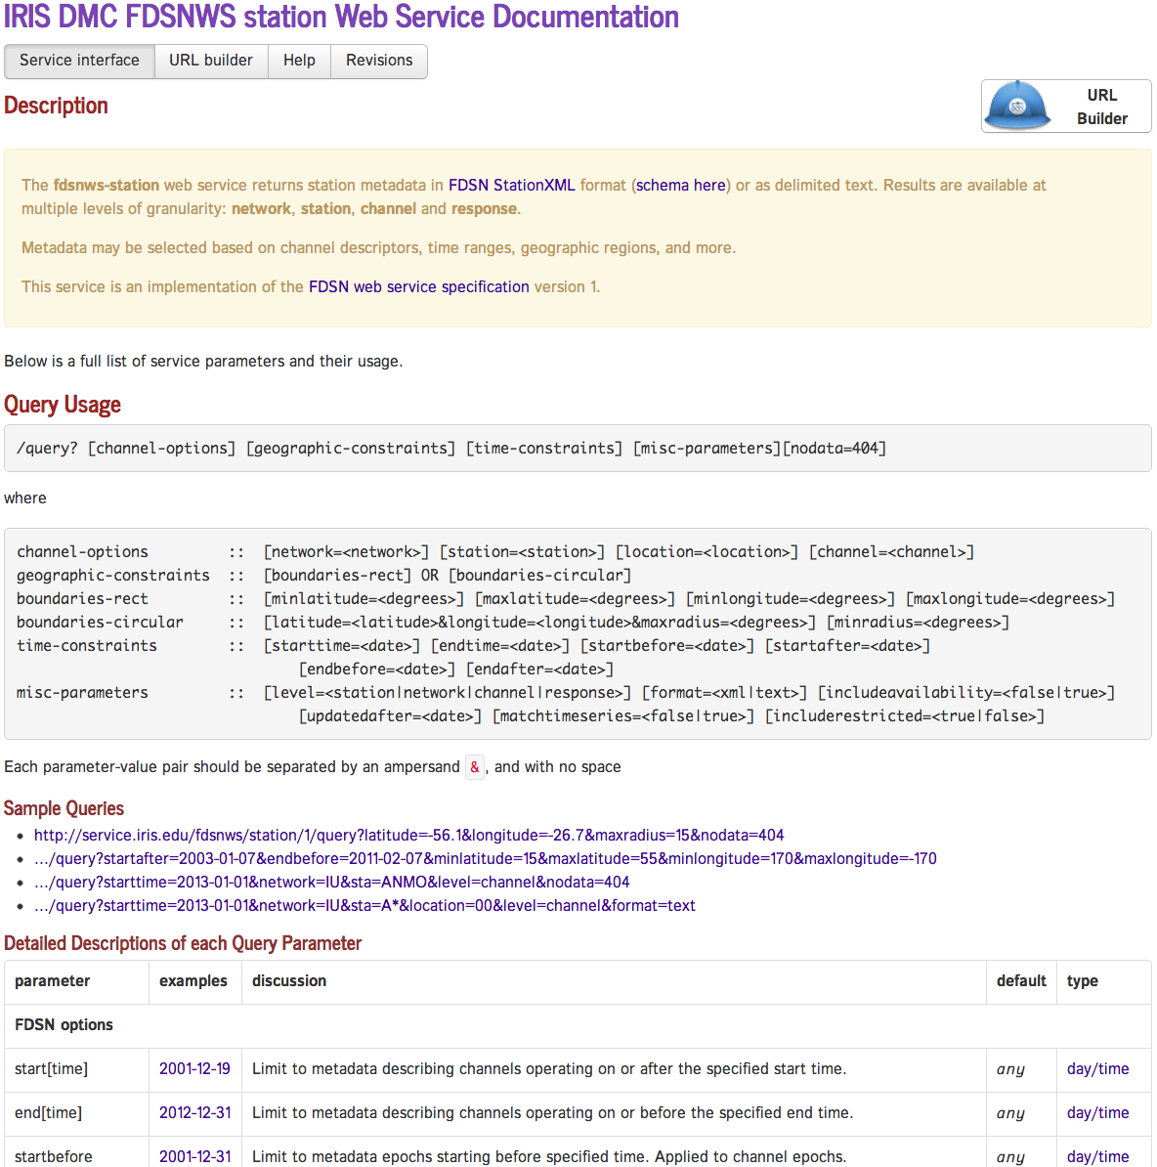
Each service is fully documented
Relevant Links
URL Builder
Description
Query Parameters
Examples
Detailed Parameter Descriptions
Notes:
This WAS the “Exploring the services” slide
Each service is fully documented
Query parameters
Examples
Usage details
URL Builder

Slide 19
Quickly access and explore web service data using the URL Builders
Notes:
Notice, roughly similar to seismiquery
At this point, show the operation of it, with a few quick examples. Then get ready for the exercise

Slide 20
Web Services exercise http://service.iris.edu
Plot 35 minutes of 3-Component data with event
From network IU and station(s) A?M?
For the LH? channels
Starting 5 min before P wave arrival
For the largest shallow (<= 10km) event occurring within the last month.
Rotated into RADIAL and TRANSVERSE components
Use web services to do it.
service.iris.edu
Notes:
Now they’ve been introduced, Time for an exercise.
Multiple web services will be needed: event parameters, station discovery, data access (as plot)
Final result will be 3 plots from the rotation service.
Next slide goes into more details

Slide 21
Web Services exercise http://service.iris.edu
Event – get event time, lat, lon, depth for largest shallow ( <10km depth) event in last 30 days.
Station – get station name, lat & lon for net: IU, station: A?M?
Distaz – get distance & azimuth
Traveltime – Find first P arrival
Rotation – plot a response corrected, ZRT rotated seismogram for 5 min before P arrival to 30 minutes after P arrival. for LH? channels.
Taking notes will be helpful
service.iris.edu
Notes:
Exercise from within browser, using builders
Next slide gives additional hints

Slide 22
Web Services exercise http://service.iris.edu
Exercise
Hints.
Event – get event time, lat, lon, depth for largest shallow ( <10k depth) event in last 30 days.
Station – get station name, lat & lon for net: IU, station: A?M?
Distaz – get distance & azimuth
Traveltime – Find first P arrival
Rotation – plot a response corrected, ZRT rotated seismogram for 5 min before P arrival to 30 minutes after P arrival. for LH channels.
Builders help…
EVENT
Text output
order by magnitude
change dates & times
max depth
don’t need ALL events
STATION
text output, station level
TRAVELTIME
Only need min P phase traveltime
ROTATION
Rotate into ZRT
service.iris.edu
Notes:
Exercise from within browser, using builders
This exercise could take a while.
At the end, walk through the exercise quickly with them.
ASK about which parts were tricky

Slide 23
About using the Browser…
Interactive
Builders only create URLs.
Faster to modify/create the URL by hand
Browser can only handle a certain amount of data.
Lots of XML may crash your browser
Requires your direct interaction
Notes:
Now that we’ve been using the browser…

Slide 24
Web services: Beyond the Browser
via HTTP clients, such as wget, curl, etc
These often are already on many systems
via DMC-provided interfaces:
command line: Fetch family of Perl scripts
Java: IRIS Java Web Service Library (IRIS-WS library)
MATLAB: irisFetch.m
via Community developed solutions:
ObsPy, SOD, Waveform Suite, EMERALD, SeisFile, etc.
via WILBER3 the JWEED and future desktop applications
Notes:
Future DMC clients, whether on the web, scripts, desktop applications, will all use web services.

Slide 25
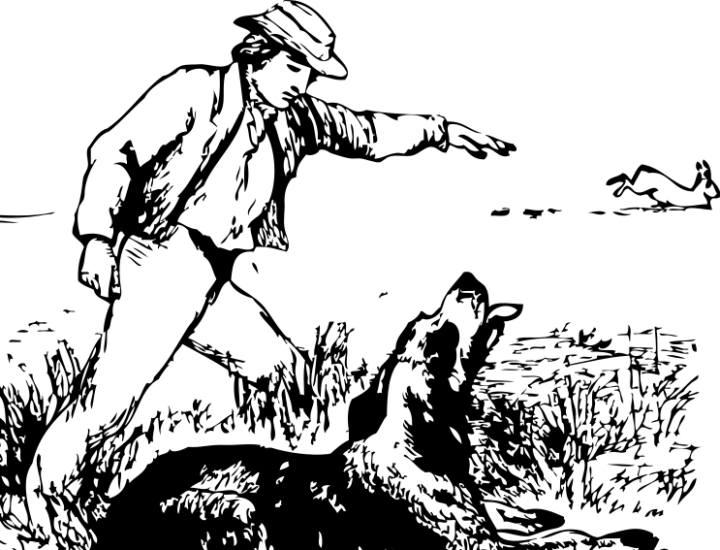
Automate access with FETCH scripts
Fetch Scripts are perfect for command-line access
FetchEvent FetchData FetchMetadata
Notes:
What if your data crunching needs are grander. If your processing routines require highly reproducable data queries? Or if they require huge amounts of data?
Then, the FETCH family of command-line scripts may provide the functionality that you’re looking for.
FETCHEVENT and FETCHDATA are the two workhorses. As their names imply, FETCHEVENT will retrieve information about one or more events, by communicating to the EVENT web service. This information is returned in a simple ASCII format.
FETCHDATA will retrieve timeseries data via the-DATASELECTweb service. These data are returned as a series of miniSEED files.
If requested, FETCHDATA will use the station service to return any associated channel metadata.
We’ve moved from Request-and-wait via emali (BREQ_FAST) to more interactive data requesting with preview (WILBER), to interactive & immediate (Web Services). Now, let’s investigate more automatable ways of accessing our data.

Slide 26
Fetch clients . . .
Allow command-line access to IRIS-held data
Have options that map to the service’s parameters
Fetch clients and mseed2sac are available from: http://seiscode.iris.washington.edu/
More usage details are available from: http://service.iris.edu/clients
Notes:
SUMMARIZE POINTS
1) Fetch clients allow command-line access to IRIS data. These scripts are written in PERL, and therefore can be ported to many different systems. Also, since these commands can be easily scripted, they are great for use in processing systems and automation.
2) Each service parameter (generally) has a matching option within the fetch script. This means that you can consult the web-pages for the nitty-gritty details of the service, or to figure out what sort of information you need, and then translate that 1-for-1 (often). Of course, usage-information is available to help navigate the specifics for each service

Slide 27
The DMC’s Fetch web service clients
FetchData:
Fetch miniSEED data, simple metadata, and instrument responses (SEED RESP & SAC PZs)
FetchEvent:
Fetch Event (earthquake) information as text or XML
FetchMetadata:
Fetch primary channel metadata (coordinates, etc.) as text or XML
service.iris.edu/clients

Slide 28
Usage: FetchEvent [options]
--help
-v More verbosity, may be specified multiple times (-vv, -vvv) -s starttime Limit to origins after time (YYYY-MM-DD,HH:MM:SS.sss) -e endtime Limit to origins before time (YYYY-MM-DD,HH:MM:SS.sss) --lat min:max Specify a minimum and/or maximum latitude range --lon min:max Specify a minimum and/or maximum longitude range --radius lat:lon:maxradius[:minradius] Specify circular region with opt. minimum radius --depth min:max Specify a minimum and/or maximum depth in kilometers --mag min:max Specify a minimum and/or maximum magnitude --magtype type Specify a magnitude type for magnitude range limits --cat name Limit to origins from specific catalog (e.g. ISC, PDE, GCMT) --con name Limit to origins from specific contributor (e.g. ISC, NEIC) --ua date Limit to origins updated after date (YYYY-MM-DD,HH:MM:SS) --allorigins Return all origins, default is only primary origin per event --allmags Return all magnitudes, default is only primary magnitude per event --orderbymag Order results by magnitude instead of time --evid id Select a specific event by DMC event ID --orid id Select a specific event by DMC origin ID -X xmlfile Write raw returned XML to xmlfile -A appname Application/version string for identification -o outfile Write event information to specified file, default: console
Notes:
FETCH DEMO:
Again, At the end of this presentation, I'll provide links on where you can download the Fetch clients
http://service.iris.edu/clients
Running the script without specifying any options gives you the documentation for the script
FetchEvent
Notice all the options here; they closely match the options from the webservice's web page. Therefore, I won't go into as much detail here as I did with the event webservice. Of note, though, is that I can save the original XML as well as this scripts default output.
Now, I'll build up a query to access a specific earthquake. I know generally when it was, and I know it was bigger than a 5.0
FetchEvent --mag 5.0
FetchEvent --mag 5.0 --s 2009-04-06
FetchEvent --mag 5.0 --s 2009-04-06 -orderbymag | head
FetchEvent --mag 5.0 --s 2009-04-06 -e 2009-04-07
FetchEvent --mag 5.0 --s 2009-04-06 -e 2009-04-07 --allmags
FetchEvent --mag 5.0 --s 2009-04-06 -e 2009-04-07 --orderbymag
Now, we take the event that we found, and pass it to FetchData, so that we may retrieve our data
FetchData
Notice again all the options here;
Including the option to use a listfile or breq_fast file. These are files that would contain a list of channels and times for retrieval.
Also, an option we'll use is to grab metadata (-m), which can be used to create SAC files.
Now, let me grab data for this event from one specific station.
FetchData -N "IU" -C "BHZ" -S "ANMO" -L "00"
-s "2009-04-06,01:32:39" -e "2009-04-06,02:02:39"
-o out.mseed -m out.meta
In the background, FetchData did exactly what the builder did: It created a URL from the parameters. and In this case, it queried both the dataselect service (to get the timeseries data) and the station service (to get the associated metadata).
Here is what the metadata looks like.
head out.meta
Now, I can use mseed2sac to join the files.
mseed2sac -m out.meta out.mseed
Instead of just one station, Let me grab everything from two networks that can be found within a 15 degree radius of the earthquake.
FetchData -N "IU,II" -C "BHZ" -s "2009-04-06,01:32:39" -e "2009-04-06,02:02:39" --radius 42.37:13.32:15 -o out.mseed -m out.meta
And combine them into sac
mseed2sac -m out.meta out.mseed
One last thing, I should mention. You can retrieve 1-d or 3-d princeton SEM synthetic seismograms from an event just as easily, as you would retrieve the actual data. Use network SY, and a channel of MX? (3-d) or LX? (1-d)
GRAB 3D SYNTHETICS AS WELL
FetchData -N "SY" -C "MXZ" -s "2009-04-06,01:32:39" -e "2009-04-06,02:02:39" --radius 42.37:13.32:15 -o out.mseed -m out.meta
mseed2sac -m out.meta out.mseed
ls *.SAC

Slide 29
Example: Quick access to metadata
$ FetchMetadata -N TA -S ELFS
Received 112.5 KB of metadata in 0.1 seconds (796.2 KB/s)
Processed metadata for 114 channel epochs in 0.4 seconds (316.7 KB/s)
#net|sta|loc|chan|lat|lon|elev|depth|azimuth|dip|instrument|scale|scalefreq|scaleunits|samplerate|start|end
TA|ELFS|--|ACE|40.6183|-120.7279|1553.0|0.0|0.0|0.0|Quanterra 330 Linear Phase Composite||0||0|2007-08-16T21:01:00|2007-10-09T18:
TA|ELFS|--|BHE|40.6183|-120.7279|1553.0|0.0|84.9|0.0|Streckeisen STS-2 G3/Quanterra 330 Linear Phase Co|6.27192E8|0.2|M/S|40|2007
TA|ELFS|--|BHN|40.6183|-120.7279|1553.0|0.0|354.9|0.0|Streckeisen STS-2 G3/Quanterra 330 Linear Phase Co|6.27192E8|0.2|M/S|40|200
TA|ELFS|--|BHZ|40.6183|-120.7279|1553.0|0.0|0.0|-90.0|Streckeisen STS-2 G3/Quanterra 330 Linear Phase Co|6.27192E8|0.2|M/S|40|200
TA|ELFS|--|LCE|40.6183|-120.7279|1553.0|0.0|0.0|0.0|Quanterra 330 Linear Phase Composite|1000000.0|0|S|1|2007-08-16T21:01:00|2007
TA|ELFS|--|LCQ|40.6183|-120.7279|1553.0|0.0|0.0|0.0|Quanterra 330 Linear Phase Composite|1.0|0|PERCENT|1|2007-08-16T21:01:00|2007
TA|ELFS|--|LHE|40.6183|-120.7279|1553.0|0.0|84.9|0.0|Streckeisen STS-2 G3/Quanterra 330 Linear Phase Co|6.25202E8|0.03|M/S|1|2007
TA|ELFS|--|LHN|40.6183|-120.7279|1553.0|0.0|354.9|0.0|Streckeisen STS-2 G3/Quanterra 330 Linear Phase Co|6.25202E8|0.03|M/S|1|200
TA|ELFS|--|LHZ|40.6183|-120.7279|1553.0|0.0|0.0|-90.0|Streckeisen STS-2 G3/Quanterra 330 Linear Phase Co|6.25202E8|0.03|M/S|1|200
TA|ELFS|--|LOG|40.6183|-120.7279|1553.0|0.0|0.0|0.0|Quanterra 330 Linear Phase Composite||0||0|2007-08-16T21:01:00|2007-10-09T18:
TA|ELFS|--|OCF|40.6183|-120.7279|1553.0|0.0|0.0|0.0|Quanterra 330 Linear Phase Composite||0||0|2007-08-16T21:01:00|2007-10-09T18:
TA|ELFS|--|UHE|40.6183|-120.7279|1553.0|0.0|84.9|0.0|Streckeisen STS-2 G3/Quanterra 330 Linear Phase Co|3.61051E7|0.002|M/S|0.01|
The existence of metadata does not guarantee that time series data exists
Notes:
output from FetchMetadata v 2013.186

Slide 30
FetchData exercise
Request 1 hour of GSN long-period vertical (LHZ) data and simple metadata for 2010-2-27 M8.8 Chilean earthquake:
$ FetchData
-N _GSN –L 00 –C 'LHZ'
-s 2010-02-27,06:34:00 -e 2010-02-27,07:34:00
-o /data/Chile-GSN-LHZ.mseed
-m /data/Chile-GSN-LHZ.metadata
Convert the miniSEED to SAC with metadata
$ mseed2sac Chile-GSN-LHZ.mseed –m Chile-GSN-LHZ.metadata
-E '2010,058,06:34:11/-36.122/-72.898/22.9'

Slide 31
Broad support for FDSN services
http://www.fdsn.org/webservices/datacenters/
Notes:
Currently, ORFEUS has FTP directories with seed, miniseed
http://www.orfeus-eu.org/data/direct_access.html
RESIF france, (ws.resif.fr)
http://comcat.cr.usgs.gov/fdsnws/event/1/
Upcoming (no dates): other tools to seamlessly use multiple data centers.

Slide 32
Integrating & customizing for your own use
#!/usr/bin/bash
# usage: ./fetchingscript minmag:maxmag startday endday
a=$(./FetchEvent --mag ${1} --s ${2} --s ${3} --orderbymag --limit 1)
# parse output
a=${a%*|*|*|*|*|*} # strip off the end
a=${a//[[:space:]]} # remove all spaces
IFS=' ' read -r evid evdt evlat evlon evdep <<< ${b//|/ } # split fields
# wrestle dates
evdate=${evdt:0:10}
evtime=${evdt:10}
evendtime=$(date -j -f "%T" -v+10M ${evtime} "+%H:%M:%S") #add 10 minutes
evstart="${evdate}T${evtime}"
evend="${evdate}T${evendtime}"
./FetchData -N _GSN -C BHZ -s ${evstart} -e ${evend} -o data.mseed -m data.meta -A test --radius ${evlat}:${evlon}:85:95
./mseed2sac data -m data.meta data.mseed
Notes:
These Fetch scripts are made to be integrated
try looking at the output of FetchEvent and FetchData
Make sure to do run this script in a protected directory.
Example to show how they can repeat a stylized request.

Slide 33
WILBER3 Event-related data access
Purpose: Leverage IRIS/FDSN web services to request event-related data
Scenario: Need waveforms relating to a specific event
Stations with spread
Choose distances & azimuths
Preview ability
Interface: Web based, all you need is a browser
ds.iris.edu/wilber3

Slide 34
Waveform access, by need

Slide 35
Batch REQuest FAST (BREQ_FAST)
Purpose: Request large volume of SEED information asynchronously
Scenario: You’re away, and need to get data.
Not at your computer
Slow internet connection
Need large volume of data
Don’t/can’t need to work on it right away

Slide 36
Order SEED now, process later with BREQ_FAST

Slide 37
BREQ_FAST via SeismiQuery
http://www.iris.edu/SeismiQuery/breq_fast.phtml
Notes:
SeismiQuery is a collection of web forms that allow you to query the IRIS DMC database.
There are several forms, but much of the functionality is duplicated elsewhere by other services.
One form that is particularly relevant, though, is the BREQ_FAST request form.
It will guide you through the finding of and requesting of timerseries data and metadata.
TRANSITION: Examining the top seciton of the request form, we see fields that help us filter the data.

Slide 38
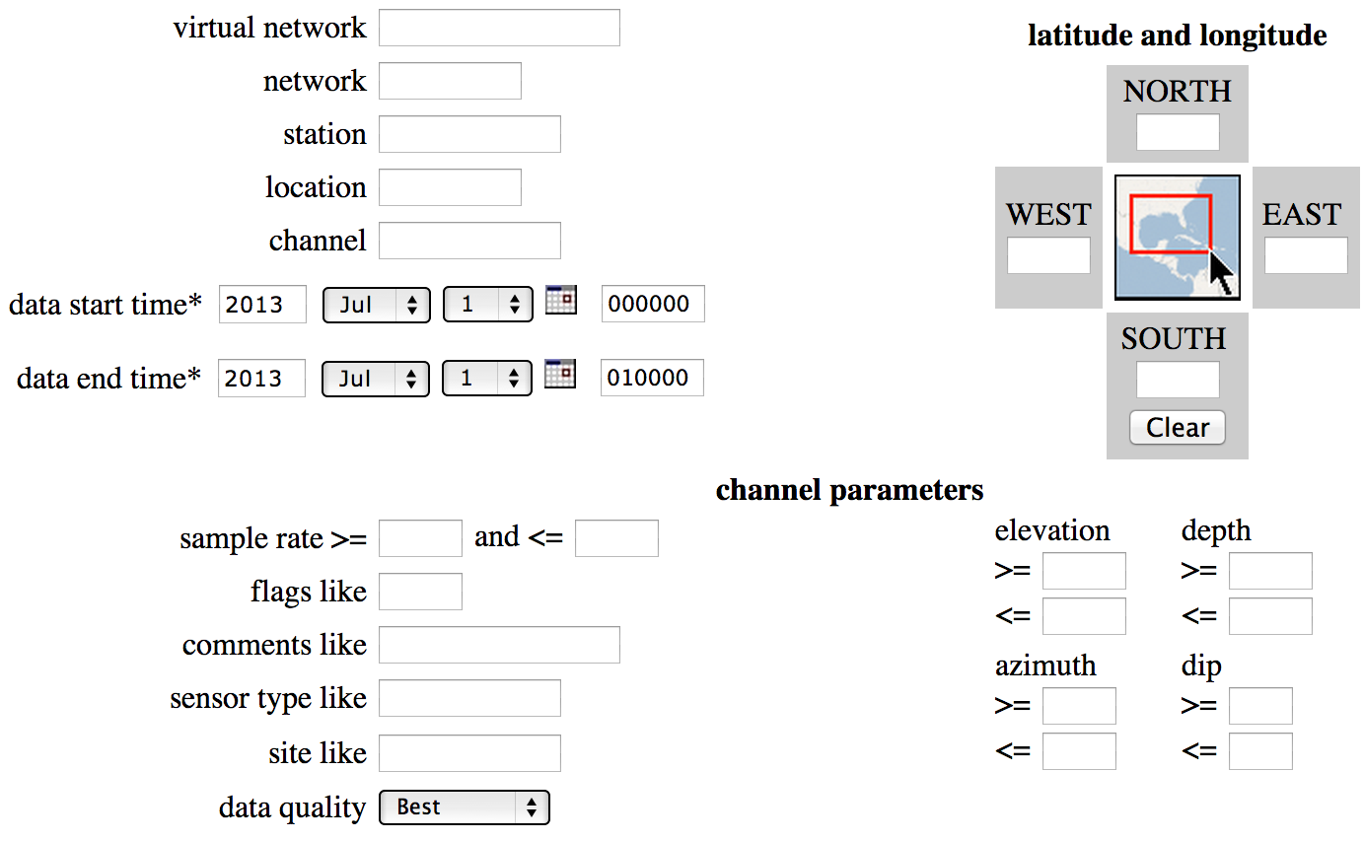
BREQ_FAST via SeismiQuery
http://www.iris.edu/SeismiQuery/breq_fast.phtml
Notes:
Describing the station and channel
Request dtimes (Required!)
Geographic filtering
misc. filtering.
Transition.
Once you’ve specified what you’re interested in,

Slide 39
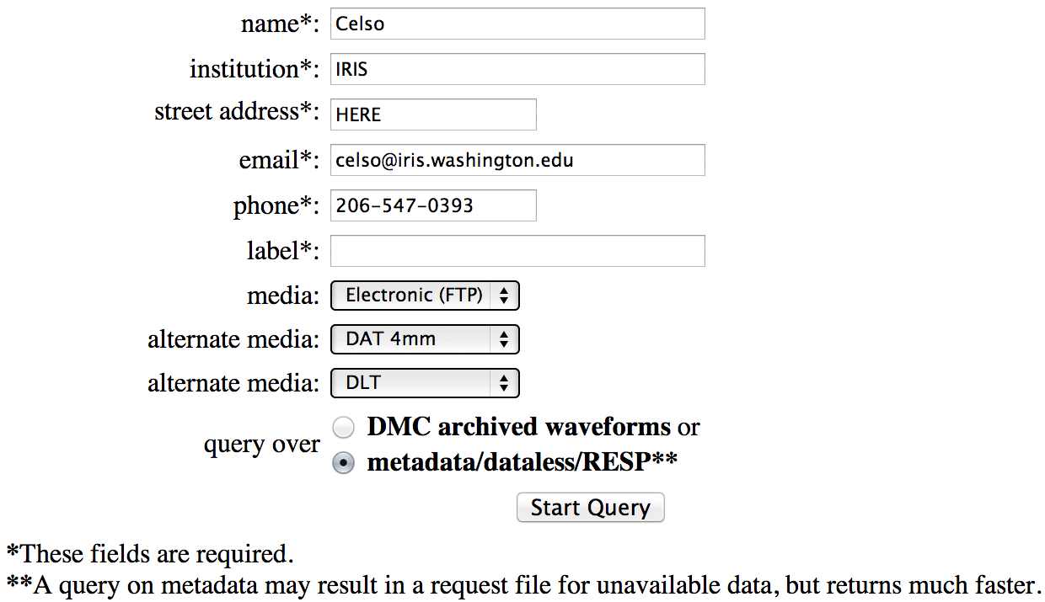
BREQ_FAST via SeismiQuiery
http://www.iris.edu/SeismiQuery/breq_fast.phtml
Notes:
provide information about yourself, and at Label., and
Specify what KIND of data you need.
metadata
dataless
RESP
TRANSITION: After filling this out, you hit “Start Query”

Slide 40
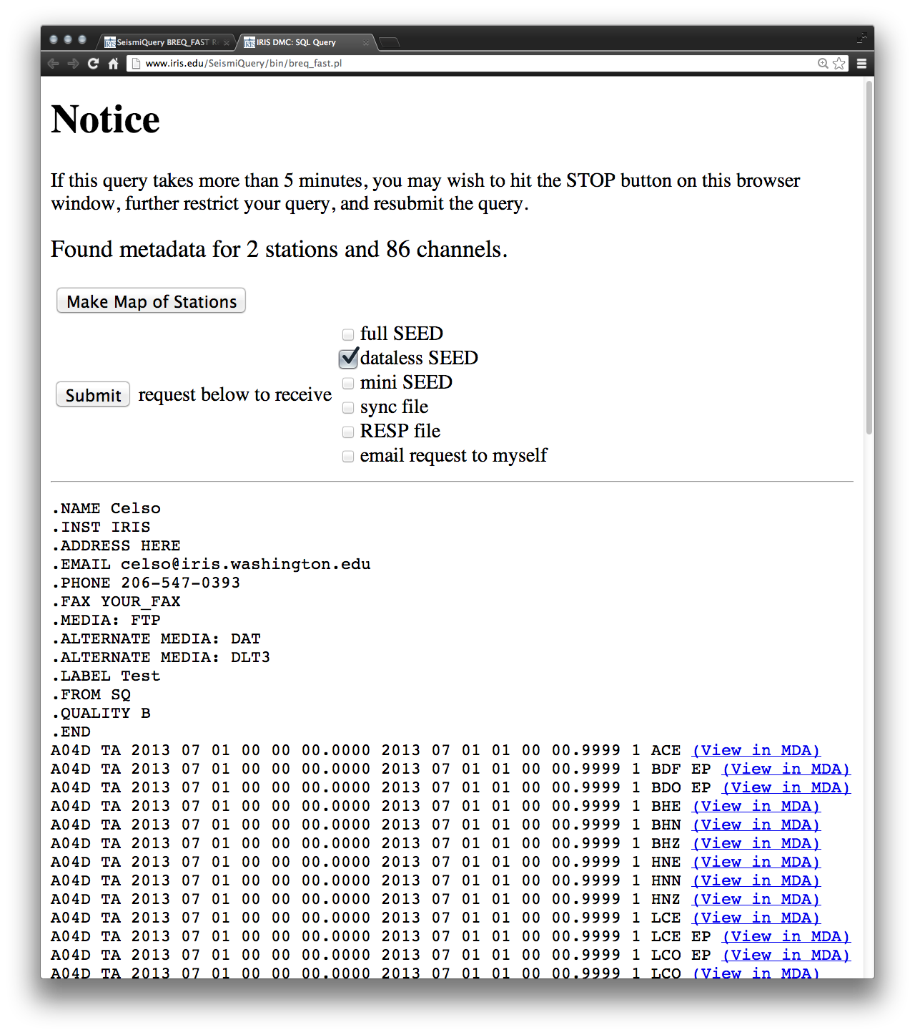
BREQ_FAST via SeismiQuiery
http://www.iris.edu/SeismiQuery/breq_fast.phtml
Notes:
You see a page containing, essentially, an email you created. (Except for all the “View in MDA” links More about that in a moment.
DESCRIBE THE BODY, and the format of the letter.
TRANSITION: of course, you don’t need to access this via the Seismiquery form.

Slide 41
Request from BREQ_FAST Via Email
Request SEED : breq_fast@iris.washington.edu
Request SEED metadata : dataless@iris.washington.edu
Request miniSEED : miniseed@iris.washington.edu
Manual: http://www.iris.edu/dms/nodes/dmc/manuals/breq_fast/
.NAME Joe Seismologist
.EMAIL joe@podunk.edu
.MEDIA FTP
.LABEL Earthquake1
.QUALITY B
.END
GRFO IU 1999 01 02 00 18 10.4 1999 01 02 00 20 10.4 1 SHZ
ANTO IU 1999 01 02 02 10 36.6 1999 01 02 02 12 36.6 1 SH?
AFI IU 1999 01 02 02 10 37.1 1999 01 02 02 12 37.1 1 BH? 00
SEE CD 1999 01 02 14 45 08.9 1999 01 02 14 47 08.9 1 SHZ
CASY IU 1999 01 04 02 42 13.4 1999 01 04 02 44 13.4 1 BHZ 10
KMI CD 1999 01 04 02 41 57.5 1999 01 04 02 43 57.5 1 BHZ
SSE CD 1999 01 04 02 18 25.4 1999 01 04 02 20 25.4 2 B?? SHZ
PAS TS 1999 1 4 2 10 49 1999 1 4 2 12 49 3 BH? SHZ L??
Notes:
You can send an email with the same information directly .
Can be auto generated.
Can be stored in a huge listd
main advantage is that it submits request for you.
Gives a little bit of a preview of what you're getting
(Batch, can do on the run if you can't send email)
Say, you’re riding on a bus
does alternate media mean anything any more?
Afterward, you will get back emails that tell you how to retrieve your data.

Slide 42
Real-Time Data Import:

Slide 43
Seedlink: Real-Time Data Export

Slide 44
Buffer of Uniform Data: BUD

Slide 45
How IRIS DS Serves “SeedLink” Data

Slide 46
Connection and Expectation (We do not regard this as High Availability)

Slide 47
Stations: Total vs RealTime

Slide 48
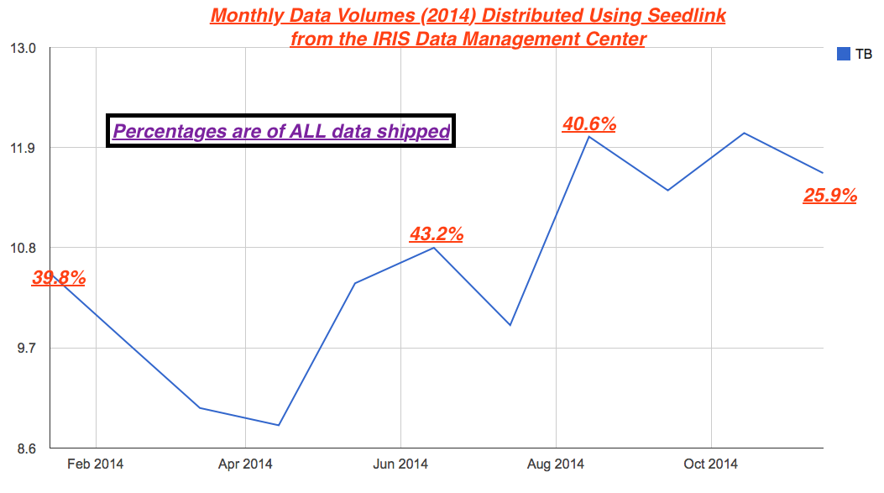
Seedlink Shipments are Significant

Slide 49
The IRIS MUSTANG Quality Assurance System
What is MUSTANG?
Modular Utility for STAtistical kNowledge Gathering
Suite of web services that calculate, store and retrieve data quality measurements
Modular – new metrics can easily be contributed and implemented
Able to house contributed measurements from other institutions
Queries for MUSTANG measurements are in the form of a URL

Slide 50
A few terms
Metric – an algorithm that calculates some value related to data quality.
Target – a data channel described by its SEED network, station, location and channel IDs, plus its SEED quality code (e.g. IU.ANMO.00.BHZ.Q).
Measurement – a value calculated by a data quality metric for a single target and time window.

Slide 51
The MUSTANG system

Slide 52
What does MUSTANG measure?
Current metrics

Slide 53
What does MUSTANG measure?
Current network coverage (mainly BH channels)
Coming next: G, GE, MN, NL & NZ

Slide 54
Where do you find MUSTANG?
Main MUSTANG web page
http://service.iris.edu/mustang/
Tutorial: Getting Started With MUSTANG
http://ds.iris.edu/ds/nodes/dmc/tutorials/getting-started-with-mustang/

Slide 55
How do you access MUSTANG measurements?
Existing clients
Builder
LASSO
Databrowser
Write a client customized to your needs
Any language that can use HyperText Transfer Protocol (HTTP) to send commands and receive data can be used to write a client.

Slide 56
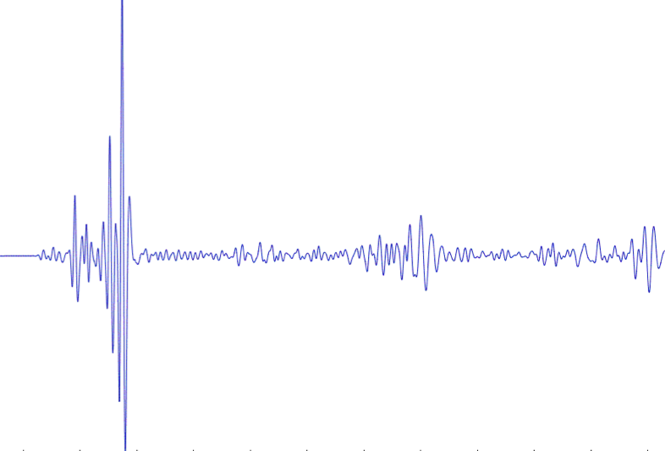
IRIS DMC: Research Ready Data Sets
MUSTANG Metric Estimators
Gaps, overlaps, completeness, signal to noise, power density, pdf mode changes,
Glitches, (~24 metrics in phase 2)
PostgreSQL Database
Data Quality Technician
Domestic & Non-US
Network Operators
DMC Filters Data Request Using Defined Constraints
Research Ready Data Sets
Archived and Real Time Data
Filtered Data Request Returned to Researcher
Researcher Specifies Required Data Metric Constraints

Slide 57
IRIS Data Services Posters
Data Access:
GC13F-0716: Developing Federated Services within Seismology: IRIS’ involvement in the CoopEUS Project
Monday, Dec. 15, 2014, 01:40 PM – 06:00 PM, Moscone West
S43A-4536: Federated data access and other services offered by the IRIS DMC
Thursday, Dec. 18, 2014, 01:40 PM – 06:00 PM, Moscone South
Data Products:
S33A-4478: The IRIS DMC’s Earth Model Collaboration (EMC) Wednesday, Dec. 17, 2014, 01:40 PM - 06:00 PM, Moscone South
S43A-4506: A highlight of data products from IRIS Data Services Thursday, Dec. 18, 2014, 01:40 PM - 06:00 PM, Moscone South
Quality Assurance:
S13C-4471: The Future of Seismic Data Quality Assurance at the IRIS DMC
Monday, Dec. 15, 2014, 01:40 PM – 06:00 PM, Moscone South
S43A-4525: MUSTANG, A Community-Facing Web Service to Improve Seismic Data Quality Awareness Through Metrics
Thursday, Dec. 18, 2014, 01:40 PM - 06:00 PM, Moscone South

Slide 58
Time for your Questions

