Slide 1
RESEARCH READY DATA SETS
Putting the MUSTANG metrics to work

Slide 2
Research Ready Data Sets (RRDS), a new service
The Research Ready Data Sets (RRDS) service aims to address the challenge of accessing high or consistent quality data.
Primary goal: reducing the time and effort spent on initial selection of raw data.
How?
Data selection using data quality measurements from MUSTANG
A web service that returns a data request:
http://service.iris.edu/irisws/rrds/1/

Slide 3
RRDS in concept
An enhanced “filter”

Slide 4
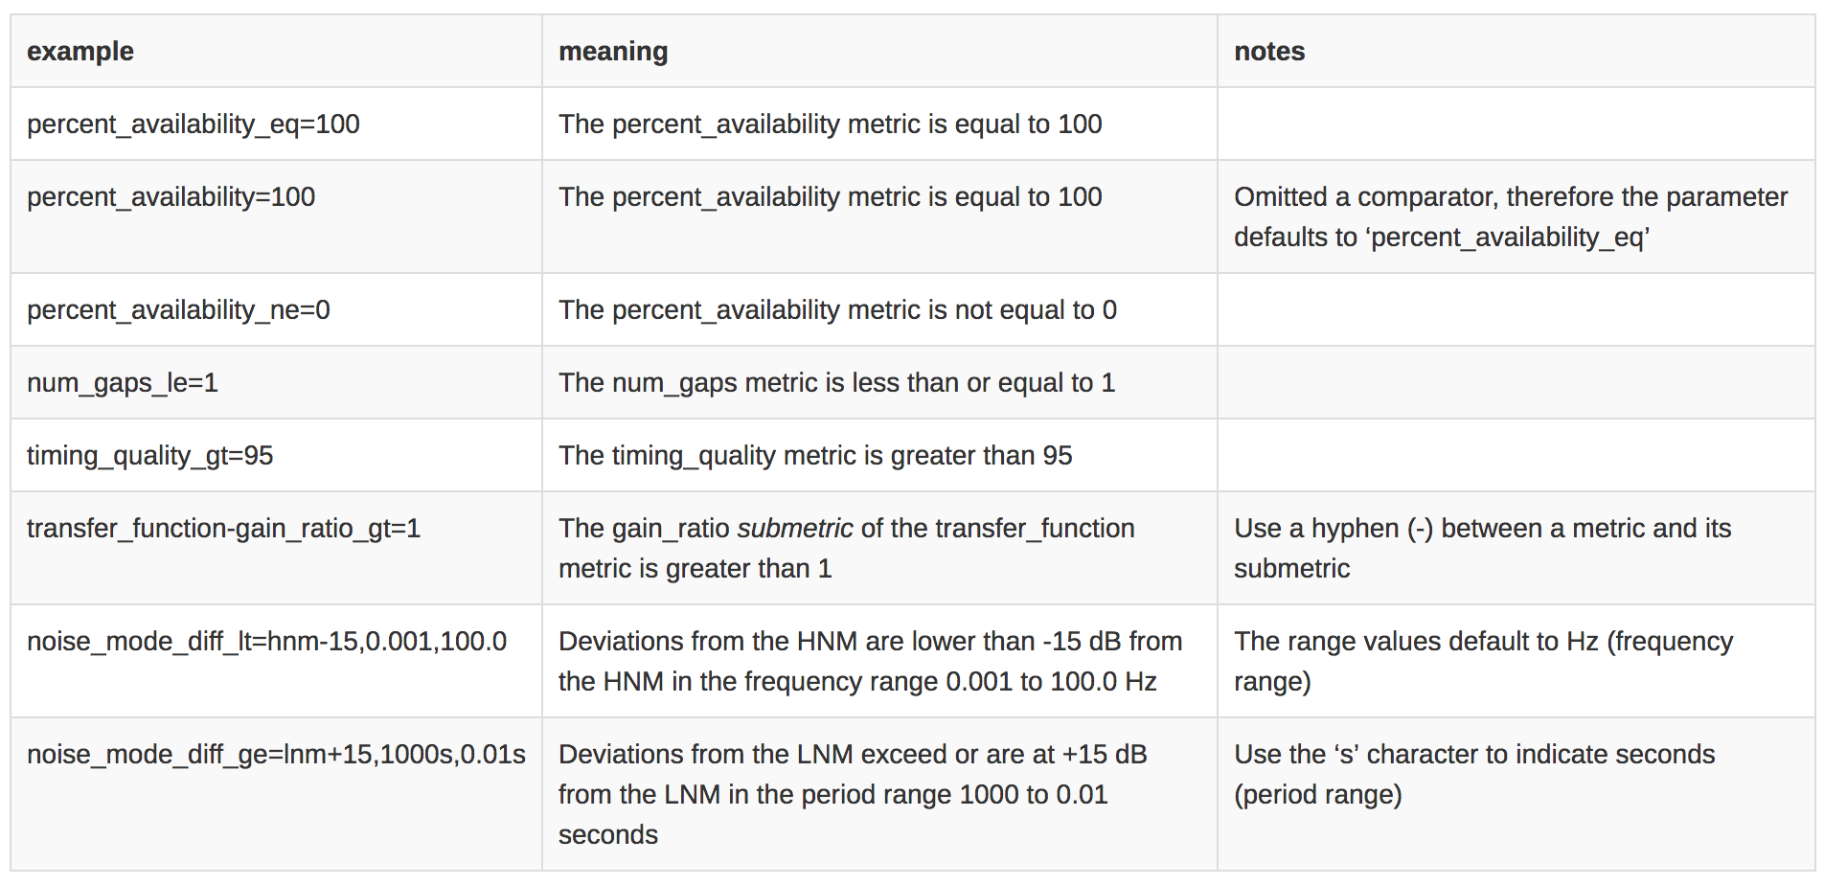
RRDS criteria and operators (from the help)

Slide 5
RRDS output formats (from the help)

Slide 6
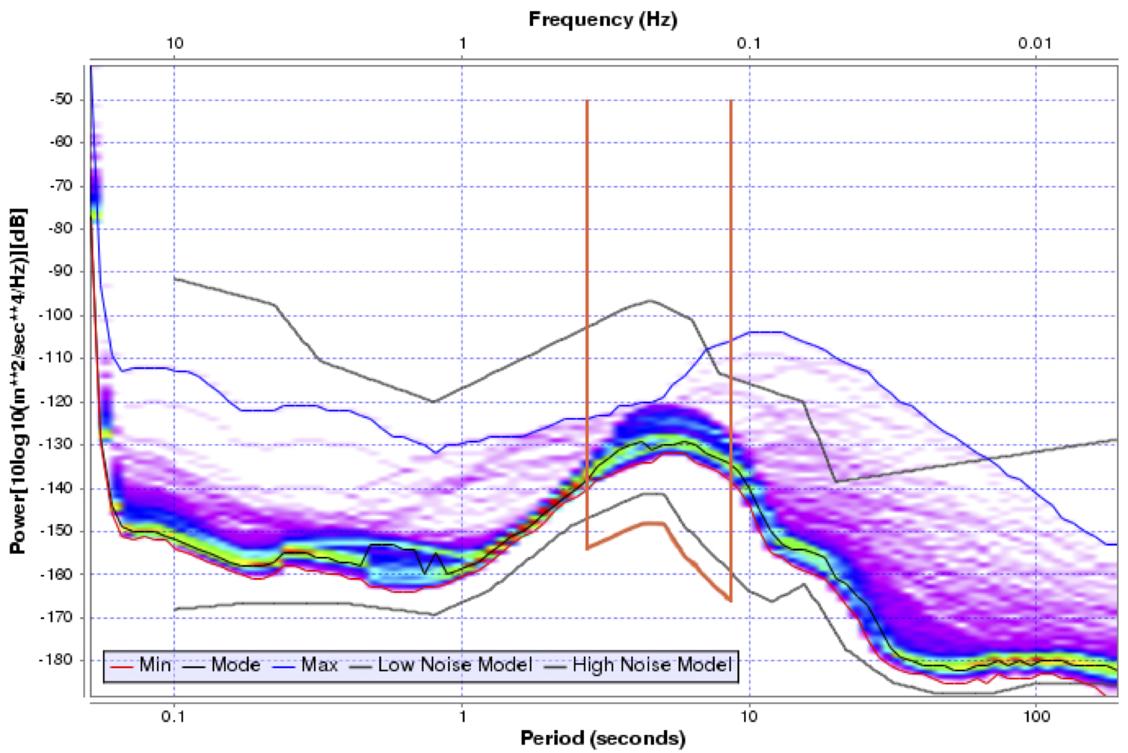
An RRDS selection example
Traditional selection:
Vertical broadband seismic channel (BHZ) data from the Global Seismographic Network (_GSN) network for the Nepal Magnitude 7.8 earthquake of 2015-04-25 06:11:25
Enhanced selection:
Maximum of STA/LTA of the seismic signal over a 24 hour period > 20.0 :
max_stalta_gt=20.0
Signal only includes ambient noise greater than 5dB below the NLNM in the 4 to 8s period band :
noise_mode_diff_gt=lnm-5,4s,8s
No gaps within selected window:
ts_num_gaps=0

Slide 7
An RRDS selection example (results)
IU ADK 00 BHZ 2015-04-25T00:00:00 2015-04-26T00:00:00 IU AFI 00 BHZ 2015-04-25T00:00:00 2015-04-26T00:00:00 IU ANMO 00 BHZ 2015-04-25T00:00:00 2015-04-26T00:00:00 IU ANTO 00 BHZ 2015-04-25T00:00:00 2015-04-26T00:00:00 IU BBSR 00 BHZ 2015-04-25T00:00:00 2015-04-26T00:00:00 IU BILL 00 BHZ 2015-04-25T00:00:00 2015-04-26T00:00:00 IU CASY 00 BHZ 2015-04-25T00:00:00 2015-04-26T00:00:00 IU CCM 00 BHZ 2015-04-25T00:00:00 2015-04-26T00:00:00 IU CHTO 00 BHZ 2015-04-25T00:00:00 2015-04-26T00:00:00 IU COLA 00 BHZ 2015-04-25T00:00:00 2015-04-26T00:00:00
...
...
RRDS CRITERIA: max_stalta > 20.0 ts_num_gaps = 0 noise_mode_diff_gt lnm-5,4s,8s RRDS REJECTION LOG: IU KOWA 00 BHZ 2015-04-25T00:00:00 2015-04-26T00:00:00 max_stalta=4.152 IU LCO 00 BHZ 2015-04-25T00:00:00 2015-04-26T00:00:00 max_stalta=19.642 IU OTAV 00 BHZ 2015-04-25T00:00:00 2015-04-26T00:00:00 max_stalta=16.476 IU OTAV 00 BHZ 2015-04-25T00:00:00 2015-04-26T00:00:00 ts_num_gaps=1 IU PMSA 00 BHZ 2015-04-25T00:00:00 2015-04-26T00:00:00 max_stalta=15.121 IU POHA 00 BHZ 2015-04-25T00:00:00 2015-04-26T00:00:00 max_stalta=19.269 IU PTCN 00 BHZ 2015-04-25T00:00:00 2015-04-26T00:00:00 max_stalta=18.916 IU PTCN 00 BHZ 2015-04-25T00:00:00 2015-04-26T00:00:00 ts_num_gaps=3
...
...
The web service request all together:
http://service.iris.edu/irisws/rrds/1/query?
net=_GSN&sta=*&loc=00&cha=BHZ
&starttime=2015-04-25T00:00:00&end=2015-04-26T00:00:00
&max_stalta_gt=20.0
&noise_mode_diff_gt=lnm-5,4s,8s
&ts_num_gaps=0
&format=report

Slide 8
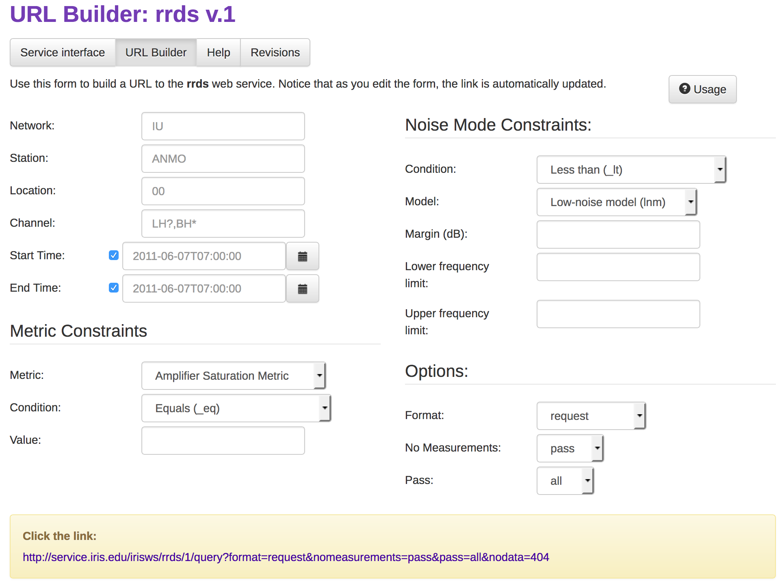
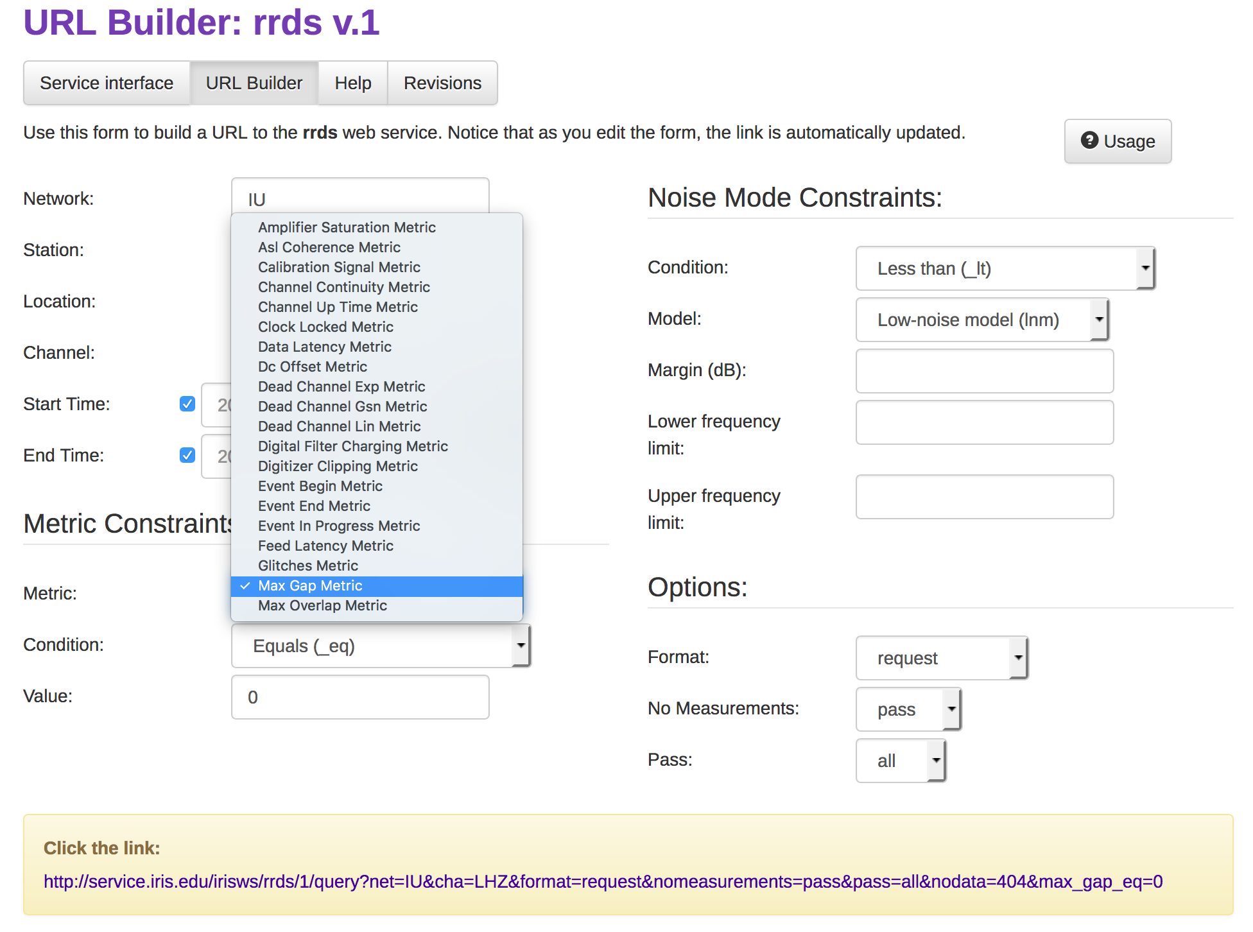
URL Builder
Notes:
URL builder is particularly useful for this service as some iteration on parameters may be needed to determine the best set of values for a given study.
Mostly for learning and interating on a single metric.

Slide 9
RRDS - take home messages
A web service to build requests and filter based on
traditional criteria and
data quality measurements
Designed for easy use and integration into current data access tools and workflows
Will be integrated with DMC data request tools
Limited to use with data at the IRIS DMC, federated data filtering not possible

