Slide 1
xSEED
a next generation time series format

Slide 2
It was 1988... SEED 2.0 landed
dataless SEED
(ASCII)
Governed by Working Group 2 of the International Federation of Digital Seismograph Networks (FDSN)
Format for time series and comprehensive related metadata
Primary purpose is exchange and archiving
Extensible, kinda, sorta
Very successful!
StationXML
(full)
SEED volume
mini-SEED
(binary + ASCII)
???

Slide 3
Limitations of miniSEED 2.4
Fixed width identifiers (aka codes), with a single naming scheme
Many awkward-isms (e.g. record length) or retroactive confirmation (byte order)
Bizarrely complex time presentation:
Base + 2 x microseconds + correction + corr flag (+ leap second)
Custom, blockette structure
Fixed record lengths, blessing and curse

Slide 4
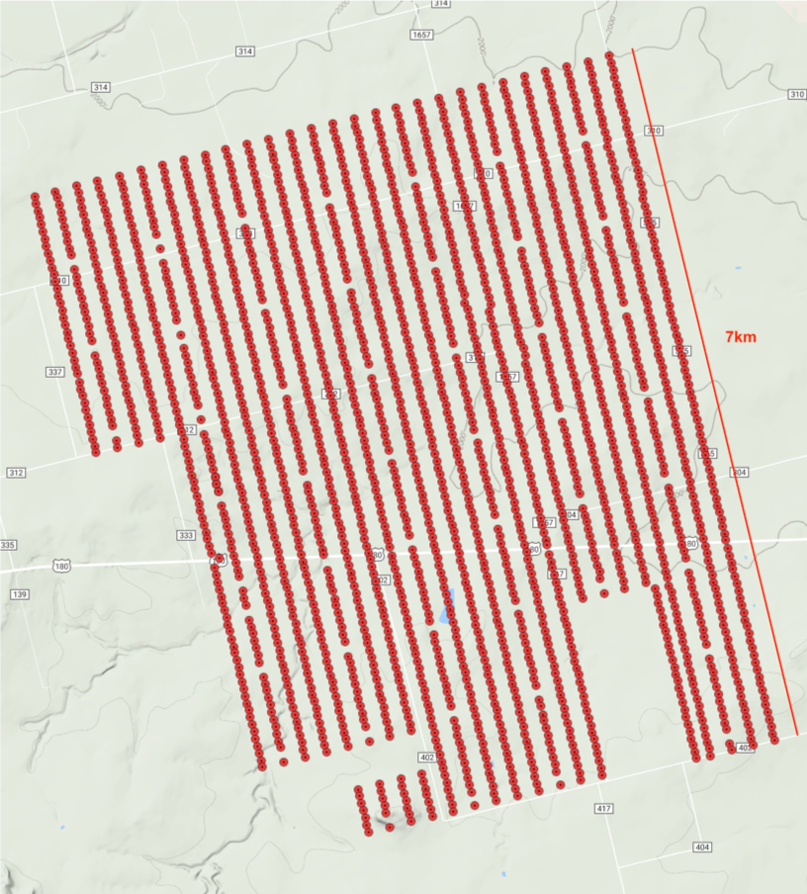
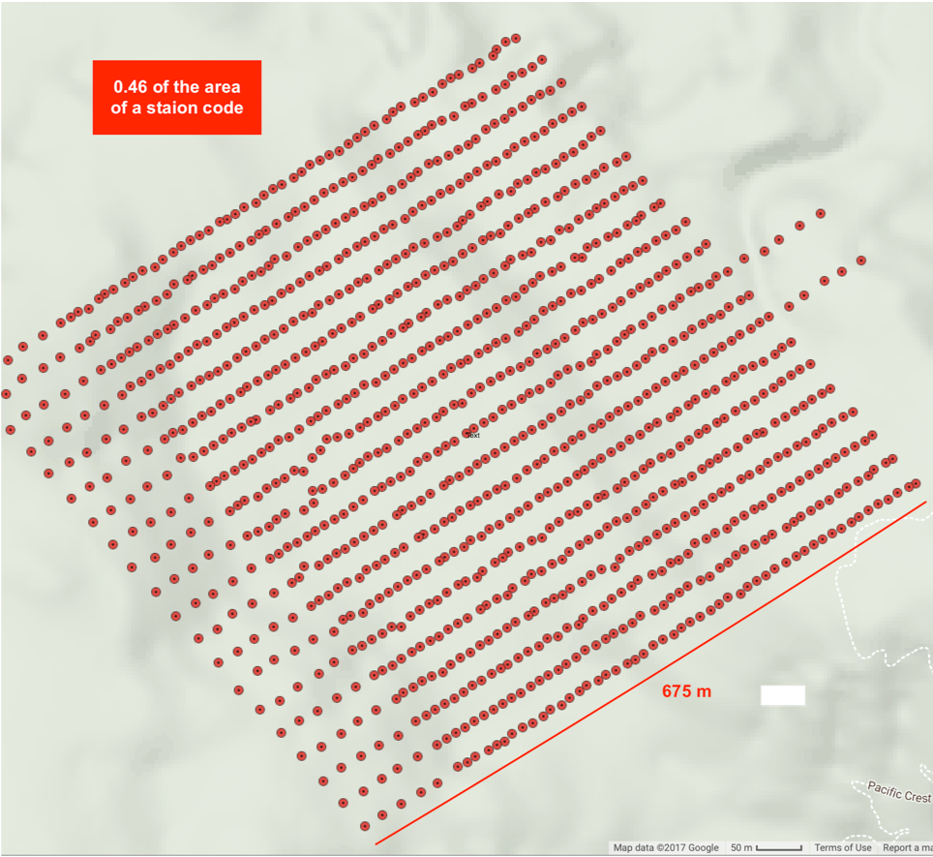
Identifiers need expansion
Sweetwater: 2,268 sensors in a 7x km² area
Sagebrush Flats: 1,108 sensors in a 0.46 km² area
Not ready for Large-N
Temporary network codes are a kludge, painful when reused
Out of instrument identifier codes
No sensible way to ID derived or synthetic data explicitly

Slide 5
FDSN steps towards a next generation
time series format
Mid-2016: IRIS spearheads a process to develop a next generation miniSEED, starting with a “strawman” as a nucleus for discussion
Significant feedback received from a broad range of stakeholders
Early-2017: Focussed Working Group II meeting in Utrecht, the Netherlands
Mid-2017: FDSN General Assembly, report from focus meeting
Early-2018: Working Group II process re-initiated to collaboratively determine requirements for a next generation time series specification

Slide 6
Next Generation Format (NGF) requirements
Use a time series identifier that is a single, mandatory but flexible name-spaced string for the in the approximate form:
FDSN:<network>_<station>_<location>_<channel>
Parsable without resolving with heuristic checks. Information not in an initial, fixed header should be encoded in a standardized format
Data loss is acceptable, a few cases of very rarely or never used structures
Include a CRC for the whole record
Include a format version
Include a data publication version
Allow arbitrary extra headers in a key-value data structure
Allow variable record lengths
Nanosecond time resolution
Double precision sampling rate
Historical problem areas fixed, e.g. set fixed byte order, no unapplied time corr., etc.
Notes:
Next steps

Slide 7
Expansion of time series identifiers
Likely the most impactful change
Currently
Network code (2 characters)
Station code (5 characters)
Location code (2 characters)
Channel code (3 individual codes)
Expansion
8 characters
8 characters
8 characters
3, 4 or more characters
New sub-codes possible!
Note: recycling temporary network codes no longer needed

Slide 8
New URI form of combined identifier
Form of the new identifier
XFDSN:<network>_<station>_<location>_<band>_<source>_<position>
where channel has been subdivided into band, source and position
Example identifiers:
XFDSN:IU_COLA_00_B_H_Z (network=IU, station=COLA, location=00 and channel=B_H_Z)
XFDSN:NL_HGN__L_H_Z (network=NL, station=HGN, location is empty and channel=L_H_Z)
FDSN identifiers and “extended” FDSN can be mapped, as long as they fit

Slide 9
IRIS’s xSEED specification: resources
A foundation for the new format:
xSEED validator
xSEED reference data set
libmseed - miniSEED library (reads old and new formats)
The goal: software that allows seamless use of both old and new formats
IRIS-maintained converters and other miniSEED software will be updated
ObsPy will be updated

Slide 10
What does this mean for you?
IRIS to propose xSEED to the FDSN in 2019,
seeking adoption in June
Key points:
The transition will start slowly
No change to the existing channel codes
No requirement to use new format for data centers or submitters
For users:
Get comfortable with expanded codes and new identifier
Update IRIS-maintained software
Port your own software

Slide 11
The IRIS xSEED specification
miniSEED 2.4
xSEED specification
Net, sta, loc, chan
Time
Sample count
Rate
etc.
Sample count
Time
Rate
etc.
Fixed header
Fixed header
B1000:
Length, encoding, WO
TSID
Time series ID
Blockettes (opt)
Extra headers
Extra headers
B100: “actual” rate
B###
Payload (data)
Payload (data)
Notes:
Not a radical design difference, making it at easy as possible to adapt older codes

