Slide 1
2018 IRIS Data Services Shortcourse
EAR-1724509 - SAGE
Tim Ahern, Manoch Bahavar, Rick Benson, Laura Keyson, Tim Ronan, chad trabant, bruce weertman
This material is based upon work supported by SAGE which is a major facility fully funded by the National Science Foundation.

Slide 2
introductions
Your name, organization and why you wanted to attend
Remote attendees
Staff introductions

Slide 3
Agenda
MUSTANG- Quality Assurance of IRIS Data Laura Keyson
Research Ready Data Sets (RRDS) Chad Trabant
Putting the MUSTANG metrics to work
Federation of Data Centers
Tim Ahern
DMC Federation of ph5 and seed archives
International Federation of Data Centers
T
Hardening Data Delivery by the Internet – ROVER Chad Trabant
New Products at the IRIS DMC (5) Manoch Bahavar
work on next generation data format xSEED (6) Chad Trabant
time series identifiers
tool modifications and what it means to you
Questions and Answer Period participants & DMC Staff

Slide 4
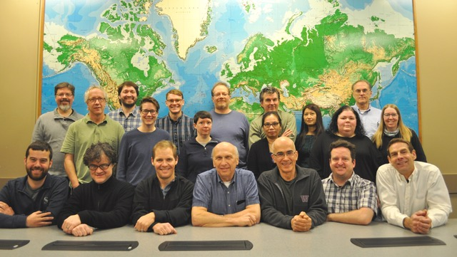
DMC Staff – more than meet your eyes today

