Slide 1
MUstang
Quality Assurance tools available through IRIS
This material is based upon work supported by SAGE which is a major facility fully funded by the National Science Foundation.
EAR-1724509 - SAGE

Slide 2
Outline
Introduction to the MUSTANG system
Web Services
Measurements, PSDs, PDFs, Noise modes, Spectrograms
Clients
Databrowser, Lasso, MUSTANGular
Quick mentions
ISPAQ, Network Reports

Slide 3
Some Terms – sometimes we talk without thinking about how confusing we sound
“MUSTANG”
Our system of Quality Assurance – generally refers to our database, code base, workflows, etc.
“Metric”
A way to describe the data, a characteristic of the data; the algorithm used
“Measurement”
The value generated for a given metric, for a given target, on a given time period
“SNCL”
The specific Network-Station-Location-Channel… may include a “Quality” code
“Target”
The SNCL, or a combination of SNCLs, that a metric run on, calculated for
“Client”
An interface between you and our metrics that manipulates the metrics to make them easier to digest by a human

Slide 4
The MUSTANG System – how it all runs
Automatically picks up:
Recently archived data
Updated metadata
Target-days that failed
Running in close-to-present form since 2015, adding channels up until Fall 2018

Slide 5
MUSTANG: Data Quality Metrics
Data Archive Metrics
real time data latency
real time feed latency
Data Continuity
percent available
channel up time
maximum gap length
minimum gap length
maximum overlap length
number of gaps
number of overlaps
Simple Data Statistics
maximum sample value
minimum sample value
median sample value
mean sample value
sample rms variance
signal-to-noise ratio
Noise Analysis
Power Spectral Density
Probability Density Function
percent above high noise model
percent below low noise model
Signal Anomalies
cross talk
DC offset change
dead channel indicator
maximum STA/LTA
number of spikes
pressure effects
Metadata Checks
orientation check
polarity check
transfer function
State of Health Flag Counts
amplifier saturation
calibration signal
clock locked
digital filter charging
digitizer clipping
event begin
event end
event in progress
glitches
missing padded data
spikes
suspect time tag
telemetry sync error
timing correction
timing quality

Slide 6
MUSTANG: Channels
BG EG HG LG SG UG VG
BH CH DH EH FH GH HH LH
MH SH UH VH
BL CL DL EL GL HL LL
ML SL UL VL
VM
BN CN DN EN FN GN HN LN
MN SN VN
BP DP EP GP HP LP MP SP
BX HX
BY
53 channel groups total including:
broadband
additional sample rates
long period and mid period
short period
strong motion
geophone
mass channels
We now run on all seismic channels that we have in our archive
*Not all metrics run on all channels*

Slide 7
Web services

Slide 8
Web Services - The way that you access our vast database of metrics
service.iris.edu service.iris.edu/mustang/
service interface | summary
measurements | The main MUSTANG web service returning measurements for data quality metrics
noise-psd | Returns Power Spectral Density estimates: text, XML, and plots
noise-pdf | Returns Probability Density Functions: text, XML, and plots
noise-pdf-browser | Returns browseable views of PDF plots
noise-mode-timeseries | Returns daily PDF Modes and Mode Timeline Plots
*noise-spectrogram | Returns Spectrogram plots

Slide 9
MUSTANG: Web Services
service interface | base URL
measurements | http://service.iris.edu/mustang/measurements/1
noise-psd | http://service.iris.edu/mustang/noise-psd/1
noise-pdf | http://service.iris.edu/mustang/noise-pdf/1
noise-pdf-browser | http://service.iris.edu/mustang/noise-pdf-browser/1
noise-mode-timeseries | http://service.iris.edu/mustang/noise-mode-timeseries/1
noise-spectrogram | http://service.iris.edu/mustang/noise-spectrogram/1

Slide 10
Measurements – The majority of MUSTANG metrics
service interface
measurements
noise-psd
noise-pdf
noise-pdf-browser
noise-mode-timeseries
noise-spectrogram
A metric is the algorithm, a measurement is the value
Most metrics are calculated on each channel at a station, the “target”
Some are on pairs of channels, locations, or stations
Most metrics are calculated daily, 00:00:00-23:59:59
Some are shorter and could have more than one per day
Most metrics are pre-computed, but…
NEW: *The new ts_ metrics are computed on the fly*
Provides daily values OR total values for the entire time range
ts_num_gaps, ts_percent_availability, ts_gap_length, ts_max_gap, ts_continuity
http://service.iris.edu/mustang/measurements/1

Slide 11
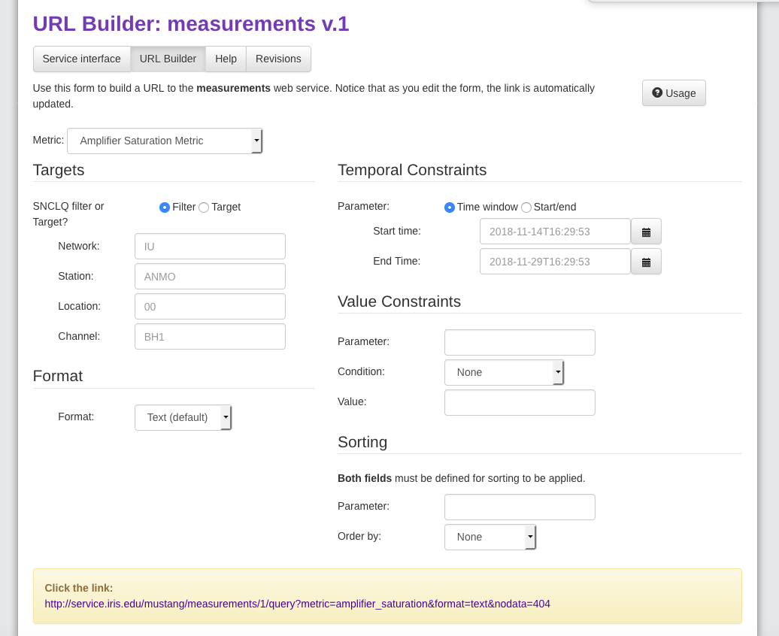
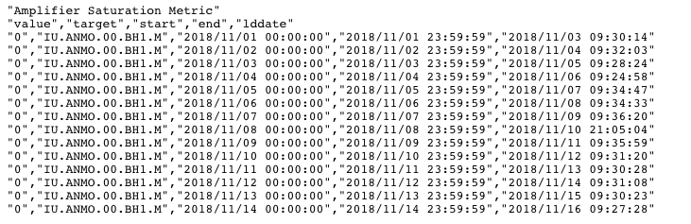
Measurements
service interface
measurements
noise-psd
noise-pdf
noise-pdf-browser
noise-mode-timeseries
noise-spectrogram
URL Builder guides through the structure of the query
Can produce more complicated queries than builder does
Value
Target
Start
End
Load Date
http://service.iris.edu/mustang/measurements/1

Slide 12
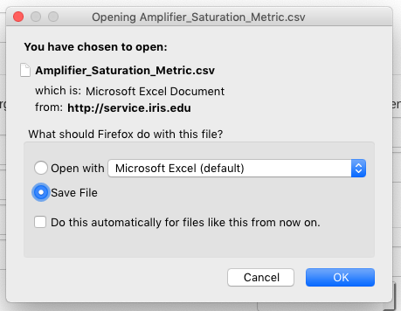
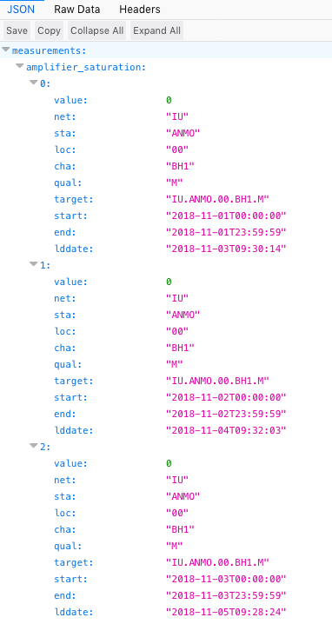
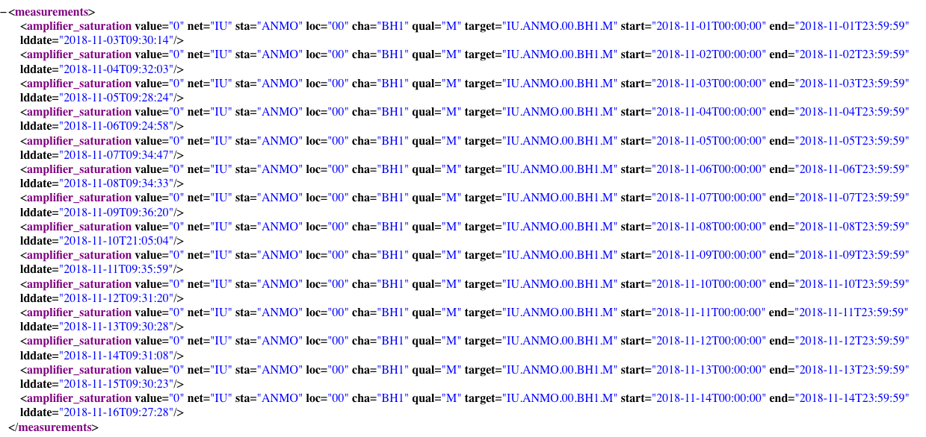
Measurements
CSV
service interface
measurements
noise-psd
noise-pdf
noise-pdf-browser
noise-mode-timeseries
noise-spectrogram
Text
JSON
XML
http://service.iris.edu/mustang/measurements/1

Slide 13
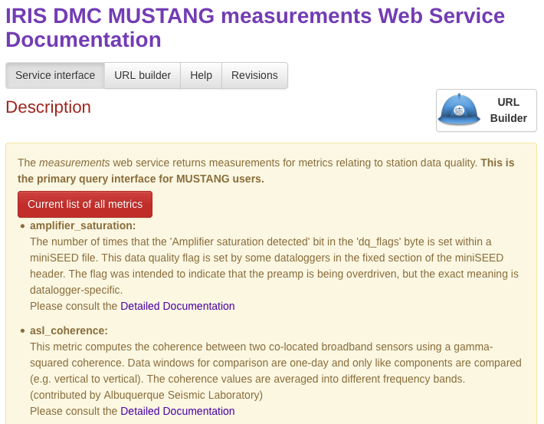
Measurements
service interface
measurements
noise-psd
noise-pdf
noise-pdf-browser
noise-mode-timeseries
noise-spectrogram
http://service.iris.edu/mustang/measurements/1

Slide 14
Noise Profiles – PSDs and PDFs
service interface
measurements
noise-psd
noise-pdf
noise-pdf-browser
noise-mode-timeseries
noise-spectrogram
PSDs are a computation of how much energy there is at different frequencies
Is there a lot of high frequency signal? Low frequency?
Computed on hour segments, with half hour overlap
Each colored line is a single, hour-long PSD
PDFs take many PSDs and create a histogram of how many cross into each frequency-power bin
What’s the probability that the SNCL will have a given power for a given frequency
Color indicates probability
http://service.iris.edu/mustang/noise-psd/1
http://service.iris.edu/mustang/noise-pdf/1

Slide 15
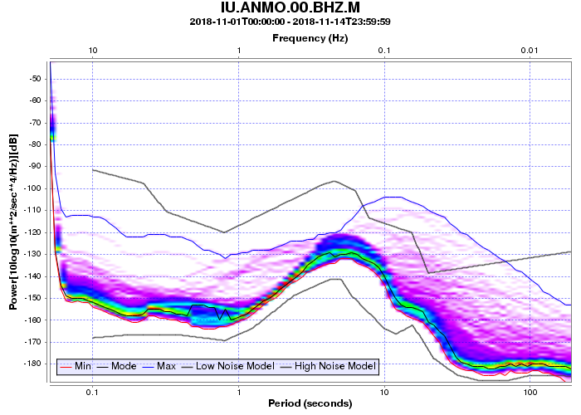
Noise Profiles – PSDs and PDFs
PSD
PDF
service interface
measurements
noise-psd
noise-pdf
noise-pdf-browser
noise-mode-timeseries
noise-spectrogram
Mode
Formats:
Text – CSV
XML
Plot (PNG)
Formats:
Text – CSV
XML
Plot (PNG)
*NEW: Can output noise model*
Algorithm described in:
McNamara, D.E. and R.P. Buland, Ambient Noise Levels in the Continental United States, Bull. Seism. Soc. Am., 94, 4, 1517-1527, 2004.

Slide 16
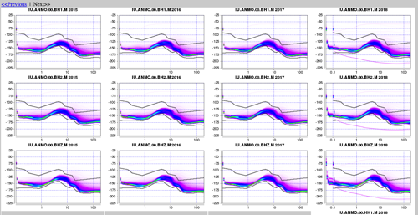
PDF Browser
service interface
measurements
noise-psd
noise-pdf
noise-pdf-browser
noise-mode-timeseries
noise-spectrogram
The PDF browser allows you to look at many PDFs at once
Breakout view: through time for a given target
Gallery view: across a network for a given time
Useful for scanning large amount of data at once
Quickly drill down to find when the noise profile changes
*Note: no URL builder for this one yet, but examples in the Service Interface or Help tabs are good jumping off points
http://service.iris.edu/mustang/noise-pdf-browser/1

Slide 17
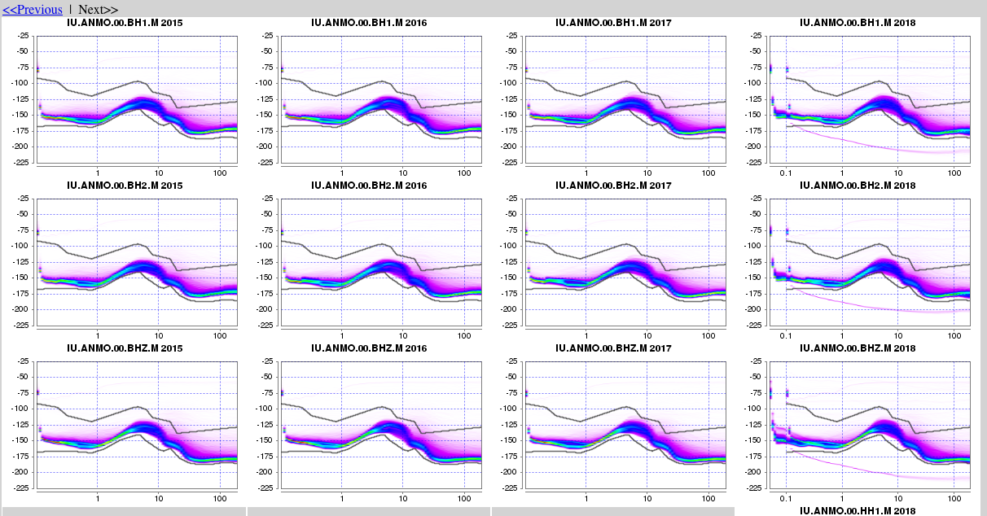
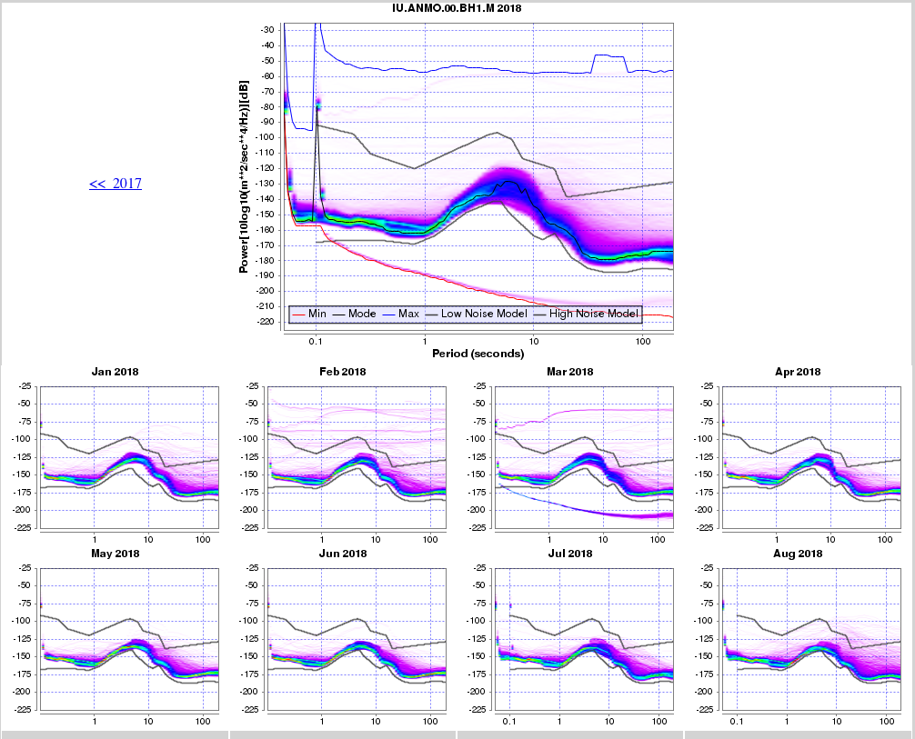
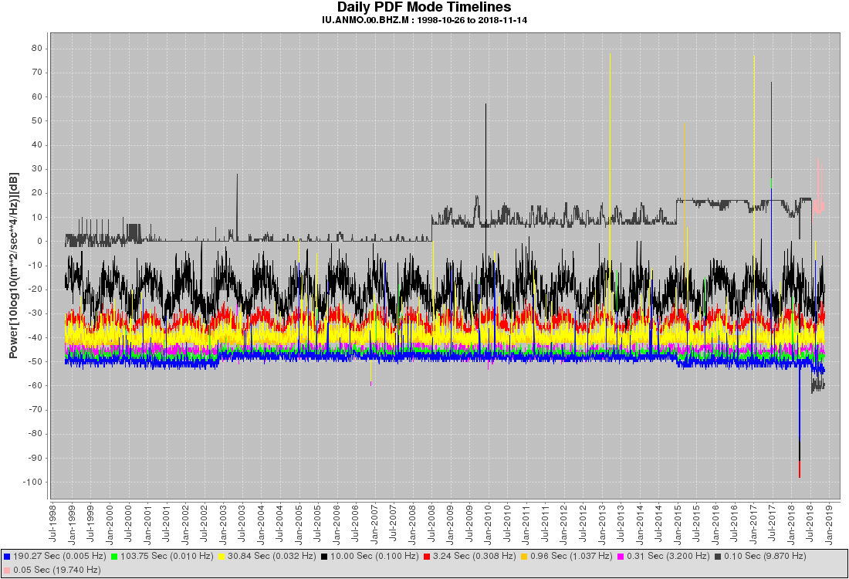
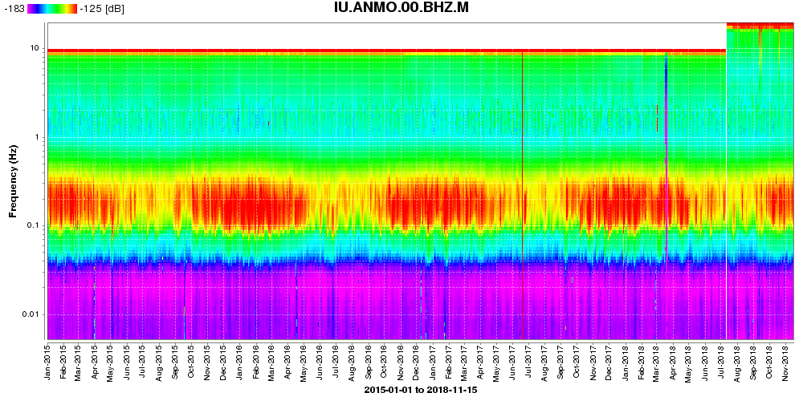
Noise Profiles Over Time
service interface
measurements
noise-psd
noise-pdf
noise-pdf-browser
noise-mode-timeseries
noise-spectrogram
Gallery View
Breakout view
PDF Browser:
Daily mode power at given frequencies
Power, or difference from noise model
Noise Mode Timeseries:
Daily mode powers
Power, or difference from noise model, or from self
*NEW*
Spectrogram:

Slide 18
PDF Browser – quickly scan many PDFs
service interface
measurements
noise-psd
noise-pdf
noise-pdf-browser
noise-mode-timeseries
noise-spectrogram
Gallery View
Breakout View
http://service.iris.edu/mustang/noise-pdf-browser/1

Slide 19
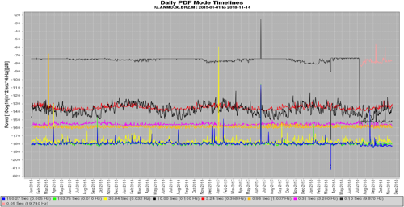
Noise-Mode-Timeseries
service interface
measurements
noise-psd
noise-pdf
noise-pdf-browser
noise-mode-timeseries
noise-spectrogram
Purpose: See how the noise signal changes over time
Good for seeing changes over long time spans
How: Given a certain frequency, calculates the mode power (over a day) at that frequency. The frequencies can be hand picked.
Changes:
Differencing from a provided noise model, such as from noise-pdf service
http://service.iris.edu/mustang/noise-mode-timeseries/1

Slide 20
Noise-Mode-Timeseries
20 years of values:
service interface
measurements
noise-psd
noise-pdf
noise-pdf-browser
noise-mode-timeseries
noise-spectrogram
Given a certain frequency, plots the mode power (per day) at that frequency. The frequencies can be hand picked.
NEW: Differencing from a provided noise model,
such as from noise-pdf service
http://service.iris.edu/mustang/noise-mode-timeseries/1

Slide 21
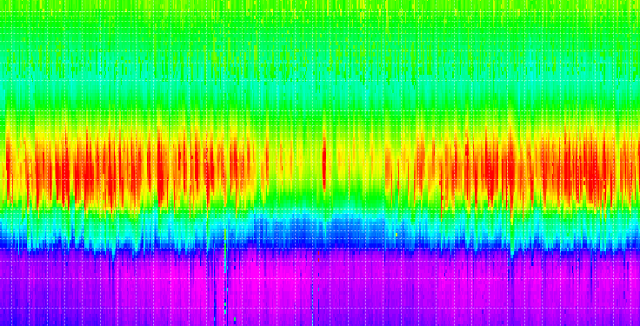
Spectrogram
service interface
measurements
noise-psd
noise-pdf
noise-pdf-browser
noise-mode-timeseries
noise-spectrogram
Spectrograms are like PDFs, with an added dimension of time
Can track changes in noise profile with time
Uses the daily mode power at various frequencies
The service has many plot options, so the plots are very customizable
Default colors are based on 5th and 95th percentile values
Can difference from a noise model, or from itself
The only format type supported is “plot”
http://service.iris.edu/mustang/noise-spectrogram/1

Slide 22
Spectrogram – A brand new service
service interface
measurements
noise-psd
noise-pdf
noise-pdf-browser
noise-mode-timeseries
noise-spectrogram
Uses the daily mode power at various frequencies
Difference from noise model or from self
Highly customizable: axis directions, plot dimensions, etc
http://service.iris.edu/mustang/noise-spectrogram/1

Slide 23
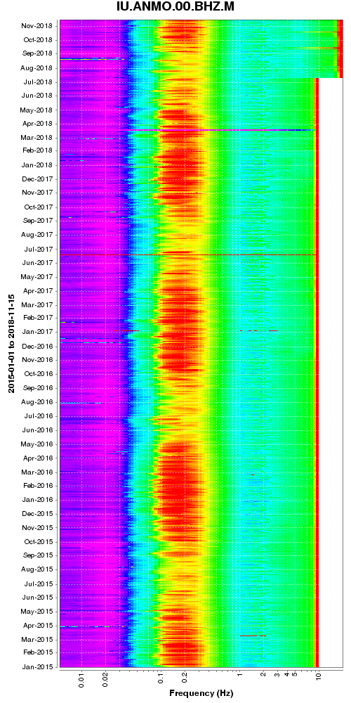
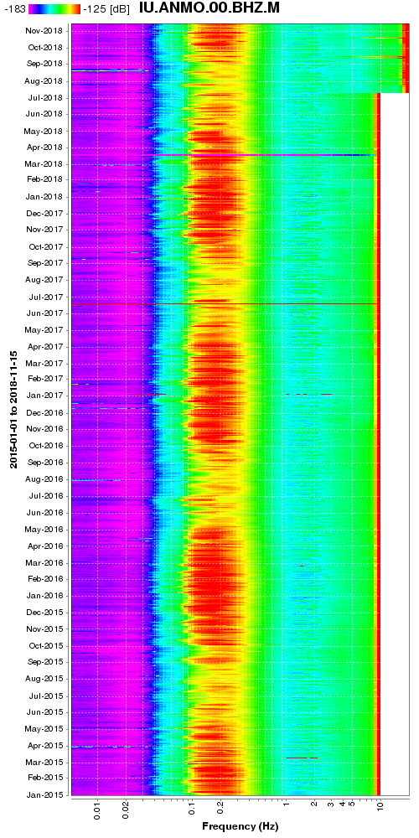
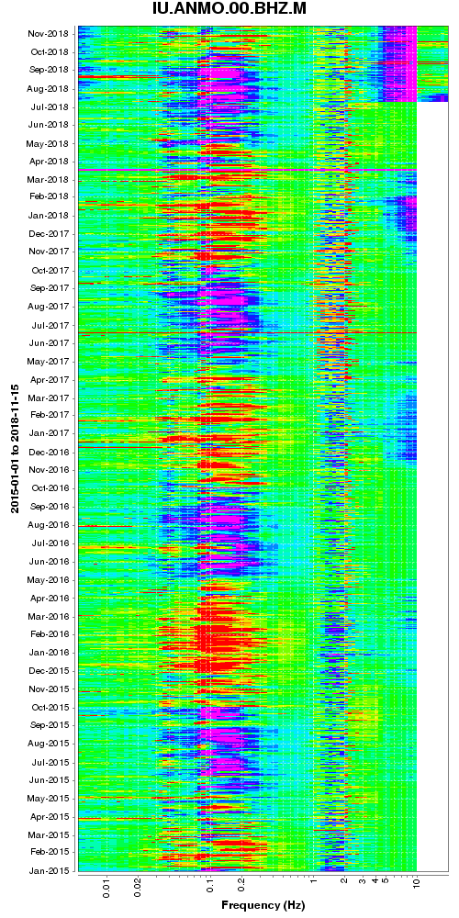
Spectrogram – A brand new service
service interface
measurements
noise-psd
noise-pdf
noise-pdf-browser
noise-mode-timeseries
noise-spectrogram
A taste of some of the options:
Switch the axes
Reverse axes
Remove or change orientation of power scale
Difference from itself or the new high and/or low power models
There are many more options to explore:
fonts, labels, powerscales, ranges, etc
http://service.iris.edu/mustang/noise-spectrogram/1

Slide 24
Clients

Slide 25
Clients – useful ways to track metrics
These are tools that grab the metrics through web services, manipulate and present them in some way to make it more useful to the user.
client | summary
Databrowser | Plots metrics timeseries, boxplots, PDFs, seismic traces
LASSO | Control panel view of stations ranked by combinations of metrics – aimed toward Network Operators, not covering here
MUSTANGular | Map view of MUSTANG metrics
All of these can be found in a list near the bottom of the page at
http://services.iris.edu/mustang/

Slide 26
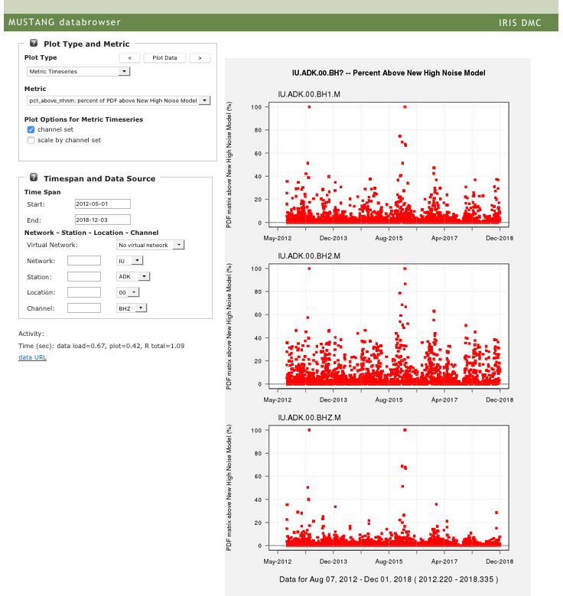
Databrowser – simple plots
client
Databrowser
LASSO
MUSTANGular
Creates simple plots of MUSTANG measurements
Timeseries: single metric or multiple metrics
Boxplots: network or station
Seismic Trace
PDF Plot
PDF Noise Mode Timeseries
Essentially all metrics are plot-able, allowing a quick way to track changes with time
Can group channel sets, scale by channel set
Works for virtual networks too
https://ds.iris.edu/mustang/databrowser/

Slide 27
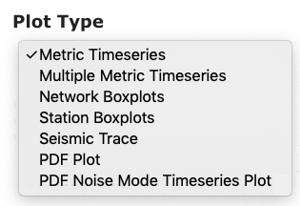
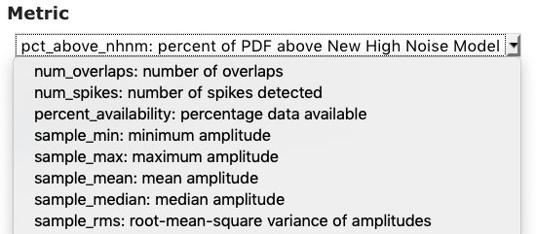
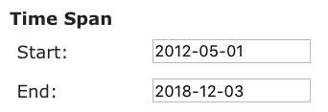
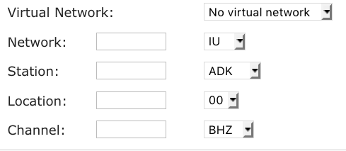
Databrowser
client
Databrowser
LASSO
MUSTANGular
https://ds.iris.edu/mustang/databrowser/

Slide 28
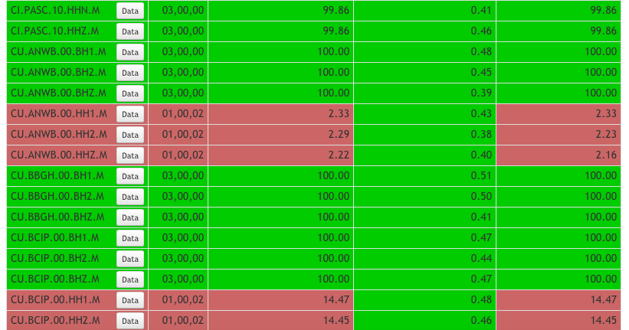
LASSO – a dashboard view
client
Databrowser
LASSO
MUSTANGular
Developed by ISTI and IRIS IS
Quickly glance at the health of the network
Ranks stations based on combinations of metrics
Preset or custom groupings
Snapshot in time, or median/mean over time
Two ranking methods: qualitative or quantitative
Can manipulate the definition of “good” or “bad”
Click on value to see history of that metric over time range
Pull up waveform plot of data for the time period
http://lasso.iris.edu/

Slide 29
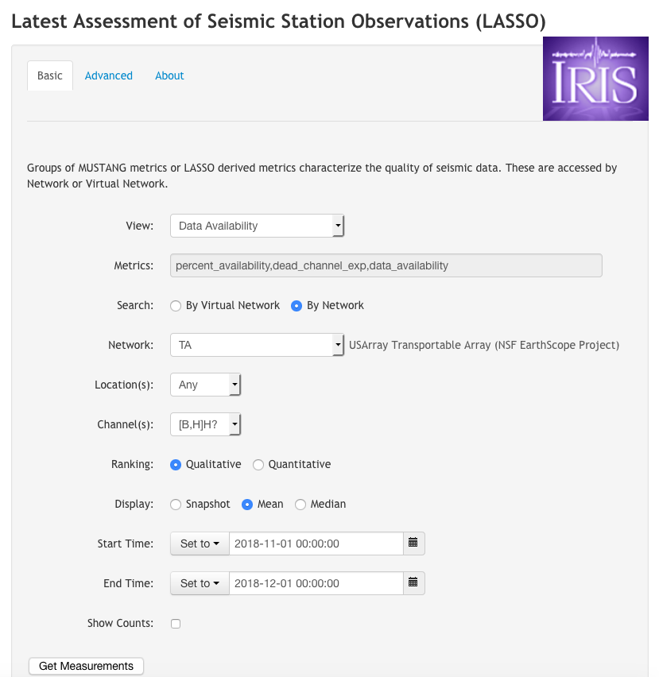
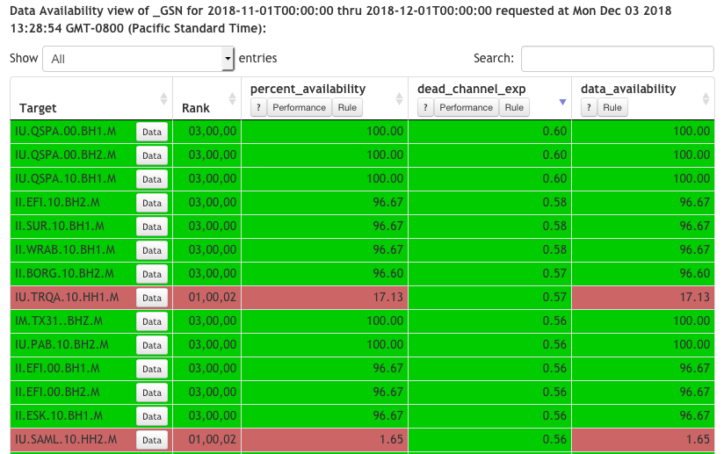
LASSO
client
Databrowser
LASSO
MUSTANGular
http://lasso.iris.edu/

Slide 30
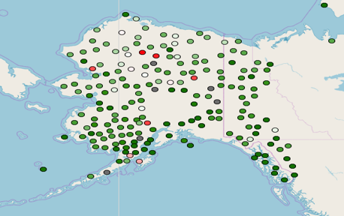
MUSTANGular – mapping metrics
client
Databrowser
LASSO
MUSTANGular
Developed by PNSN
View spatial patterns of MUSTANG metrics laid out on a map
Simple entry form
Allows for multiple metrics, easy to flip between them
Allows for multiple channels, ranked
Flexible binning, adjustable color maps
Choose from min/max/median/5th/95th for the time range
Click on station to see history of that metric over time range
http://ds.iris.edu/mustang/mustangular

Slide 31
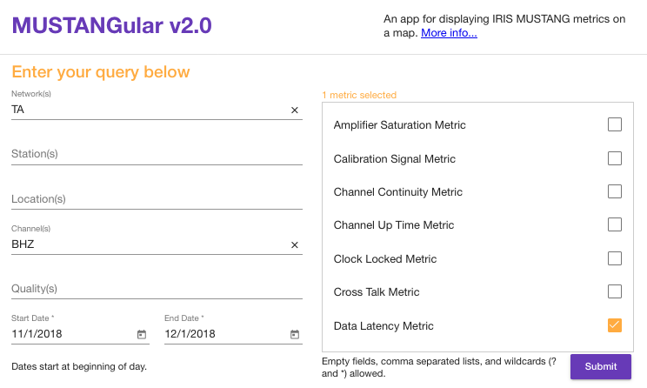
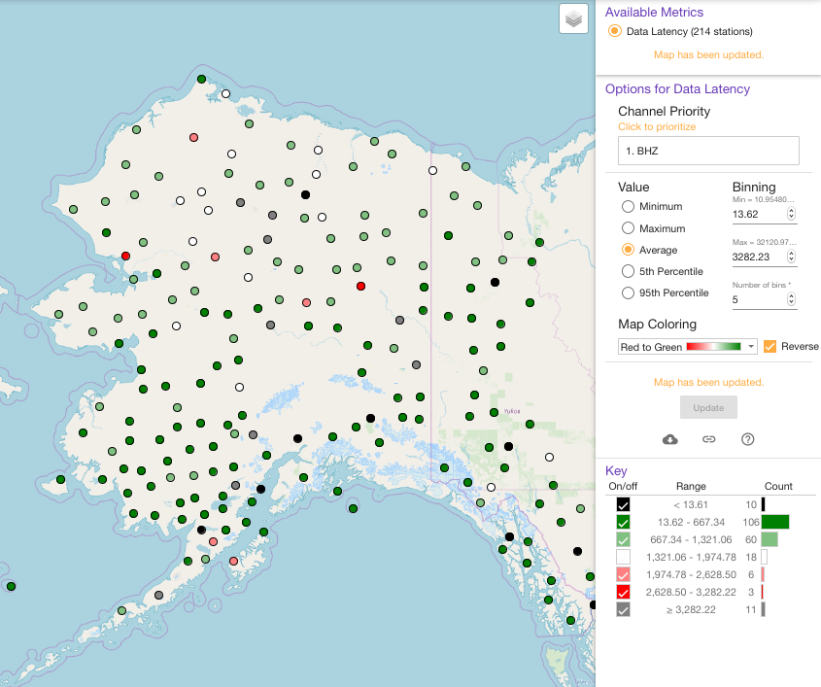
MUSTANGular – mapping metrics
client
Databrowser
LASSO
MUSTANGular
View spatial patterns of MUSTANG metrics laid out on a map
Simple entry form
Allows for multiple metrics, easy to flip between them
Allows for multiple channels, ranked
Flexible binning, adjustable color maps
Choose from min/max/median/5th/95th for the time range
Click on station to see history of that metric over time range
http://ds.iris.edu/mustang/mustangular

Slide 32
Honorable Mentions – not enough time to cover today
ISPAQ
Portable “MUSTANG” to calculate metrics on your own computer
Local files or from web services
Doesn’t have to be at the DMC
New: multi-day PDFs coming very soon
https://github.com/iris-edu/ispaq
Network Reports (QUARG)
For network operators
Metric combinations and threshold that catch typical issues
Utilities to help with QA
Could use improving for usability
Demos:
“MUSTANG” - Tuesday 10:00-11:30
“MUSTANG Clients” - Tuesday 14:00-15:30

