Slide 1
Station Installation Issues and Techniques IRIS Metadata Workshop August 13, 2010 Peter Davis Project IDA Scripps Institution of Oceanography University of California, San Diego

Slide 2
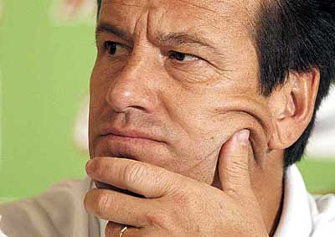
Topics to be addressed:
Nature of seismic noise
Site selection criteria
Installation techniques

Slide 3
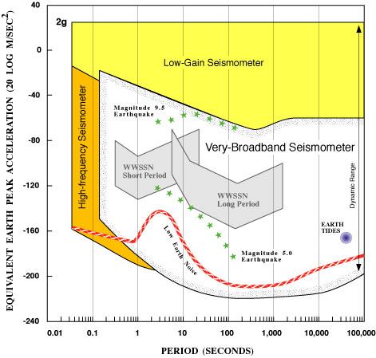
Bandwidth + Dynamic Range of modern sensors
M~9.2 Sumatra
M~0.5 local
Notes:
Example of goals
Recollection about 20 sps data
about 1 Tb/yr logged, 18 Tb/yr usage

Slide 4
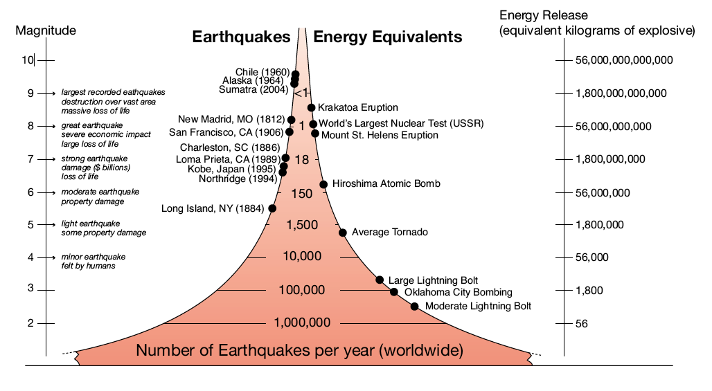
Size of Earthquakes

Slide 6
Ocean waves ->
Rayleigh waves

Slide 7
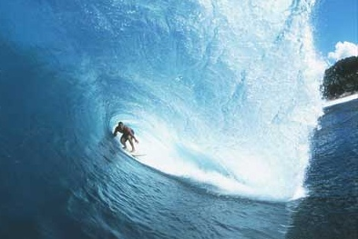
Ocean waves -> Rayleigh waves
(Hasselmann, 1963)
Dominant period – 20 seconds
Conversion at coast to Rayleigh-type motion

Slide 8
Ocean waves ->
P-waves

Slide 9
Opposing wave motion
(Longuet-Higgins, 1952):
Interaction of standing waves with ocean bottom
reflection from a coast
wake of a moving storm
center of a storm
(Haubrich and McCamy, 1969)

Slide 10
Temperature variations

Slide 11
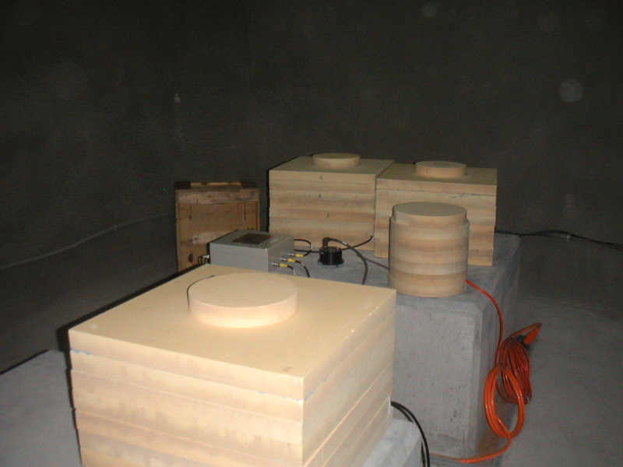
Temperature effects:
Beyond 250 seconds period, temperature becomes very important
Temperature dependence varies with the model of seismometer
Temperature changes of 1e⁻⁶ ºC are important
Foam thermal insulation at GSN station in the UAE

Slide 12
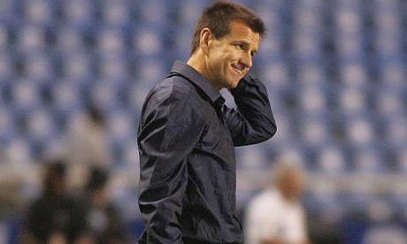
Effect of changes in barometric pressure:
buoyancy of the seismometer mass
Newtonian attraction of air mass

Slide 13
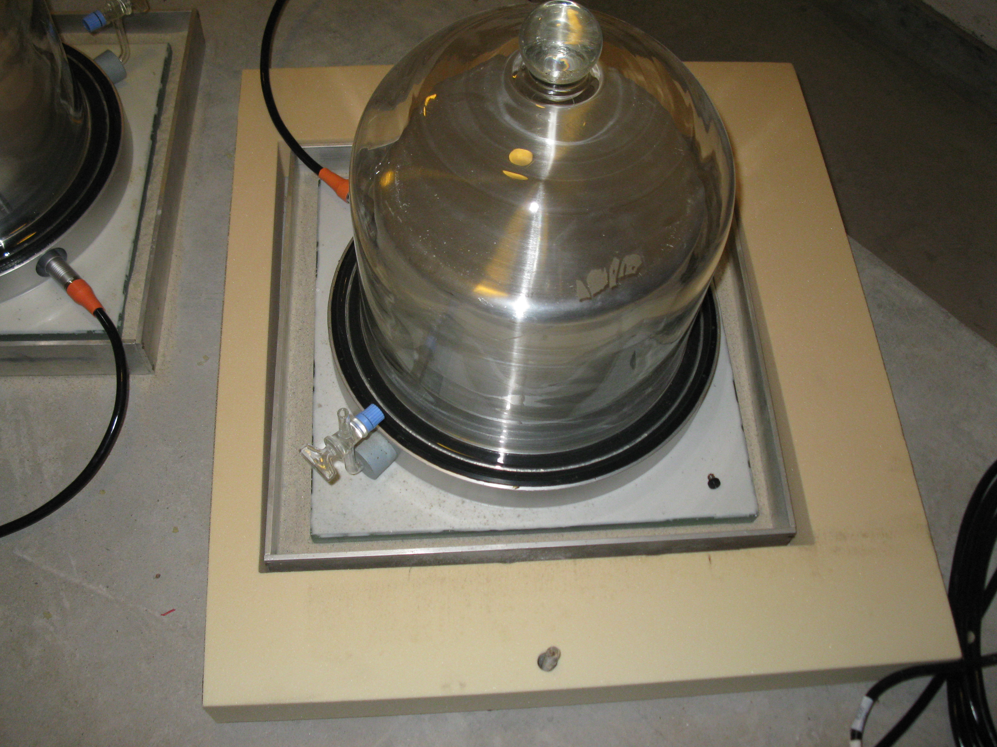
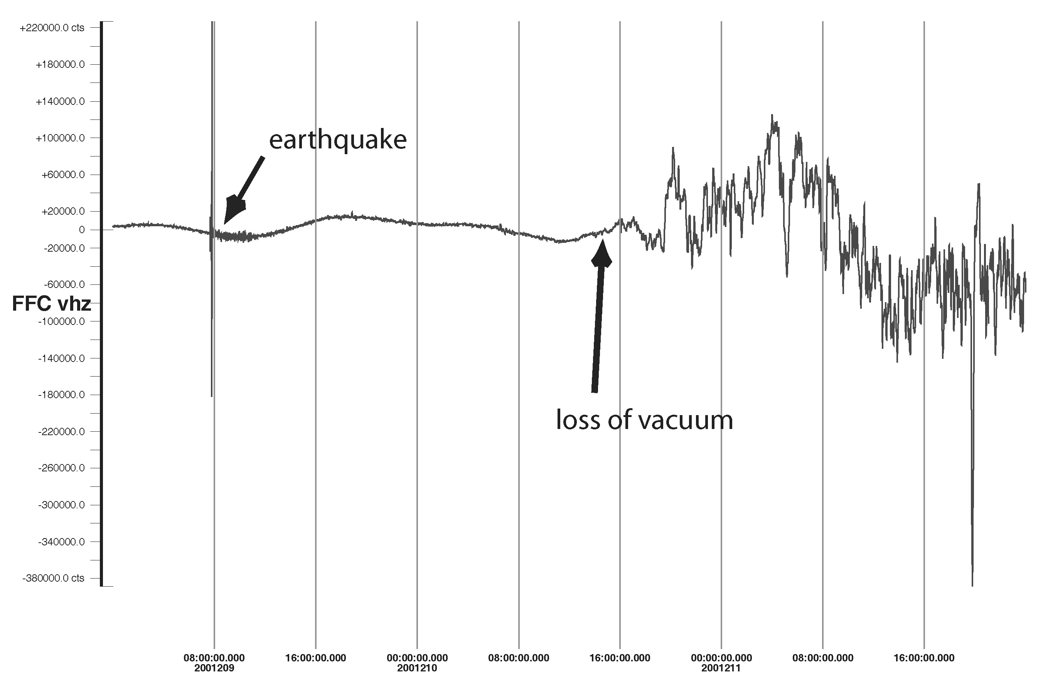
STS1 placed under vacuum at GSN station SUR
Vacuum lost!

Slide 14
Barometer data used to remove effect of air pressure changes in seismic data:
(Zuern and Widmer, 1995)

Slide 15
Effect of changes in barometric pressure:
buoyancy of the seismometer mass
Newtonian attraction of air mass
loading effect of air mass

Slide 16
Change of air pressure in a cavity
Symmetric Case

Slide 17
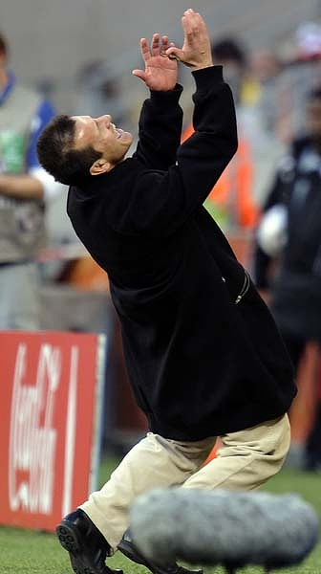
Change of air pressure in a cavity
Asymmetric Case

Slide 18
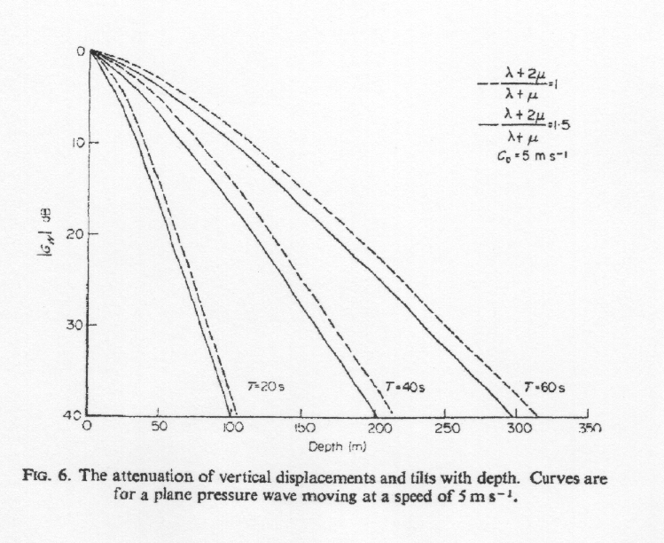
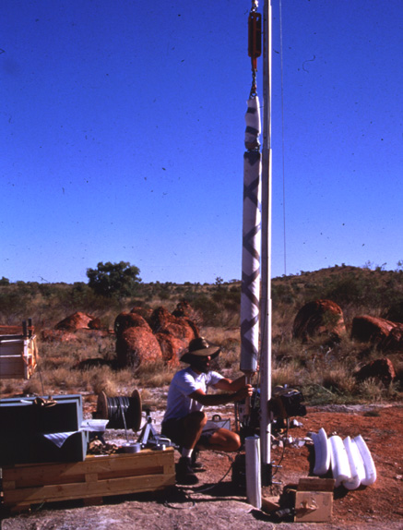
(Sorrels, 1971)
KS-54000 borehole seismometer installed at WRAB GSN station

Slide 19
Continuous free oscillations

Slide 20
(Nishida and Kobayashi, 1999)

Slide 21
Human-induced noise

Slide 22
Examples of human-induced noise:
Car and truck traffic
Repeating machinery (pumps, generators)

Slide 23
Frequency bands most effected by installation:

Slide 24
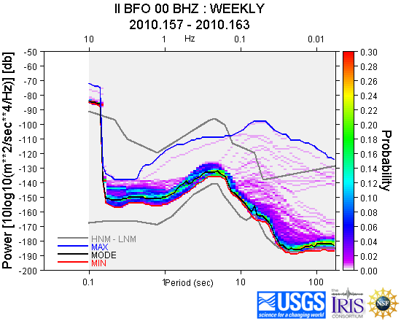
IRIS DMC provides tools to analyze data
http://www.iris.edu/servlet/quackquery/

Slide 25
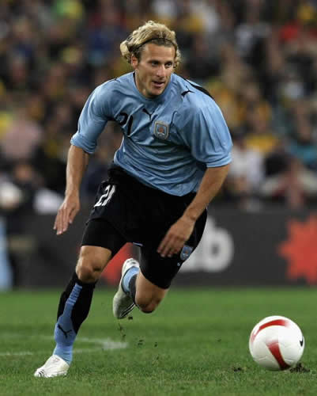
Goal of a good installation:
accurate recording of seismic signals
low background noise
ease of servicing
stability

Slide 26
Characteristics of a good site:
access to bedrock

Slide 27
Characteristics of a good site:
access to bedrock
far from human-induced noise sources

Slide 28
Characteristics of a good site:
access to bedrock
far from human-induced noise sources
clear of trees or towers

Slide 29
Characteristics of a good site:
access to bedrock
far from human-induced noise sources
clear of trees or towers
good drainage

Slide 30
Characteristics of a good site:
access to bedrock
far from human-induced noise sources
clear of trees or towers
good drainage
secure

Slide 31
Suggested clearances:
Hydroelectric turbines – 10 km
Frequent train traffic – 3 km
Irrigation pumping stations – 2 km
Large machinery – 1-2 km

Slide 32
Some examples of installation designs:
STS2 enclosure in a vault
High frequency sensor deployed at a temporary site
Broadband sensor vault
The Earthscope Transportable Array

Slide 33
STS2 installation design for the German Regional Seismographic Network (GRSN).
Courtesy E. Wielandt.

Slide 34
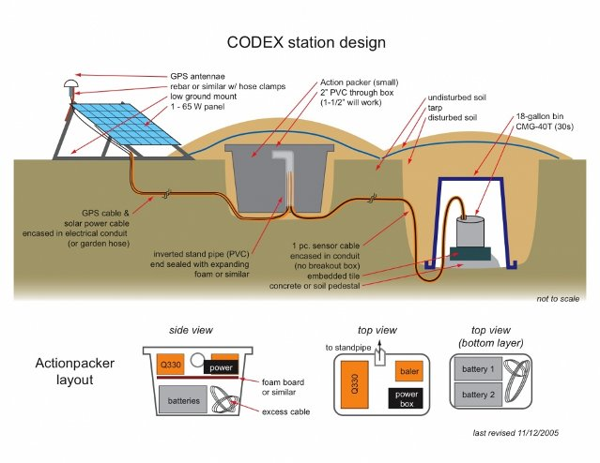
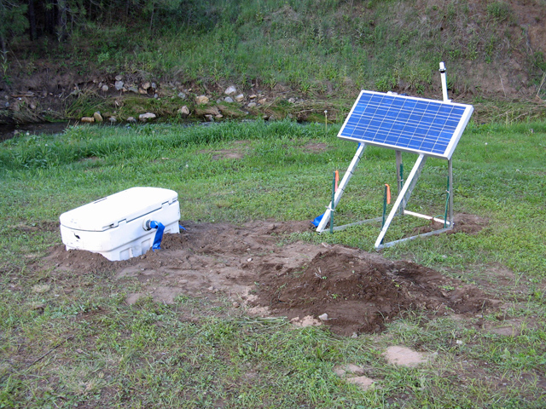
Codex design courtesy M. West.

Slide 35
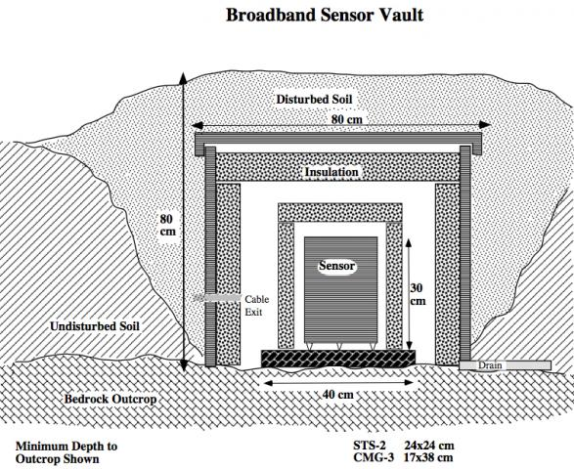
http://www.passcal.nmt.edu/content/broadband-vault-construction

Slide 36
Field Station Design
Transportable Array
Courtesy R. Busby

Slide 37
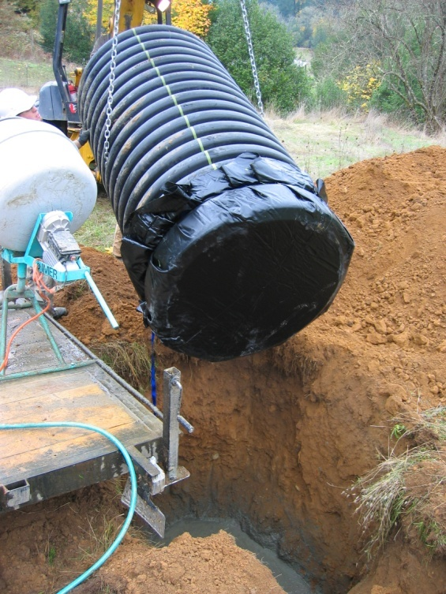
Transportable Array
Current method; custom trailer with water tank, room for cement bags, and onboard mixer
Have truck, will travel
42” dia. pipe set into 7’ deep pit with concrete on either side of rubber membrane
Flex conduit was replaced with straight sticks reducing field time significantly. Wires are pulled during construction phase
Using 3 vehicles, 1 trailers, 1 backhoe, and three people, it is feasible to construct 4 sites in 5 days

Slide 38
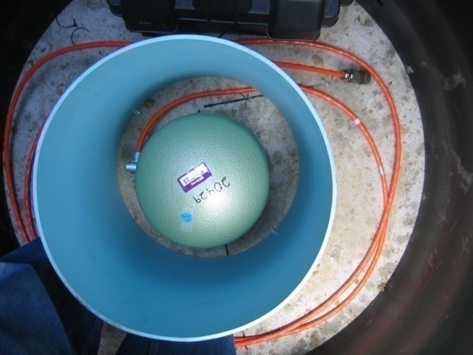
Transportable Array
Power distribution panel. CDMA Cell radio , Trace C12 charge controller, Phoenix terminal strip
Sensor alignment, leveling and insulation
Takes over an hour
VSAT located in barn with AC power
View into vault. Sensor encased in sand, Q330 and baler on shelf, foam insulation
Mast supports 80 W solar panel, GPS antenna, Cell omni directional antenna

Slide 39
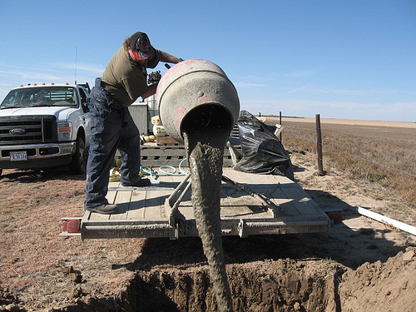
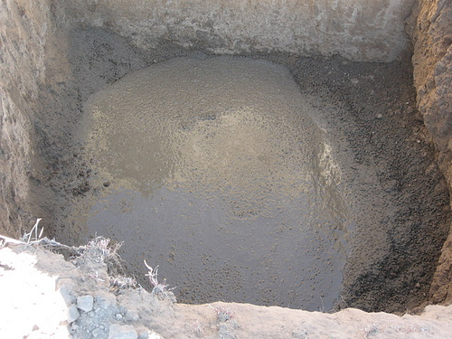
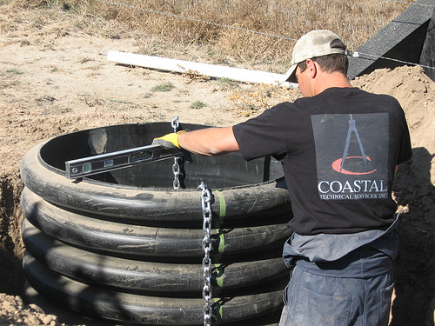
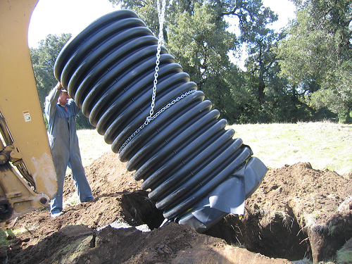
Transportable Array
Concrete pad, vault conduit installation

Slide 40
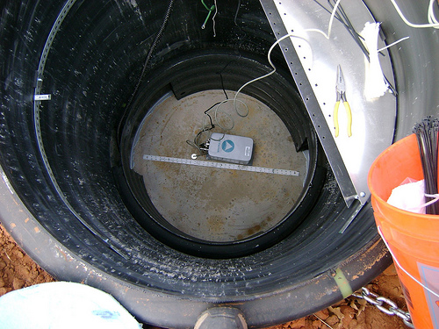
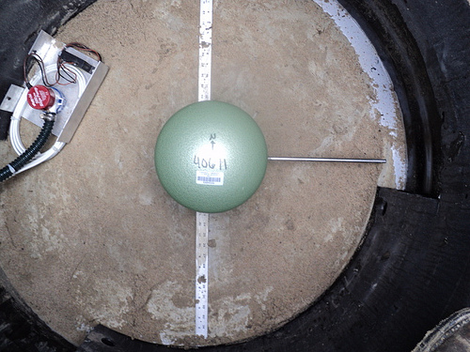
Transportable Array
Gyrocompass used to orient guide tape.
Alignment rod used orient sensor.

Slide 41
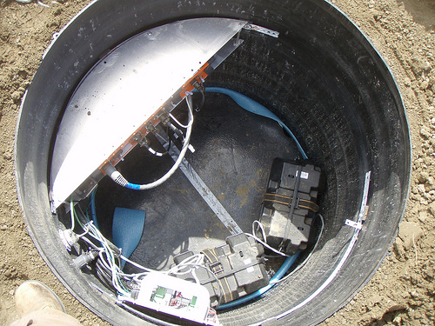
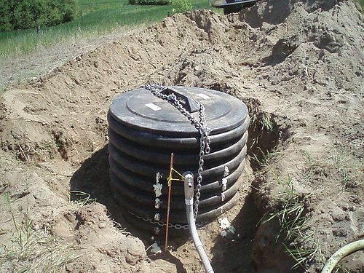
Transportable Array
Insulation separates sensor from system electronics
Cover provides security for equipment.

Slide 42
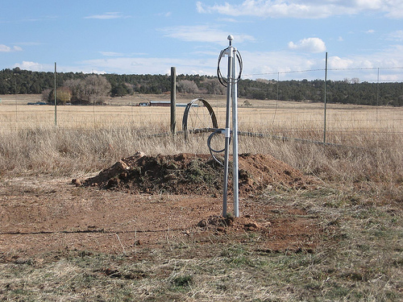
Transportable Array
Soil provides additional thermal insulation.

Slide 43
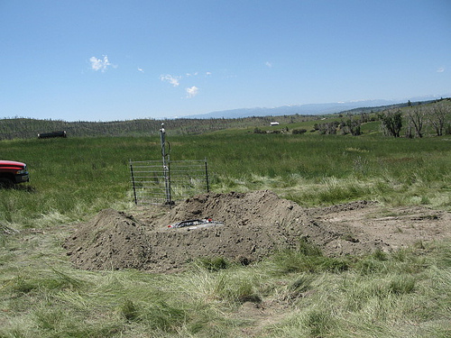
Transportable Array
This soil will be moved to cover the vault.

Slide 44
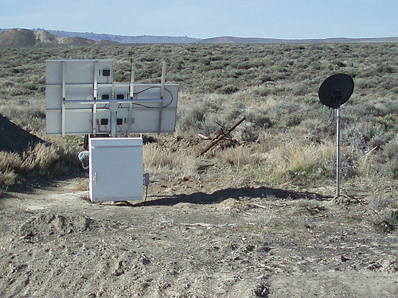
Transportable Array
The vault is completely covered. These are solar panels and a cell phone antenna for telemetry.

Slide 45
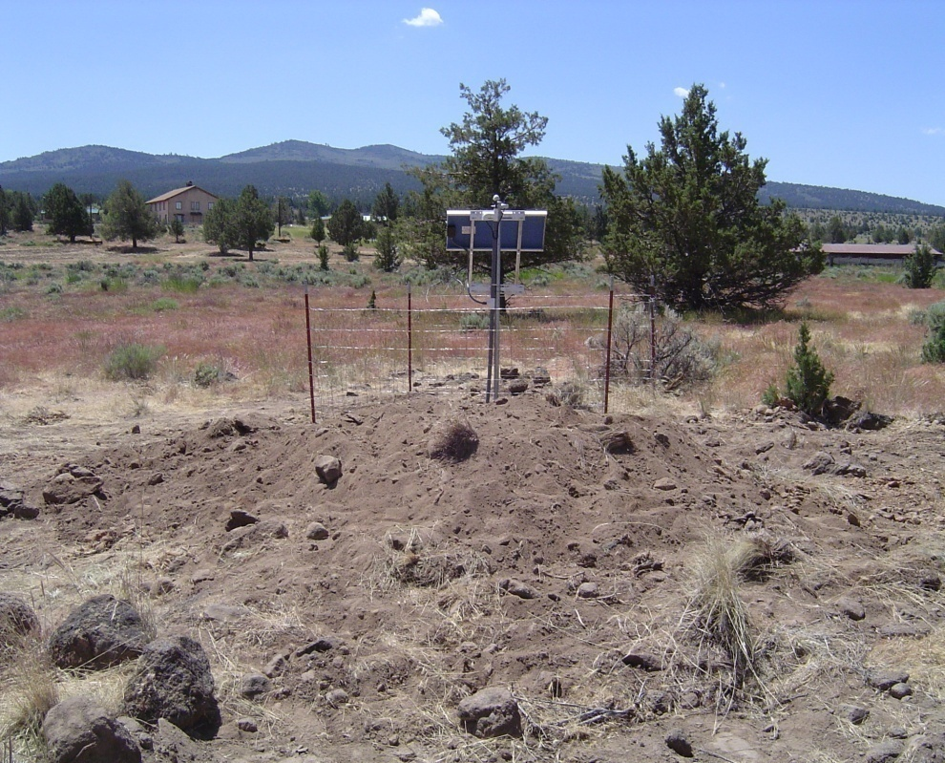
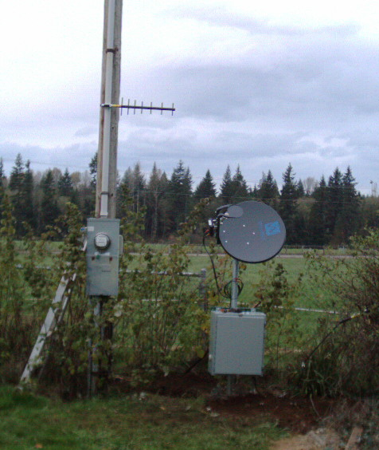
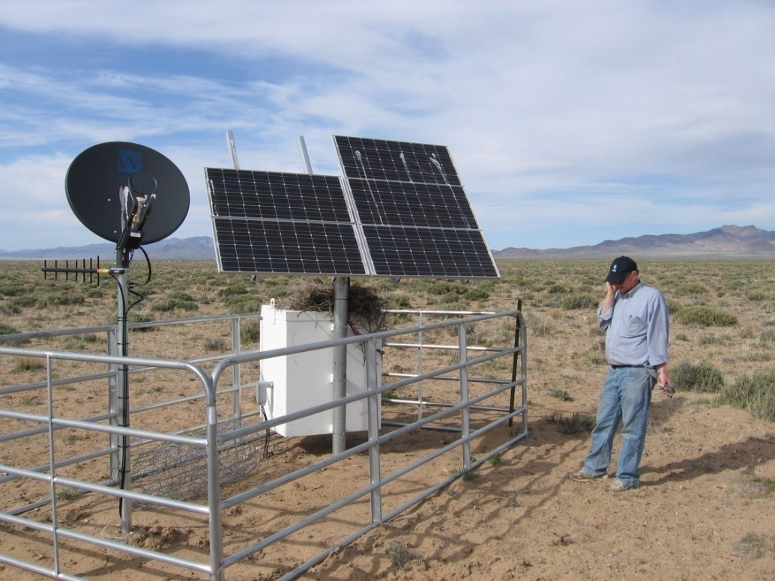
Modularity in Communications
Cellular Modem
AC VSAT or BB provider
Solar VSAT

Slide 46
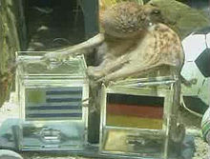
Eight things to remember:
place seismometer on bedrock
create stable temperatures
avoid human noise sources
avoid trees or towers
guard against flooding
consider security of installation
octopi cannot count

Slide 47
Thank you!

