Slide 1
Altay-Sayan Regional Seismic Network
Altai-Sayan Branch of Geophysical Survey Siberian Branch of the RAS

Slide 2
Geophysical Survey of Siberian Branch of the RAS
Three seismological branches with regional scale seismic networks:
Altay-Sayan Branch (35 sites)
Baikal Branch (25 sites)
Yakutia Branch (22 sites)
Buryatia Branch (local network at Selenga)
Laser Branch (laser deformography and digitizer development)

Slide 3
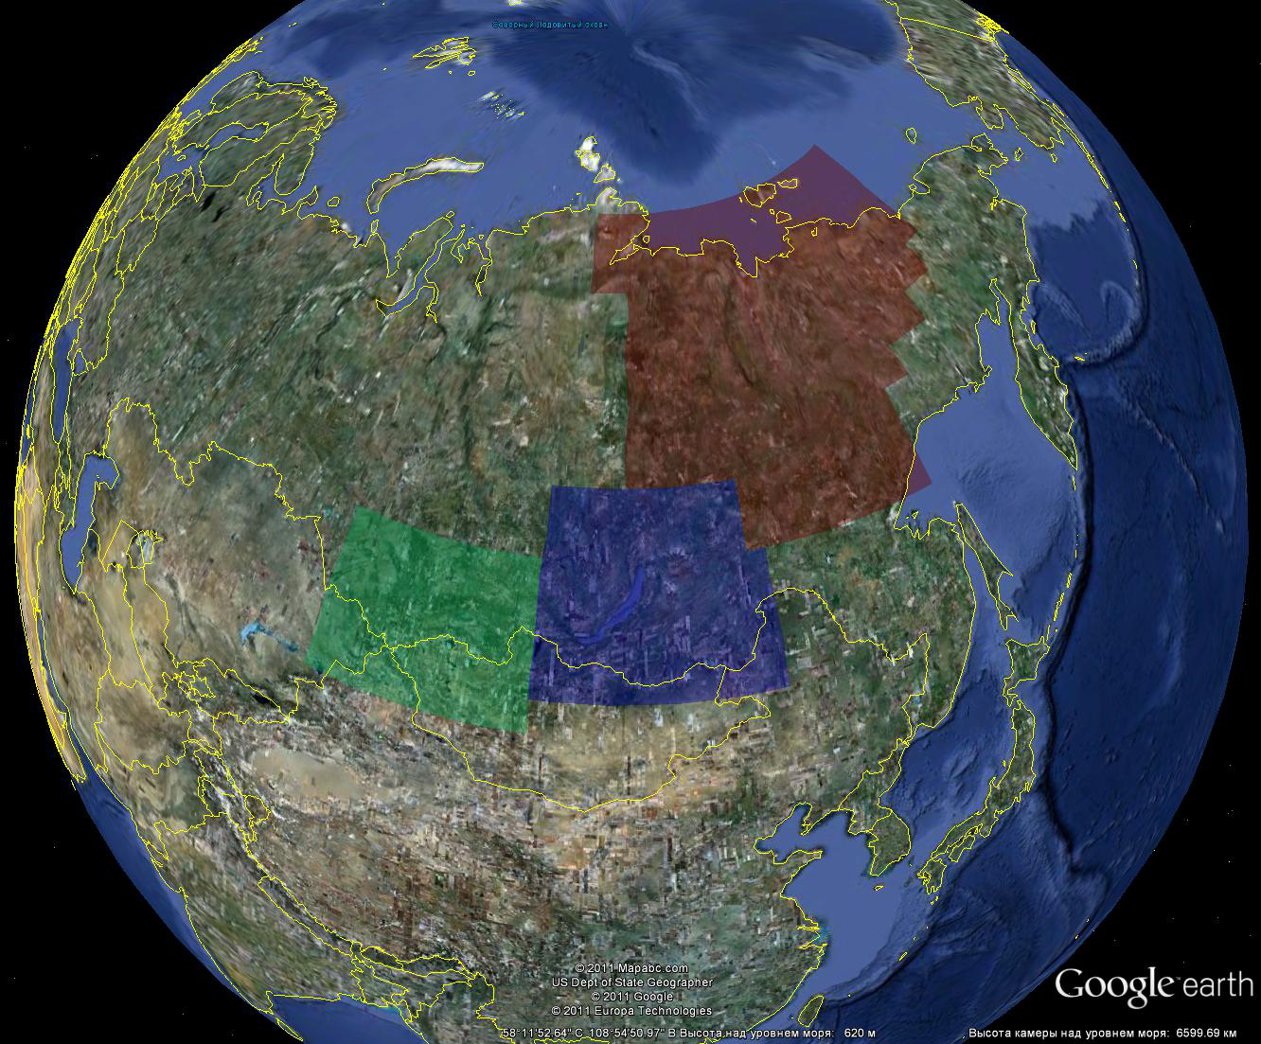

Slide 4
Altay-Sayan Branch of GS SB RAS
Operation of the permanent seismic network in Altay-Sayan mountain region
Observations with temporary networks at epicentral areas and areas with human induced seismicity
Seismic hazard assessment
Instrumental evaluation physical state of buildings and constructions
Deep seismic sounding
Vibro-source sounding and monitoring

Slide 5
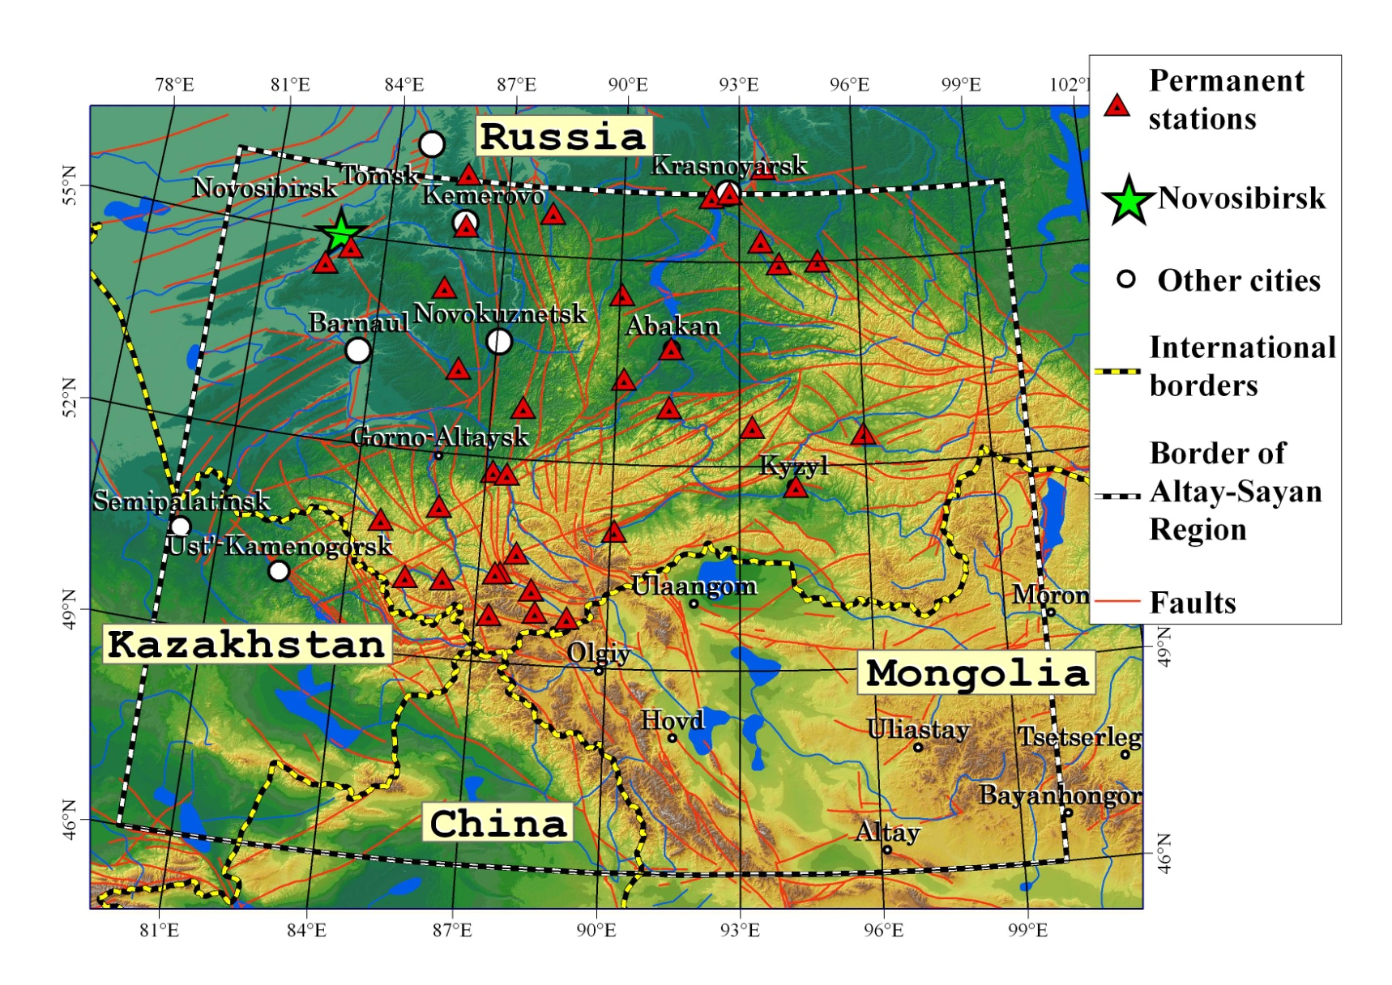
Altay-Sayan Regional Seismic Network

Slide 6
Altay-Sayan Regional Seismic Network
Observation started since 1963
Till 1998 all the recording is analog (12 s/sites)
At 2000 all the network equipped with digital instruments
At 2002 increased number of seismic sites at Mountain Altay
2006 digitizer software converted to seiscomp
Now we have 35 seismic sites.
New digitizer Baikal-8 based on ADC TI-ADS1282 with internal seedlink server

Slide 7
Nowadays state
35 seismic sites
Most of stations short period, some have 20sec SKD as low gain channels
5 broadband (CMG-3T or CMG-3ESP)
Most of seismic sites have telemetry and real-time data transfer
In the data center we keep all continuous data

Slide 8
Telemetry
VSAT links
ISDN links
GPRS links
Direct Cable Internet links

Slide 9
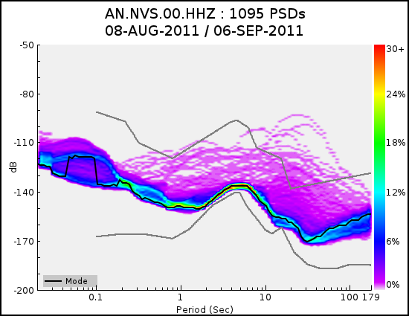
NVS HHZ, Guralp CMG-3ESPC

Slide 10
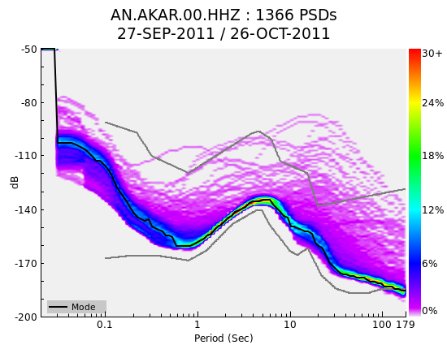
AKAR HHZ, Guralp CMG-3ESPC

Slide 11
Seismological Test Site yearly temporary seismic observations
Altay Seismological
Test Site

Slide 12
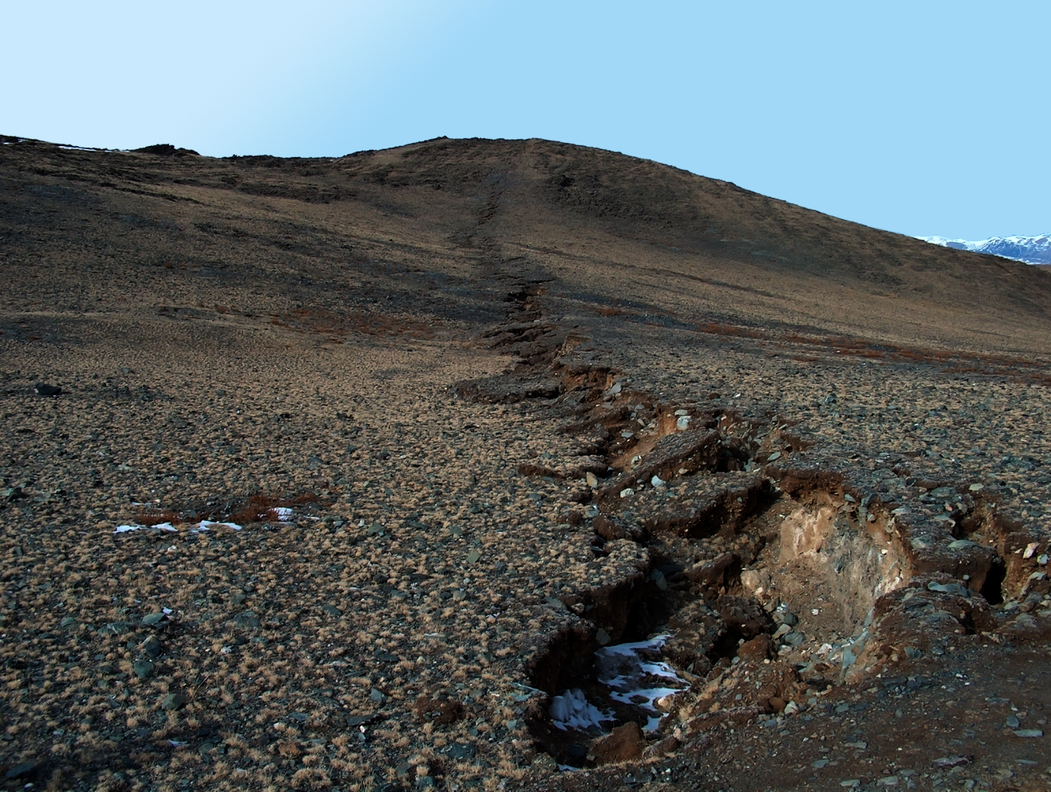
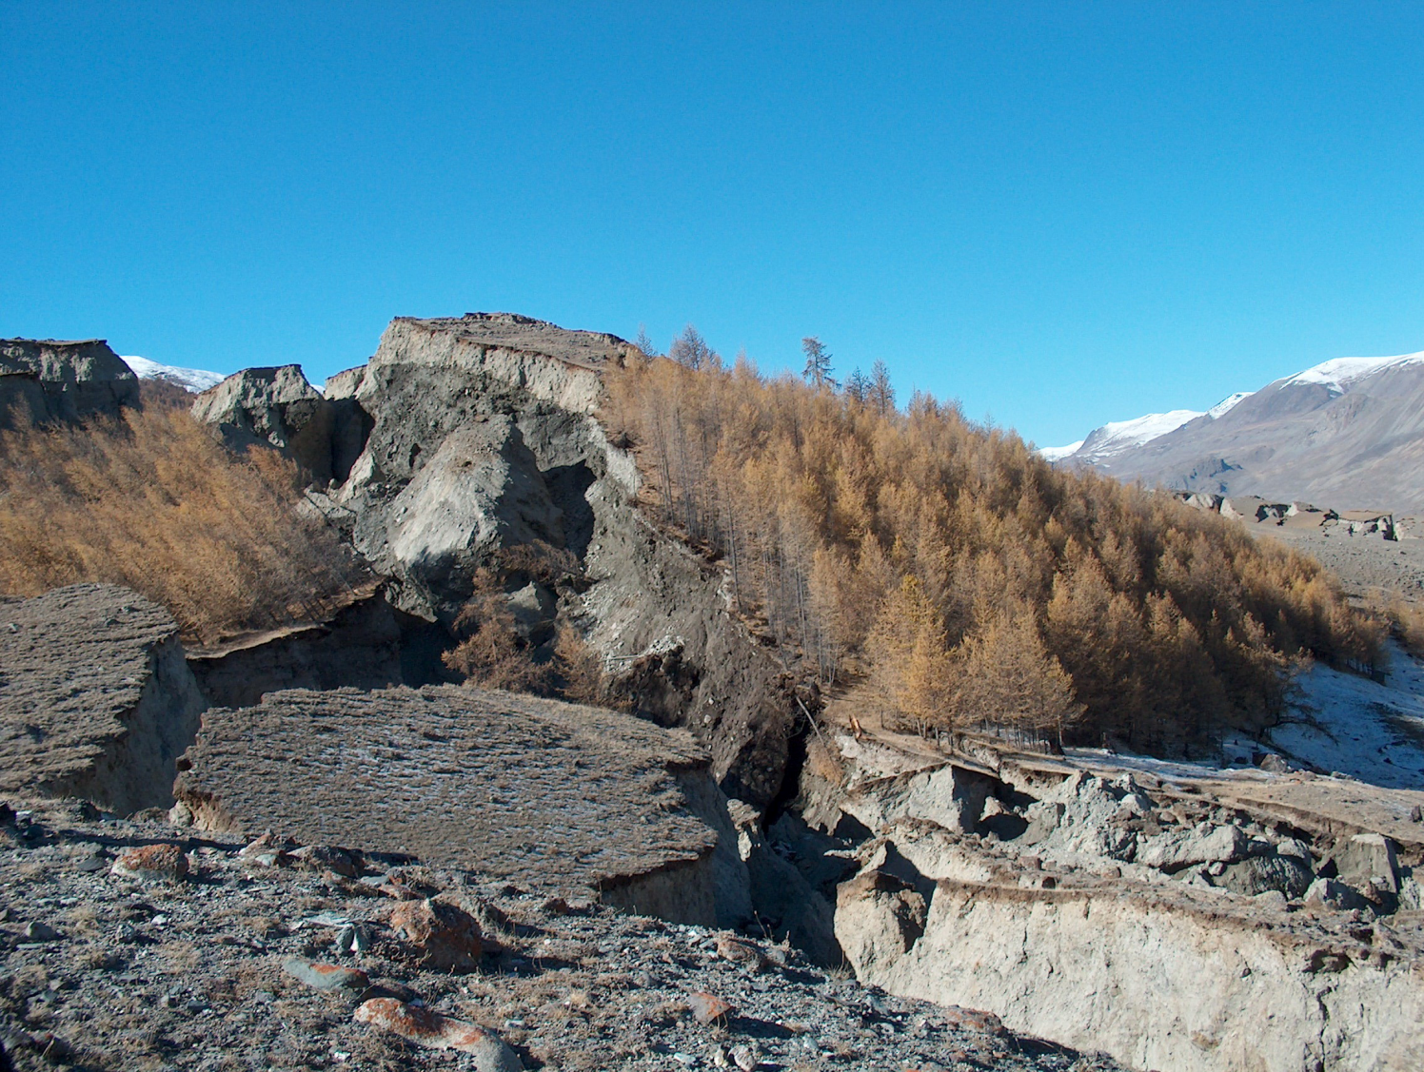
Chuy earthquake 27.09.2003 Ms= 7.3 (Mountain Altay)

Slide 13
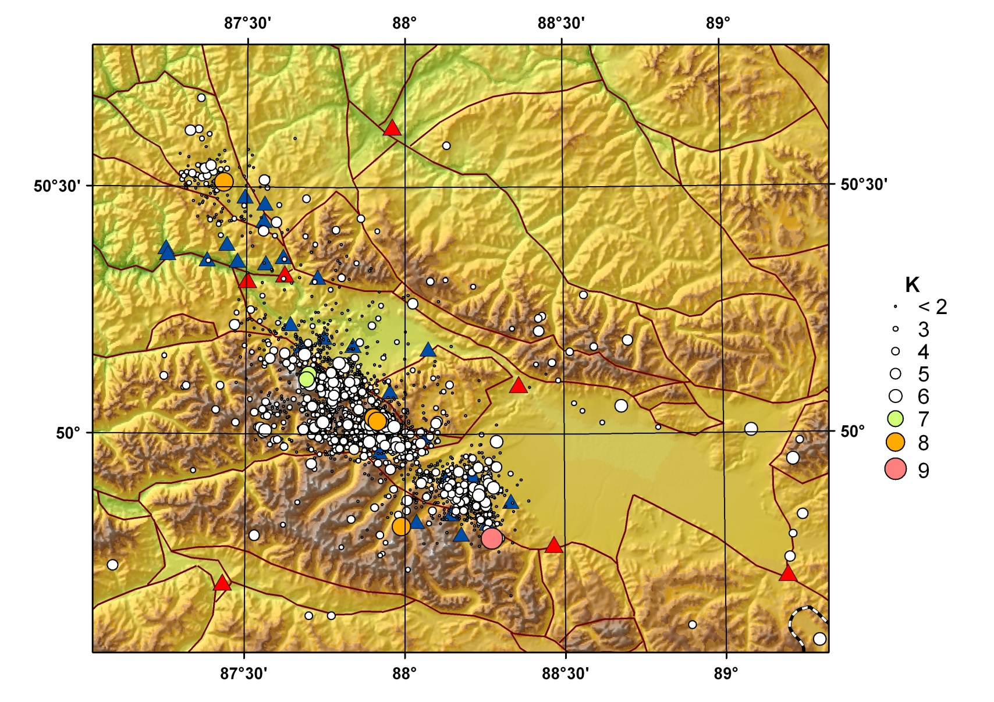
Epicentral fieldworks summer 2009

Slide 14
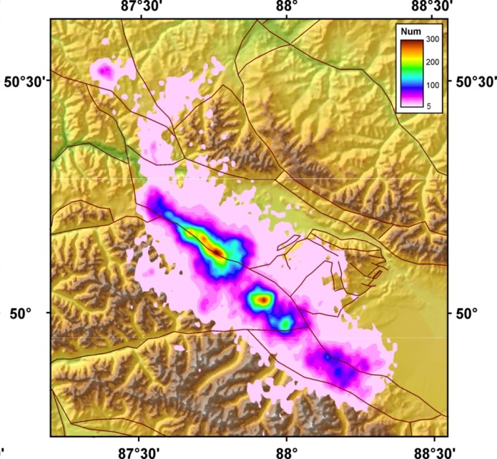
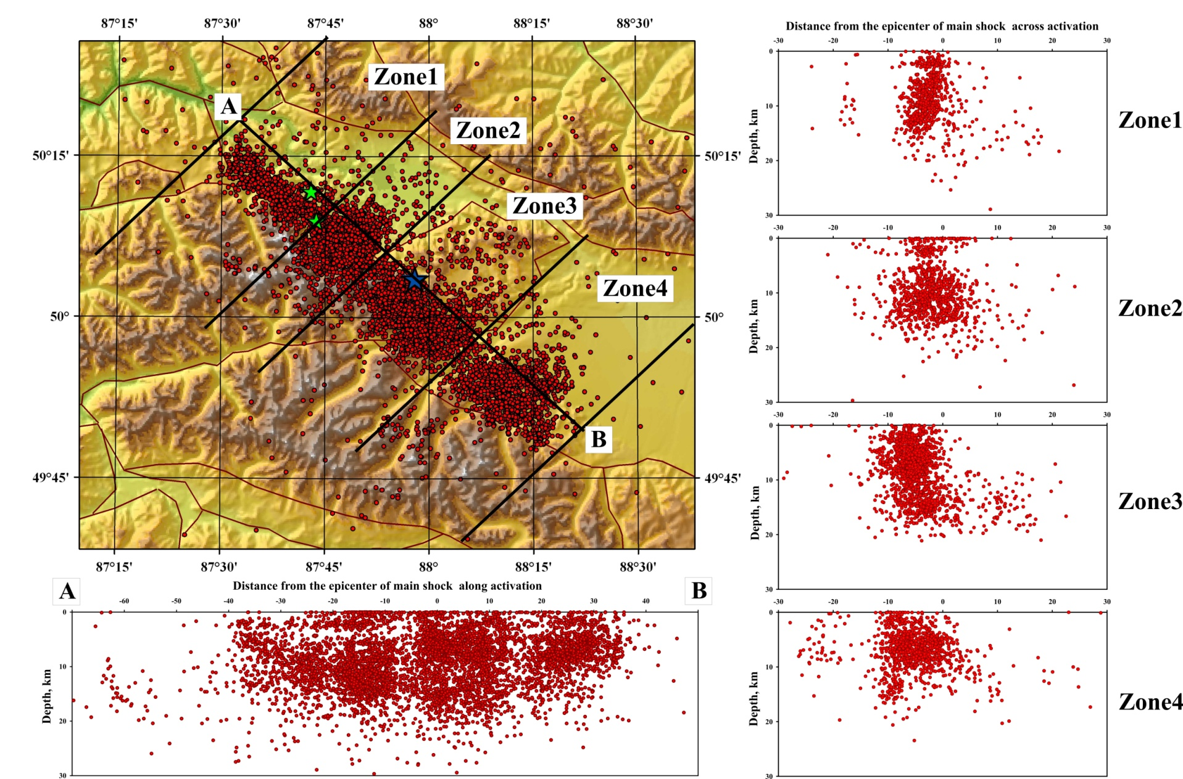
Chuy earthquake (Mountain Altay) aftershocks (more than 40000)

Slide 15
Our plans
We have received 20 CMG-3ESP and going to build broadband seismic network with real-time telemetry over Siberia
We are going to increase number of strong-motion observation at seismic sites

Slide 16
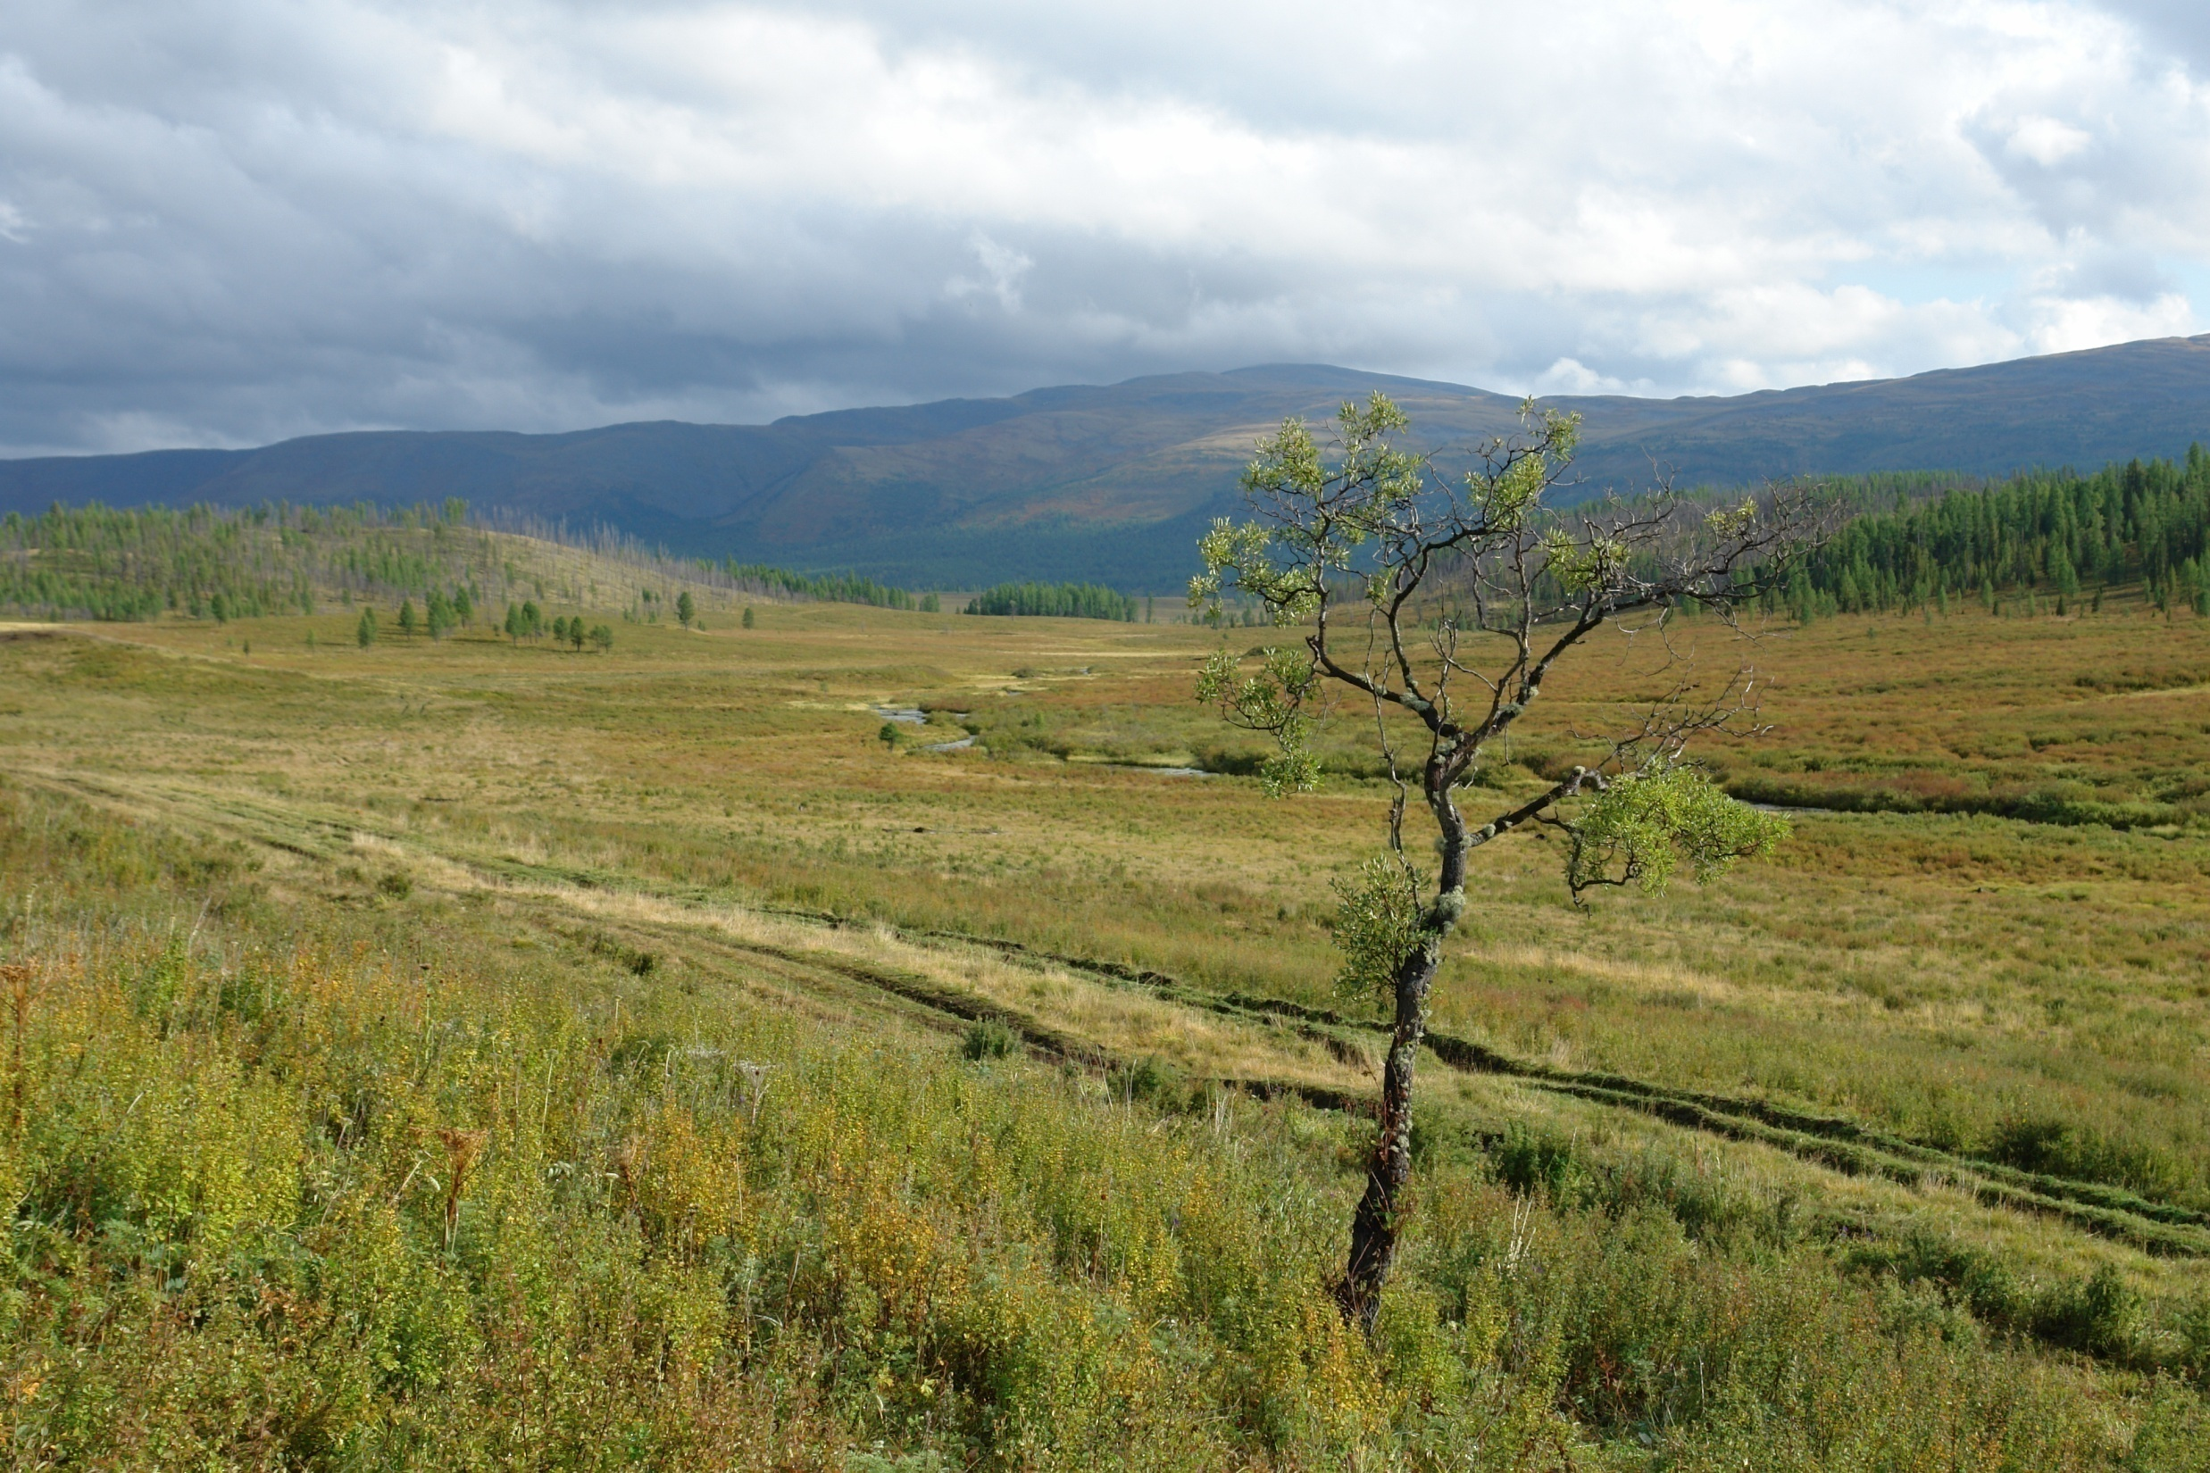
Thank YOU!

