Slide 1
Improved Quality Control for Seismic Networks ---MUSTANG

Slide 2
Quality Assurance Using MUSTANG Modular Utility for Statistical Knowledge Gathering
What is MUSTANG
A system providing ~four-dozen QA metrics
Web services design
Crawls through all data in the archive not just real time data
Changes in data, metadata, metric algorithms trigger recalculation
Integration with IRIS Web Services suite
Metrics available as web services
Can be part of a larger network of QA systems
Metrics derived externally can be incorporated into MUSTANG

Slide 3
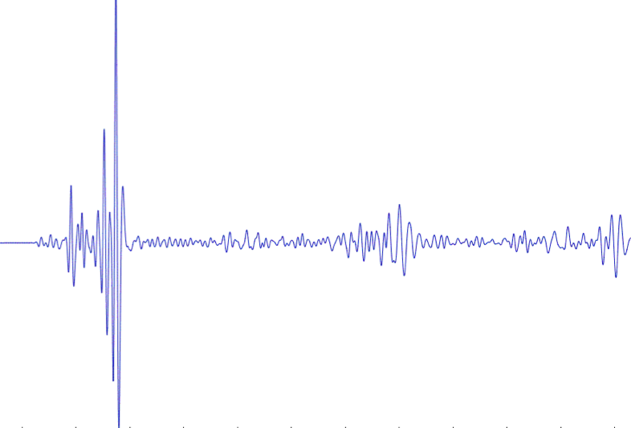
IRIS DMC: Enhanced Quality Assurance
MUSTANG Metric Estimators
Gaps, overlaps, completeness, signal to noise, power density, pdf mode changes,
Glitches, (~ 50 metrics as of July 2014)
PostgreSQL Database
Data Quality Technician
Domestic & Non-US
Network Operators
Archived and Real Time Data

Slide 4
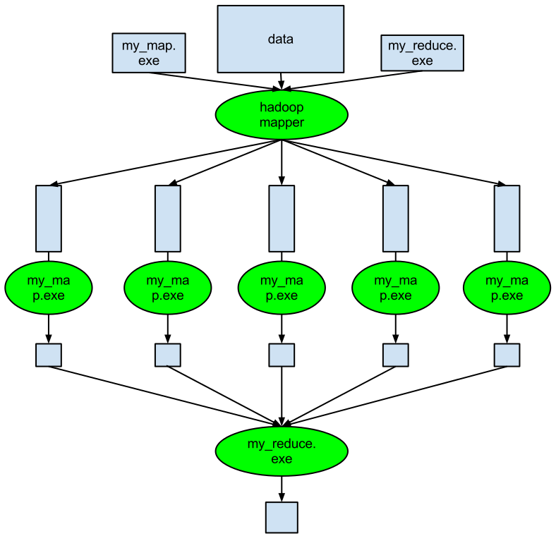
How is MUSTANG designed?
Consists of 3 major components
A Master Scheduler (MCR)
A centra lDBMS storage system (BSS)
A metrics compute cluster
sched
mcrmom
resched
jobmgr
Node A
Node B
Node C
Node D
Node E
store

Slide 5
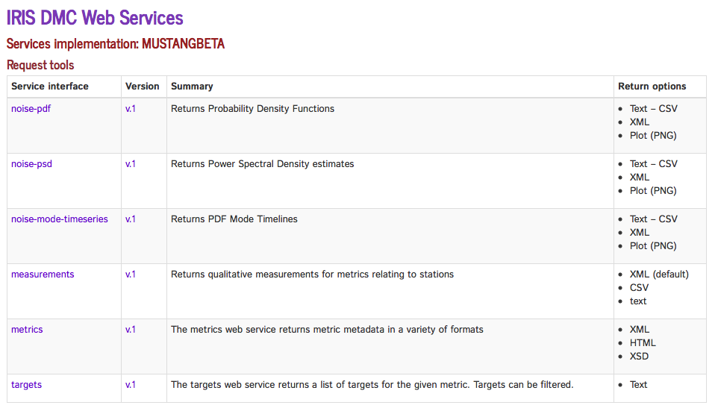
MUSTANG builds upon web services experience
http://service.iris.edu/mustangbeta/

Slide 6
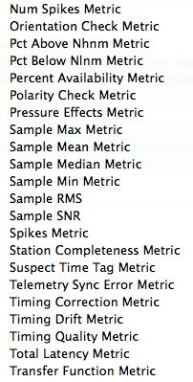
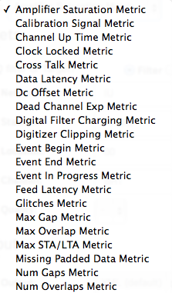
Extensive measurements metrics
43 different metrics

Slide 7
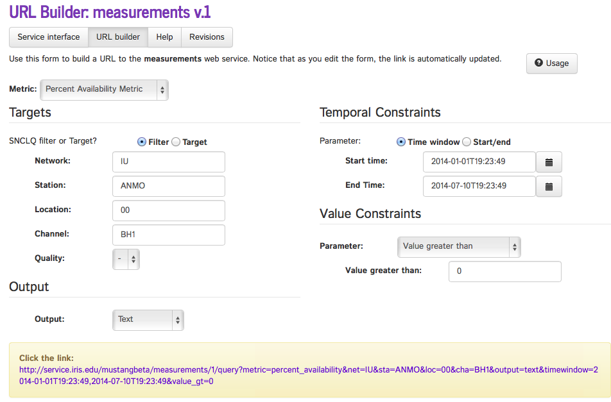
Percent Availability Metric - builder

Slide 8
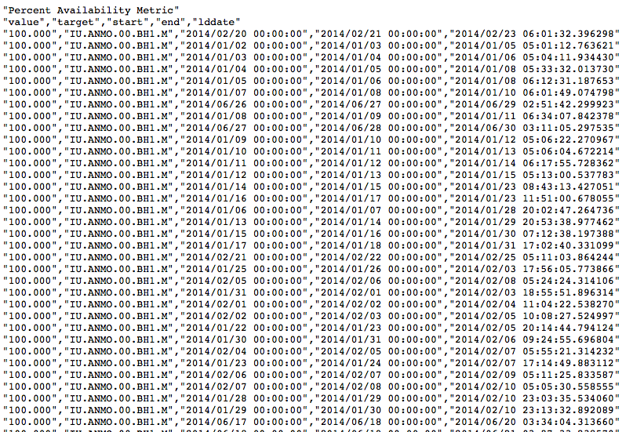
% Available as a text file or an XML doc or CSV file

Slide 9
MUSTANG builds upon web services experience
http://service.iris.edu/mustangbeta/

Slide 10
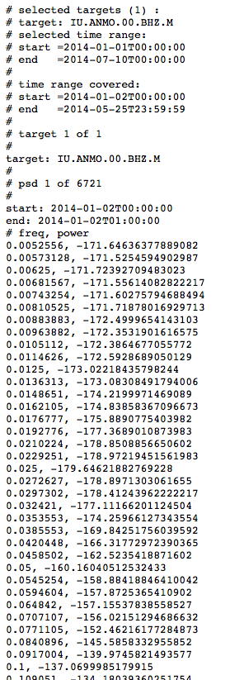
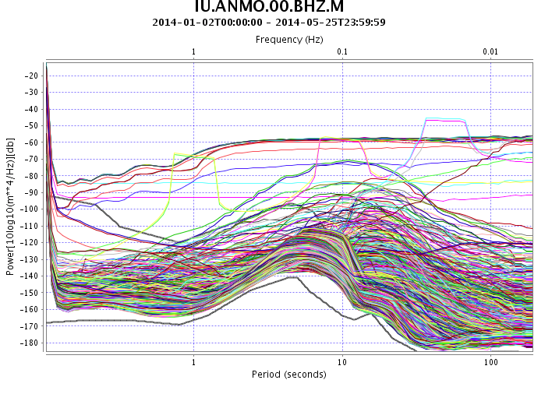
Similar for PSDs

Slide 11
MUSTANG builds upon web services experience
http://service.iris.edu/mustangbeta/

Slide 12
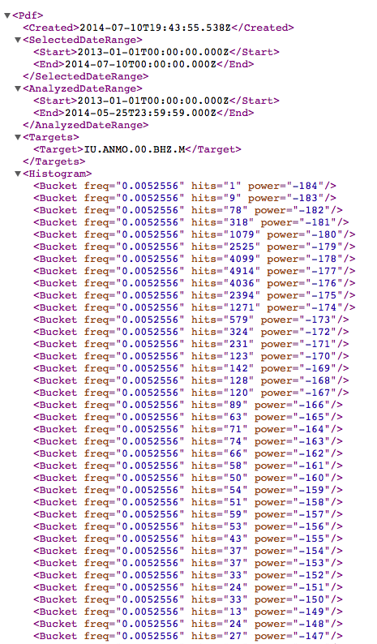
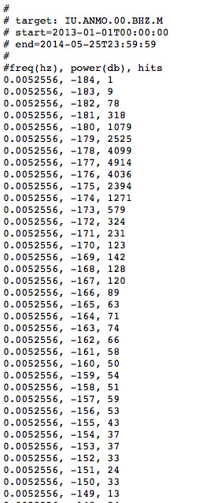
Output as XML for programs/computers or text for humans

Slide 13
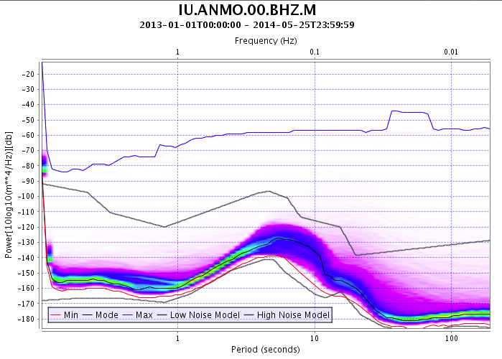
Or of course as a picture Example PDF for 1.5 years
http://service.iris.edu/mustangbeta/noise-pdf/1/query?net=IU&sta=ANMO&loc=00&cha=BHZ&quality=M&starttime=2013-01-01&endtime=2014-07-10&format=plot&plot.interpolation=bicubic

Slide 14
Visualization Client -LASSO
Visualization client
Provide ability to easily browse metrics data
Provide ability to generate plots of indicated metrics
Provide ability to organize results in web page
Intended audiences
Network operators
Scientific users
http://lasso.iris.edu

Slide 15
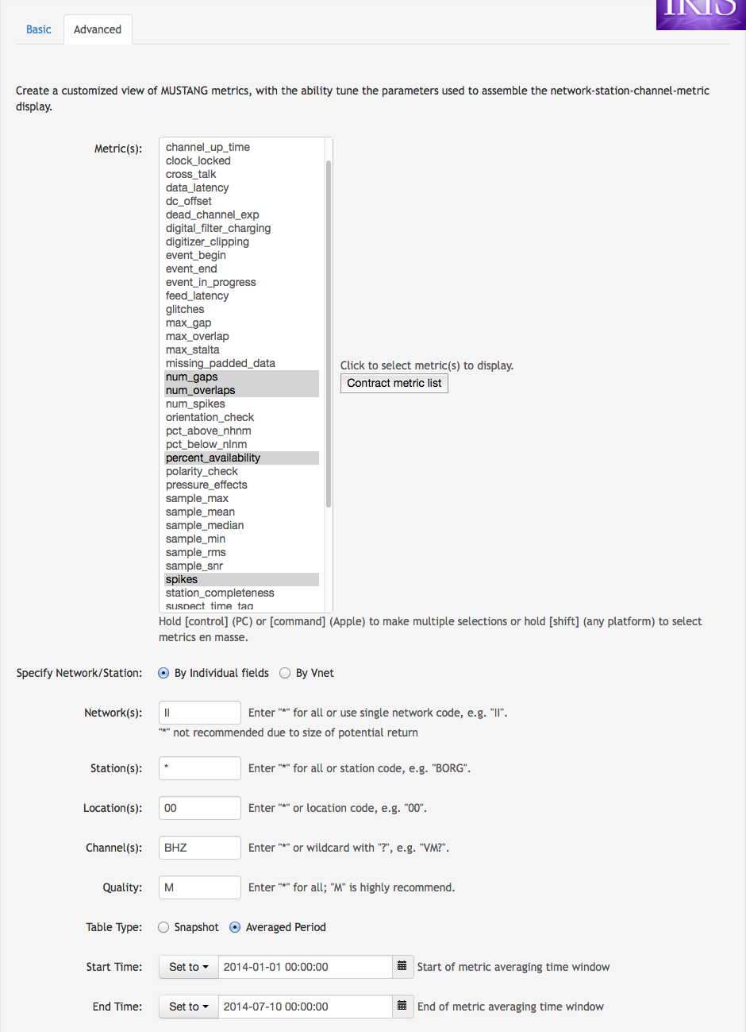
LASSO – Advanced interface

Slide 16
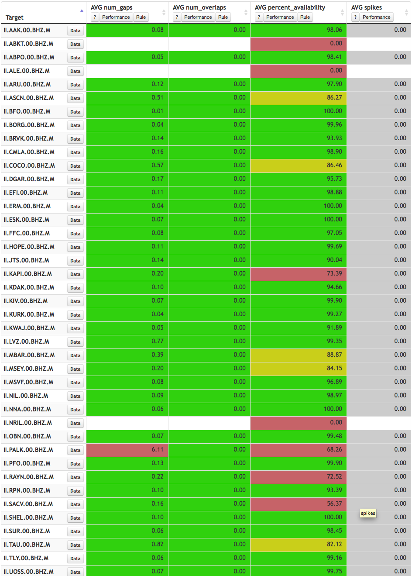
LASSO - Traffic Light Display

Slide 17
Visualization Clients that connect with MUSTANG
IRIS Data Services Browser
http://www.iris.edu/mustang/databrowser

Slide 18
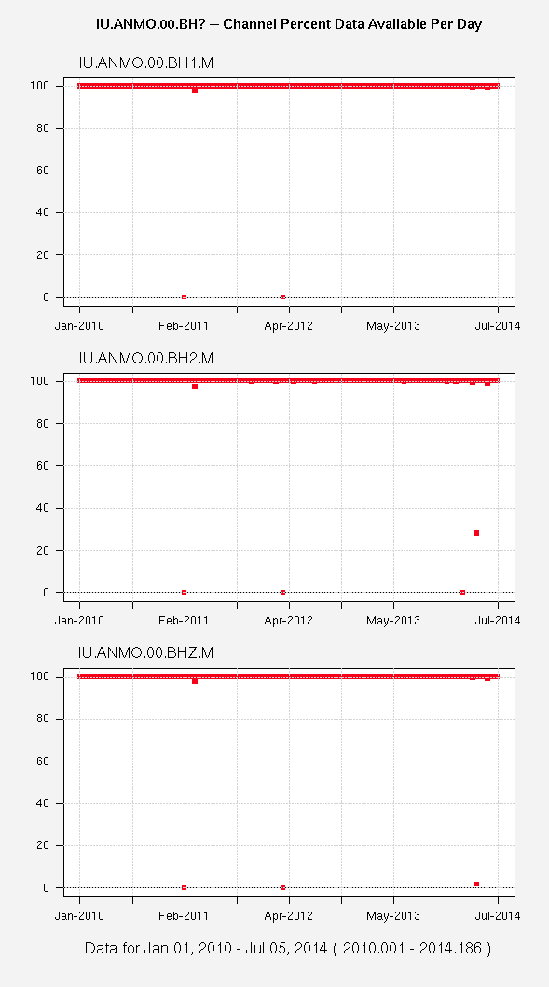
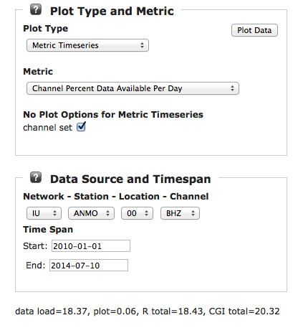
MUSTANG Data Browser

Slide 19
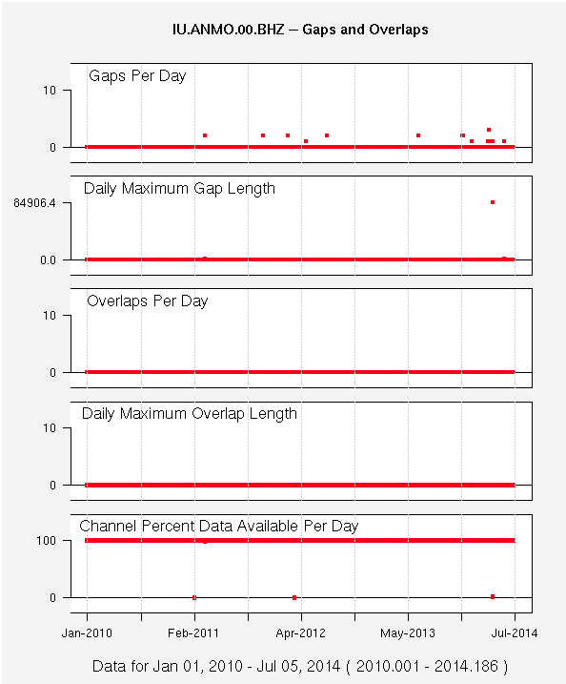
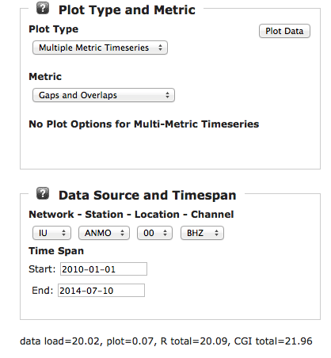
Multiple Metric Displays

Slide 20
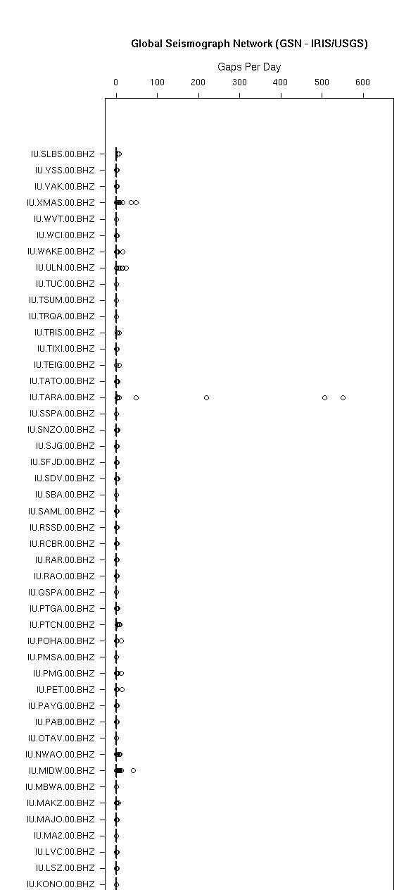
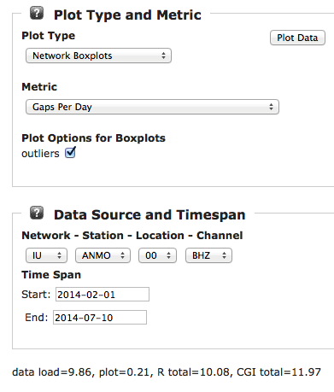
Network Box Plots

Slide 21
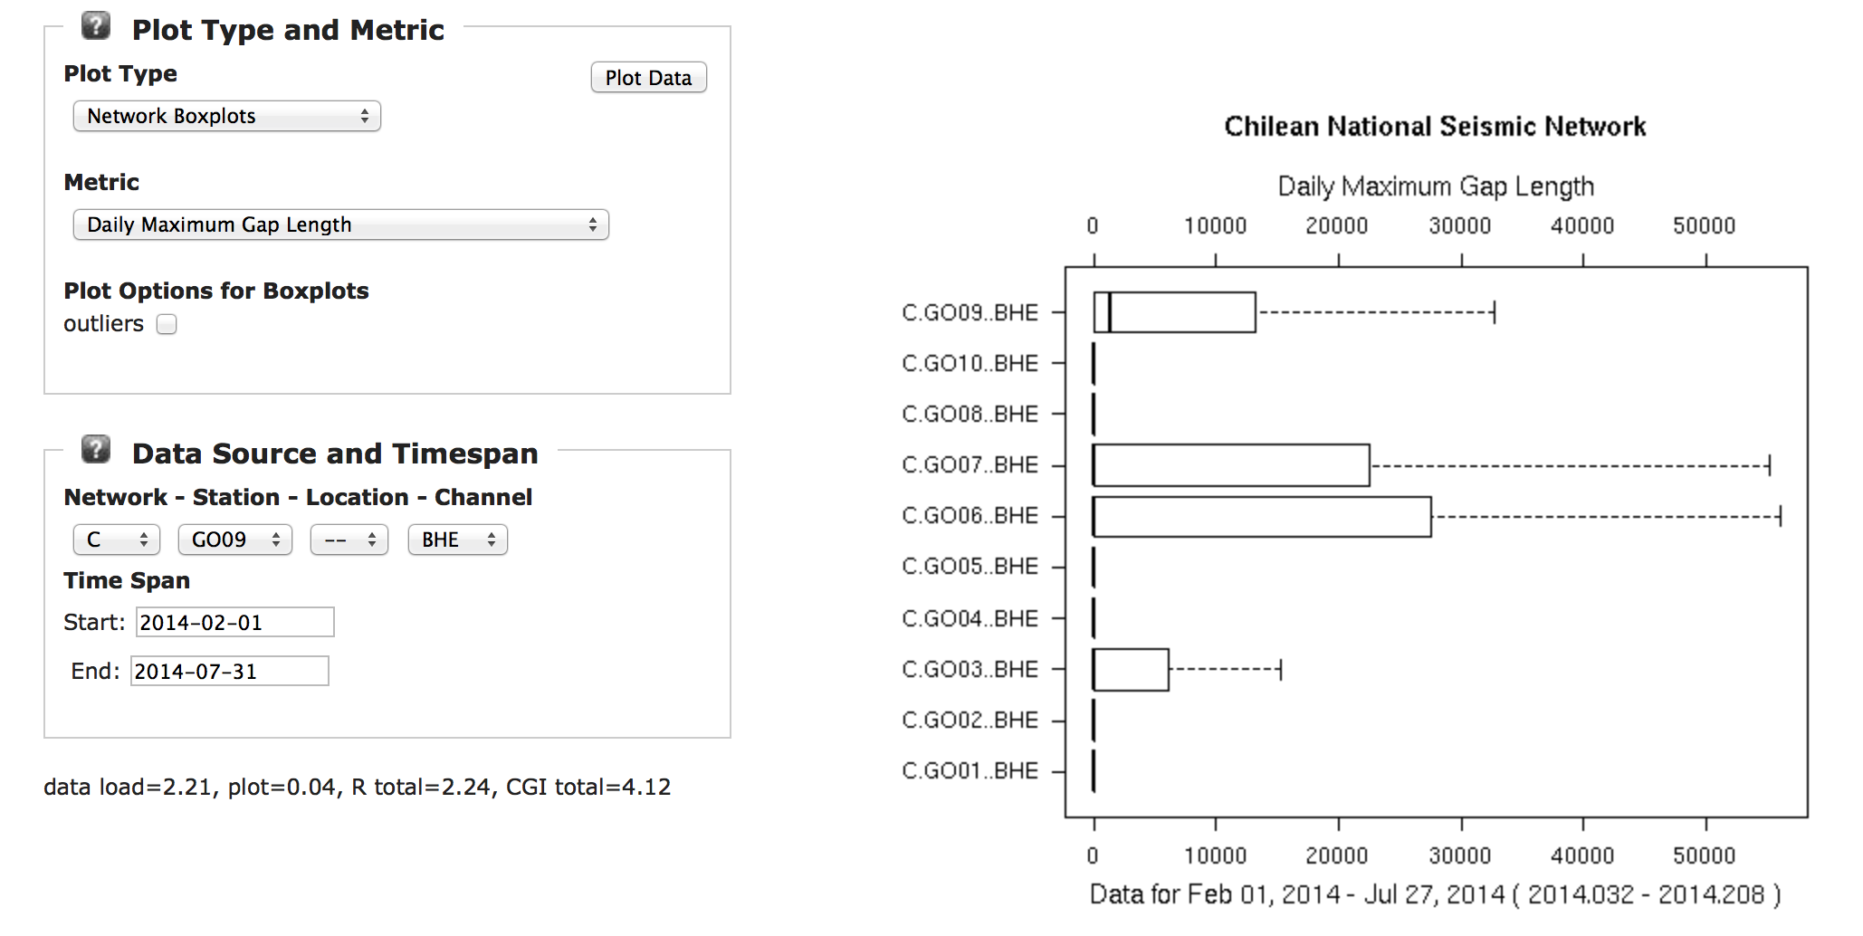
Network Box Plots

Slide 22
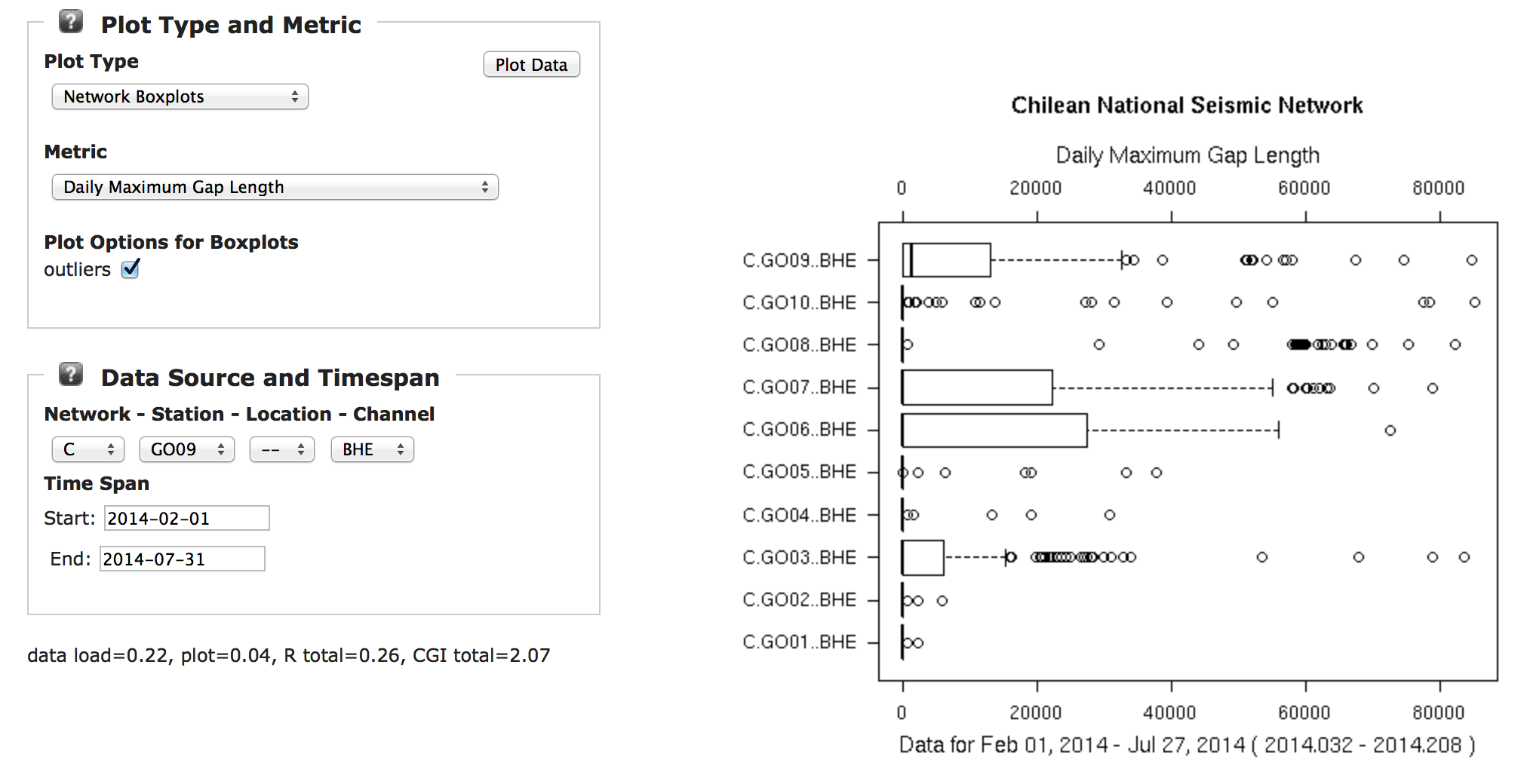
Network Box Plots

Slide 23
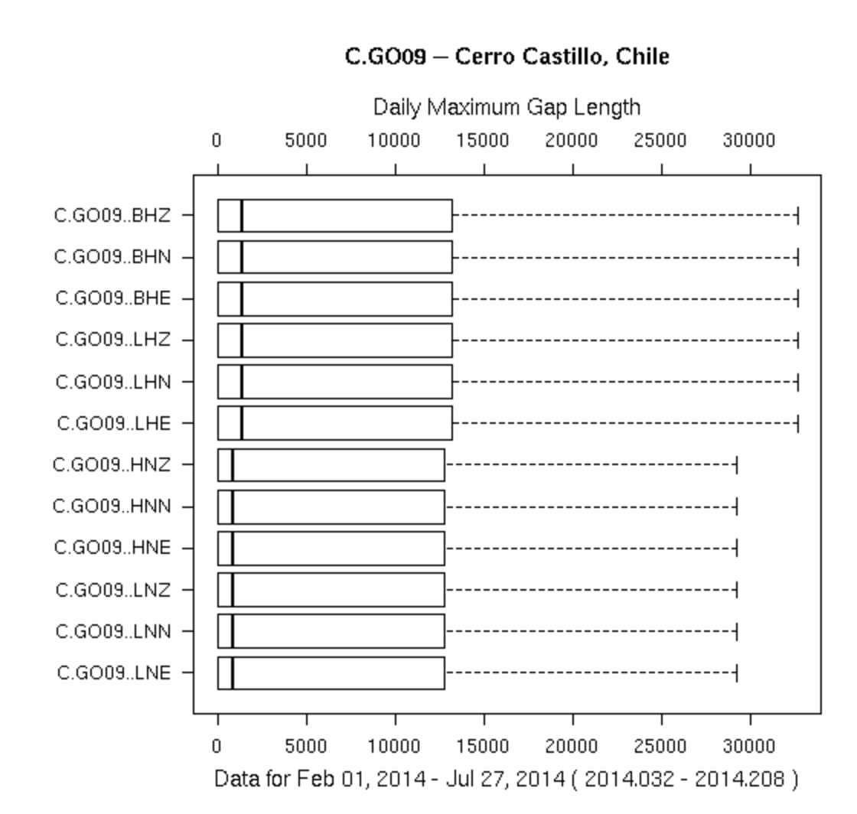
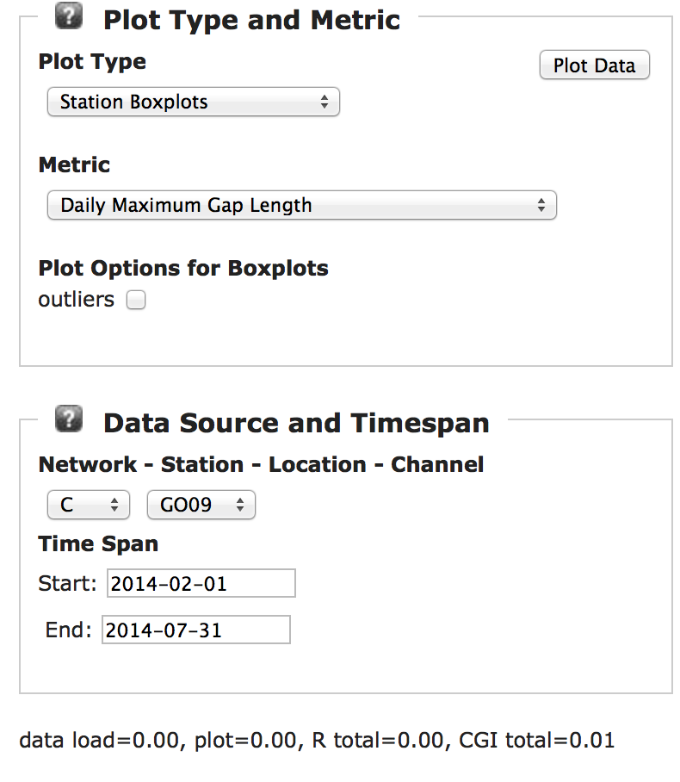
Station Box Plots

Slide 24
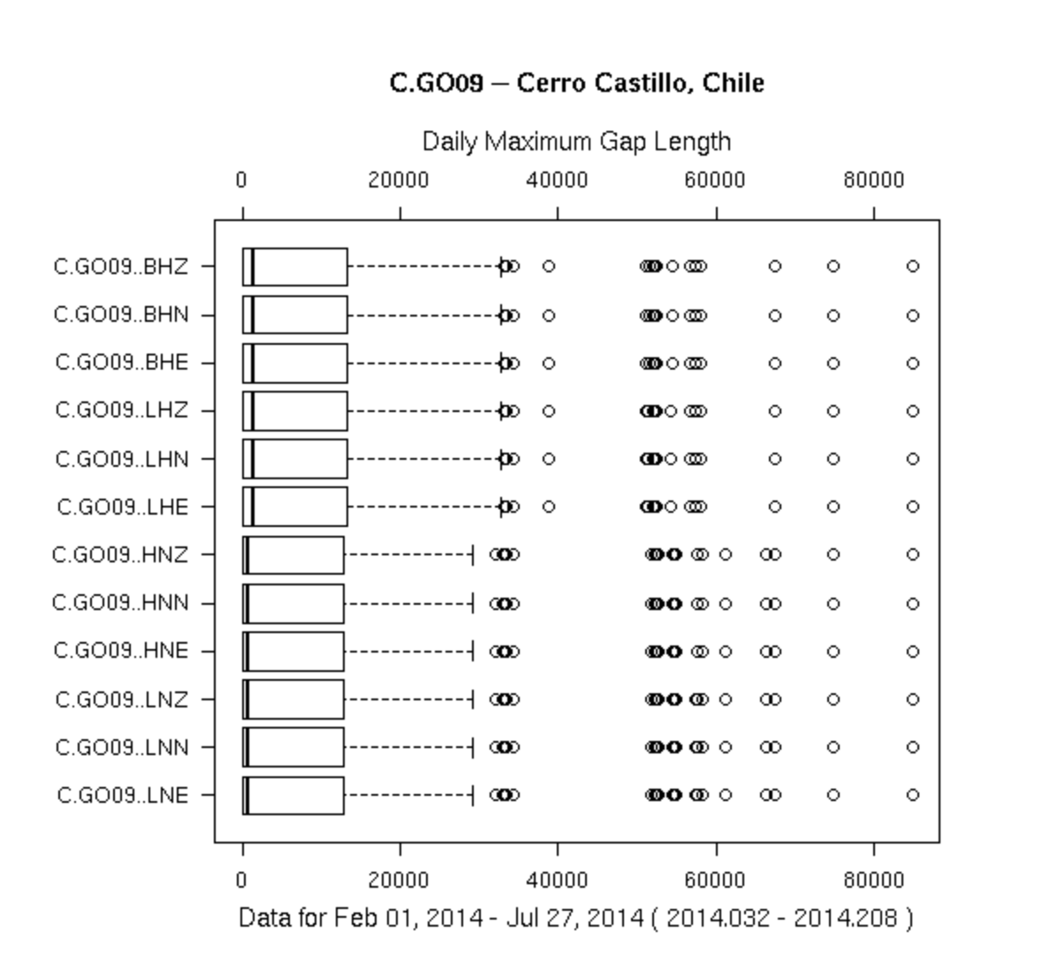
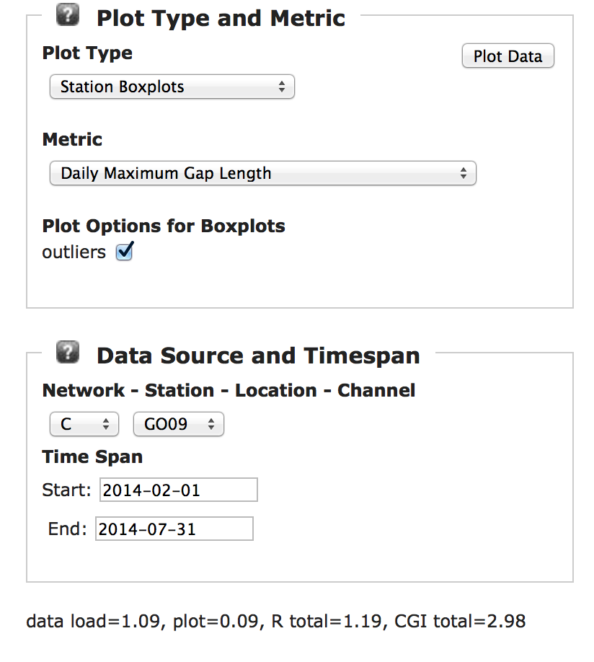
Station Box Plots

Slide 25
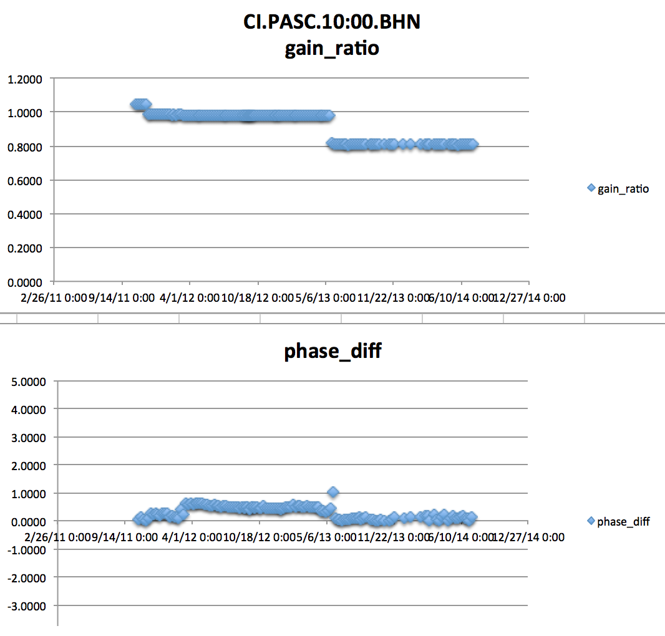
New metrics can always be added
The two steps in gain ratio steps can be tracked to metadata changes taking place
This plot represents gain ratios and phase differences
@ T=6s
measured weekly
only values with magnitude squared coherence > 0.999 are shown

Slide 26
IRIS DMC: Research Ready Data Sets
MUSTANG Metric Estimators
Gaps, overlaps, completeness, signal to noise, power density, pdf mode changes,
Glitches, (~24 metrics in phase 2)
PostgreSQL Database
Data Quality Technician
Domestic & Non-US
Network Operators
DMC Filters Data Request Using Defined Constraints
Research Ready Data Sets
Archived and Real Time Data
Filtered Data Request Returned to Researcher
Researcher Specifies Required Data Metric Constraints

