Slide 1
Seismic Network in PNG
Port Moresby Geophysical Observatory (PMGO)
Geohazards Management Division
Department of Mineral Policy & Geohazards Management (DMPGM)
Managing data for seismic networks, Hanoi, 2015

Slide 2
Purpose of the network
To be able to record earthquakes as and when they happen
To be able to determine their location, size and damage potential
To be able to inform relevant stakeholder partners, line agencies & the public of their significance
To be able to provide partial tsunami early warning where necessary to disaster authorities
To be able to share data for the common goal towards saving lives and property from natural disasters
Managing data for seismic networks, Hanoi, 2015

Slide 3
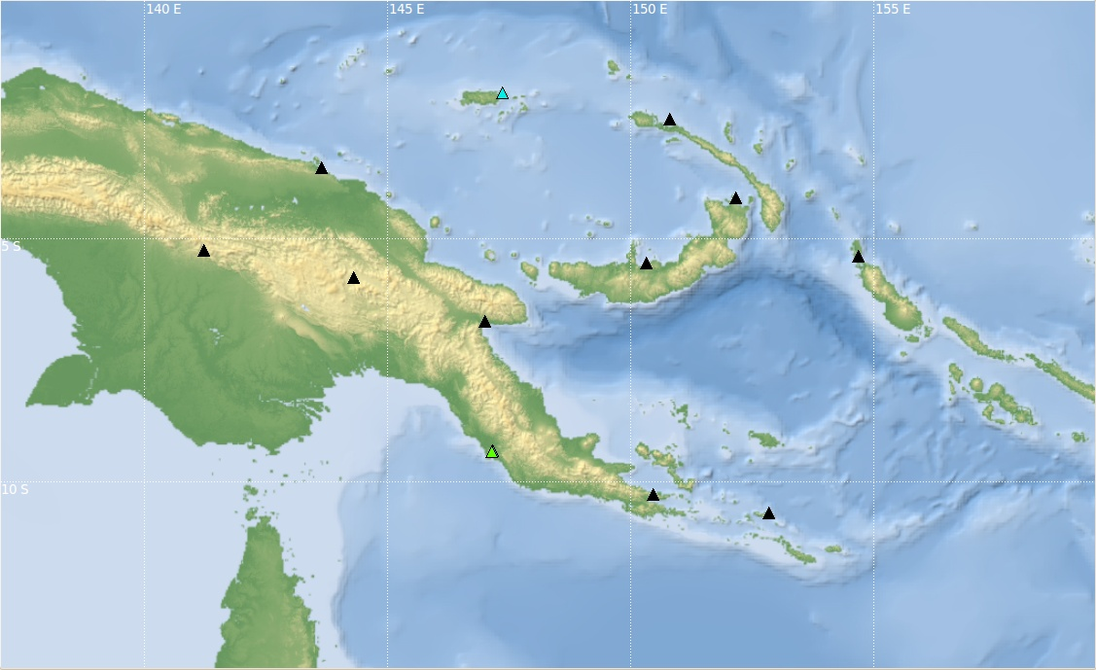
National seismic network
Manus
Kavieng
Wewak
Rabaul
Tabubil
Buka
Mt. Hagen
Kimbe
Lae
Port Moresby
Alotau
Misima
Local Network
IRIS/GSN/USGS
JATWS
Managing data for seismic networks, Hanoi, 2015

Slide 4
Network setup
Seismometers » 1Hz 3c-short period (Lenartz LE-3DLite)
Accelerometers » triaxial, low noise, MEM, (Reftek 131A-02/3)
Digitizer » Reftek data loggers (Reftek 130-01/6)
Accessories » comms., power, gps, etc.,
Managing data for seismic networks, Hanoi, 2015

Slide 5
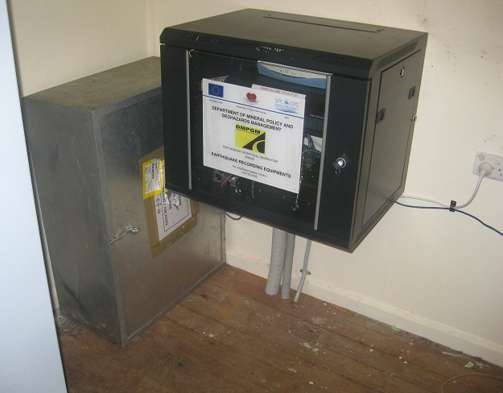
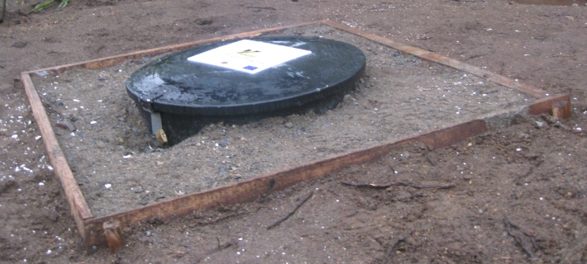
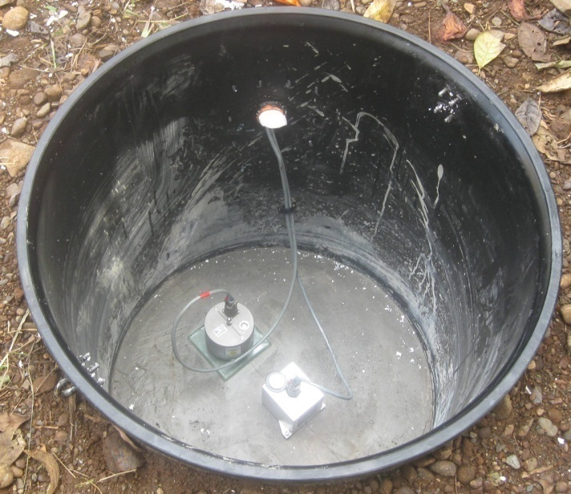
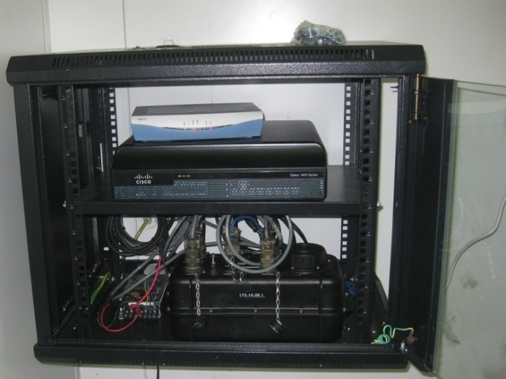
Network setup
Outdoor unit
Indoor unit
Seismometer
(Lennartz LE-3DLite)
Modem
Router
Accelerometer
(Reftek 131 02/3)
Data logger
(Reftek 130 1/6)
Managing data for seismic networks, Hanoi, 2015

Slide 6
Data acquisition system
Data acquired from local stations are done using Reftek’s supplied software
Regional data are accessed via internet through seedlink protocol plug-ins, installed with SeisComP3 software at the central server
The network utilises SeisComP3 as the primary software for data acquisition, analysis and archival
Managing data for seismic networks, Hanoi, 2015

Slide 7
Seismic data processing
Data processing is done using the SeisComP3 software for weak motion events
For strong motion events - analysis are done using the Compass software from Reftek Inc.
Data storage and archival
Merged and archived into one server – also stored on tapes
Data stored in both seed and reftek format
Managing data for seismic networks, Hanoi, 2015

Slide 8
Outcomes
The ultimate goal is to provide timely early warning seismic information to disaster authorities public safety
Updating of earthquake database for the PNG region through earthquake cataloging
Planning for the effects of earthquakes and tsunamis promotes safer communities
Managing data for seismic networks, Hanoi, 2015

Slide 9
Future plans
To expand on the existing setup as required
Option to upgrade current setup to bb status
Option to improve telemetry issues for reliability and a robust data acquisition system
Provision of data sharing with regional data centers and other monitoring organizations for a collective benefit
Managing data for seismic networks, Hanoi, 2015

Slide 10
Thank you ,,,

