Slide 1
Federation of Digital Broad-Band Seismograph Networks
The FDSN and Sustainable Seismic Networks
Tim Ahern
FDSN Archive for Continuous Data

Slide 2
Federation of Digital Broad-Band Seismograph Networks
The FDSN: Origins
Founded in 1985 to bring together digital broad-
band seismic networks
Support national institutions and seismic networks
moving into the broad-band seismic technology
Coordinate the location of new seismic stations to
avoid duplications and promote global distribution
FDSN has commission status within IASPEI
(International Association of Seismology and
Physics of the Earth Interior)

Slide 3
Federation of Digital Broad-Band Seismograph Networks
The FDSN: Goals
Coordinates site selection, data exchange and
instrument standardization
Promotes the installation of seismic stations. There
are about 2000 broad band sites now; 200 in real
time (backbone stations)
Promote a variable network geometry approach:
local, regional, national, worldwide scales
Promotes the deployment of ocean bottom
seismometers

Slide 4
Federation of Digital Broad-Band Seismograph Networks
The FDSN: A Unique Organization
FDSN does not have inter-governmental status
Has no budget
No permanent staff
Operated by support offered by member institutions

Slide 5
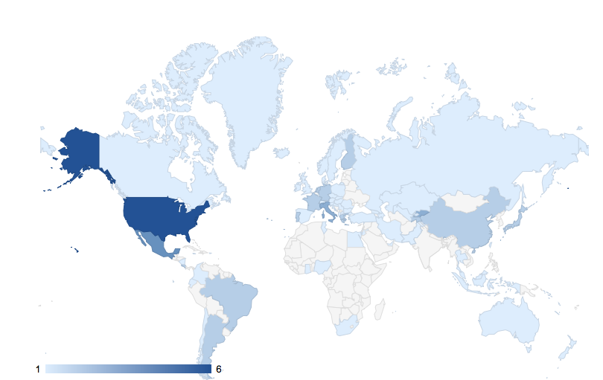
FDSN Membership in 2011 91 institutions in 67 countries
http://www.fdsn.org/forms/membership_form.htm

Slide 6
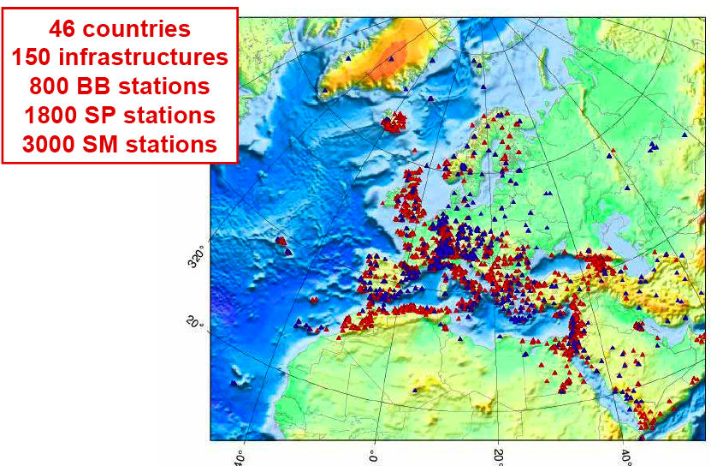
Regional Coordination
an Important FDSN Function

Slide 7
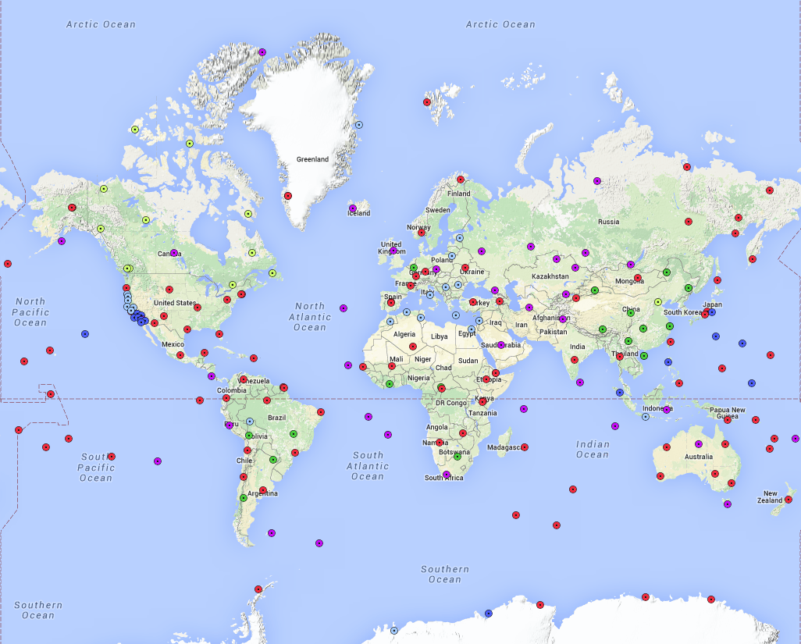
The FDSN Backbone
of 205 stations from 16 Networks
Networks
AU
BK
CD
CI
CN
CZ
G
GE
GT
H2
IC
II
IU
MN
NL
PS

Slide 9
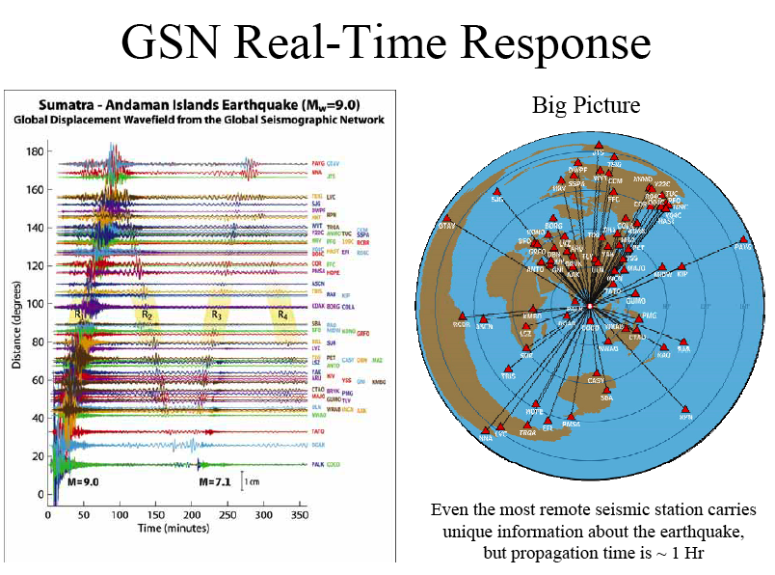

Slide 10
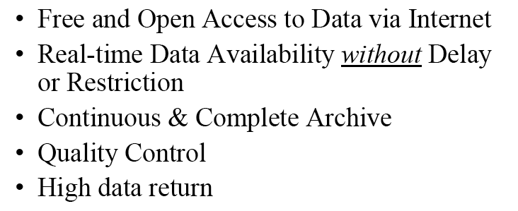
Federation of Digital Broad-Band Seismograph Networks
Data Distribution Performance Goals

Slide 11
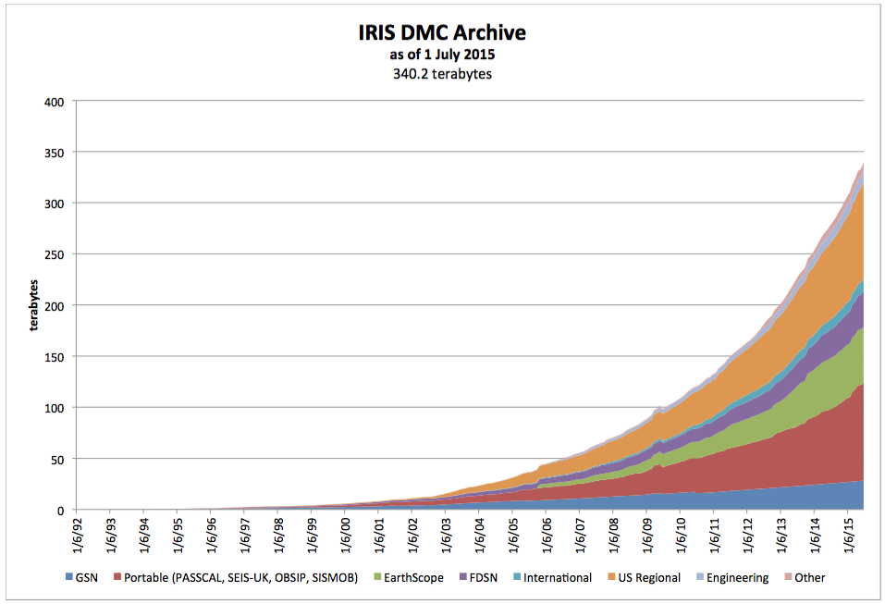
The IRIS Archive (~350 tbytes)

Slide 12
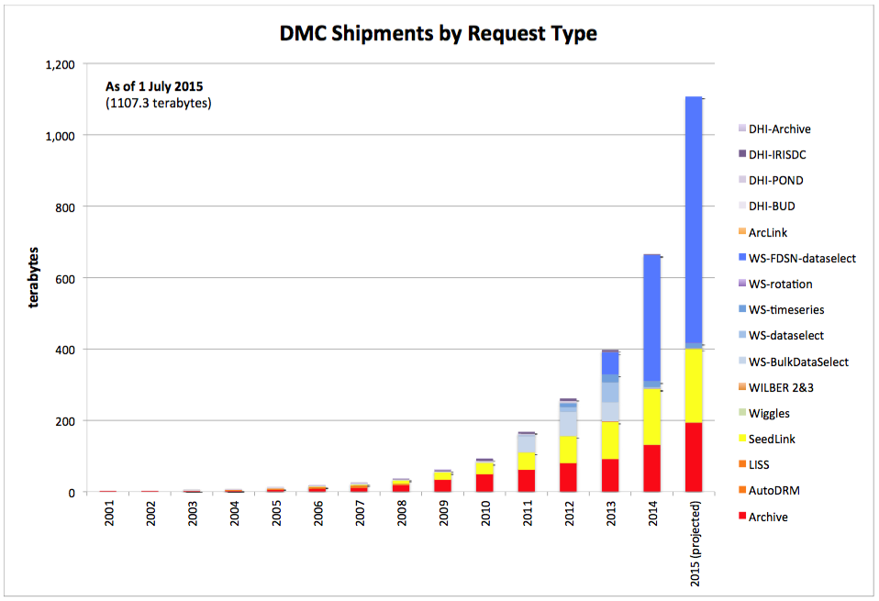
IRIS will ship ~ 1 petabyte in 2015

Slide 13
Federation of Digital Broad-Band Seismograph Networks
The FDSN Challenges:
Encourage and support the development and
Implementation of tools for societal benefit:
Early damage assessment
Tsunami and earthquake warning efforts
Shake maps
Long-term scientific research
Source Characterization

Slide 14
Federation of Digital Broad-Band Seismograph Networks
Future Challenges for the FDSN Community:
Maintain the current infrastructure
Diversify the offer of products and services
Improve the coverage of broad band stations
Enlarge the number of FDSN members
and broad band stations transmitting real time
Improve coverage by offering societal advantages
Increase the number of broad band stations

Slide 15
Federation of Digital Broad-Band Seismograph Networks
THANK YOU!

