Slide 1
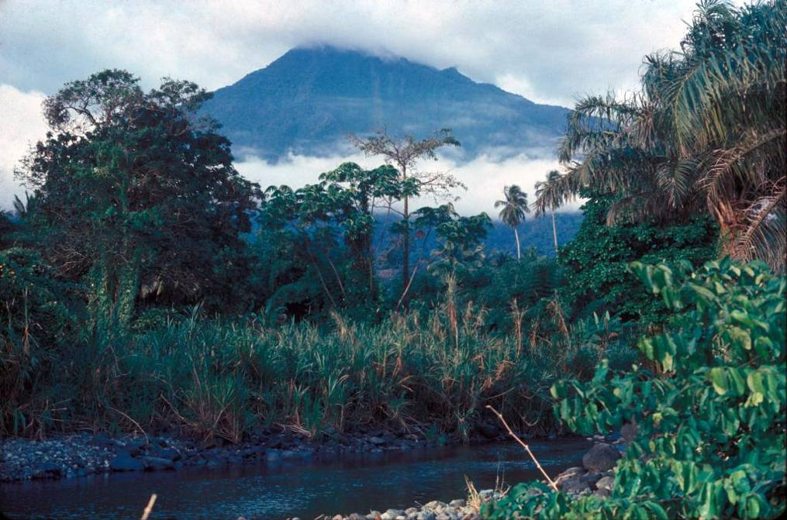

SEISMIC STUDIES IN CAMEROON
WELCOME
TO THE PRESENTATION ON THE CAMEROON SEISMIC NETWORK
Notes:
----- Meeting Notes (02/12/14 23:22) -----
Dear Profs.
Honorable member of jury,
fellow assistance !
You are very welcome to this PhD presentation !
Thanks for giving me the opportunity to present what i have been carrying on as research since some years in many countries!

Slide 2

PRESENTATION OF THE CAMEROON SEISMIC NETWORK
MOUZONG PEMI MARCELIN
Department of Physics, University of Yaounde 1
Department of Renewable Energy, Higher Technical Teachers’ Training College, University of Buea Cameroon
20-26th AUGUST 2017 IRIS WORKSHOP, PRETORIA
IRIS WORKSHOP- “Managing Waveform Data
and Related Metadata from Seismic Networks”

Slide 3

INTRODUCTION
PAST AND
TEMPORARY SEISMIC
NETWORK
PRESENTATION OF THE CAMEROON SEISMIC NETWORK
DATA AND WORK DONE SO FAR
CONCLUSION AND FUTURE PLANS
SEISMICALLY ACTIVE ZONES AND INTERPRETATION
Notes:
----- Meeting Notes (03/02/15 21:08) -----

Slide 4


PROBLEM
STATEMENTS
GENERAL INTRODUCTION
Unclear understanding of the tectonic setting of the CVL
Unknown origin and kind of processes triggering seismic activity
Very limited datasets, and based on limited zones
The inaccessibility to many areas
Crustal structures beneath Cameroon rarely analysed
The past seismic campaigns using short period seismometers therefore perform local investigations
Information on how the CVL and surrounding areas develop their atypical present-day tectonics has remained limited and controversial
Notes:
----- Meeting Notes (03/02/15 21:08) -----
THE AVAILABLE GRAVITY DATA IN CAMEROON HAVE BEEN COLLECTED SINCE ABOU 50 YEARS AND
THEY ARE MOSTLY CONDUCTED IN THE HIGH POTENTIAL MINERAL AREAS.
----- Meeting Notes (04/02/15 21:14) -----
BEARING IN MIND ALL THESE LIMITATIONS, HOW CAN WE BRING OUR CONTRIBUTION. IN OTHER WORDS WHAT ARE HOW OBJECTIVES.

Slide 5

SEISMOLOGICAL CHALLENGES IN CAMEROON
There is an urgent need to :
Update the understanding of the Cameroon tectonics,
Anticipate the effects and consequences of disasters,
Compute an accurate velocity model of Cameroon
Location the epicenters of the local and regional events
Compute the event magnitudes and study their spatial distribution
Deeply investigate its crustal structures for scientific
and exploration aspirations.
Finally, to solve key questions related to the Cameroon tectonics.
Notes:
----- Meeting Notes (03/02/15 21:08) -----

Slide 6

CAMEROON SEISMIC RELATED QUESTIONS
TO FIGURE OUT WHAT IS HAPPENING, WE DO ASK
QUESTIONS SUCH AS:
Where are their locations ?
What are the causes of quakes ?
What are their depths ?
What are the magnitudes ?
What is the pattern of seismicity ?
What types of faulting trigger them ?
What are seismotectonic implications ?
Are earthquakes on increase ?
Are there similarity between past and present seismicity ?
Are we expecting a large earthquake in Cameroon ?
Notes:
----- Meeting Notes (04/02/15 06:07) -----
SEVARAL QUESTION COULD BE ASKED WHEN INVOLVED IN THJE SEISMIC STUDIES IN CAMEROON

Slide 7
PAST SEISMIC PATTERN OF CAMEROON
Mont Cameroon Network (1984)
with 6 stations set up around Mont Cameroon
Mainly Wilmore MK III short period seismometers
In 1986 these stations were augmented by 8 temporary ones
Northern Network (lake Nyos) (1987-1989) location to monitor any trace of the seismicity after the gas emission that killed 1400 people

Slide 8
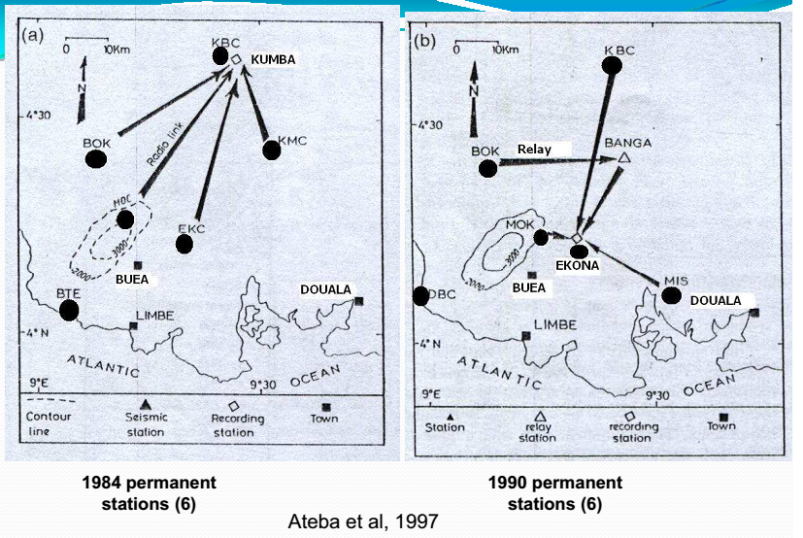
PAST SEISMIC PATTERN OF CAMEROON
Seismic Network (PERMANENT)

Slide 9
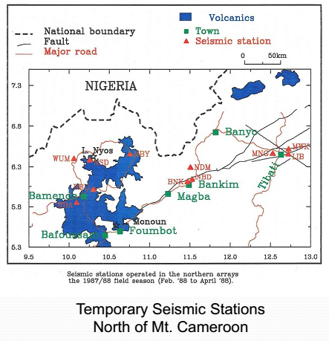
PAST SEISMIC PATTERN OF CAMEROON
Temporary Seismic Network (1988)

Slide 10
PAST SEISMIC PATTERN OF CAMEROON
These past networks allowed to located tenths of events with magnitude greater than 3.5
Feld and recorded earthquakes of magnitude > 3.5, since 1852 (figure)
Cameroon past seismicity have been portrayed by several authors:
Fairhead, 1985;
Ambraseys and Adams, 1986;
Ambeh et al., 1989;
Tabod et al., 1992;
Ateba et al., 1997;
Ntepe et al., 2004
Tokam et al., 2010
Article Eloumala et al. 2014

Slide 11
LOCATIONS OF THE CAMEROON BROADBAND SEISMIC STATIONS
Longitude (°) | Latitude (°) | Station
9.99210 | 2.3873 | CM01
13.2888 | 2.6984 | CM02
15.0344 | 3.5190 | CM03
11.9596 | 2.9792 | CM04
9.91210 | 2.9404 | CM05
11.2680 | 2.3850 | CM06
11.4560 | 3.8700 | CM07
9.32800 | 4.2340 | CM09
10.6189 | 4.2234 | CM10
13.1878 | 3.9803 | CM11
11.6337 | 4.4810 | CM12
9.46100 | 4.5870 | CM13
14.3583 | 4.4215 | CM14
9.93140 | 5.0325 | CM15
10.5709 | 5.4788 | CM16
12.3121 | 5.5461 | CM17
9.31210 | 5.7230 | CM18
9.35500 | 5.9736 | CM19
11.2305 | 6.2242 | CM20
10.0523 | 6.4657 | CM21
12.6234 | 6.4758 | CM22
13.2667 | 6.3690 | CM23
10.7914 | 6.5230 | CM24
14.2880 | 6.7588 | CM25
14.2880 | 7.2650 | CM26
13.5480 | 7.3582 | CM27
12.6659 | 8.4680 | CM28
13.2356 | 9.3470 | CM29
13.3850 | 9.7558 | CM30
13.9575 | 10.3266 | CM31
15.2610 | 10.6186 | CM32
COORDINATES OF THE 32 BROADBAND SEISMIC STATIONS DISTRIBUTED ALL OVER CAMEROON
Notes:
----- Meeting Notes (09/02/15 23:26) -----
An american project installed 32 broadband seismic stations in cameroon !
The experiment consisted in the deployment of thirty-two (32) portable broadband seismometers all over Cameroon.

Slide 12
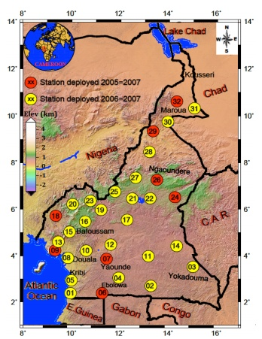
LOCATIONS OF THE CAMEROON BROADBAND SEISMIC STATIONS
8 seismic stations
(red circles) installed in 2005
24 stations (yellow
circles) in 2006
Notes:
----- Meeting Notes (09/02/15 23:26) -----
An american project installed 32 broadband seismic stations in cameroon !
The experiment consisted in the deployment of thirty-two (32) portable broadband seismometers all over Cameroon.

Slide 13
CAMEROON SEISMIC DATA
The instruments were recording data in continuous real mode at a sampling interval of 40 s.p.s (samples per second) on three-component instruments
GPS receivers provided absolute timing
Cameroon Seismic data available on the IRIS website

Slide 14
METHODS OF DATA ANALYSIS
Careful examination of all dataset
Analysis of the 3-component records
Classification of the
'local’
'regional’
'teleseismic’ events

Slide 15
PRESENT DAY SEISMIC PATTERN
Instrumental earthquakes 2005-2007

Slide 16
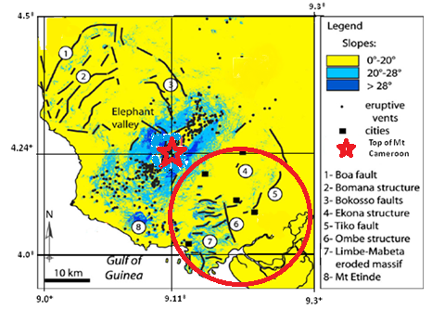
MOST SEISMICALLY ACTIVE AREA IN CAMEROON
Red circle represents the most seismically active area.
Main geological entities of Mt. Cameroon area from SRTM, Lucie et al. (2011).
It lies to the southeast of the mountain, Tiko zone (red circle)

Slide 17
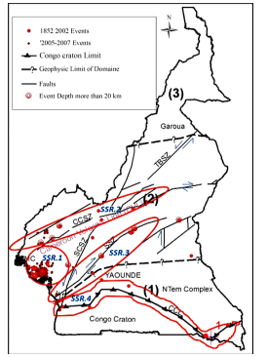
SEISMICALLY ACTIVE ZONES IN CAMEROON
Seismic Source Regions (SSR); SSR. 1: Mount Cameroon Seismic Source; SSR. 2: Central Cameroon Seismic Source; SSR. 3: Sanaga Seismic Source; SSR. 4: Congo Craton Seismic Source.

Slide 18
SEISMOTECTONICS
Notes:
----- Meeting Notes (17/02/15 00:18) -----
The purpose of the section is to gain better understanding of the current tectonic processes.
#
The basic attack has been to attemp to compare the seismic activity with the geological strutures which is dominated by complex system of faults that are considered active from geological evidences,
In doing so , several questions could be asked.

Slide 19
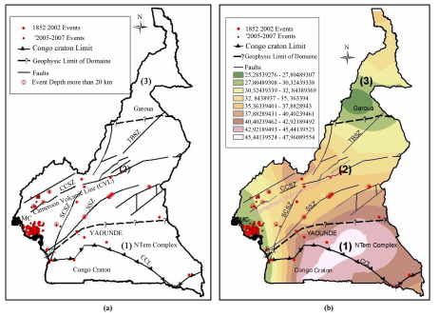

Slide 20
CONCLUDING STATEMENTS
Cameroon is affected by many local and regional tectonic structures.
This work, which integrates the most recent seismic data, was undertaken in an attempt:
- to analyze and interpret crustal structure and seismic activity. (three main domains) which are consistent with their contrasting tectonic environments.
Very thin crust in S-W Cameroon results principally from area’s location in a transition zone between continental crust to the East and oceanic crust of the Atlantic margin to the West.
The Ntem complex which has the highest crust thickness is the equilibrium created by the uprising of Cameroon Volcanic Line. Besides, according to the crustal thickness map, both Ntem complex and CVL appear to be parallel.
Four Seismic Source regions are identified; three in the Central Domain and one in the South domain.
The distribution of seismic activity is particularly denser in the area of Mount Cameroon and related to the magmatic activity.
Elsewhere the seismicity, as induced by the tectonic activity, is weak to moderate.
Sanaga Source Region is characterized by events with 33 km depth for 35 km of Crust thickness in this area; that allows one to think that the faults segments are deep for about 33 km.
An event with 33 km depth in Congo Craton Source Region allows also predicting deep faults.

Slide 21

CONCLUSION
The tectonic units of entire Cameroon are composed of many small-scale faults, making the crustal structures very complicated.
The present-day deformation in Cameroon is mainly driven by the shallow deformation along some pre-existing faults.
The CVL is seismically active with continuous occurrence of earthquakes of M < 5.

Slide 22
FUTURE PLANS
Study the real time deformation of the CVL through a high resolution dataset
More collaboration in analyzing the geodynamics of the CVL to stop various debate on the origin of the CVL.
Notes:
----- Meeting Notes (11/02/15 16:07) -----
This work is by no means a conclusive answer. But it is certainly a contribution towards a better understanding of the processes that govern the emplacement and evolution of the CVL. It provides some answers to outstanding questions, adds some constraints, and point towards new directions for new researches.
----- Meeting Notes (17/02/15 22:30) -----
THIS WORK IS BY NO MEANS A CONCLUSIVE ANSWER. BUT IT IS CERTAINLY A CONTRIBUTION TOWARDS A BETTER UNDERSTANDING OF THE PROCESSES THAT GOVERN THE EMPLACEMENT AND EVOLUTION OF THE CVL. IT PROVIDES SOME ANSWERS TO OUTSTANDING QUESTIONS, ADDS SOME CONSTRAINTS, AND POINT TOWARDS NEW DIRECTIONS FOR NEW RESEARCHES.

Slide 23

THANKS FOR YOUR KIND ATTENTION
I AM LOOKING FORWARD TO MEETING YOU IN CAMEROON

