Slide 1
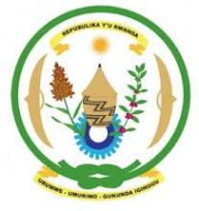
Kivu Seismological Network (KivuSnet)
Georges Mavonga ¹, Katcho Karume ¹, François Kervyn ², Silvanos Fiama ³, Adrien Oth ^{4,5}, Nicolas d’Oreye ^{4,5}, Jean de Dieu Bigirande ⁶, Laurent Habonimane ⁷
¹ Goma Volcano Observatory (GVO/DRC)
² Royal Museum For Central Africa (MRAC)
³ Centre de Recherche en science Naturelles (DRC)
⁴ Museum for Natural History (Luxemebourg)
⁵ ECGS (Luxemebourg)
⁶ Rwanda Natural Ressources Authority (RNRA/RWANDA)
⁷ University of Burundi (BURUNDI)

Slide 2
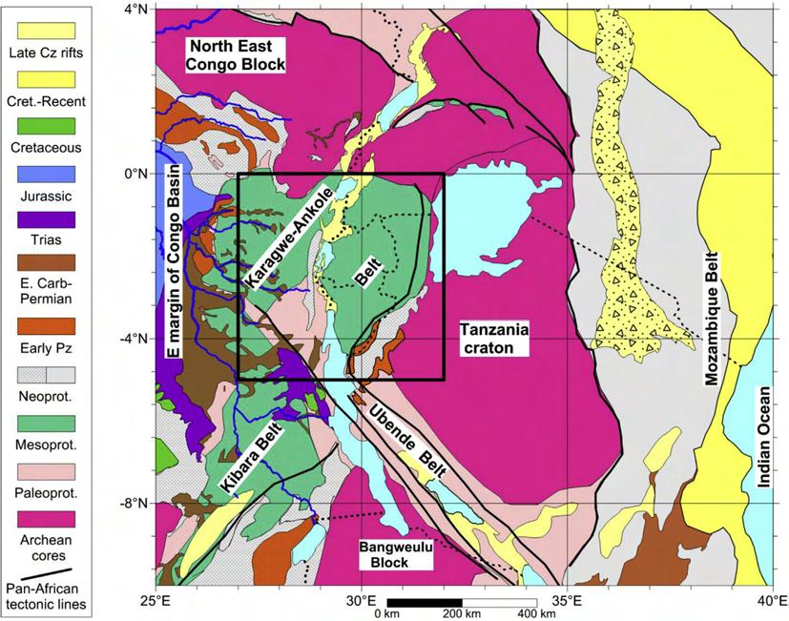
1. History of the Kivu Seismological Network
The Kivu rift region lies in the central part of the western branch of the East African rift system (Ebinger, 1989a) which is considered in an early continental extension stage (Deprez et al., 2003)
It extends over Rwanda, Burundi, eastern Democratic Republic of Congo (DRC), SW Uganda and NW Tanzania)

Slide 3
1. History of the Seismological Network of Kivu
It was extended later by setting up the Rumangabo (RMG) and Butembo (BTC) stations in the North Kivu Province. In cooperation with the IRSAC, the “Union miniere du Haut Katanga (UMHK)”, now “Generale de carrieres et des mines (GECAMINES)” set up a seismological network for Katanga from 1960 to 1970. This network included the stations of Delcommune (DCC), Lubudi (LBD) and Mulungwishi (MLN) (Bram, 1972). However, most of these seismic stations were closed during the period 1964 to 1970 due to the political instability in DRC.
The seismograph network of the “Institut pour la recherche en Afrique Centrale (IRSAC)” in Eastern DRC has been in operation since May 1953 when the station at Lwiro was set up.
This network operated initially with three stations: Lwiro (LWI), Butare (BTR) and Uvira (UVI) [Sutton and Berg, 1958].

Slide 4
1.History of the Seismological network of the Kivu
From 1994 to October 1996, an analogue-digital telemeter system based at Goma City composed of GOM, KBT, RSY, KNN, and BHB stations has been operating in cooperation with Tohoku University.
Due to instability in neighbouring country (Rwanda), most stations were destroyed excepted stations KTL and BLG which were equipped with short period Kinemetrics vertical SS-1 seismometers (T o = 1 sec) connected to PS-2 drum recorders .
On 17 January 2002, the Nyiragongo volcano erupted again, extruding about 20 x 10 m3 of lava. Lava flows originated out of the central crater as well as several locations along a huge system of fractures that rapidly developed along the entire southern flank of the volcano towards the city of Goma.
Two main flows entered the town producing major devastation, and forced the rapid exodus of 300,000–400,000 people. About 15% of the surface of the town was affected, including parts of the airport, most of the business centre, and the dwellings estimated 120,000 people. An estimated 150 people died as a consequence of eruption.

Slide 5
1. History of the Seismological network of the Kivu
With the aid of international community, on November 2003, GVO began the deployment of three-component short-period Lennartz (LE-3D/5 s) seismometers at Kunene (KNN), Rusayo (RSY), Kibumba (KBB), Goma and Bulengo (BLG) stations. On May 2004, the Lennartz short-period seismometer at KNN and KBB was replaced with Nanometrics Trillium 40 broadband seismometers. Signals from these stations were locally digitized from a modular acquisition system (GAIA), specifically developed by the‘‘IstitutoNazionale di Geofisica e Vulcanologia (INGV)”, with a sampling frequency of 50 Hz and an A/D resolution of 24 bits, and were telemetered to the Goma base station where they were recorded in triggered and continuous files.
Froml 2009, the seismograph stations in DRC were operated by the “Centre de recherche en Sciences Naturelles (CRSN)” , “Goma Volcanic Observatory” and the University of Lubumbashi (UNILU). The observation network was composed of seven stations: Katale(KTL), Luboga (LBG), Kunene (KNN), Rusayo (RSY), Kibumba (KBB), Goma and Bulengo (BLG). KTL and LBG stations were equipped with short period Kinemetrics vertical SS-1 seismometers (T o = 1 s) connected to PS-2 drum recorders due to transmission problems. In July 2007, the MRAC provided a broadband seismic station at Lubumbashi, in collaboration with UNILU and AfricaArray.

Slide 6
2. Seismological network of the Kivu
In 2012/2013 and since October 2015, 13 stations, mostly concentrated in the Virunga volcanic area , are operated with real-time data transmission.
The development of KivuSNet has been carried out in the framework of several research projects and is in particular associated with the project REmote Sensing and In Situ detection and Tracking of geohazards (RESIST), funded by the Belgian Science Policy and the National Research Fund of Luxembourg.

Slide 7
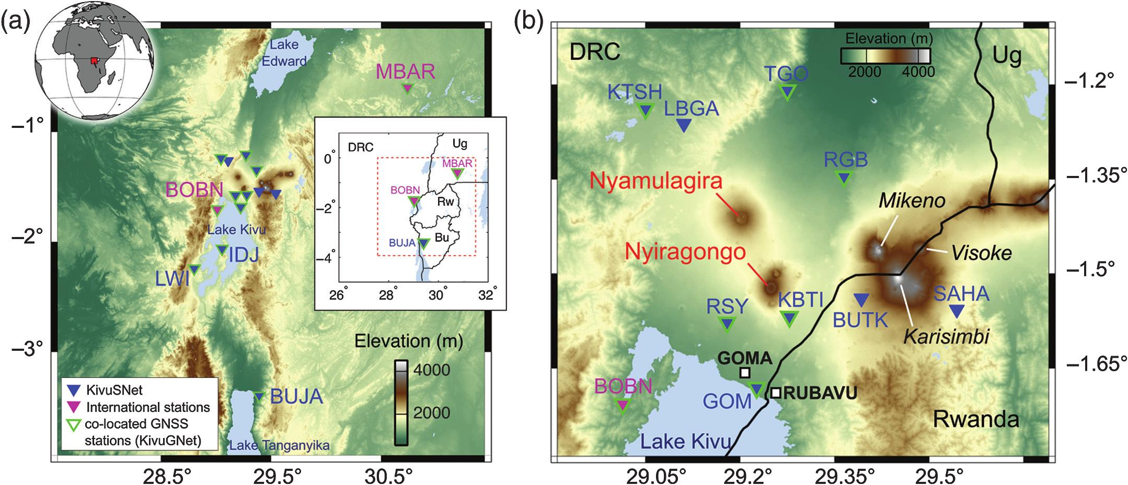
2. Seismological Network of the Kivu

Slide 8
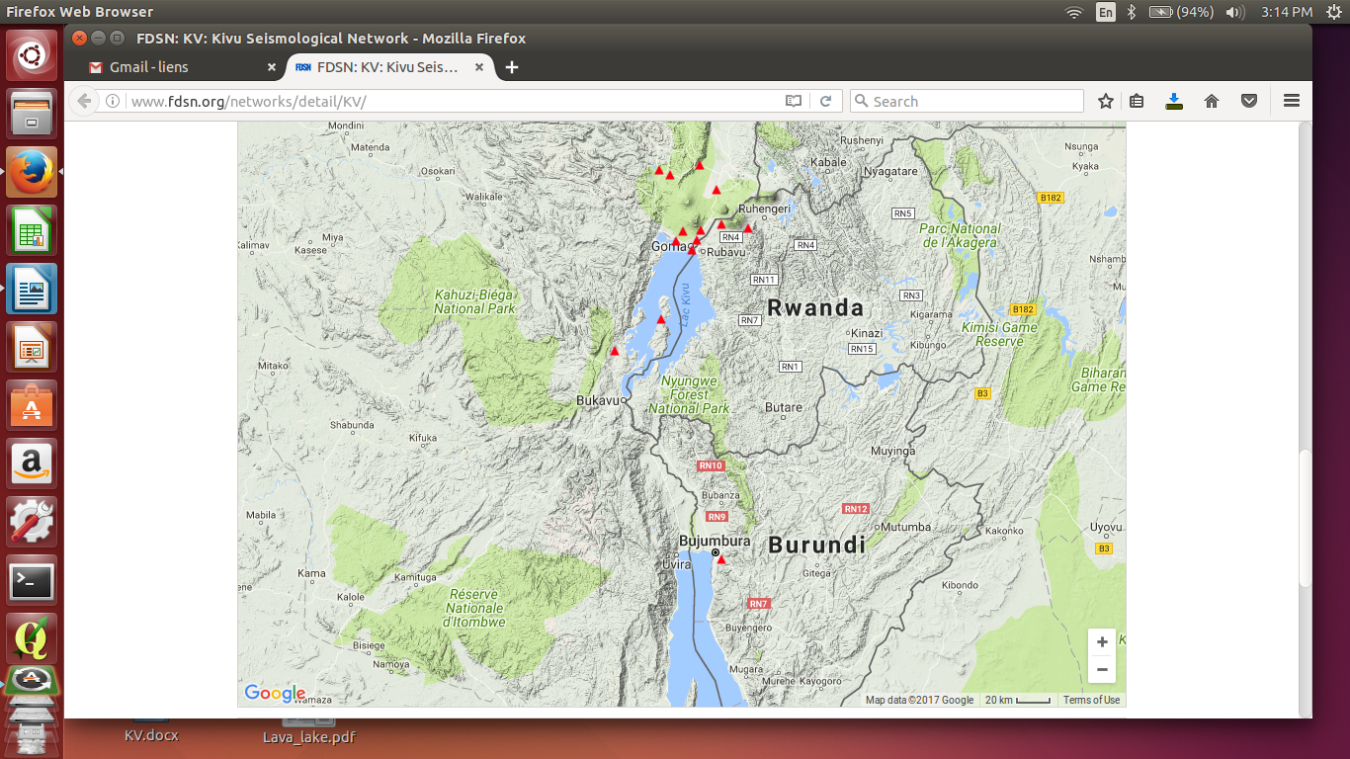
2. Seismological Network of the kivu

Slide 9
3. List of stations of Kivu Network

Slide 10
3. List of stations of Kivu Network
All seismic data are acquired at sample rates of 200 Hz (local storage only) and 50 Hz (local storage and real-time transmission), whereas the infrasound data are acquired at sample rates of 100 Hz (local storage only) and 50 Hz (local storage and real-time transmission
The RefTek RT130 datalogger at station BOBN was replaced with a Nanometrics Centaur datalogger on 4 October 2016. Prior to this date, data at BOBN were acquired with a sample rate of 40 Hz

Slide 11
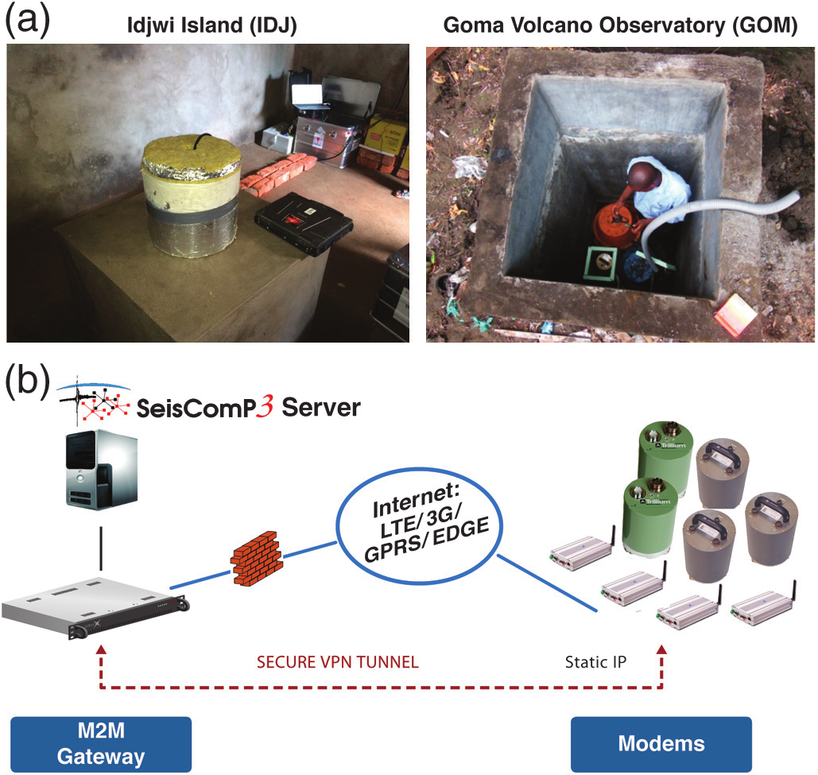
4. Station Design and Instrumentation
(a) Photographs of sensor installations at stations IDJ and GOM. All sensors are either installed on a seismic pier or in a shallow vault directly installed on the bedrock.
(b) Network communication setup illustration for real-time data trans-mission and remote-station confi-guration access. Each station is equipped with a modem for cellular data communication, and a secure VPN tunnel is established with the datacenter in Luxembourg

Slide 12
4. Station Design and Instrumentation
The digitizers are operated at a sampling frequency of 200 Hz, with secondary channels at 50 Hz transmitted in real time by cellular data network to the data center in Luxembourg.
All data are recorded onsite in miniSEED format on flash storage and regularly collected by the technicians of the responsible institutions
Each station was equipped in September/October 2015 with a Viola Systems (recently acquired by ABB) modem for wireless communication via cellular data (LTE/3G/GPRS/EDGE) network, in combination with an M2M gateway unit located in the data center in Luxembourg establishing secure VPN connections with all stations (Fig. 2b)

Slide 13
5. Data and Ressources
Station Bobandana (BOBN) has been installed in the framework of AfricaArray ( www.africaarray.psu.edu , last accessed November 2016), with instruments funded through AfricaArray and installation support from the Belgian Ministry of Foreign Affairs. A recent datalogger upgrade at BOBN has been carried out with financial support from the Council of Europe Major Hazards Agreement (EUR-OPA) and European Center for Geodynamics and Seismology (ECGS).
Station Luboga (LBGA), Munigi (MUNI), Rumangabo (RGB), Bulengo (BULE), Sake(SAKE), Mushaki(MUSK) has been acquired and installed by Goma Volcano Observatory (GVO) with support from the Luxembourgian partners using the Democratic Republic of the Congo government and MONUSCO funding.
The remaining stations have been acquired and installed with funding from the Direction générale Coopération au développement et Aide humanitaire of Belgium (DGD) (project RGL-GeoRisk); Lotto Belgium; the Belgian Science Policy (Belspo) and the Fonds National de la Recherche (FNR), Luxembourg (project Remote Sensing and In Situ Detection and Tracking of Geohazards [RESIST], http://resist.africamuseum.be , last accessed November 2016); and internal funds of the ECGS, Luxembourg, National Museum for Natural History (Mnhn, Luxembourg), and Royal Museum for Central Africa (RMCA, Belgium).

Slide 14
5. Data and Ressources
As part of AfricaArray, the data from station BOBN are freely available from Incorporated Research Institutions for Seismology (IRIS) with a time delay of three years. All other KivuSNet data are underlying an embargo policy following the conditions of the Memoranda of Understanding between the partner institutions of RESIST. The seismic data acquired during RESIST (2014–2018) will be opened five years following the end of the RESIST project. Data acquired after the end of RESIST will be opened with a time delay of three years. Beyond this embargo policy, data may be shared for collaboration purposes upon request with the approval of all RESIST partner
Data archiving and accessibility will be ensured through the GEOFON program of the GFZ German Research Centre for Geosciences, and KivuSNet is registered within the International Federation of Digital Seismological Networks (FDSN) with network code KV ( http://www.fdsn.org/networks/detail/KV/ , last accessed November 2016).

