Slide 1


Ethiopian Seismic Station Network
Birhanu Abera
Managing Data from Seismic Networks
Pretoria, South Africa
20 Aug 2017

Slide 2
Outline
Introduction
Map of the current ESSN network
Data Acquisition and processing
Description of the instrumentation
Product of ESSN seismic network
Plans for ESSN network in the next 5 years

Slide 3
Introduction
From 1959, the Geophysical Observatory deployed various seismometers.
Since then many local, regional and teleseismic EQs have been recorded.
Ethiopia is world's tectonic laboratory (e.g continental rifting AFAR depression and Triple junction of Afar Red See & Gulf of Eden).
Deformation due to rifting produced complex structures.
Earthquakes registered in Afar, MER, Rift margin & near cities.

Slide 4
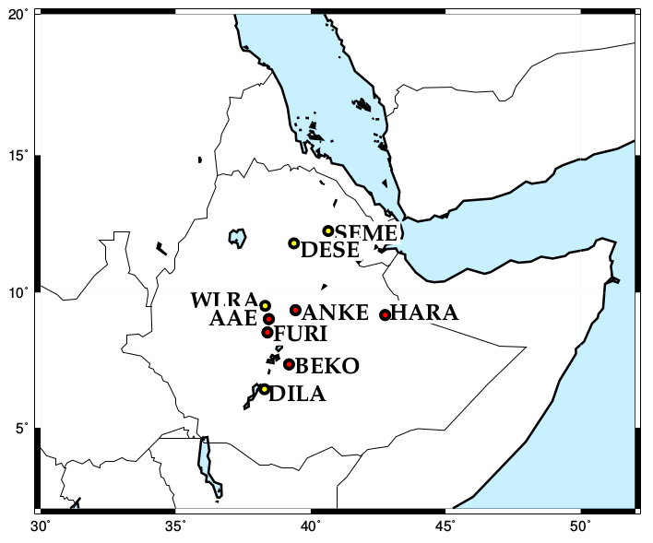
Map of the current ESSN network
Fig.1 Locations of the
ESSN stations. Stations
which are marked by red
circles are real time and
the rest are non-real time
N.B Regional Seismic network
included in ESSN
ATD ( Republic of Djibouti)
KMBO (Kenya)
LODK (Kenya)
MBAR(Uganda)

Slide 5
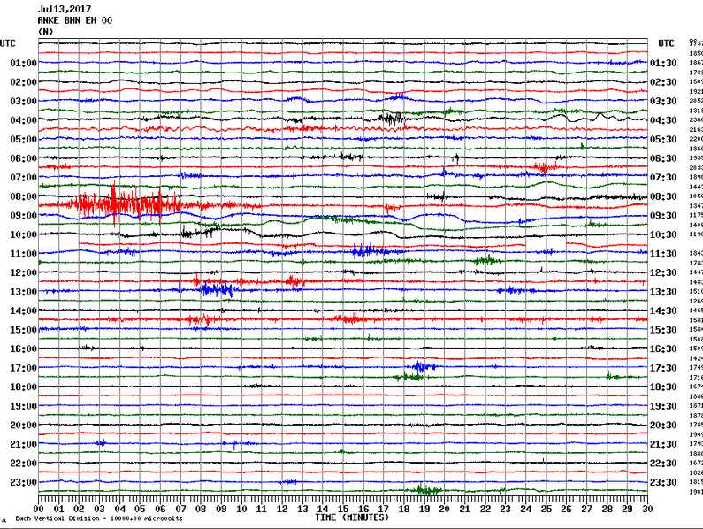
Data Acquisition and processing
ANKE Helicorder Display Jul 13, 2017
EarthWorm (v7.9 ) real time data acquisition
software.
Data stored in IGSSA data base
in miniSEED & SEISAN format.
Routine Data Processing is
undertaken using PQL, SAC
and SEISAN.

Slide 6
Description of the ESSN instrumentation
Station code | Site name | Installation date | Remark
AAE | Addis Ababa | 1959 | CMG-3T sensor and RT130 data logger
FURI | Mount Furi | 1997 | STS1 and STS2 sensor & Quantera 330 logger
ANKE | Ankober | 2007 | Trillium compact sensor with RT130 data logger
DESE | W/sh School | 1999 | Le-3d/20s working with RT130
HARA | Harar town | June, 2012 | CMG-3ESP sensor &Taurus data logger.
SEME | Semara Univ. |  | Trillium Compact + Taurus
WLRA | Welmera | January, 2017 | REF TEK data logger and CMG-3T sensor
DILA | Dila Univ. |  | CMG-3ESP sensor &Taurus data logger.
BEKO | Bekogi Tech. | 2016

Slide 7
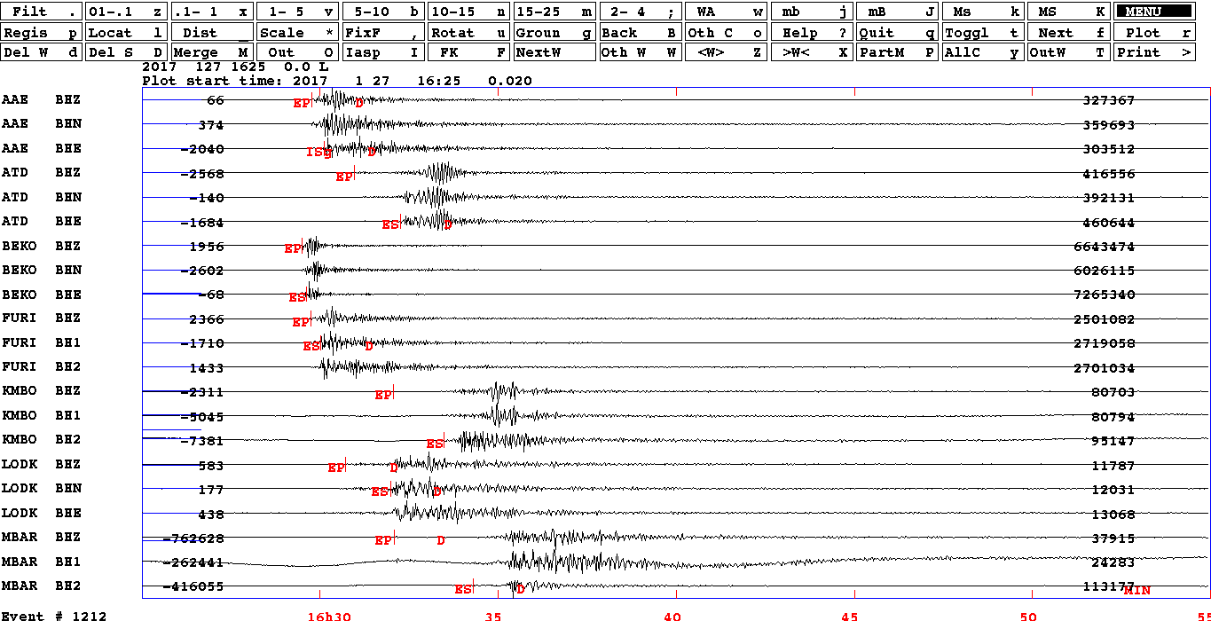
The 27 Juanary 2017 Ziway M 5.3 earthquake as recorded by Ethiopian seismic station Networks

Slide 8
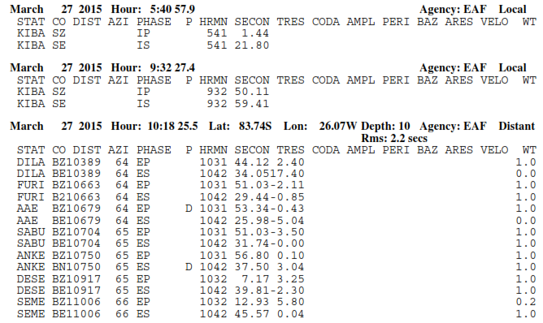
Product of ESSN seismic network

Slide 9
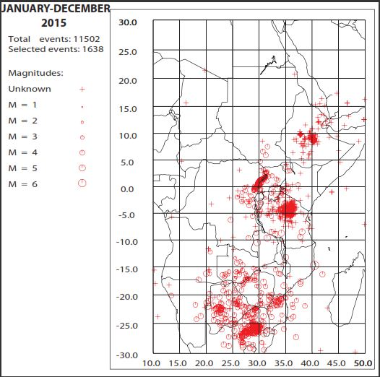
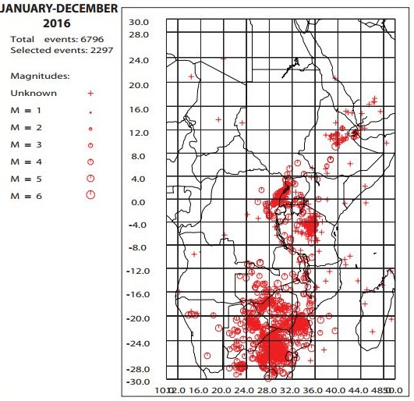
Seismicity Map of Eastern &Southern Africa 2015 & 2016

Slide 10
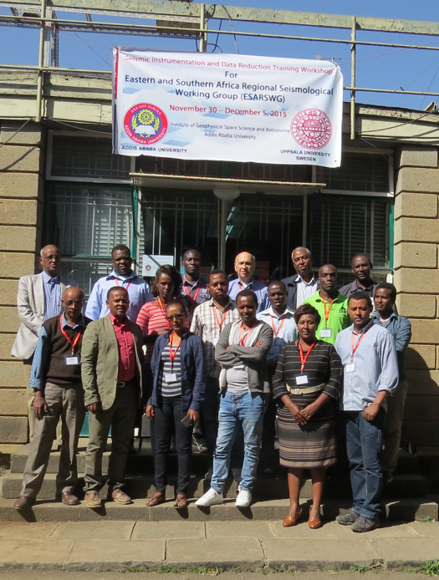
Plans for ESSN network in the next 5 years
Building complex
tower with good
facility
Developing the IGSSA seismology unit in
skilled manpower
More participation in regional
& international workshop
increasing staff proffessional development ESARSWG December 2015 (AAU)

Slide 11
Thank You

