Slide 1
REPORT ON MALAWI SEISMIC NETWORK
Chindandali P., Lunda J., Mphepo F.
Geological Survey Department of Malawi
Managing Data from Seismic Networks
August 20-26, 2017, Pretoria, South Africa

Slide 2
Contents
Introduction
Objectives
Seismic Network
Real-Time Monitoring
Data Availability
Seismicity
Collaborations
Summary/Conclusion

Slide 3
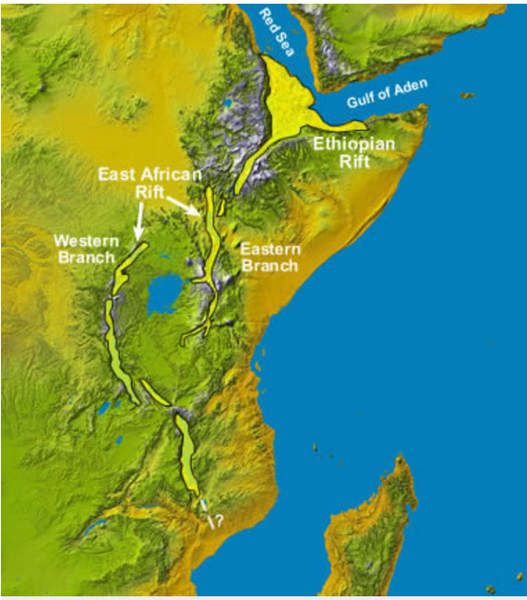
Introduction
Malawi is located on the western branch of the East African Rift System –EARS (Figure 1).
It is a seismically active belt mostly characterized by shallow earthquakes
Malawi
Figure 1: The East African Rift System

Slide 4
objectives
Determination of earthquake locations
Seismic hazards research & monitoring
Mapping of suspected faults
Research on the interior of the earth
Dissemination of earthquake information to general public
Advising Government and civil society on matters relating to earthquakes
Public awareness

Slide 5
Seismic Network
Instrumental seismological observation in Malawi dates back to 1962
Currently, 6 broadband stations are operational.
Four stations are co-located with GPS stations
AfricaArray operates two seismic stations in Zomba and Mzuzu, co-located with GPS and weather Stations.
Figure 2: Seismic Stations in Malawi (Basemap: Ryan et. Al., 2009)

Slide 6
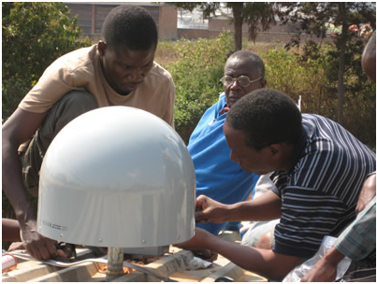
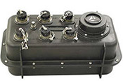
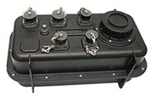
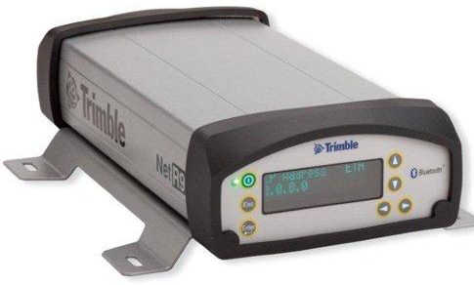
Seismic Network
Equipment:
RT 130-01/B Data Loggers by RefTek
151-120A Seismometers by RefTek (Figure 3)
Trillium Compact broadband seismometers
Trimble NetRS/NetR9 GPS system
151-120A Sensor. Phot courtesy of RefTek
Installation for GPS antenna. Photo courtesy of UNAVCO
RT130-01 Data Logger
RT130-B Data Logger
NetR9 GPS system.
http://www.trimble.com/
Compact Trillium Sensor
http://www.nanometrics.ca

Slide 7
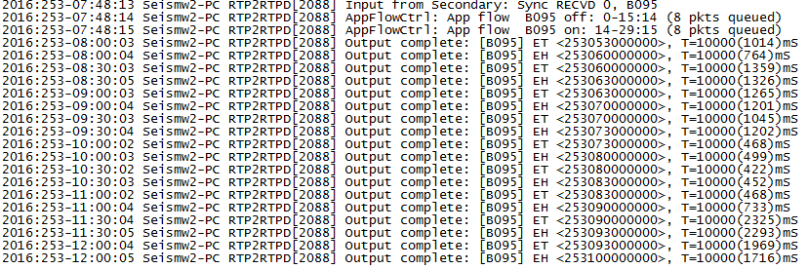
Real-Time Monitoring
Currently, only ZOMB is streaming data to IRIS in real-time under AfricaArray –AF. (Figure 4)
Dedicated IP address
We intend to establish remote access to a few more stations in future through GSM
Figure 4: Real-time data streaming to IRIS from ZOMB using RTP2RTPD

Slide 8
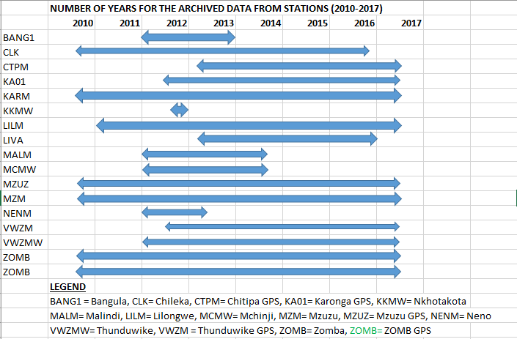
Data Availability since 2010

Slide 9
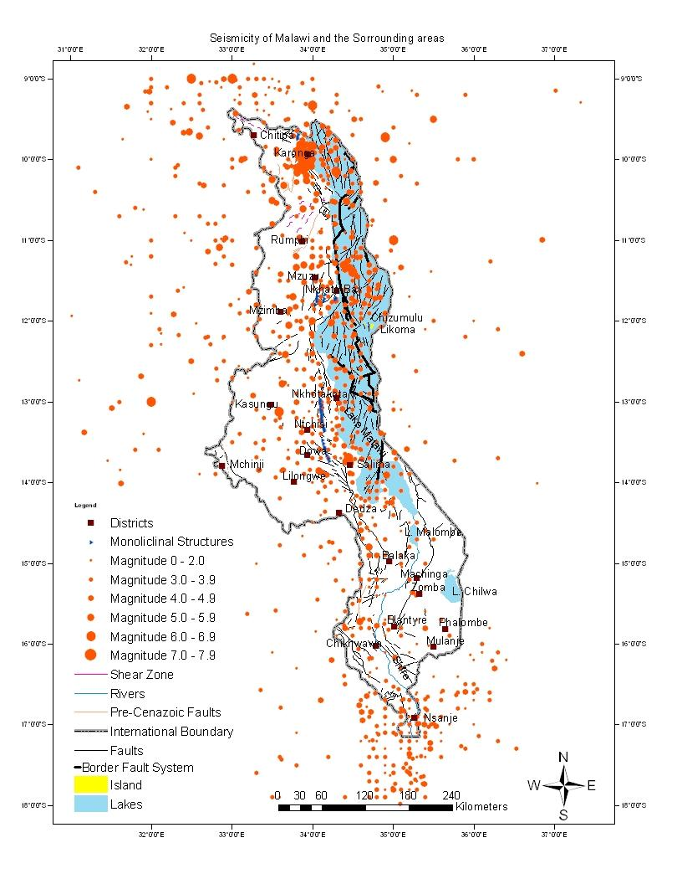
Seismicity
Small-to-moderate earthquakes occur both from within the country and from neighbouring countries
Spatial distribution shows northern Malawi as highly active followed by the centre whereas the south is sparsely distributed
Seismicity picks up again further south of the country into Mozambique (Figure 5).
Figure 5: Seismicity of Malawi

Slide 10
Collaborations
Geological Survey Department of Malawi
Malawi Polytechnic- University of Malawi
Mzuzu University
Chancellor College- University of Malawi
Malawi University of Science and Technology
Malawi Institute of Engineers
Catholic University
CTBTO
IRIS
Goetz Observatory, Bulawayo
ESARSWG
Lamont-Doherty Institute,Columbia University, USA etc.

Slide 11
Summary/Conclusion
Generally, spatial distribution of earthquakes concentrates along the rift structures.
Northern Malawi is highly active followed by the centre. The southern part is sparsely distributed before it picks up again in the Mozambique area
Recent events in the country needs consistent monitoring and densification of stations.
5 stations will be reinstalled soon
To add a few more stations on Open Data Policy as part of FSDN effort

Slide 12
Thank you for listening

