Slide 1
SUMMARY OF SEISMIC NETWORK IN MOZAMBIQUE

Slide 2
SUMMARY OF SEISMIC NETWORK IN MOZAMBIQUE

Slide 3
1. History of Seismology in Mozambique
1954 - Construction of the first seismographic station, installed in Maputo, in the current Metrology.
1957 - Transfer from Seismographic Station to Changalane.
1970 to 1974 - Constroi is the station of Tete, Nampula and Songo.
More or less 1990 - Construction of the station of Manica and Lichinga.
Later, between 2000 and 2010, the stations of Chibotane, Mapinhane, Mueda and Mocuba were built.

Slide 4
1. Historical data on earthquakes in Mozambique

Slide 5
2. Occurrence of earthquakes between 2006 and 2017
During this period the greatest earthquake occurred on February 23, 2006, in Chitobe, Matchaze (magnitude 7.0 on the Richter scale);
It was felt in the provinces of Manica, Tete, Niassa, Sofala, Inhambane, Gaza, Maputo and in the surrounding countries
It caused the death of 5 people, 28 wounded and destruction of more than 280 houses, as well as others that suffered cracks in its structure.

Slide 6
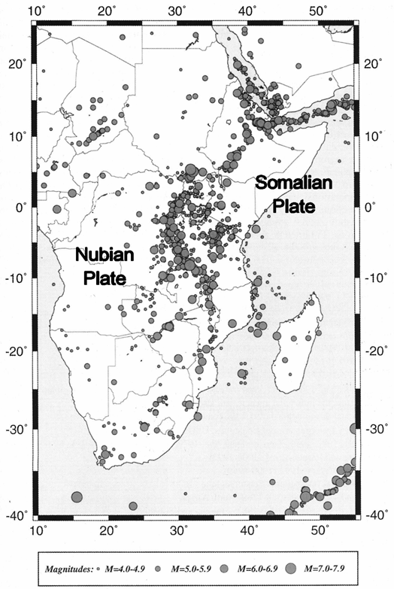
3. Seismic Activity in Mozambique
The zones with the greatest concentration of earthquakes are:
African Rift extension to the south from Lake Niassa and heading south more or less parallel between meridians 33⁰-35⁰ E to the parallel 25⁰ S;
Channel of Mozambique:
10⁰-18⁰S; 40⁰-42⁰E and
21⁰-24⁰S; 37⁰-40⁰E.

Slide 7
CURRENT STAGE OF THE SEISMIC NETWORK IN MOZAMBIQUE

Slide 8
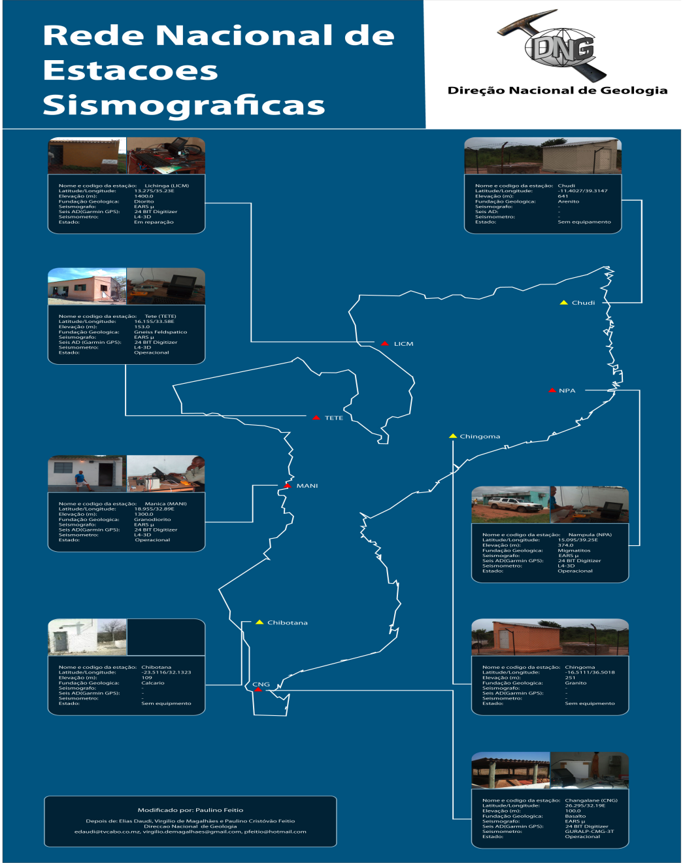
6. National Network of Seismographic Stations of Mozambique
The National Network of Seismographic Stations, is currently constituted by 10 (ten) seismographic stations. Being 3 (three) of broadband and 6 (six) of short period. Broadband namely: Changalane, Tete and Mueda. Short period namely are: Nampula, Niassa, Mocuba, Manica, Chibotana and Mapinhane.
Of the total of 10 (Ten) stations; Only 2 (two) are in operation; And the remaining 8 (eight) are stopped, for various reasons, and work is in progress to replace the remaining stations.

Slide 9
We use the following equipment:
Reftek 130B and JetBox 8150 (Industrial Communication Computer), as data loggers;
Sensors L-4-3-D short period and Nanometric Broadband.
Two software are used, Linux Opensuse and seiscomp3.
On the server is installed Linux opensuse and Seiscomp3, and in some stations.
All the data of the stations are sent in real time to the data server, in the center of analysis and data processing; Using VPN transmission.

Slide 10
7. Characterization of Seismographic Stations
Ord. | Station Name | Type of existing equipment / use
01 | Changalane (CNG). | Seismometer: DataLogger 130B Sensor: Compact Trillium Nanometric ( Broadband )
02 | Nampula (NPA). | Seismometer: Jetbox 8150 Korenix Sensor :L-4-3-D
03 | Manica (MANI). | Seismometer: Jetbox 8150 Korenix Sensor :L-4-3-D
04 | Tete (TET). | Seismometer: DataLogger 130B Sensor: Compact Trillium Nanometric ( Broadband )
05 | Lichinga (LICH). | Seismometer: Jetbox 8150 Korenix Sensor :L-4-3-D

Slide 11
Ord. | Station Name | Type of existing equipment / use
06 | Mapinhane.
07 | Chibotane.
08 | Mocuba. | Seismometer: DataLogger 130B Sensor: Compact Trillium Nanometric ( Broadband )
08 | Mueda. | Seismometer: DataLogger 130B Sensor: Compact Trillium Nanometric ( Broadband )

Slide 12
8. Expansion of the National Network of Seismographic Stations
To guarantee network coverage and efficient determination of epicenters and study of seismic risk in Mozambique; The government is expanding the network of seismographic stations. Thus, one (1) new infrastructure will be built to function as a seismographic station, namely:
Machaze Station, In the province of Manica, along the Rift Valley.

Slide 13
5. Objectives of Seismic Monitoring in Mozambique
Monitor seismic events throughout the country
Collection and analysis of seismographic stations data; Determination of magnitude and intensity of earthquakes;
Determination and location of seismic epicenters;
Update of the epicenters letter;
Updating of the Seismic Zoning letter;
Provision of data to interested entities and
Civic education;
Updating of the catalogs of earthquakes;
Preparation of weekly, monthly, and annual seismic bulletins; and
Ensure the sharing of data with international institutions in this area;

Slide 14
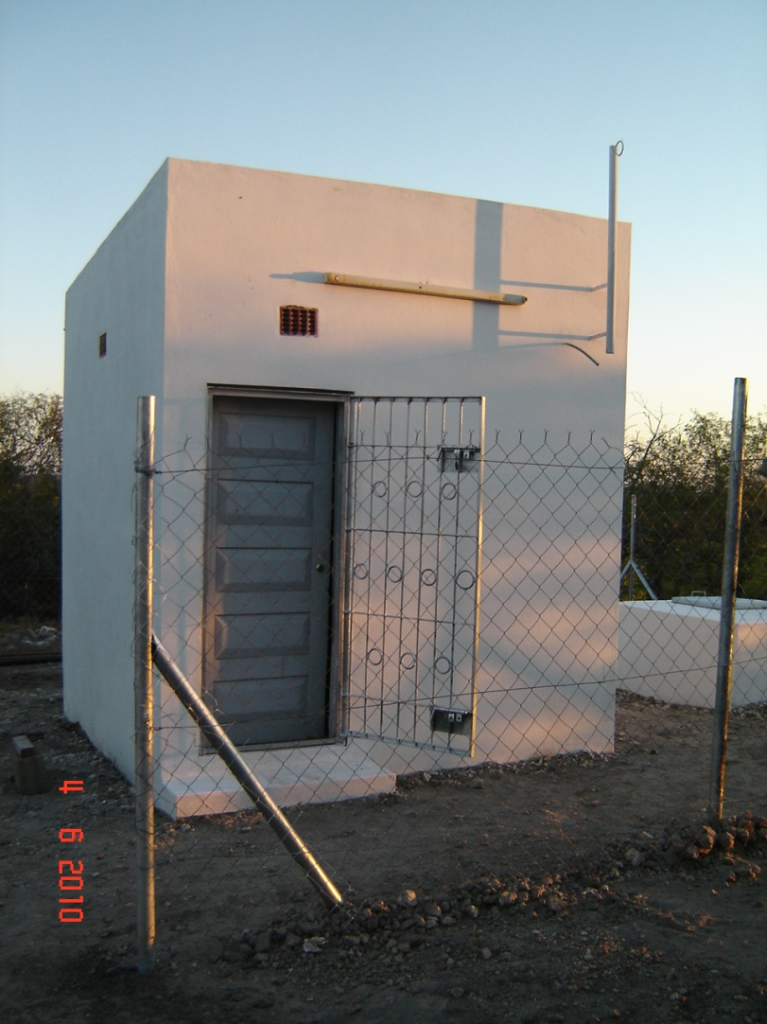
9. House for Seismographic Station
Casota para a Estação Sismográfica de Massingir

Slide 15
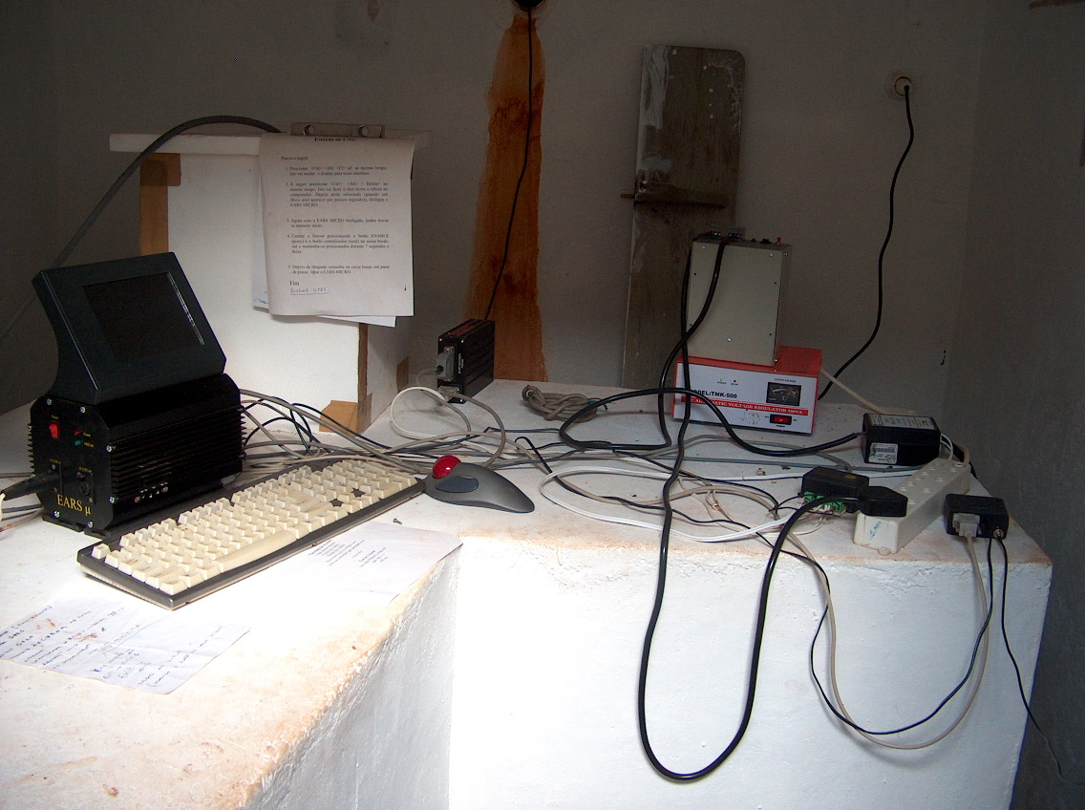
9. COMPOSITION OF A SISMOGRAPHIC STATION
Batteries charger
Seismograph
Estabil. tensao
Voltage regulator
Keyboard
Mouse
Distrib. tensão
Modem
Digitallizer

