Slide 1
The FDSN and International Data Exchange

Slide 2
What is the FDSN?
The FDSN is an International organization that has commission status within IASPEI
It is the standards body that created the SEED format
FDSN Executive Committee
Chair of the FDSN - Sergio Barrientos, Chile
Secretary - Michelle Grobbelaer, S. Africa
WG I Station Siting and Instrumentation - Wen-Tzong Liang, Taiwan
WG II Data Exchange - John Clinton, Switzerland
WG III Coordination of Products Tools and Services - Tim Ahern, USA
WG IV CTBT Issues - Istvan Bondar, Hungary
Portable Instruments - Bruce Beaudoin, USA

Slide 3
FDSN acts like an NGO and has no direct funding
FDSN activities are undertaken by its members using resources they have at their disposal

Slide 4
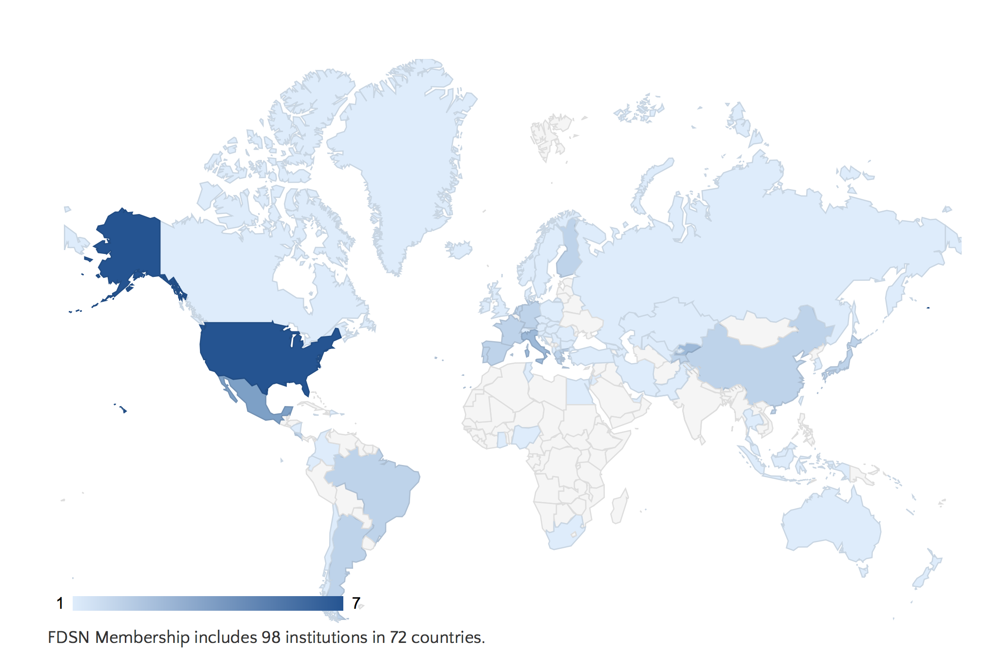
FDSN Membership
98 Institutions in 72 countries

Slide 5
Africa is underrepresented
We encourage you to join the FDSN
No cost and you become part of the primary global organization in seismology
Join at http://www.fdsn.org/forms/membership_form.htm

Slide 6
Register your network or temporary deployments with the FDSN
On behalf of the FDSN, IRIS assigns unique
network codes
Permanent networks
Temporary Networks
Start with X, Y, Z or a number 1-9 and assigned for specific years
Digital Object Identifiers
http://www.fdsn.org/networks/request/

Slide 7
FDSN Products and Activities
FDSN Web Site
Support for the SeisComp3 System
SEED Manual and format
FDSN Station Book
Assignment of Network Codes and DOIs
Definition of standardized FDSN Services
Federated Data Centers

Slide 8
FDSN: 2 ways for African Networks to Participate Directly
FDSN Web services
dataselect – timeseries data
station – metadata describing seismic stations
event – earthquake catalogs
Federation of Data Centers
Highly leverages the standard services

Slide 9
An example of using the FDSN Station Web Service
Link to IRIS Services and to FDSN Station Service & URL Builder
http://service.iris.edu
http://service.iris.edu/fdsnws/station/1/
http://service.iris.edu/fdsnws/station/docs/1/builder/
http://service.iris.edu/fdsnws/station/1/query?net=IU&sta=ANMO&level=station&format=geocsv&includecomments=true&nodata=404

Slide 10
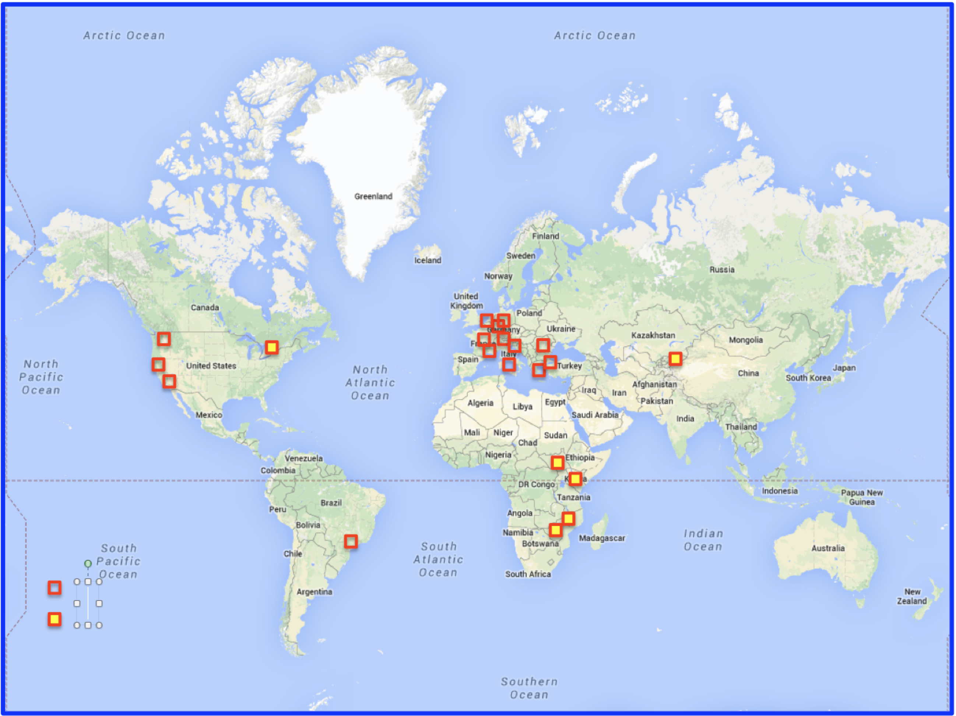
Federated Centers

Slide 11
A Federated model in seismology
DC1
DC2
DC3
DC4
DC 5
DC 6
DC 7
Client
IRIS
Catalog Service
DC n

Slide 12
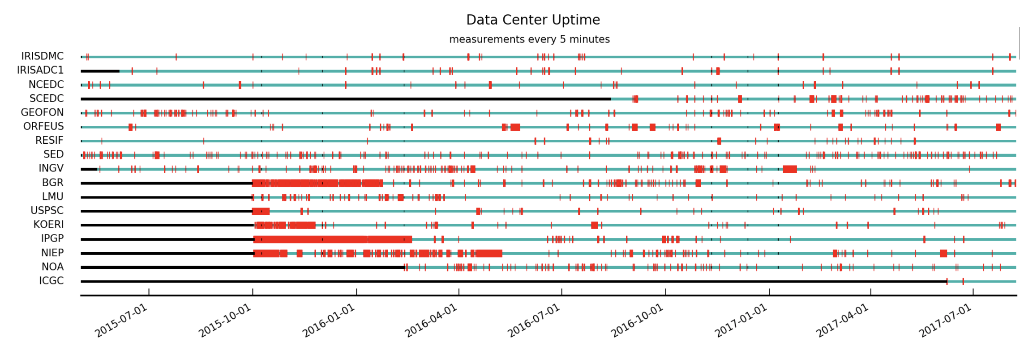
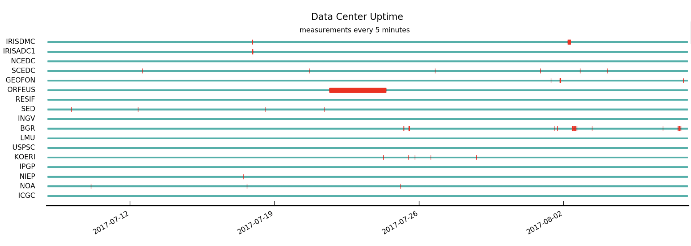
Reliability of Federated Centers
Last 2+ years
Last Month

Slide 13
SeisComp3: A Solution for Networks Becoming a Federated Data Center
SeisComp3 was initially developed by Winfried Hanka and the GEOFON project within GFZ, Potsdam
Now supported by GEMPA, Potsdam, and other groups
Seiscomp3 releases that support FDSN Web Services
Seattle version March 25, 2014
Jakarta version November 28, 2016
Supported FDSN Web Services
Dataselect
Station
Event
SeisComp3 is freely available from
https://www.seiscomp3.org
Requires licensing

Slide 14
A Workshop Goal
Use the knowledge you gain in this workshop to
Install SeisComp3 to manage your network
Activate FDSN Web Services
Become part of the Federated Data Center System
Share your data with neighboring networks and the international community

