Slide 1
The FDSN and International Data Exchange
Dr. Tim Ahern
Director of Data Services
IRIS
Training in Network Management Systems and Analytical Tools for Seismology • 23–27 October 2017 • Baku, Azerbaijan

Slide 2
What is the FDSN?
The FDSN is an International organization that has commission status within IASPEI
It is the standards body that created the SEED format
FDSN Executive Committee
Chair of the FDSN - Sergio Barrientos, Chile
Secretary - Michelle Grobbelaer, S. Africa
WG I Station Siting and Instrumentation - Wen-Tzong Liang, Taiwan
WG II Data Exchange - John Clinton, Switzerland
WG III Coordination of Products Tools and Services - Tim Ahern, USA
WG IV CTBT Issues - Istvan Bondar, Hungary
WG V Portable Instruments - Bruce Beaudoin, USA
Training in Network Management Systems and Analytical Tools for Seismology • 23–27 October 2017 • Baku, Azerbaijan

Slide 3
Primary goals of the FDSN
1. Development of instrumentation standards
2. Development of standards for quality control, archiving, and data exchange
3. Facilitating coordination of station siting
4. Pursuing and promoting open access to data
5. Improving access to data in real time
Training in Network Management Systems and Analytical Tools for Seismology • 23–27 October 2017 • Baku, Azerbaijan

Slide 4
FDSN has no direct funding
FDSN activities are undertaken by its members using resources they have at their disposal
Training in Network Management Systems and Analytical Tools for Seismology • 23–27 October 2017 • Baku, Azerbaijan

Slide 5
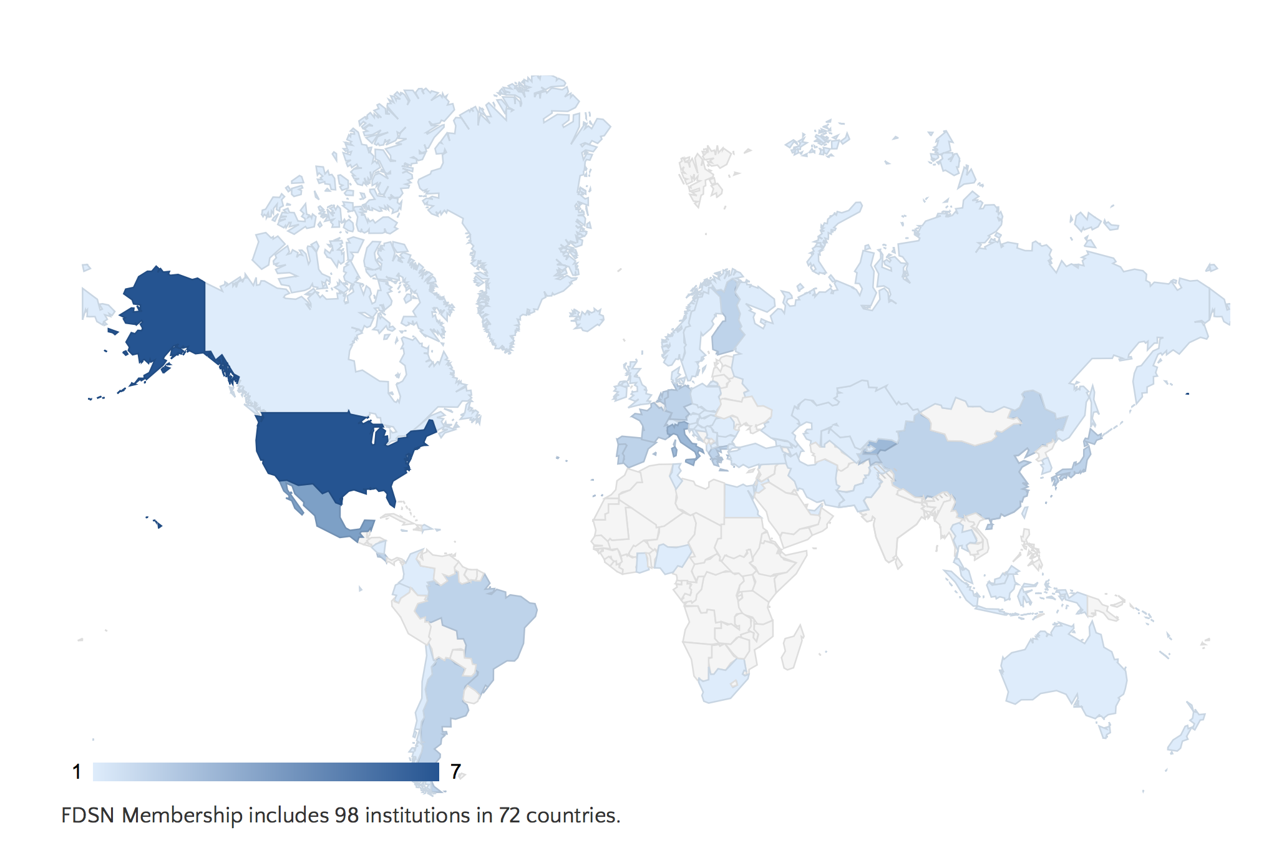
FDSN Membership
98 Institutions in 72 countries
Training in Network Management Systems and Analytical Tools for Seismology • 23–27 October 2017 • Baku, Azerbaijan

Slide 6
Joining the FDSN
We encourage you to join the FDSN
No cost and you become part of the primary global organization in seismology advocating for free and open access to data in real time
Join at http://www.fdsn.org/forms/membership_form.htm
Training in Network Management Systems and Analytical Tools for Seismology • 23–27 October 2017 • Baku, Azerbaijan

Slide 7
Register your network or temporary deployments with the FDSN
On behalf of the FDSN, IRIS assigns unique
network codes
Permanent networks
Temporary Networks
Start with X, Y, Z or a number 1-9 and assigned for specific years
Digital Object Identifiers
http://www.fdsn.org/networks/request/
Training in Network Management Systems and Analytical Tools for Seismology • 23–27 October 2017 • Baku, Azerbaijan

Slide 8
IRIS Support for the FDSN Products and Activities
FDSN Web Site
Support for the SeisComp3 System
SEED Manual and format
FDSN Station Book
Assignment of Network Codes and DOIs
Definition of standardized FDSN Services
Federated Data Centers
Training in Network Management Systems and Analytical Tools for Seismology • 23–27 October 2017 • Baku, Azerbaijan

Slide 9
FDSN: 2 ways for Seismic Networks to Participate Directly
FDSN Web services
dataselect – timeseries data
station – metadata describing seismic stations
event – earthquake catalogs
Federation of Data Centers
Highly leverages the standard services
Training in Network Management Systems and Analytical Tools for Seismology • 23–27 October 2017 • Baku, Azerbaijan

Slide 10
An example of using the FDSN Station Web Service
Link to IRIS Services and to FDSN Station Service & URL Builder
http://service.iris.edu
http://service.iris.edu/fdsnws/station/1/
http://service.iris.edu/fdsnws/station/docs/1/builder/
http://service.iris.edu/fdsnws/station/1/query?net=IU&sta=ANMO&level=station&format=geocsv&includecomments=true&nodata=404
Training in Network Management Systems and Analytical Tools for Seismology • 23–27 October 2017 • Baku, Azerbaijan

Slide 11
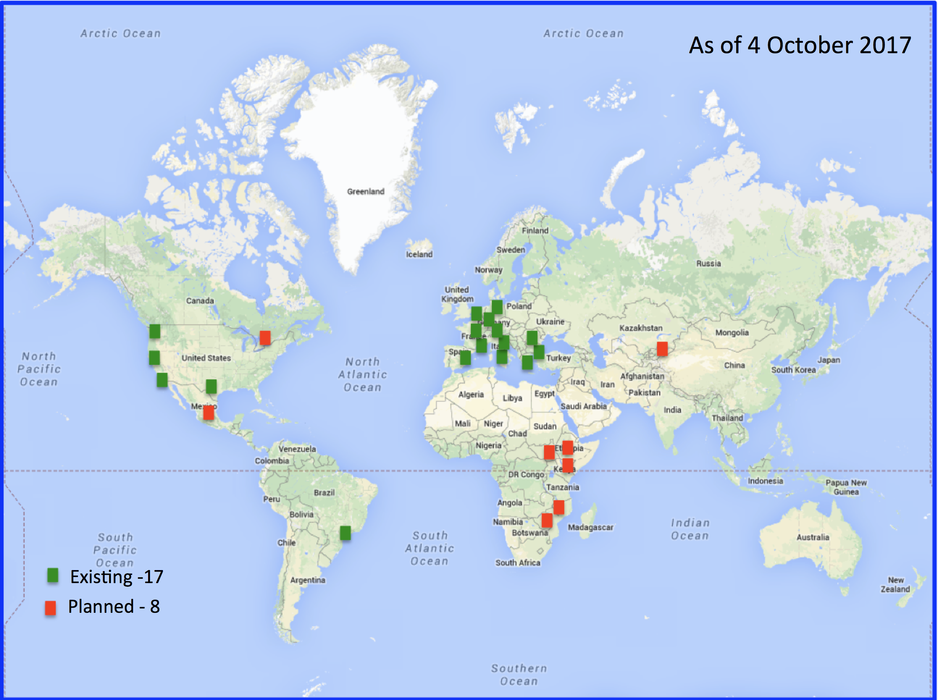
Federated Centers
Training in Network Management Systems and Analytical Tools for Seismology • 23–27 October 2017 • Baku, Azerbaijan

Slide 12
A Federated model in seismology
DC1
DC2
DC3
DC4
DC 5
DC 6
DC 7
Client
IRIS
Catalog Service
DC n
Training in Network Management Systems and Analytical Tools for Seismology • 23–27 October 2017 • Baku, Azerbaijan

Slide 13
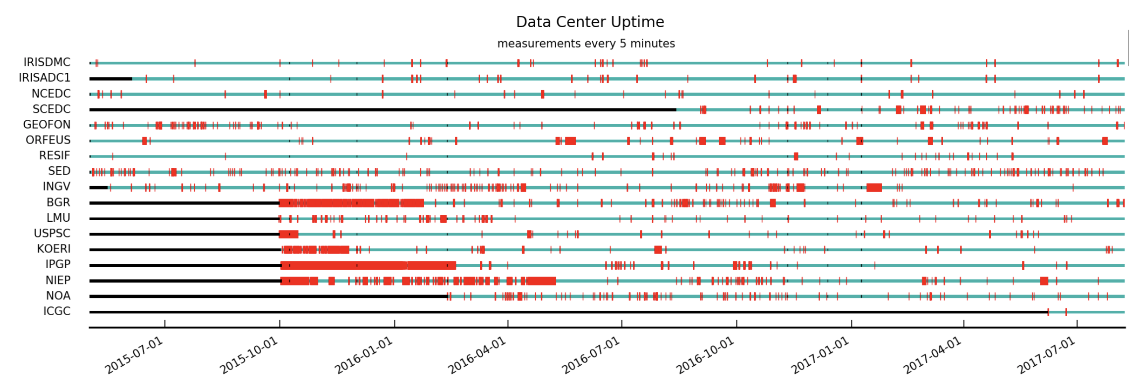
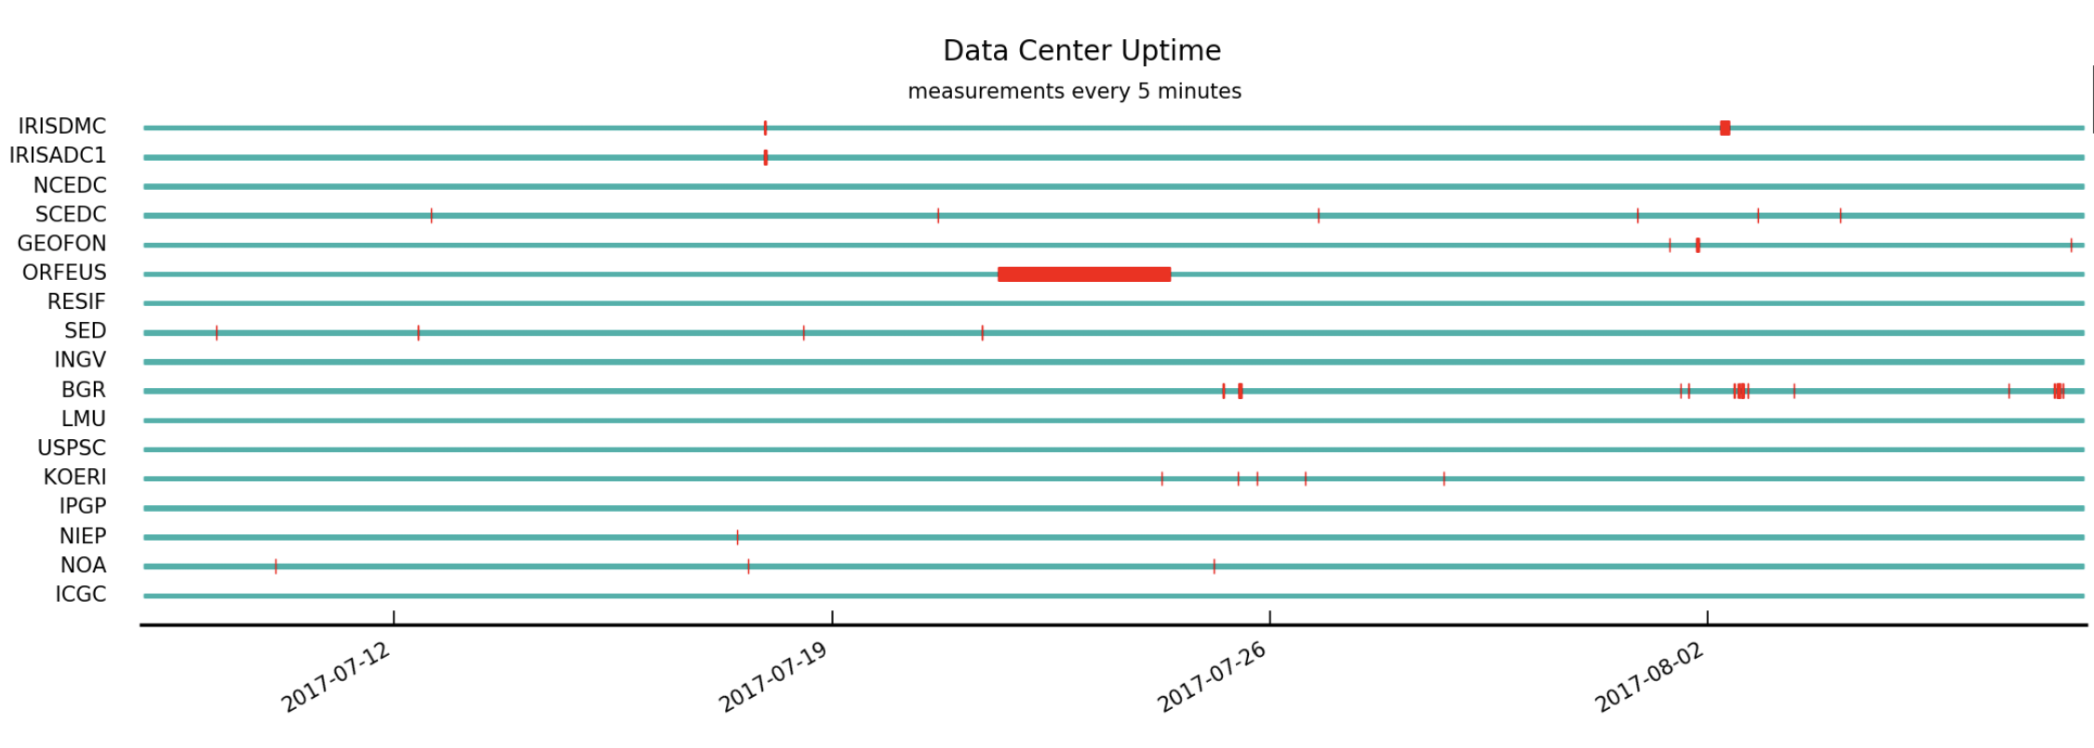
Reliability of Federated Centers
Last 2+ years
Last Month
Training in Network Management Systems and Analytical Tools for Seismology • 23–27 October 2017 • Baku, Azerbaijan

Slide 14
SeisComp3: A Solution for Networks Becoming a Federated Data Center
SeisComp3 was initially developed by Winfried Hanka and the GEOFON project within GFZ, Potsdam
Now supported by GEMPA, Potsdam, and other groups
Seiscomp3 releases that support FDSN Web Services
Seattle version March 25, 2014
Jakarta version November 28, 2016
Supported FDSN Web Services
Dataselect
Station
Event
SeisComp3 is freely available from
https://www.seiscomp3.org
Requires licensing
Training in Network Management Systems and Analytical Tools for Seismology • 23–27 October 2017 • Baku, Azerbaijan

Slide 15
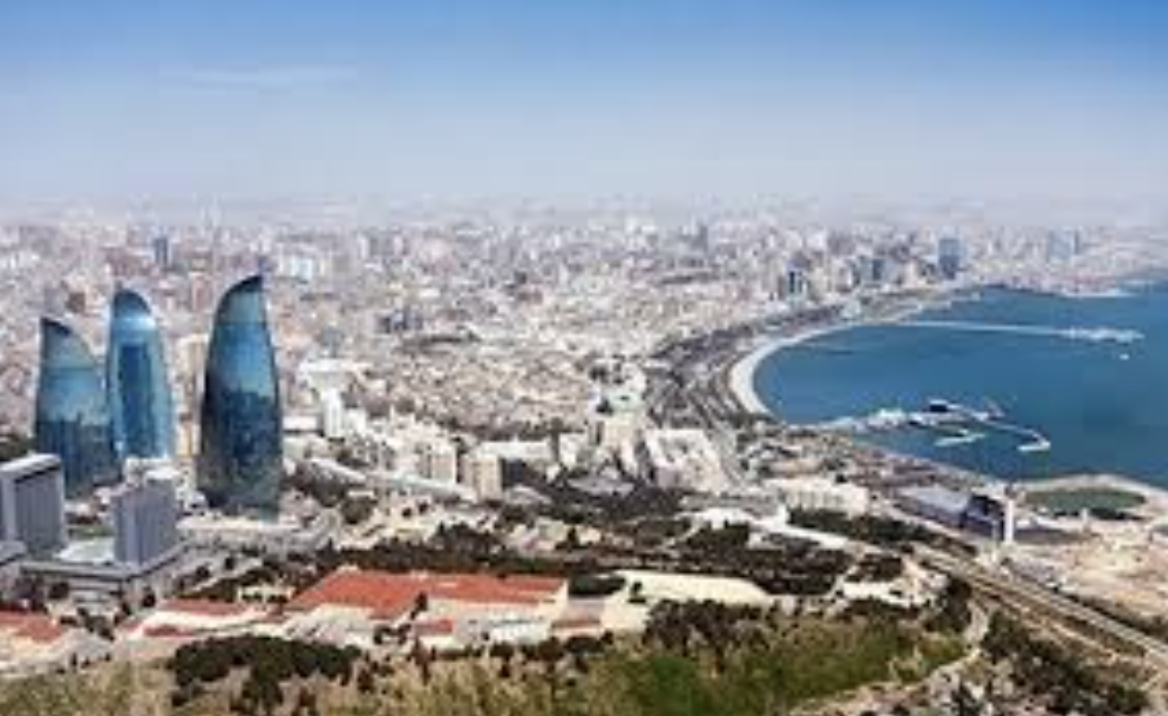
FDSN Relevant Workshop Goal
Use the knowledge you gain in this workshop to
Install SeisComp3 to manage your seismic network
Activate FDSN Web Services
Become part of the Federated Data Center System
Share your data with neighboring networks and the international community
Training in Network Management Systems and Analytical Tools for Seismology • 23–27 October 2017 • Baku, Azerbaijan

Slide 16
Thanks for providing time for the FDSN at this workshop

