Slide 1
Network interactions with mustang
MUSTANG Clients
Laura hutchinson, IRIS DMC

Slide 2
Network Interactions
Other than using web services, these clients provide ways to utilize the MUSTANG metrics
MUSTANG Databrowser
LASSO – IRIS IS
MUSTANGular – PNSN
These are ways to visualize the MUSTANG metric values, which can be easier to digest
Can be useful for your own QA

Slide 3
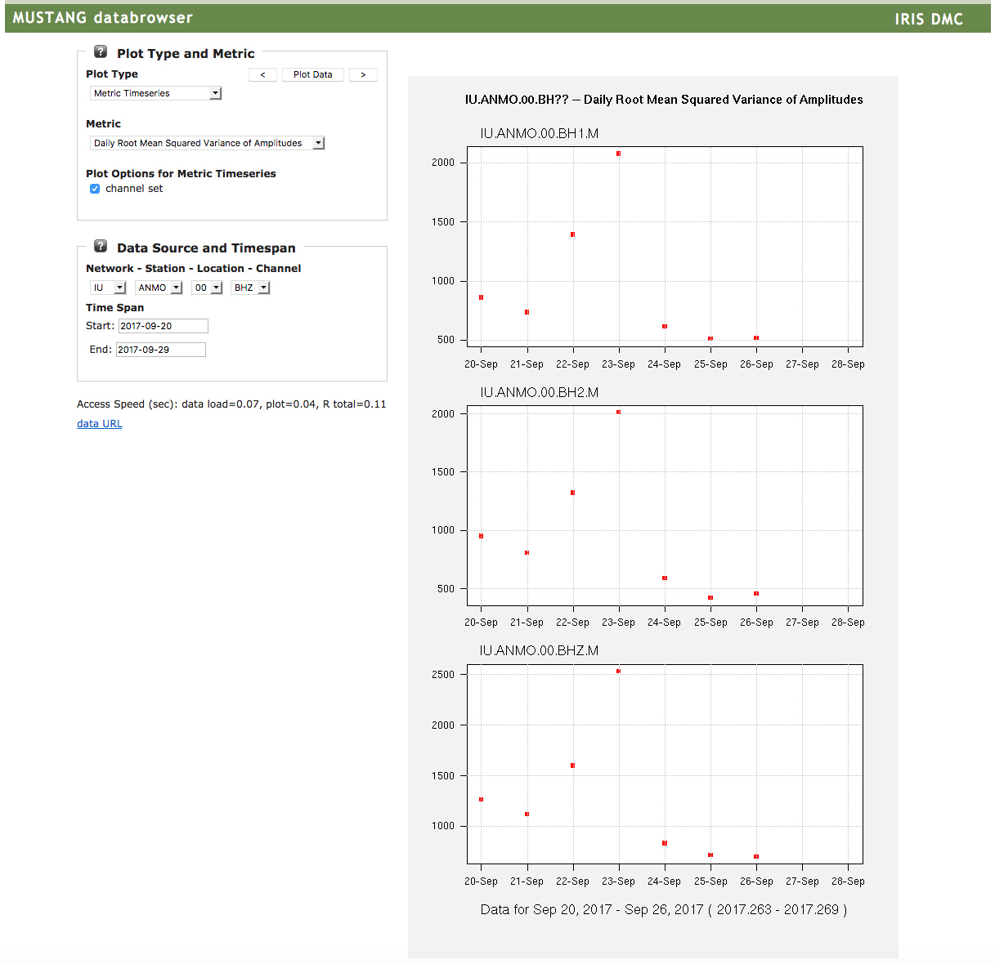
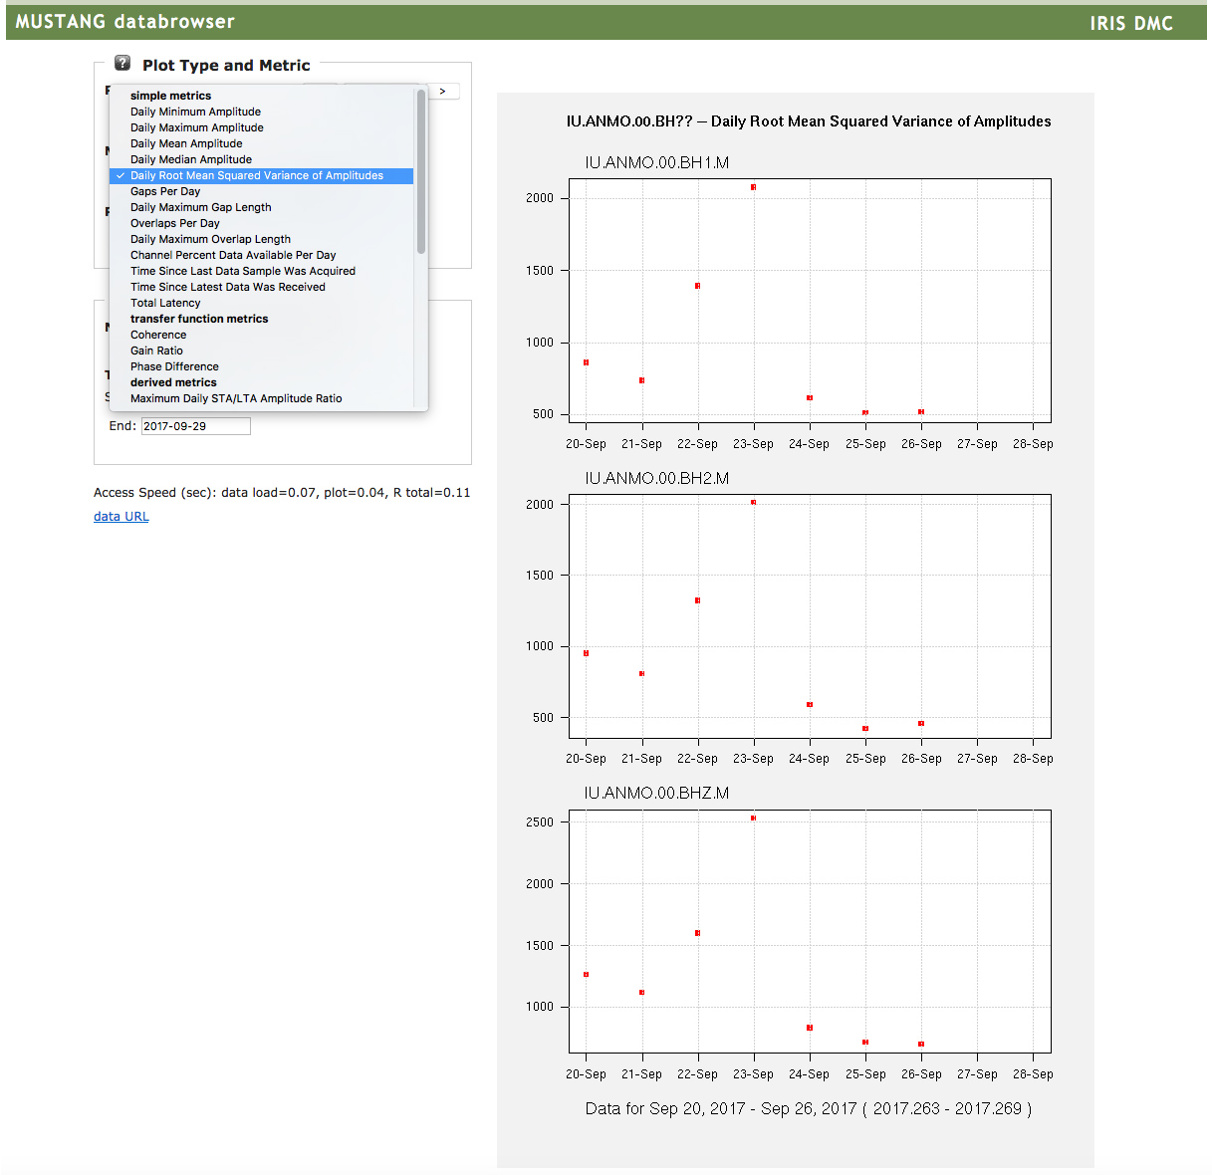
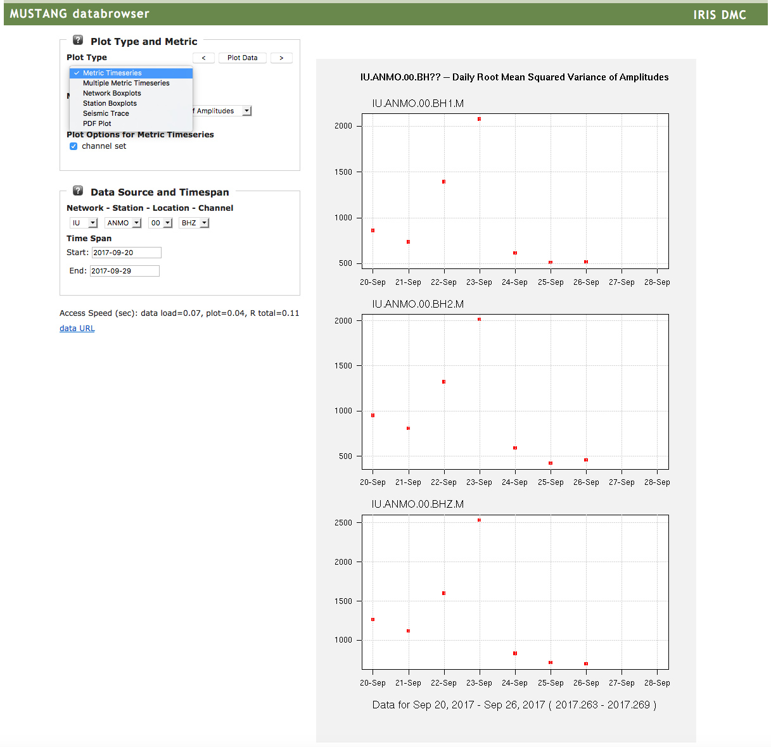
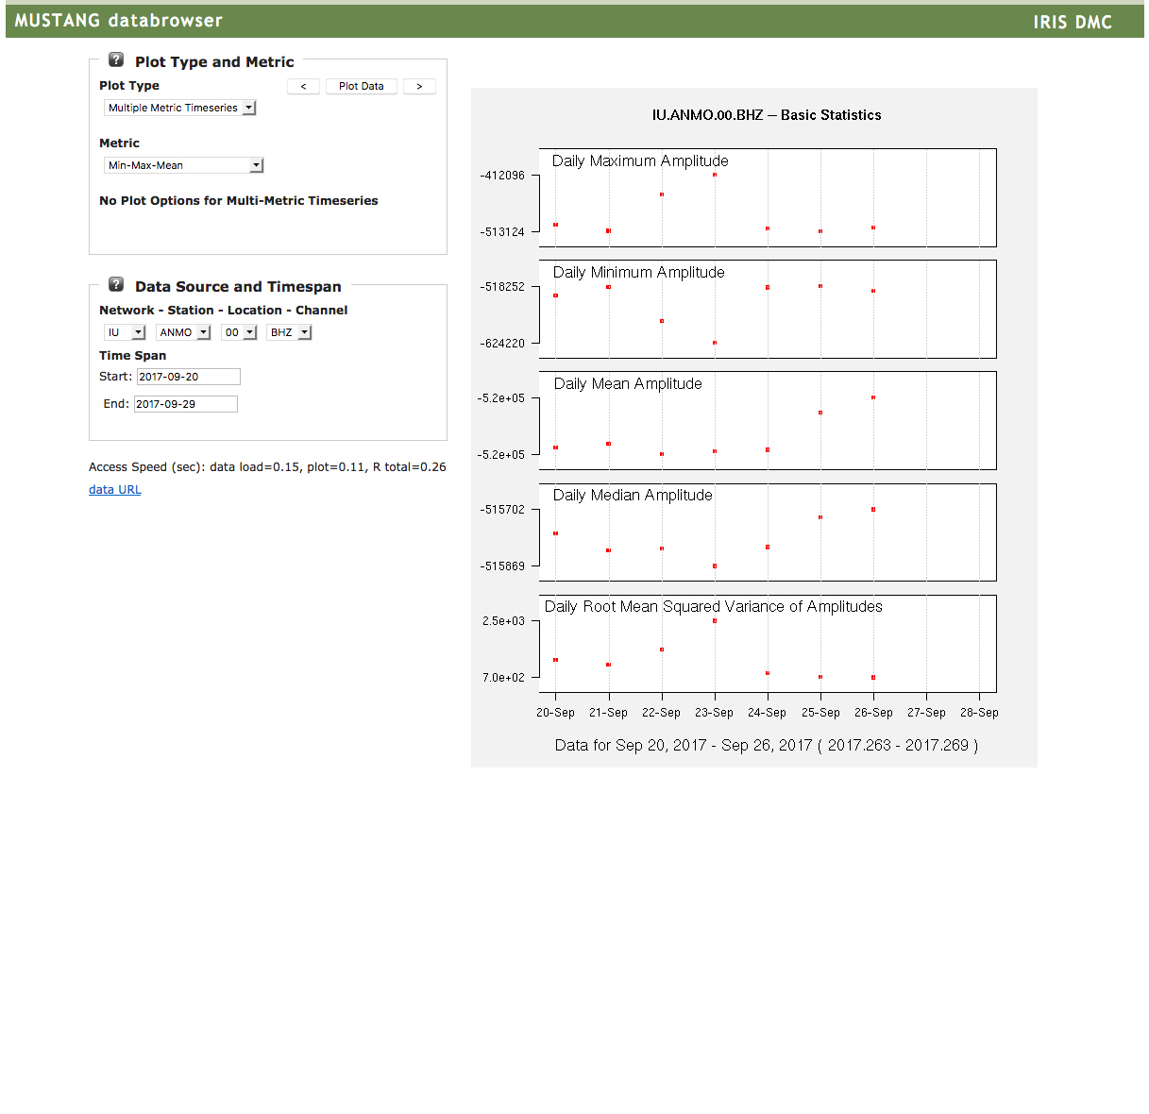
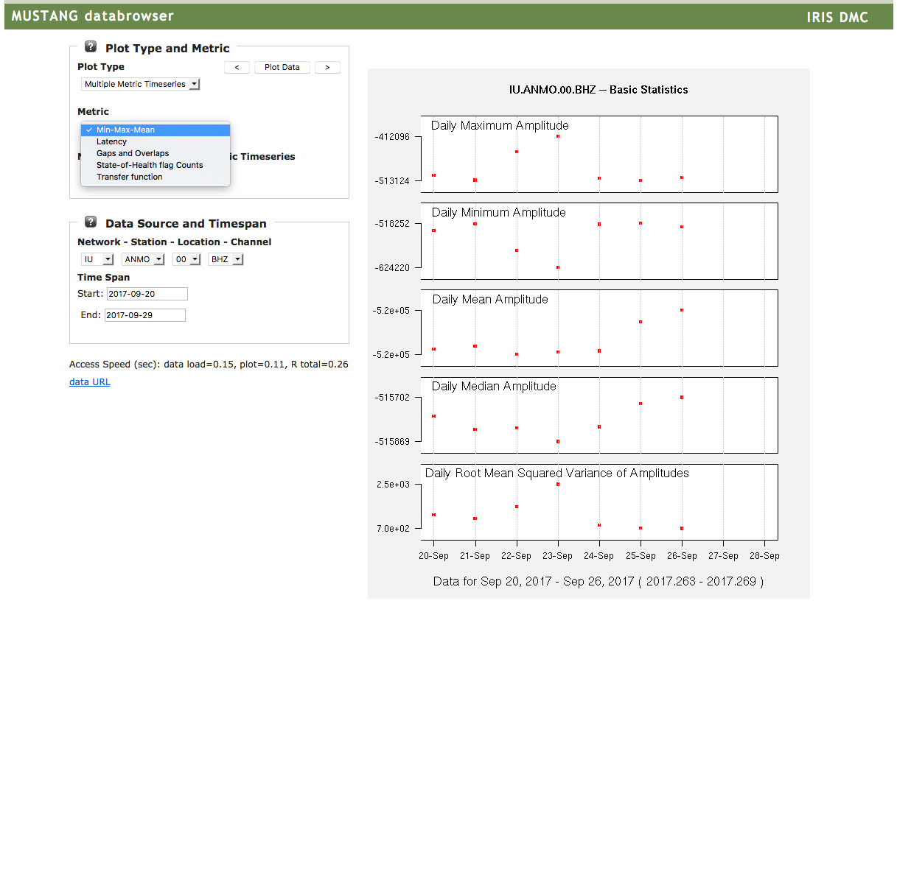
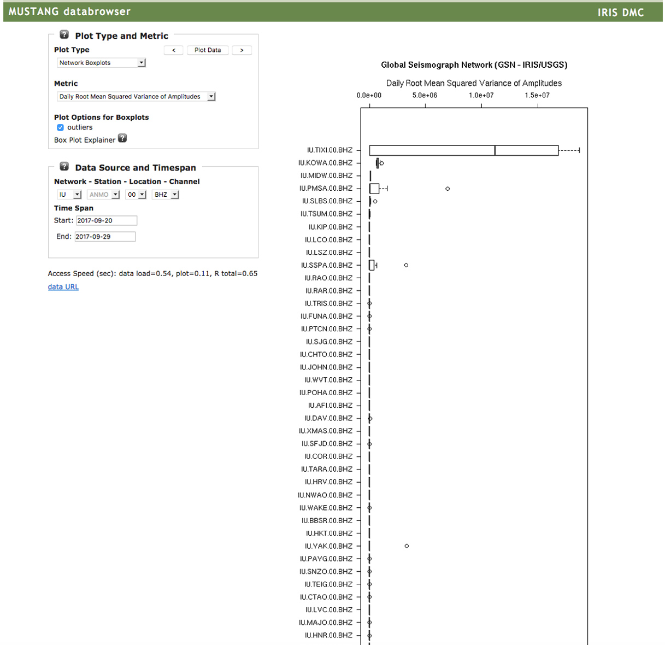
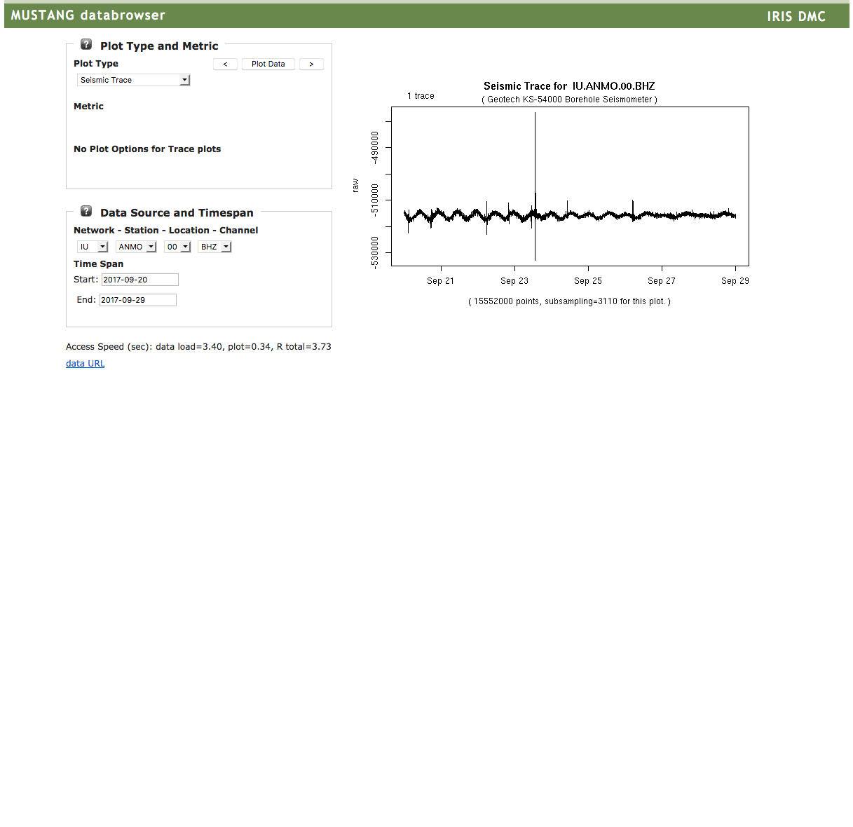
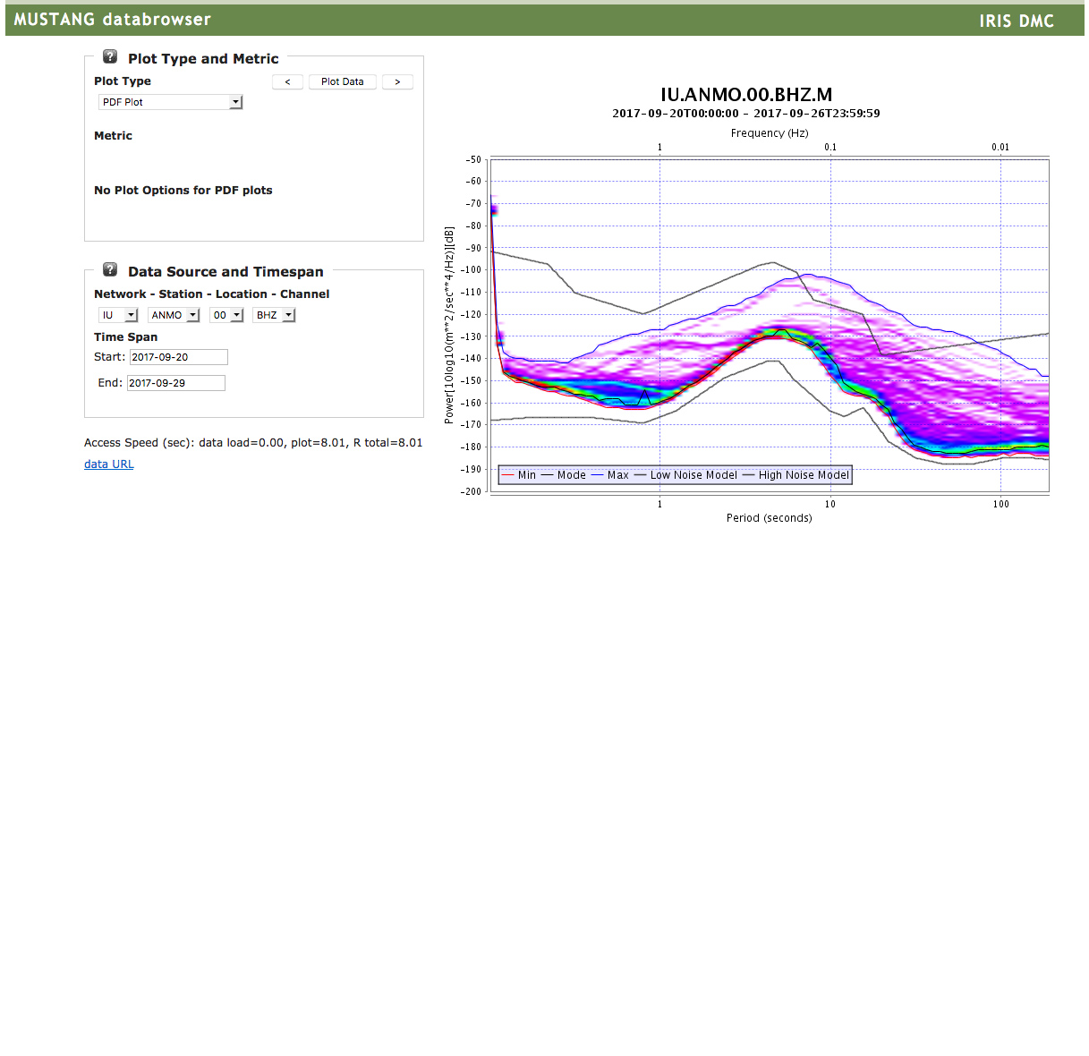
Databrowswer
http://ds.iris.edu/mustang/databrowser/
Graphical display of MUSTANG metrics
Time Series
Grouped with similar channels
Grouped with similar metrics
Boxplots
By station for one network
By channel for one station
Seismic trace
PDF

Slide 4
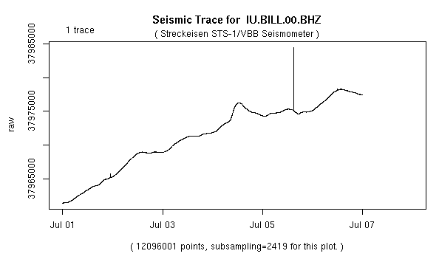
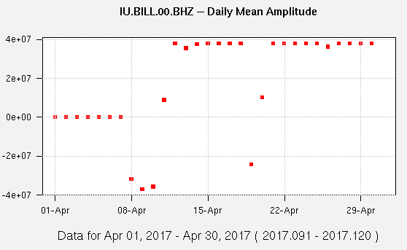
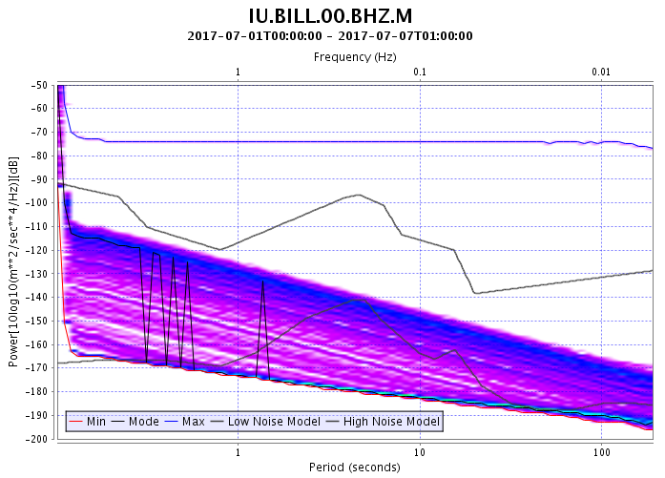
An example using databroswer
Seismic trace: drift is confirmed
Metric Timeseries:
Drift began April 8, 2017
PDF Plot: Seismic energy is absent

Slide 5
Hands-on: databrowser
http://ds.iris.edu/mustang/databrowser/
Generate a boxplot of the percent of data available per day for BHZ channels for the entire IU network, for the month of September
Generate a plot of the percent availability per day for IU.PMG.00.BHZ for September
What does the channel set option do?
Get the amplitude values for IU.BILL.00.BHZ for September
Plot the seismic trace for that period too – note the subsampling

Slide 6
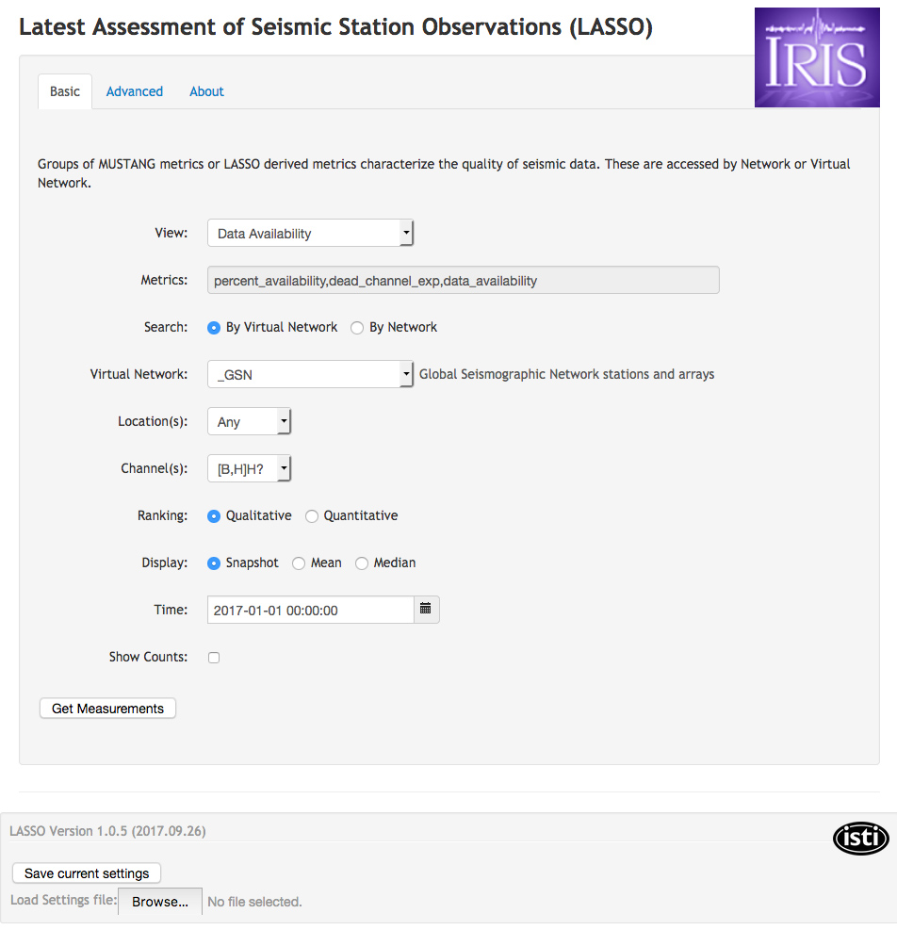
LASSO
http://lasso.iris.edu/
Displays MUSTANG metrics in either
Control-panel
Time series
Ranks data based on metric values
Multiple metrics for virtual networks
Derived metrics

Slide 7
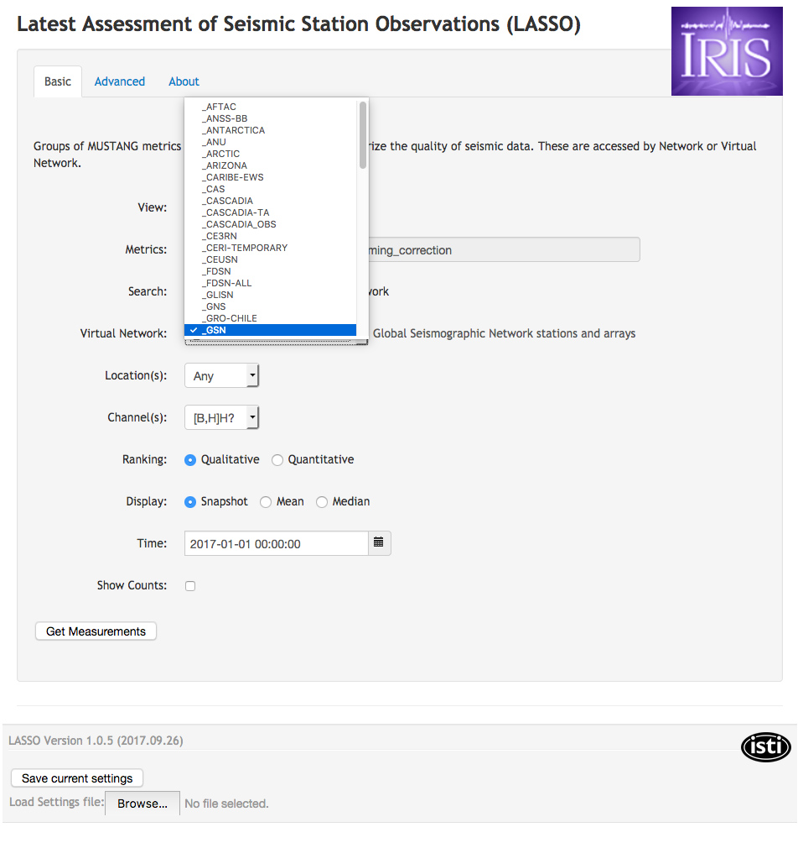
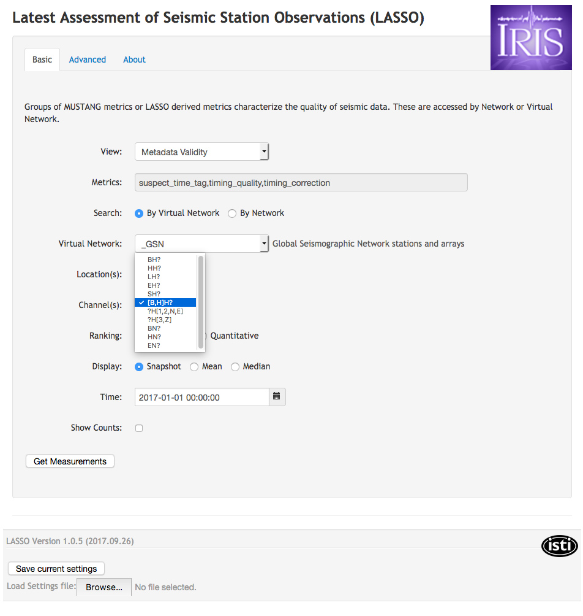
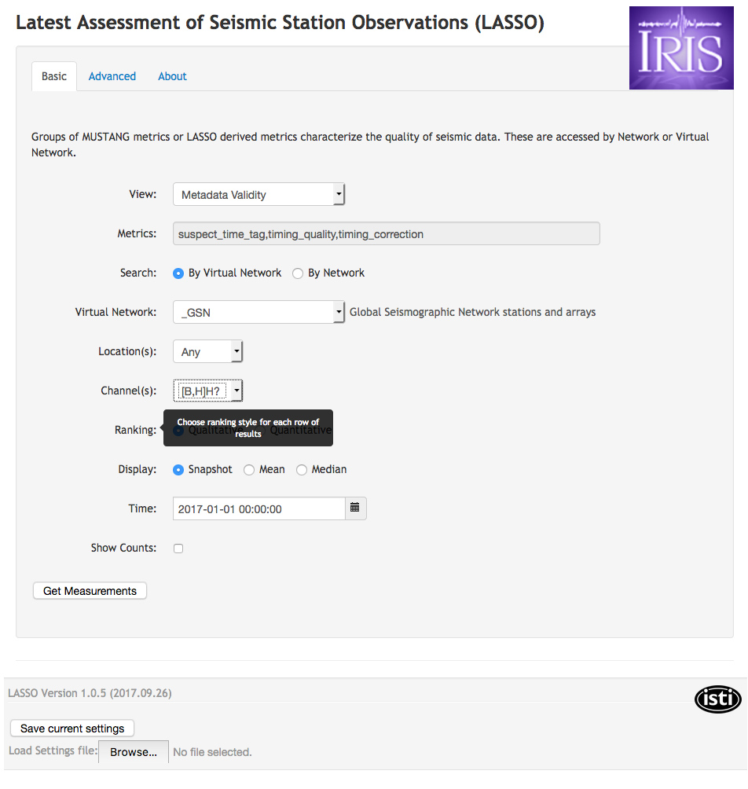
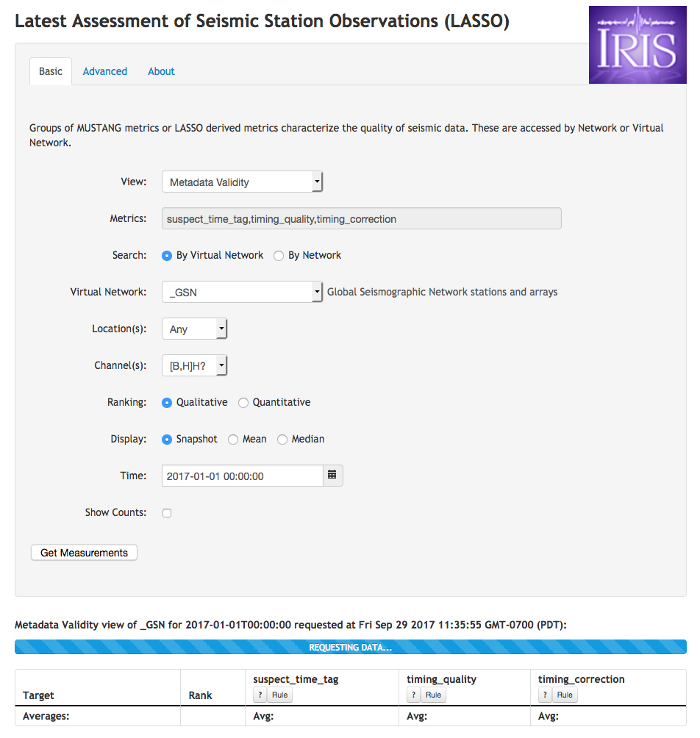
LASSO - BASIC
Choose from 6 sets of metrics
Data Availability
Mass Positions
Noise Power
Signal Quality
Metadata Validity
Time Series Integrity
Quantitative ranks channels From 0 (all metrics poor) to 100 (all metrics good).
Qualitative lists a count of good, fair and poor metrics.

Slide 8
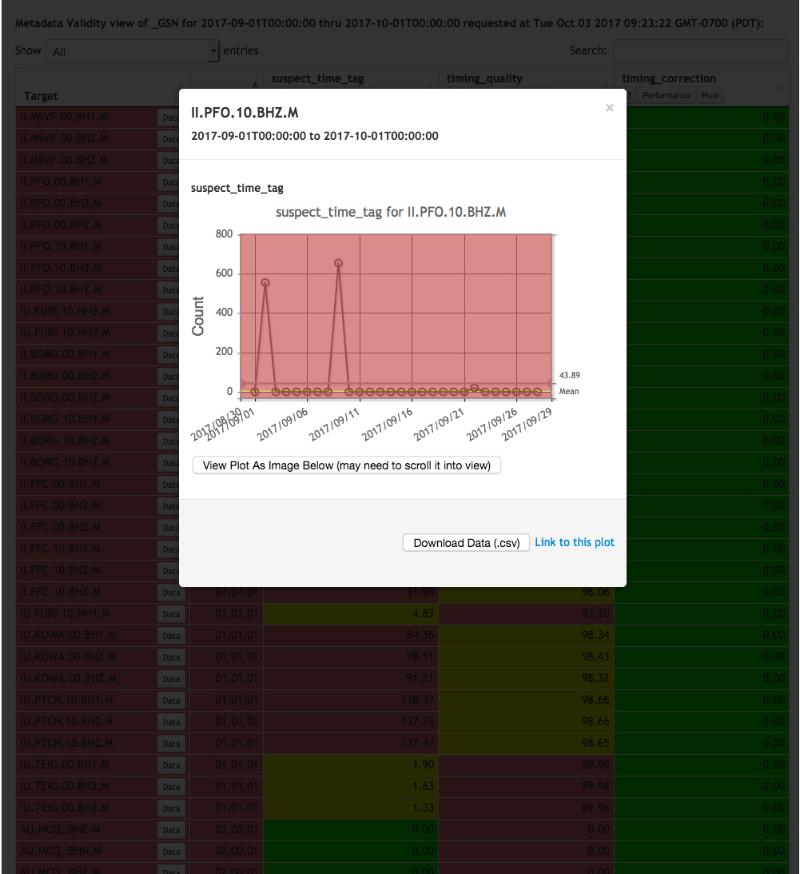
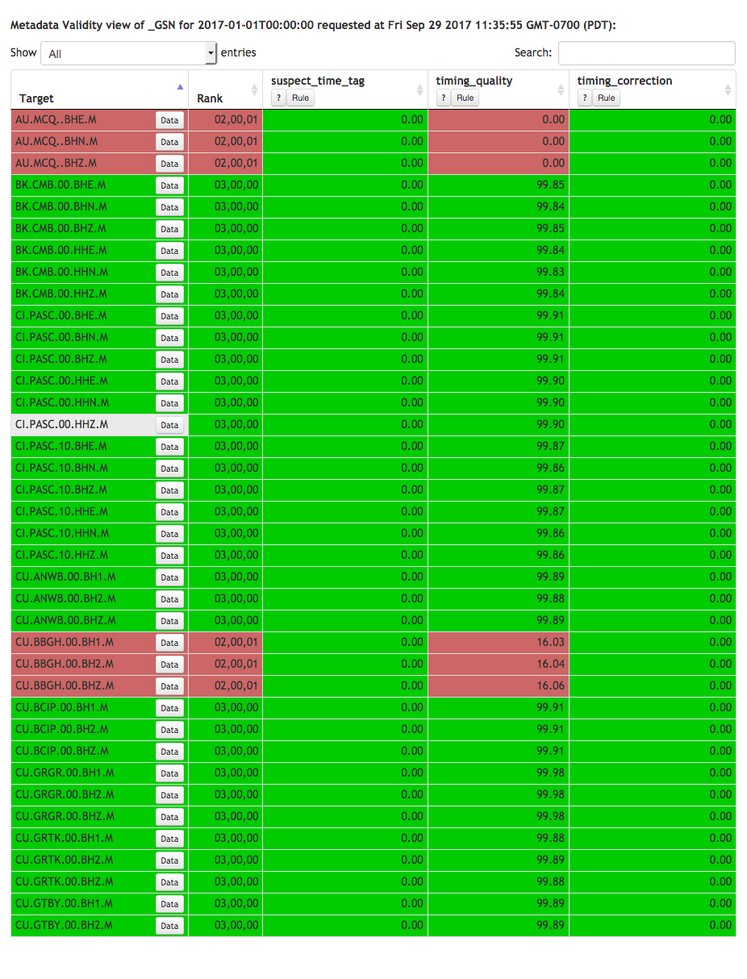
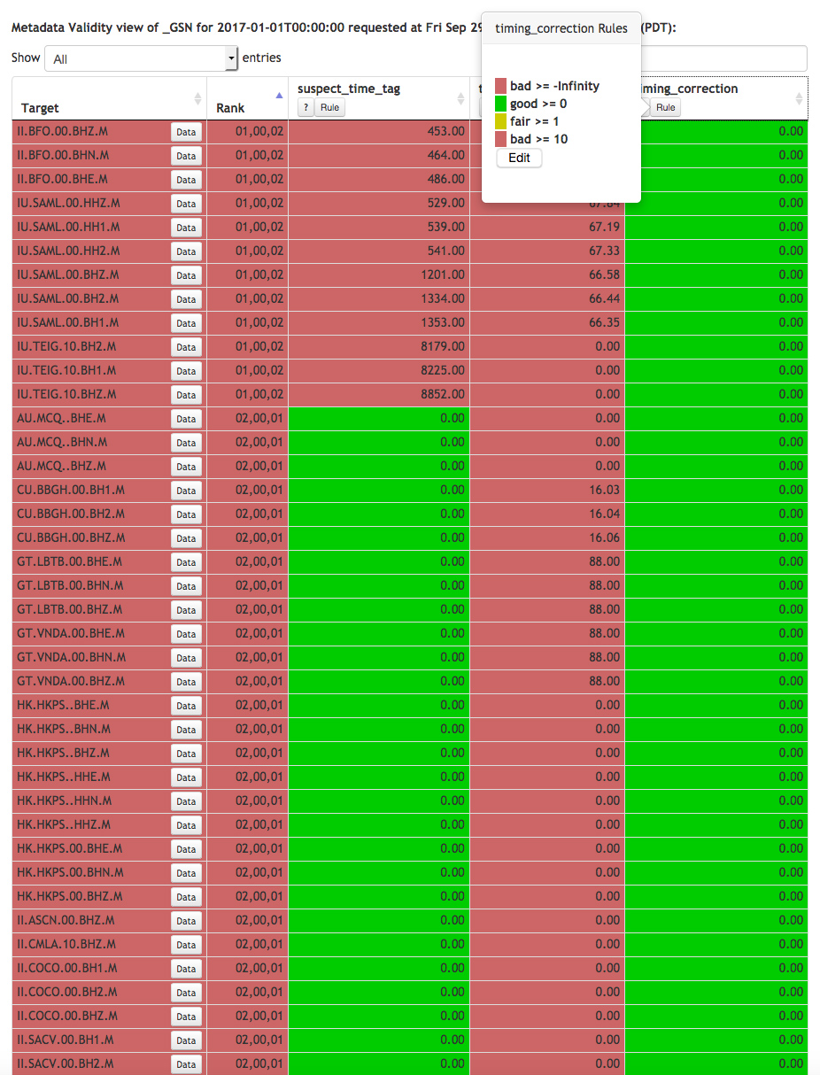
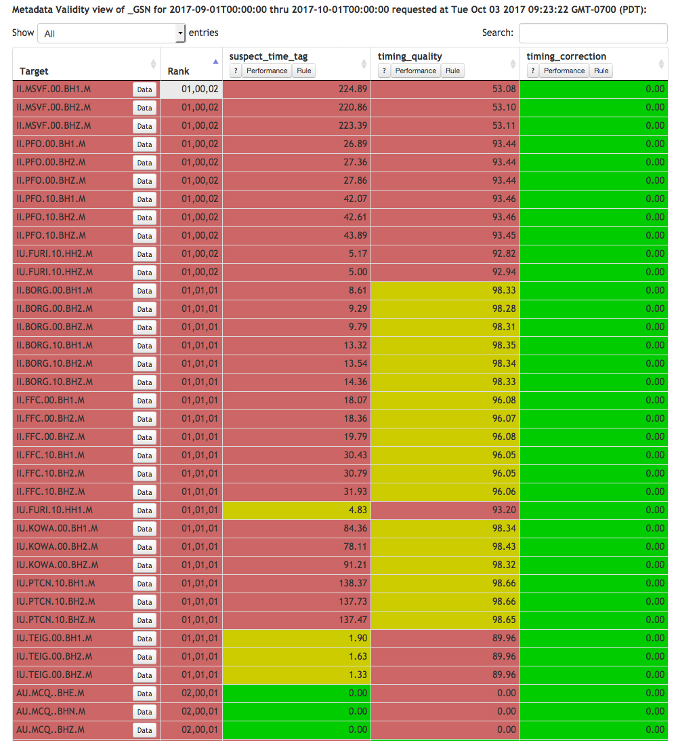
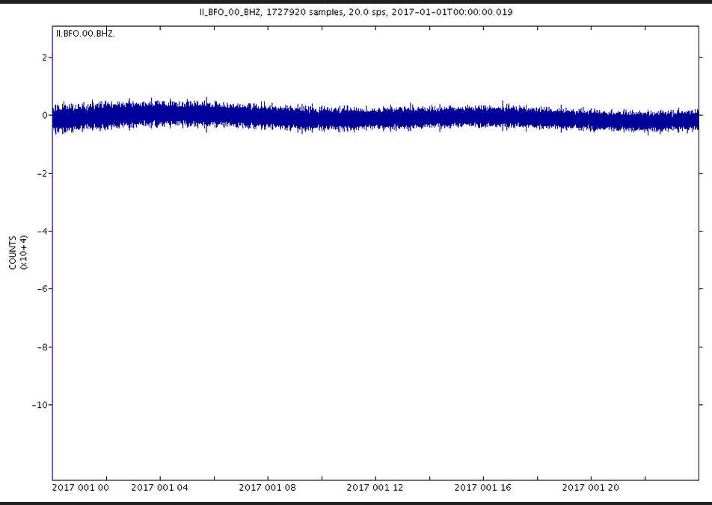
Lasso - basic
Choose from 6 sets of metrics
Data Availability
Mass Positions
Noise Power
Signal Quality
Metadata Validity
Time Series Integrity
Quantitative ranks channels From 0 (all metrics poor) to 100 (all metrics good).
Qualitative lists a count of good, fair and poor metrics.

Slide 9
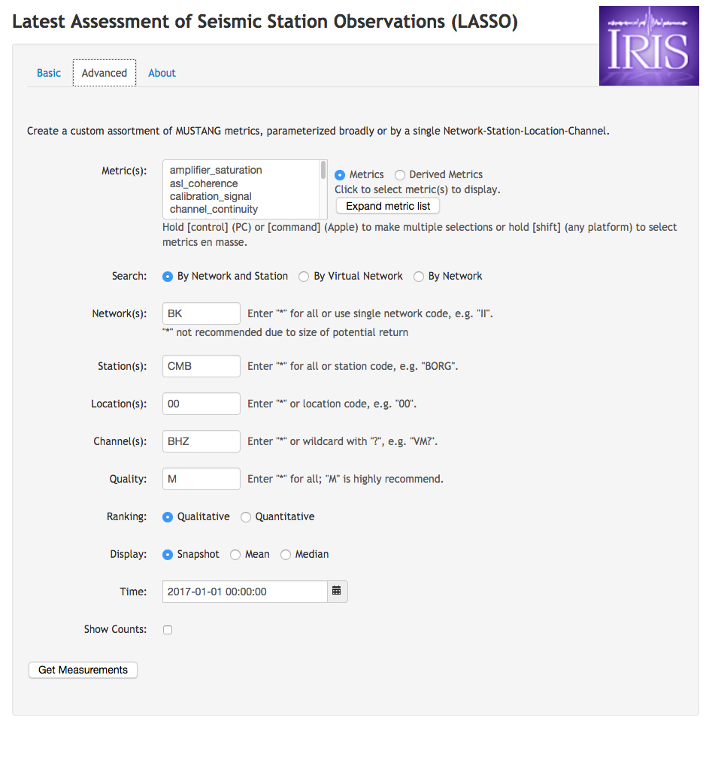
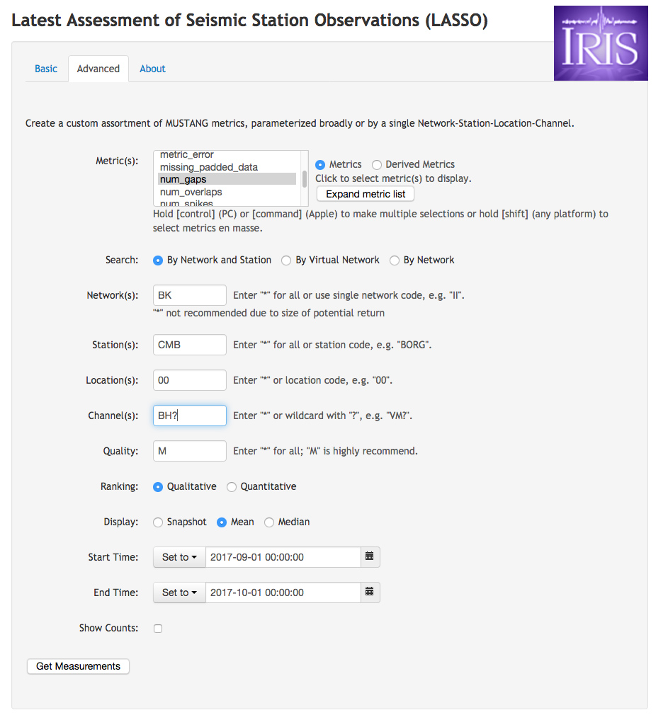
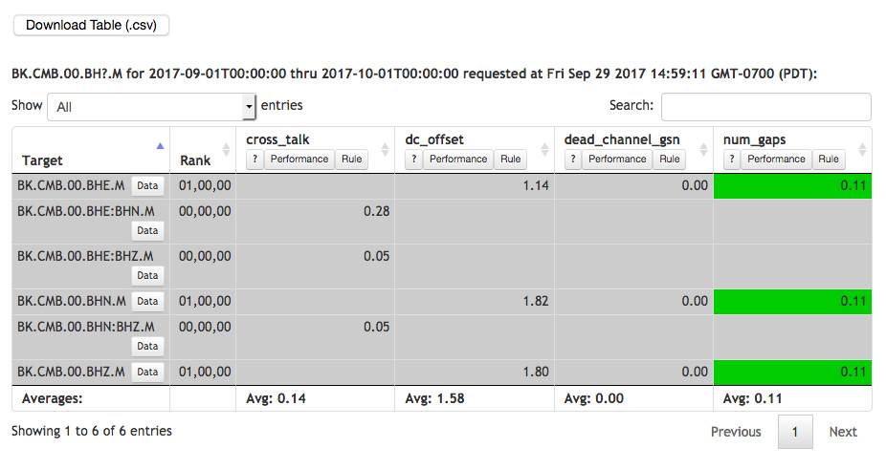
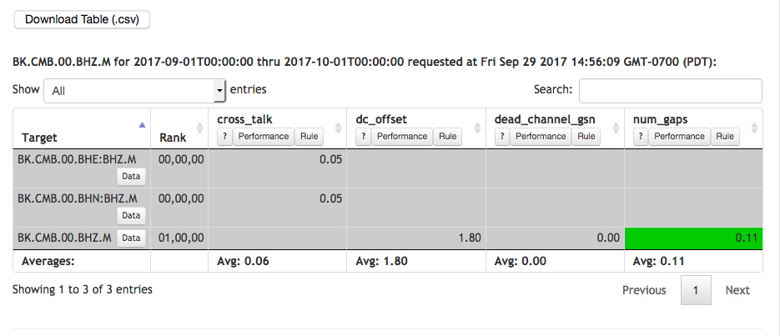
Lasso - advanced
Custom metric combinations
Increased customizability in SNCLs

Slide 10
Hands-on: lasso
http://lasso.iris.edu/
Find the quietest BH channels within the II network for December 2016
How is it different for the Mean vs Median?
Pull up the waveforms for one of the SNCLs
Look at the time series metrics plots for one of the SNCLs
Play around with the advanced tab – select some metrics, choose a network or virtual network and a time range, and see what you can find.

Slide 11
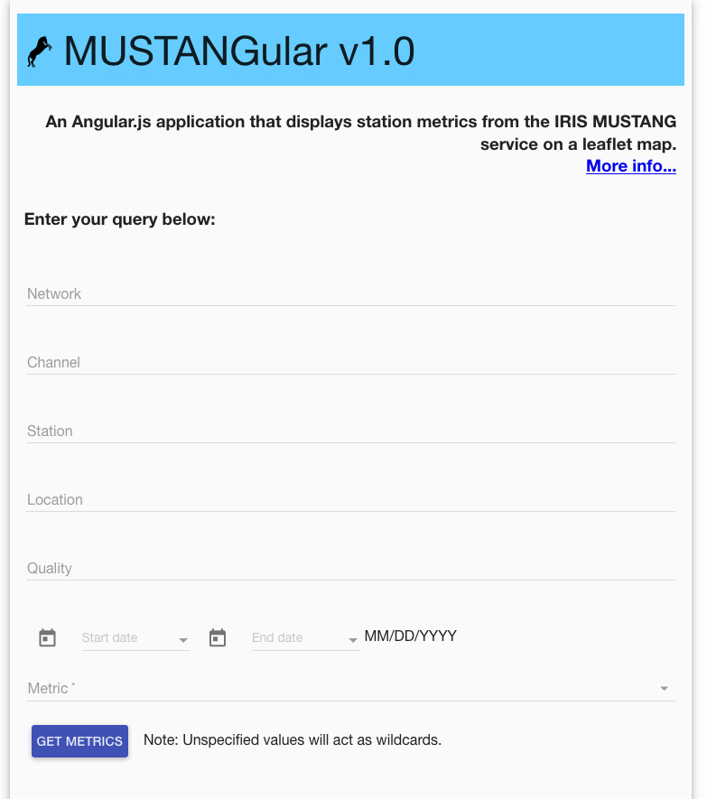
MUSTANgular
http://ds.iris.edu/mustang/mustangular/
Map-based plotting client
Created by the Pacific Northwest Seismic Network

Slide 12
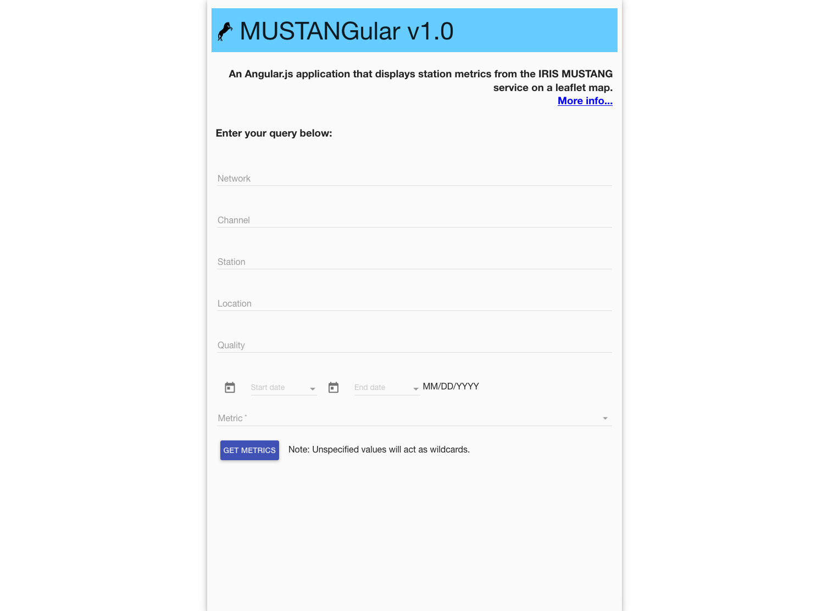
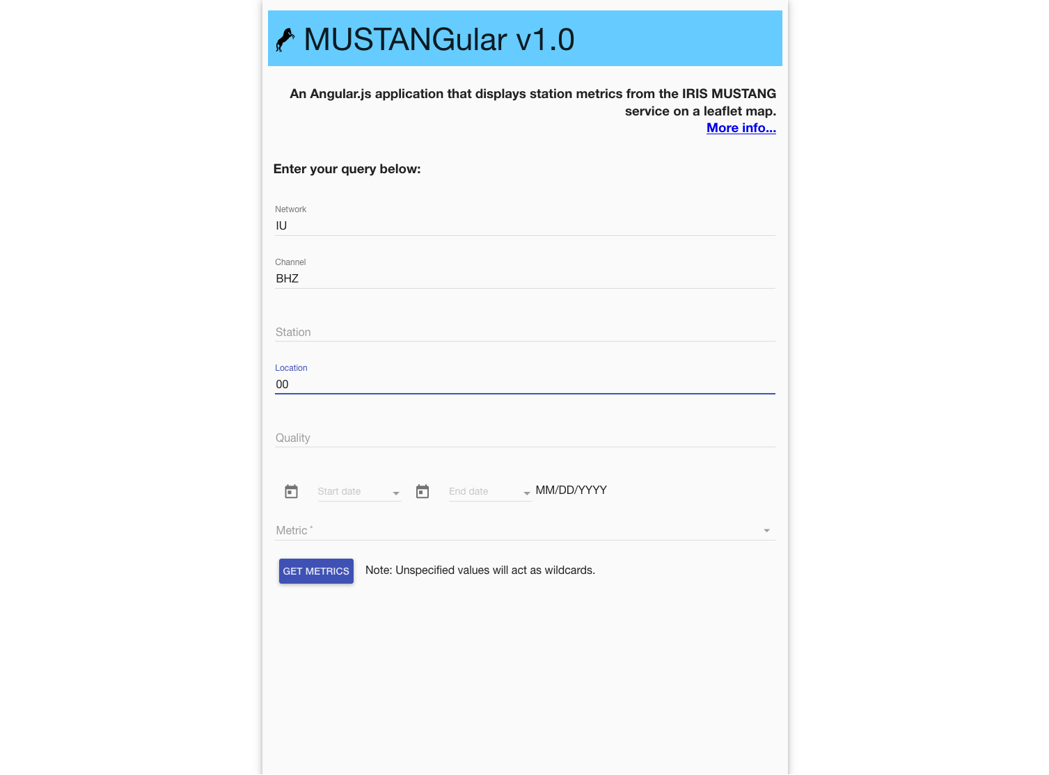
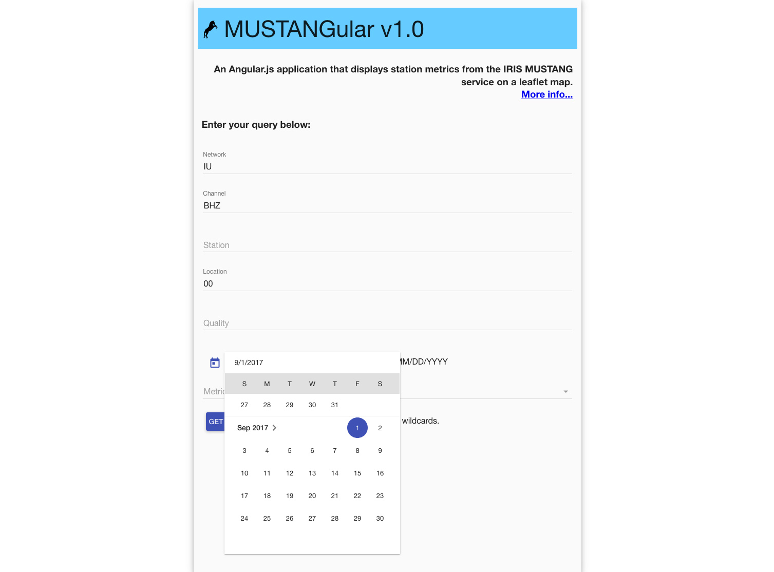
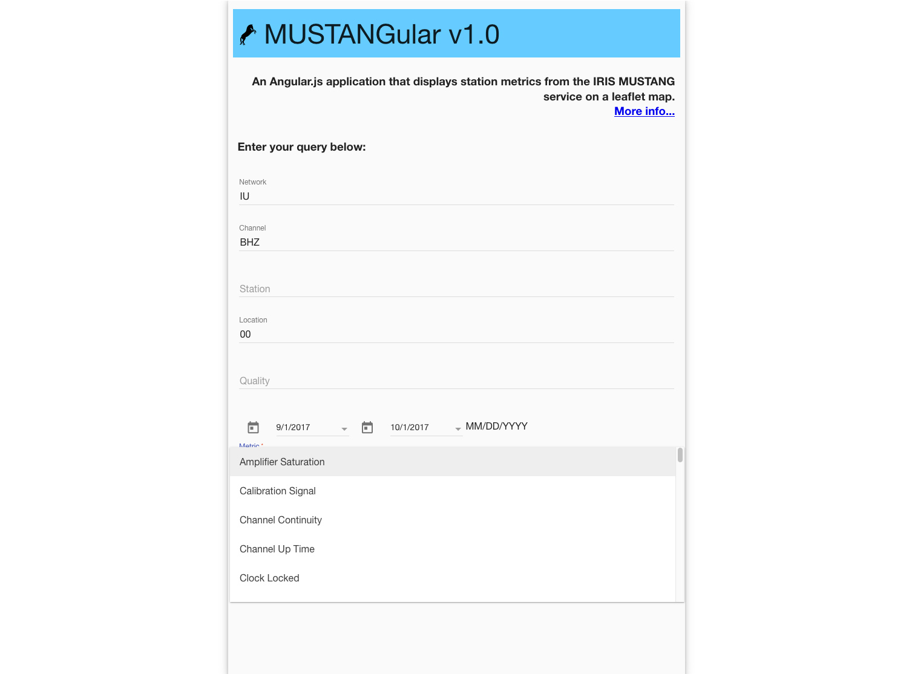
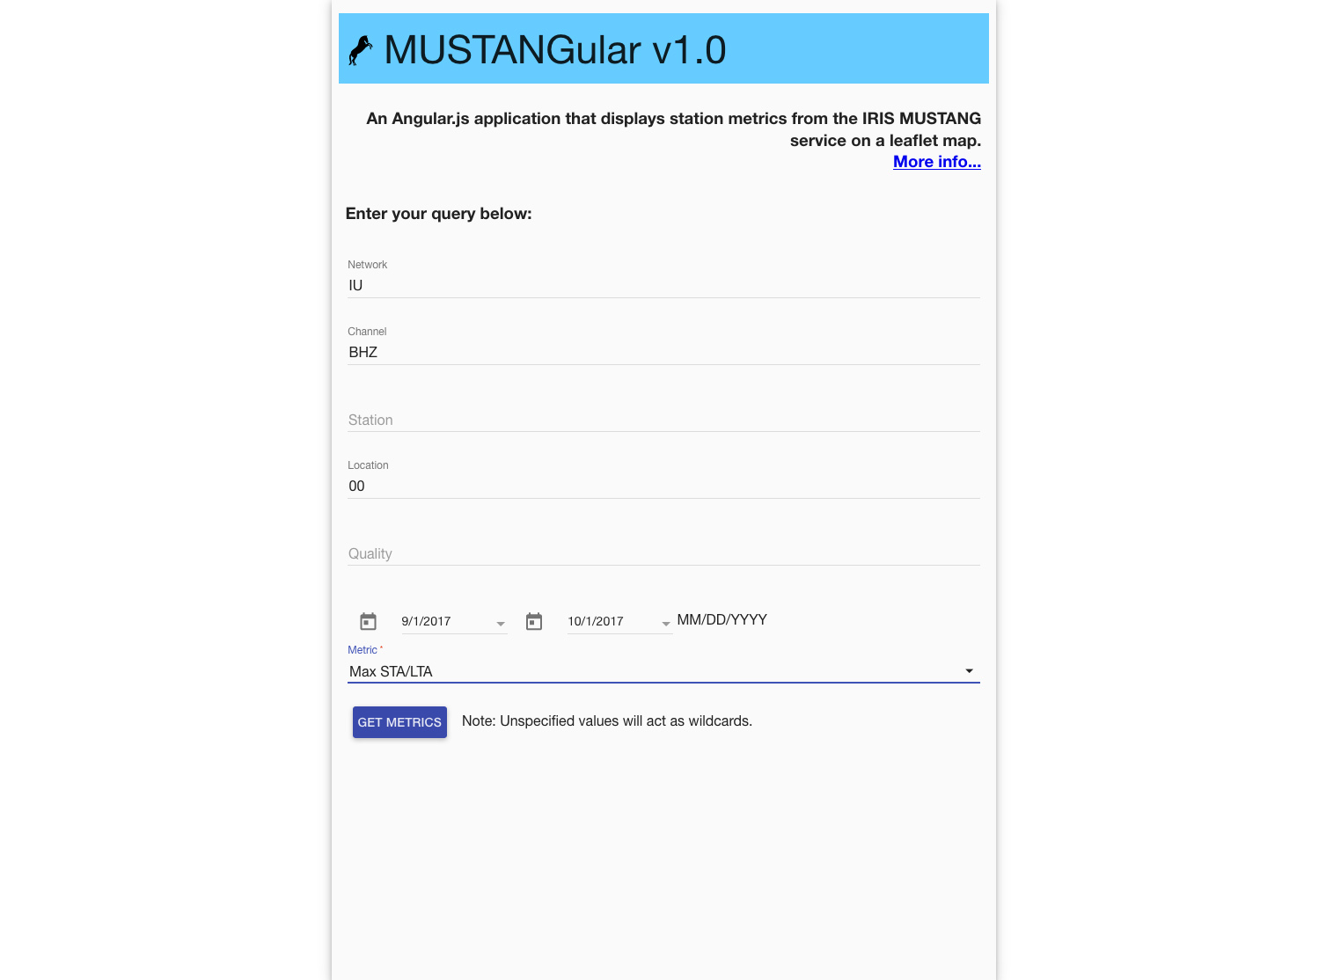
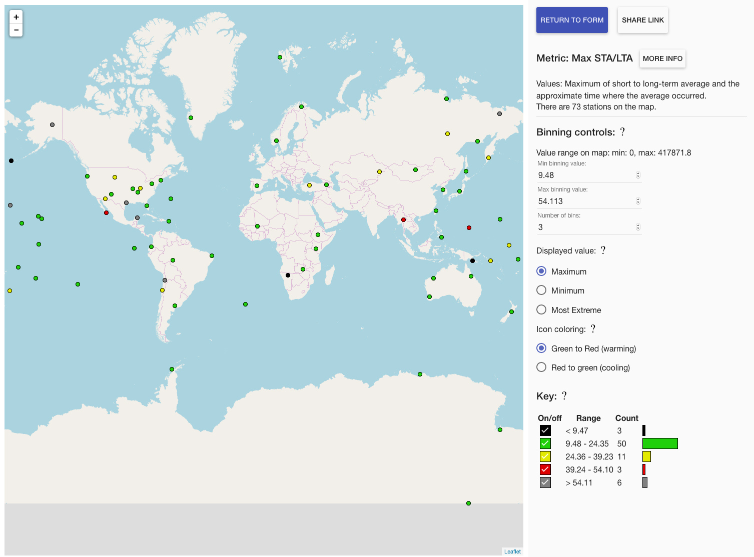
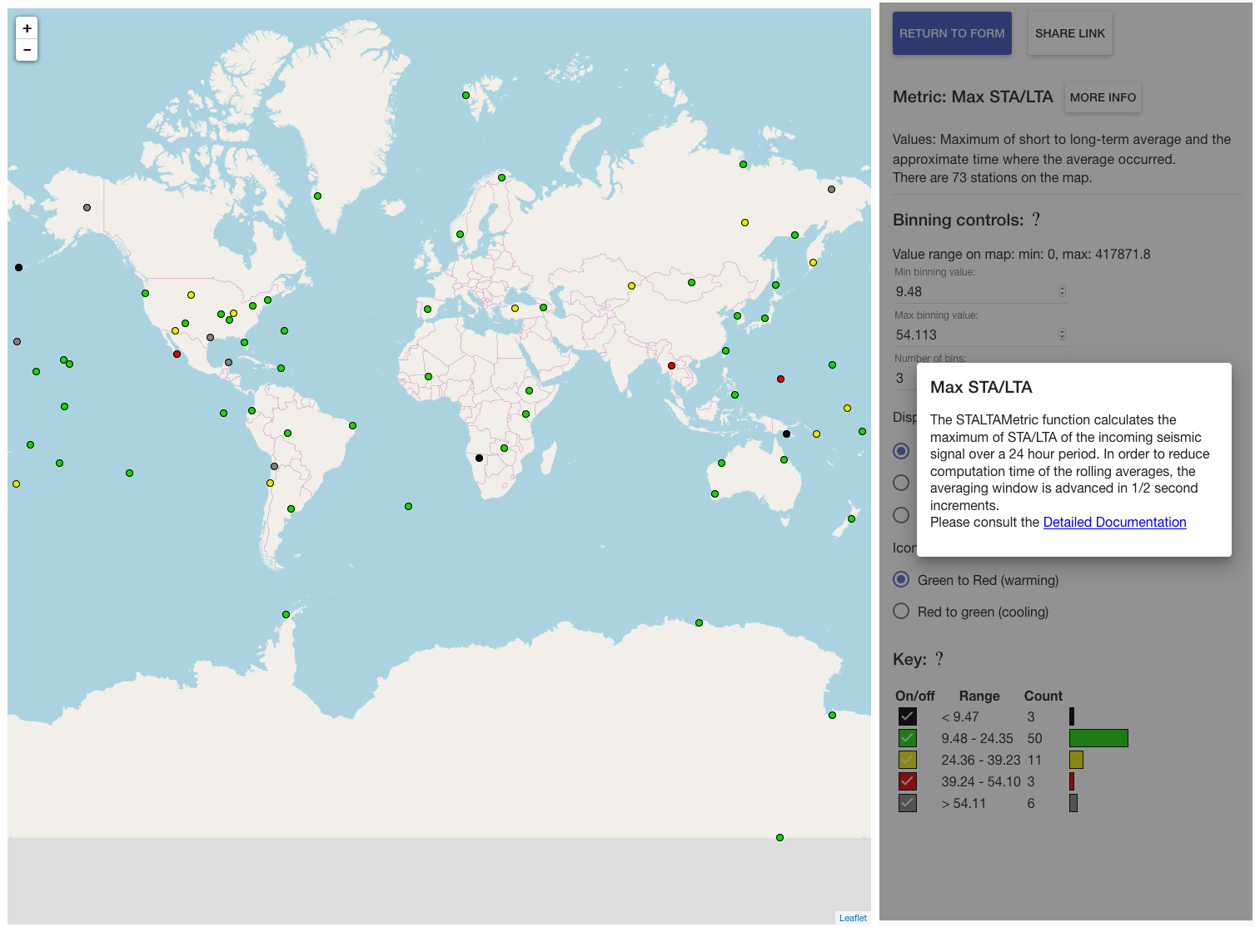
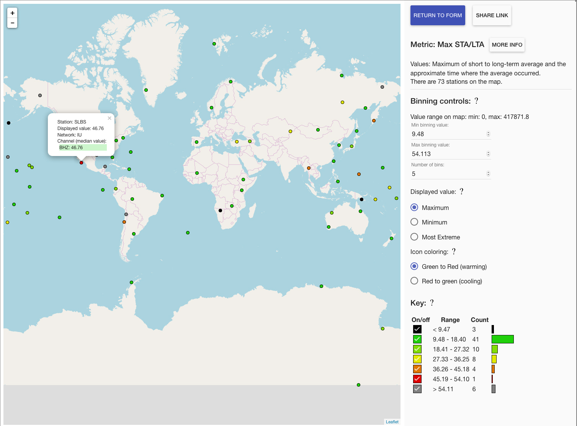
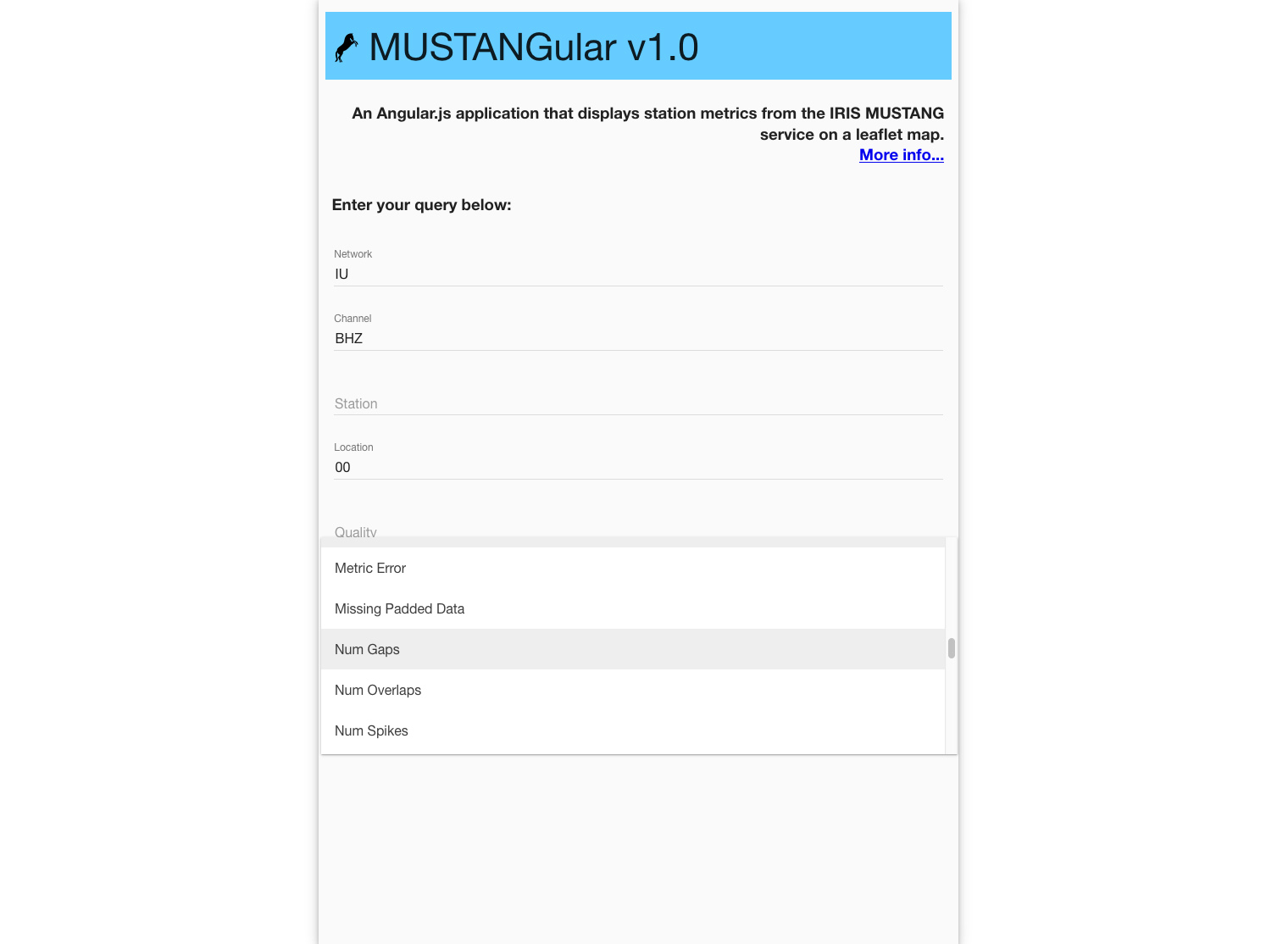
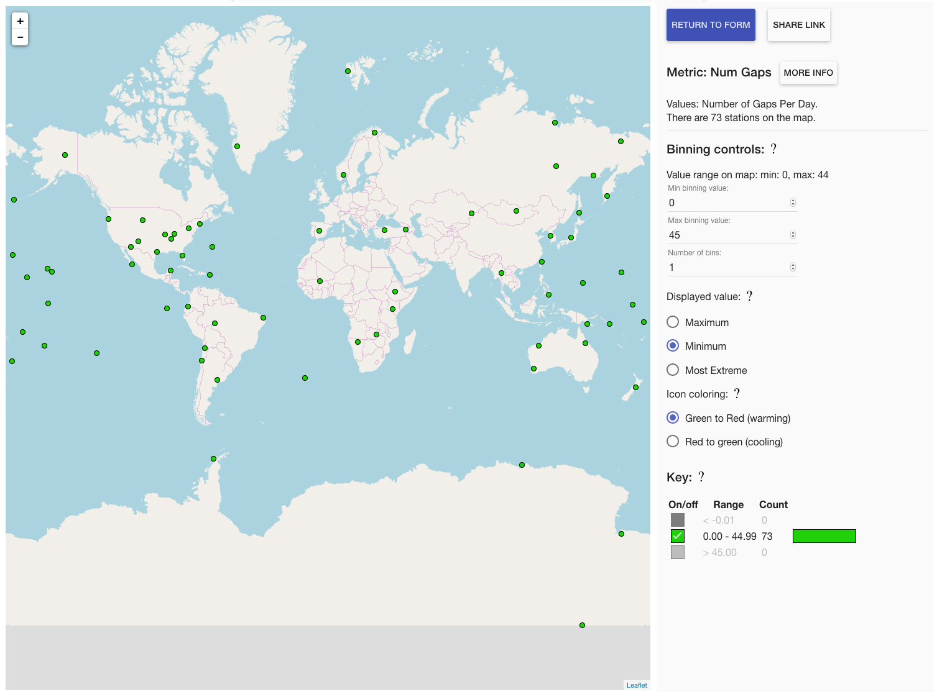
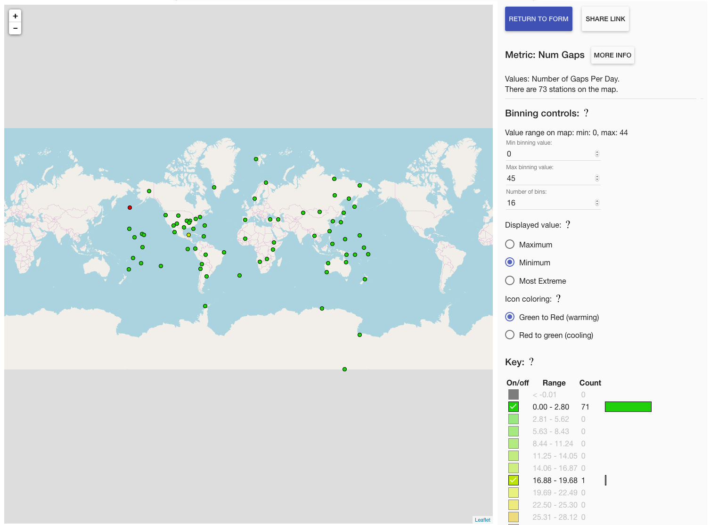
Blanks taken to be wildcard
http://ds.iris.edu/mustang/mustangular/mustangular_map.html?bincount=5&binmax=54.113&binmin=9.48&chan=BHZ&coloring=warming&loc=00&metric=num_gaps&net=IU&timewindow=2017-09-01T07:00:00,2017-10-02T06:59:59&view=min
http://ds.iris.edu/mustang/mustangular/mustangular_map.html?chan=BHZ&loc=00&metric=max_stalta&net=IU&timewindow=2017-09-01T00:00:00,2017-10-01T23:59:59

Slide 13
Hands-on: mustangular
http://ds.iris.edu/mustang/mustangular/
Plot the IU BHZ channels for percent above the New High Noise Model (NHNM) in 2017
Increase the number of bins to get a better sense of the distribution
Click on a station to see the median value for the time period
Plot the Data Latency for GO network for 2015
What does the Data Latency metric measure?

Slide 14
Q: Who can create clients?
Answer: Anyone who wants to.
Use your favorite language to grab MUSTANG measurements and manipulate them into something beneficial for you (and others?).
Some tutorials to help you learn more:
Seismic Data Quality Assurance Using IRIS MUSTANG Metrics
http://ds.iris.edu/ds/nodes/dmc/tutorials/seismic-data-quality-assurance-using-iris-mustang-metrics/
R Class for Seismologists
http://ds.iris.edu/ds/nodes/dmc/tutorials/r-class-for-seismologists/

