Slide 1
Regional Seismic Travel Times
István Bondár
Research Centre for Astronomy and Earth Sciences, Hungarian Academy of Sciences
(based on Steve Myers’s slides on RSTT)
Training in Network Management Systems and Analytical Tools for Seismiology
Baku, Azerbaijan, 23-27 October 2017

Slide 2
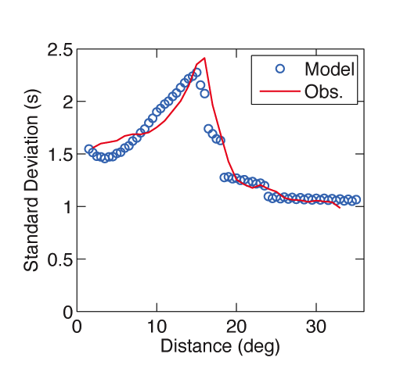
Motivation
Travel time prediction errors are higher at regional distances than at other distances.
Using regional data often increases epicenter error
Reduce travel-time prediction errors to levels comparable to those observed at teleseismic distances.
Regional
Teleseismic
Local

Slide 3
Objectives
Improve travel time prediction accuracy with respect to global 1D models for the regional phases Pn, Pg, Sn and Lg.
Fast travel-time predictions that can be used in an operational environment
Development by LLNL, LANL and Sandia labs
Regional Seismic Travel Times (RSTT)
Can be downloaded from
http://www.sandia.gov/rstt/

Slide 4
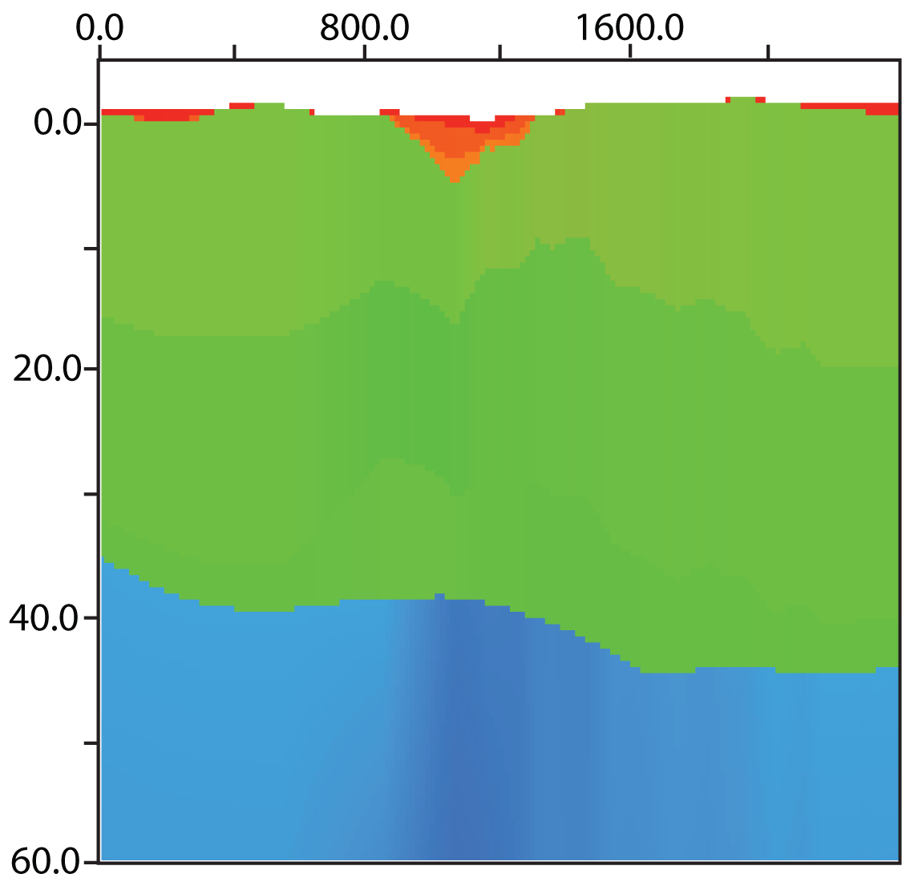
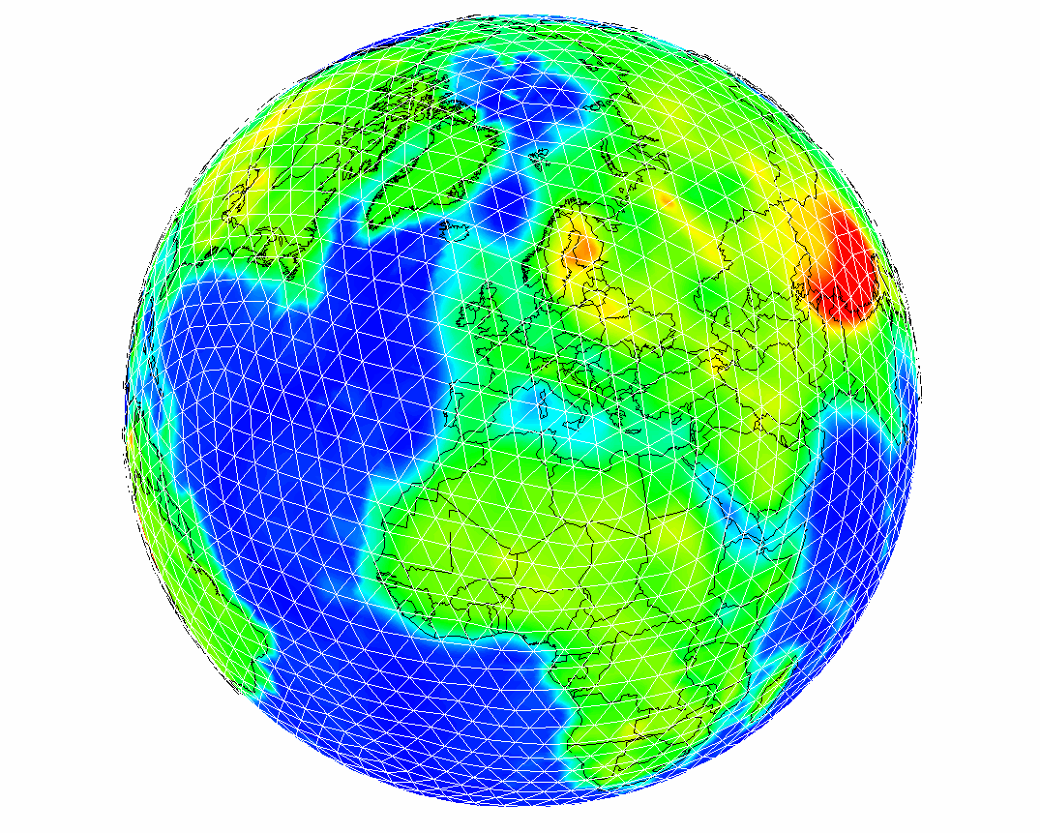
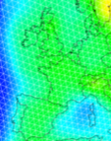
RSTT model structure
Vertical velocity profile at each tessellation node
Interpolation renders 3D crust and laterally varying upper mantle velocity
RSTT model: example cross section
Distance (km)
Spherical Tessellation
Sediments
(P-wave velocity ~3 km/s)
Depth (km)
Crust
(P-wave velocity ~6 km/s)
Mantle
(P-wave velocity ~8 km/s
RSTT reduces model error by accounting for 3D structure in the crust and the upper mantle

Slide 5
2.5D approach: A mantle velocity gradient
Travel Time Predictions with and without a velocity gradient
Pn Travel Time
TravelTime-distance/8.0 km/s
Distance (km)

Slide 6
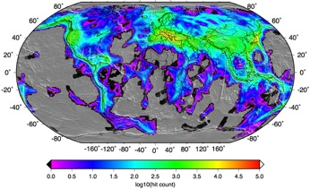
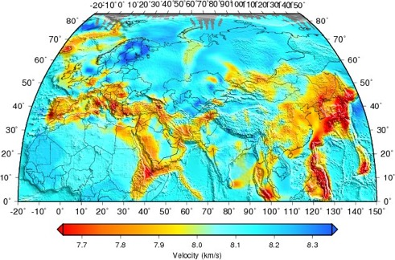
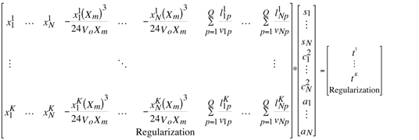
RSTT tomography
Tomographic data set
Updated Map of P-wave velocity
Tomographic system of equations
RSTT tomography adjusts
Mantle velocity
at the Moho
Velocity gradient
Crustal slowness

Slide 7
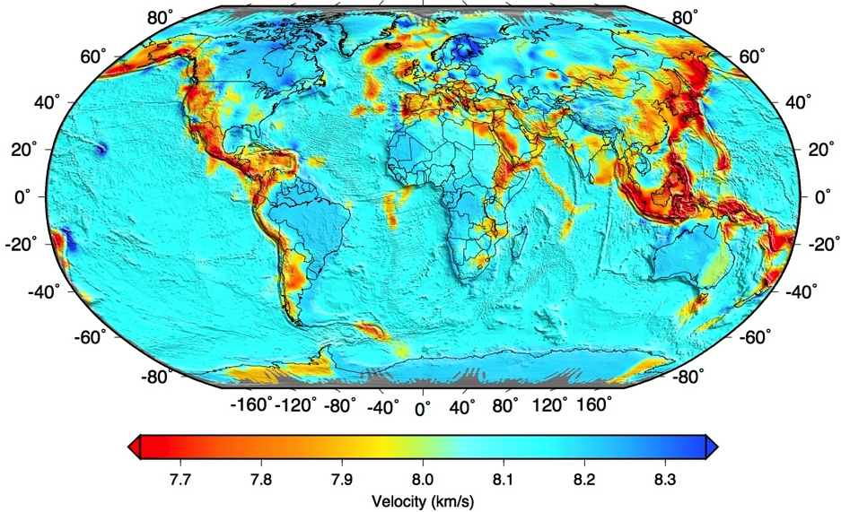
RSTT: global crust and upper mantle model
http://www.sandia.gov/rstt/

Slide 8
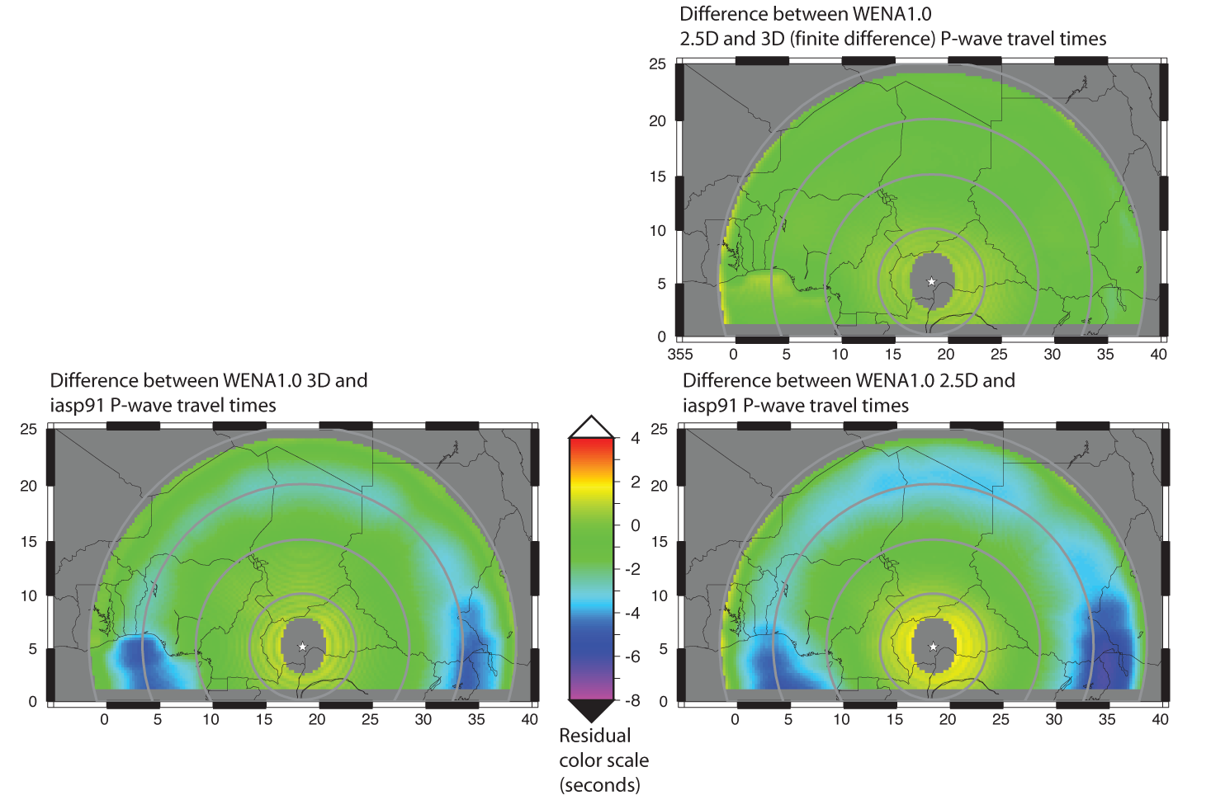
Accuracy with respect to a 3-D model
Maps of travel time differences
3D model minus (1D) iasp91 (below)
RSTT minus iasp91 (below, right)
RSTT minus 3D model (right)

Slide 9
RSTT travel time corrections to iasp91

Slide 10
RSTT travel time corrections to iasp91

Slide 11
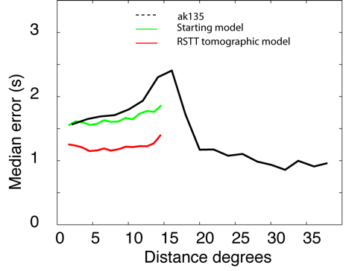
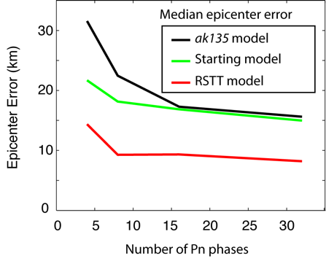
RSTT validation tests
Travel-time error reduction
Regional prediction error is reduced to teleseismic level
Epicenter error reduction
Epicenter error is reduced by approximately a factor of 2.
Largest improvement for sparse networks.
Myers et al, 2010
Myers et al, 2010

Slide 12
Summary
Increased travel time prediction error at regional distances causes increased event location error
RSTT reduces regional travel time error by developing an efficient travel-time calculation method and a 3D model of Earth’s crust and upper mantle
RSTT is integrated into the iLoc program and openly available at
http://www.sandia.gov/rstt
http://www.orfeus-eu.org/website_until_17aug2016/software/seismo_softwarelibrary.html
http://www.seismology.hu/data/iLoc
The RSTT model can be improved through contributions of geological studies, ground truth events, and phase arrival time observations

