Slide 1
Introduction to IRIS Quality Assurance Network Reports
What are Network Reports and how have we been generating them?

Slide 2
Intro to QA Reports
Quick outline
Goal: For you to understand the process of QA enough to take it home and perform it on your own network. This could be using the scripts we provide, or not.
Introduction
Semi-automated, monthly QA reports use MUSTANG metrics to identify issues
Sent to network operators to help focus attention and improve quality
Finding Issues
GUI: doQA.py - facilitates QA process start to finish
Script: findIssues.py – grabs, sorts, and subsets metrics
Examining Issues
GUI: QuARG.py – organizes issues as analyst sorts through them
Utilize the many services we’ve learned about so far
Writing Report
Script: generateHTML.py – creates final report from CSV file
Warning: I will be delving into code in hopes of giving you a solid understanding of the process.

Slide 3
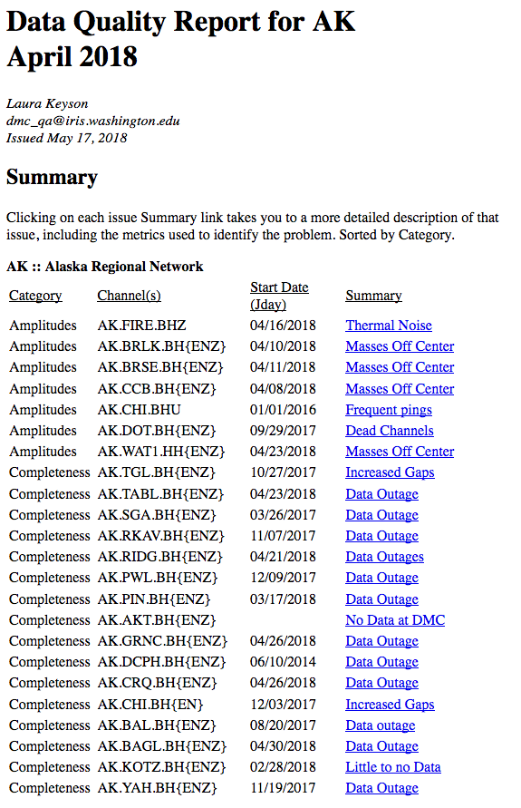
Intro to QA Reports
Purpose: To highlight places where the data quality could be improved.
Some things are easier to fix than others, some more important than others, but this can help prioritize field work.
Telemetry and power
Site Construction or design
Aging or dysfunctional instruments
Seasonal fluctuations or environmental factors
By using MUSTANG, it reduces the amount of manual time spent looking through the data

Slide 4
Intro to QA Reports
A Brief History of Network Reports
TA: Used MUSTANG (pre-MUSTANG) and manual review to find data problems on a weekly basis
_GSN: Formulated a “Network Report” that was sent out monthly
_LACSN: Generated monthly reports, though never distributed
AK: Began in Fall 2016, broadband instruments in monthly reports
UU: Winter 2018, addition of short period instruments
The tools and report format have come out of an iterative process of refining the methods used to produce these reports. The goal has been to make them simpler to generate and to include more information in a digestible way.

Slide 5
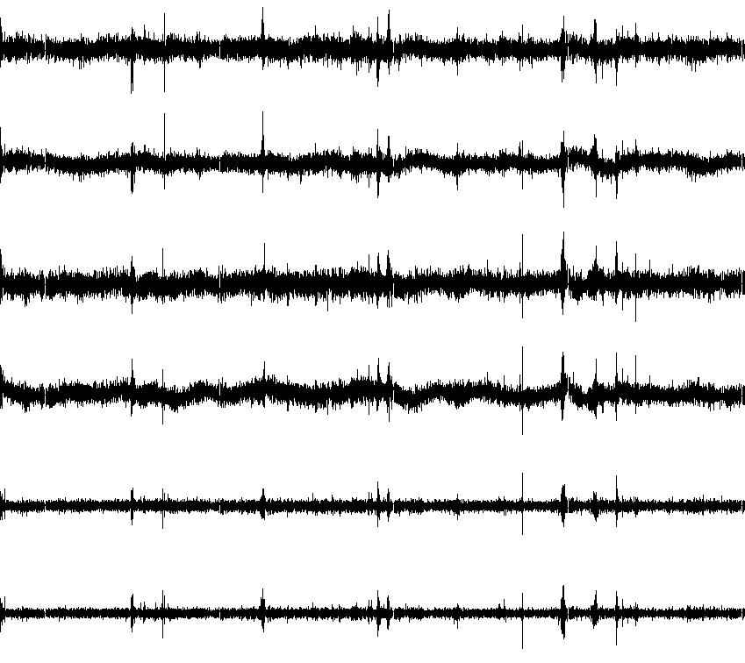
Intro to QA Reports
How We Do It
They can be done using different tools and utilities, but this is how we do them:
Retrieve MUSTANG metrics through web services
Using combinations of metrics and thresholds, generate a list of “issues”
Manually review the issues to tease out potential causes and because false positives occur
Ticket real issues in our dmscode system
Export open tickets into a CSV file
Generate HTML report from CSV file

Slide 6
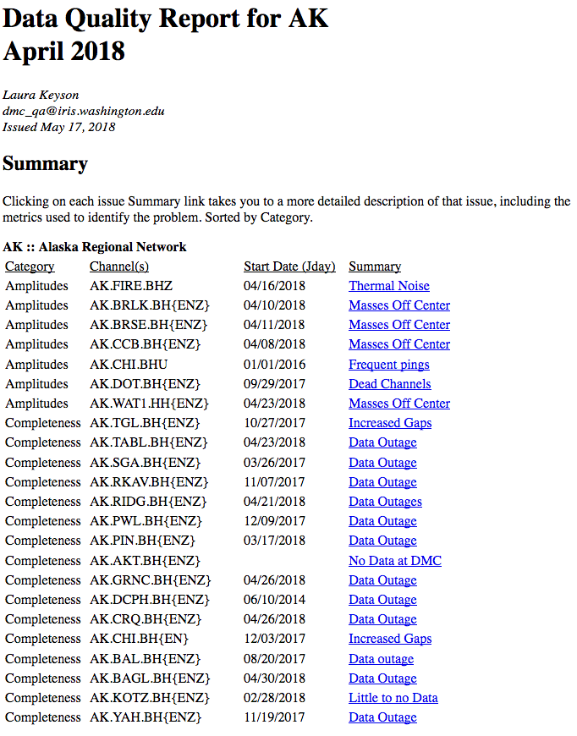
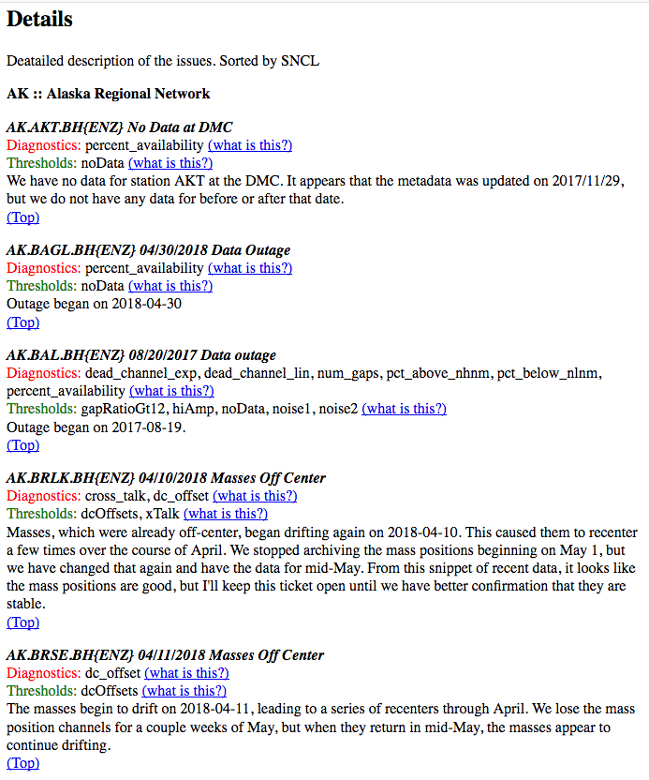
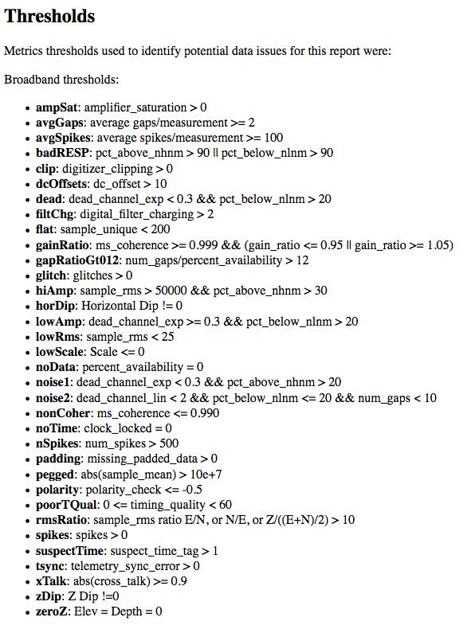
Intro to QA Reports
Structure and Content of the Report
Informational heading at top, then…
The report is divided into three sections:
summary, detailed description, diagnostic information

Slide 7
Intro to QA Reports
Structure and Content of the Report
Summary is the quick glance section, where you can get a feel for the number and type of issues in the report.
Category: The type of issues, in the broadest sense. Is it an amplitude problem? A completeness problem? Metadata?
Channel(s): Which channels are affected by the issue. Often times the entire station is, but sometimes it is just a subset of the channels.
Start Date: When did the problem begin?
Summary: A slightly more informative, yet still brief, description of the problem.
By clicking on the Summary field, it will take you to the Detailed Description section

Slide 8
Intro to QA Reports
Structure and Content of the Report
Details contains more specifics, so you can get a more thorough understanding of the scope of problem and possibly an understanding of the cause.
Diagnostics: Which metrics were used to find the issue.
Thresholds: Which thresholds were used to find the issue.
After those two fields is the area where the actual description goes. This can include links or embedded images, whatever helps to convey the nature of the issue.
By clicking on the “what is this?” link, it will take you to the diagnostics section.

Slide 9
Intro to QA Reports
Structure and Content of the Report
The Diagnostics section contains information about the metrics and thresholds used in the report.
Diagnostics: A list of all of the MUSTANG metrics with a link to the measurements service
Links to the other MUSTANG web services, as well as GOAT, MDA, Purgatory, and SeismiQuery
Thresholds: The definitions of the thresholds used to find issues in this report – good to include in case they change later.

Slide 10
Intro to QA Reports
Walking through an example report
(Go to the file)

Slide 11
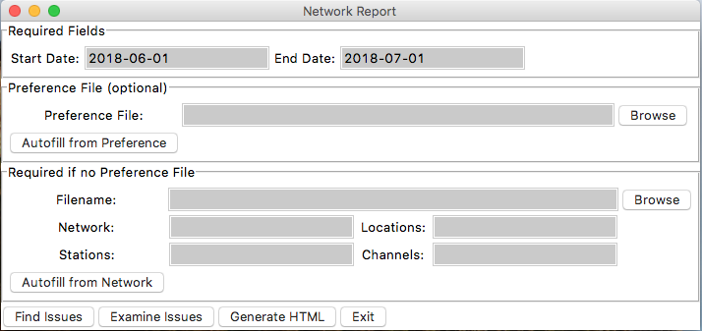
Intro to QA Reports
After the break:
Creating an issue file
Examining the issues
Creating a report
Defining Thresholds
Using Preference file
Running the script
GUI to simplify things
Utilizing web services
Tracking system
CSV to HTML

